Slide 1
RESI- SDG– Creativity Festival
Welcome!

Slide 2
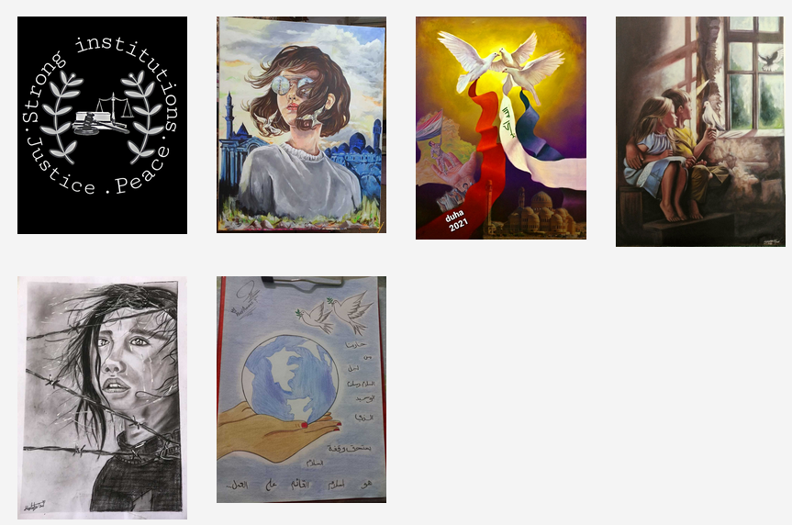
RESI- SDG– Creativity Festival – your submissions

Slide 3
Deadline Extended...
SDG 16 is about:
Building strong and reliable institutions
Ending violence against children
Providing legal identity to everybody
Reducing corruption
…..and more!

Slide 4
Introduction: SDG 2021

Slide 5
Introduction: SDG 2021
In May 2021…
SDG 11 is about:
Adequate, safe and affordable housing
Affordable and accessible public transport
Saving the worlds natural and cultural heritage
Access to green and public spaces for everyone
…..and more!

Slide 6
RESI- SDG– Creativity Festival
1
Check the SDG of the month on the Website of United Nations
2
Make a nice creative work about the topics of the SDG of the month:
Literature/poetry (in English language)
Short Videos (2 minutes maximum)
Drawings/paintings/computer design (include English descriptions please)
Sculptures and models (include English descriptions please)

Slide 7
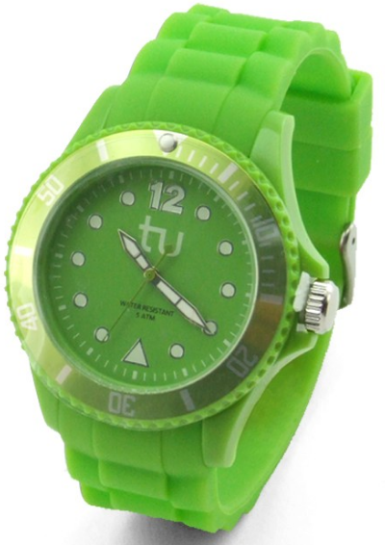
RESI- SDG– Creativity Festival
3
Submit your work to:
https://www.resi.tu-dortmund.de/sdg
See your works on the same website and – if possible – in live events at your university.
4
5
Receive a certificate and maybe win a price.

Slide 8
RESI- SDG– Creativity Festival – Don‘t miss any updates:
Follow us:
Facebook => https://www.facebook.com/resi.projekt.7
Instagram => https://www.instagram.com/resi_project/
Or check our website: https://www.resi.tu-dortmund.de

