Slide 1
HmailServer
Karam al-sofy & Faten alhasan

Slide 2
What is HMailServer
Overview
HMailServer is an email server for Microsoft Windows. It allows you to handle all your email yourself without having to rely on an Internet service provider (ISP) to manage it. Compared to letting your ISP host your email, hMailServer adds flexibility and security and gives you the full control over spam protection.

Slide 3
History
The hMailServer project was started in late 2002 by Martin Knafve. Since then, it has become one of the most popular email servers for Windows. From the start, the focus has been to create an easy-to-use email system that includes all the basic features you need. HMailServer software up to v4 is open source, v5 and later is closed source but still free .

Slide 4
reason's martin to convert his project to closed source
1- Most users who have wanted to contribute have downloaded the source and then not done anything (after I've spent hours on helping them getting started) , in terms of development speed I've lost more than I've gained.

Slide 5
2- Some companies have downloaded hMailServer and built their own commercial products with ignoring the GPL (General Public License). I'm feeling like a quite stupid to sit and write code for free when other companies break the law that way. (Each one of them claimed that thought that open source meant that the software was free for anything).

Slide 6
3- Some companies who have requested quotes on support services have believed that because it's open source, the prices for support services will be extremely low. One of the largest organization here in Europe contacted me and requested support for about 100 servers spread across more than 20 countries. They wanted to pay not more than 250 EUR per month in total, claiming that they were a non-profit organization (even though this organization manages a budget of over 100 billion euro and supporting such an organization would most likely be a full time job). What I mean is that I find it somewhat annoying with companies and organizations who have serious amount of money but want to "ride the open source wave" and get away cheap without really contributing anything them self.

Slide 7
About hMailServer 5.3
News in hMailServer V5 :
1- Score based spam protection :
In this version every spam protection mechanism generates a spam score for an email message. If the total spam score reaches a certain threshold, the message will be marked as spam. If it reaches an even higher threshold, it may be deleted.

Slide 8
2- Built in SSL encryption :
Using this new functionality, you can set up a secure connection between hMailServer installation and your users. The SSL functionality is also available when hMailServer communicates with other servers which supports SSL.

Slide 9
3- New auto-ban setting : By using this tool you can configure hMailServer to automatically disconnect and temporarily ban users after too many failed logon attempts.
4- Diagnostic tool : This tool has been added to hMailServer Administrator to performs basic tests on your set up and checks DNS settings. The purpose of the diagnostic tool is to help you with troubleshooting.

Slide 10
5- Version 5.3 : Support for IPv6
NOTE :
for more information go to web site
www.hmailserver.com

Slide 11
What are SMTP, POP3 and IMAP?
Overview
SMTP, POP3 and IMAP are TCP/IP protocols used for mail delivery. If you plan to set up an email server such as hMailServer, you must know what they are used for. Each protocol is just a specific set of communication rules between computers.

Slide 12
SMTP :
Simple Mail Transfer Protocol is used when email is delivered from an email client, such as Outlook Express, Outlook 2007 to an email server or when email is delivered from one email server to another. SMTP uses port 25.

Slide 13
POP3 :
Post Office Protocol. POP3 allows an email client to download an email from an email server. The POP3 protocol is simple and does not offer many features except for download. Its design assumes that the email client downloads all available email from the server, deletes them from the server and then disconnects. POP3 normally uses port 110.

Slide 14
IMAP :
Internet Message Access Protocol. IMAP shares many similar features with POP3. It, too, is a protocol that an email client can use to download email from an email server. However, IMAP includes many more features than POP3. The IMAP protocol is designed to let users keep their email on the server. IMAP requires more disk space on the server and more CPU resources than POP3, as all emails are stored on the server. IMAP normally uses port 143.

Slide 15
Installation
System requirements
Operating system
hMailServer 5 :
1- Microsoft Windows 2008 (all editions , except for Core)
2- Microsoft Windows Vista
3- Microsoft Windows 2003 (all editions)
4- Microsoft Windows XP Professional
5- Microsoft Windows 2000 (all editions)

Slide 16
Other Software
Database Server:
HMailServer was designed to provide, in one single download, everything you need to run an email server. Its own integrated database server, but if you not wish to use it, you can select one of the following database engines:

Slide 17
1- MySQL 4 and MySQL 5 .
2-Microsoft SQL Server 2000, 2005 and 2008 (including Express, Standard and Enterprise edition) .
3- PostgreSQL 8 .

Slide 18
Squirrel , roundcube Mail :
If you plan to use the hMailServer password changer plugin or auto-reply plug-in with SquirrelMail, you will need SquirrelMail 1.4.7 or later, or roundcube v6 or later .
Web administration:
If you plan to use PHPWebAdmin to manage your hMailServer installation via a web browser, you need to run a web server like (Apache or IIS) where support for PHP is available.

Slide 19
Installation tutorial Installing hMailServer

Slide 21
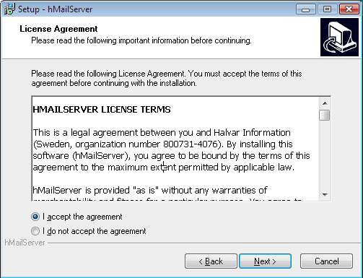

Slide 22
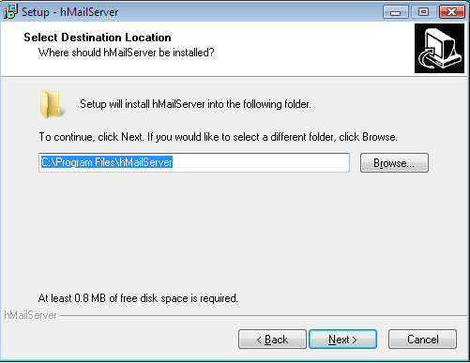

Slide 23
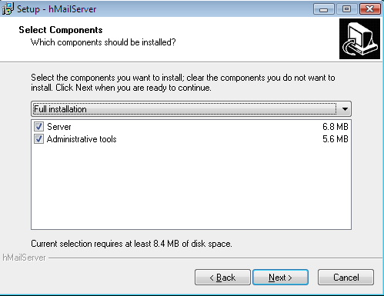

Slide 24
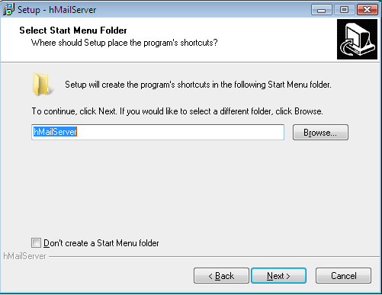

Slide 25
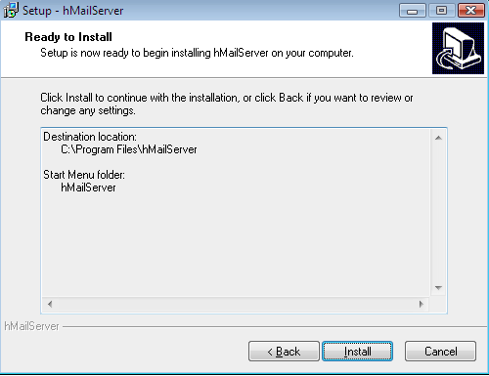

Slide 29
DNS configuration :
After installing hMailServer, make sure you configure your DNS server correctly. For SMTP to work, you must define MX records for your domain. MX stands for Mail eXchanger. Simply put, the MX records tell other email servers what server in your domain is responsible for handling mail.

Slide 30
Configuration tutorial

