Slide 1
FTP Server
Presentation
prepared by
Mohammed Ibrahim
Programmer
Computer & Internet Center
Mosul University

Slide 2
FTP Protocol Overview
File Transfer Protocol (FTP) is a standard network protocol used to transfer files from one host to another host over TCP / IP system (such as the Internet or an intranet).
FTP protocol Uses the port 20, port 21, port 21 is responsible for the transfer orders ftp while using port 20 for data transfer.

Slide 3
FTP Type
From a security side, there are two types of file transfer
Secure FTP
Need a user name and password to enter the system and get it from the system administrator
Anonymous FTP
Do not require a user name and a password to enter and you can often use a guest or anonymous instead of them.

Slide 4
Ownership Classifications
Classified sources online programs into three sections
Public Domain
Freeware
Shareware
Public Domain
The software developed for general use here, there is no ownership rights to one or restrictions on its use, distribute and modify.

Slide 5
Ownership Classifications
Freeware
All the right to use or distribute this software but there are property rights and the dissemination and may not be modified or sold.
Shareware
These programs are distributed the purpose of the experiment before you buy may not include all the features and must destroy the copies after the end of the period

Slide 6
FTP and viruses
At first you should know that your files and programs are divided into two ASCII & Binary
ASCII
short for (American Standard Code for Information Interchange) and files of this type contain seven bits molecules, ranging between zero and 127. This term is used to express the standard by which converts letters to numbers in the computer. Text files used this kind of formulas.

Slide 7
FTP and viruses
Binary
Means files with binary system containing 8 molecules Bytes
between zero and 255 included pictures and programs compressed and files under this type

Slide 8
FTP and viruses
The virus can not be transmitted via ASCII files and can not be transmitted through images format : jpg, gif, bmp,and other image formats and via video and audio files such as avi, ram, mpg, mp3, wav, etc. In other words, it moves across programs and system files and compress programs usually and exe, com, bat, dll, drv, sys, bin, ovl, zip, mim, uue, xxe, b64, bhx, also can be transmitted macro viruses across applications MS Office, so beware of these files and check alwaysbefore the operation.

Slide 9
Top Free FTP Server Software
WS_FTP Server
War FTP Daemon
zFTPServer Suite
FileZilla Server
Serv-U FTP Server
Xlight FTP Server
Golden FTP Server

Slide 10
FileZilla Server Features
Easy to use
Supports FTP, FTP over SSL/TLS (FTPS) and SSH File Transfer Protocol (SFTP)
Cross-platform. Runs on Windows, Linux, *BSD, OSX and more
IPv6 support
Available in many languages
Supports resume and transfer of large files >4GB
Powerful Site Manager and transfer queue
Bookmark

Slide 11
FileZilla Server Features
Drag & drop support
Configurable Speed limits
Filename filters
Directory Comparison
Network configuration wizard
HTTP/1.1, SOCKS5 and FTP Proxy support
Logging to file
Synchronized directory browsing
Remote file search

Slide 12
Download frome site https://filezilla-project.org/

Slide 13
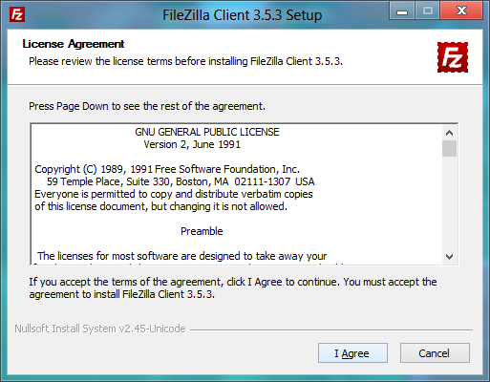
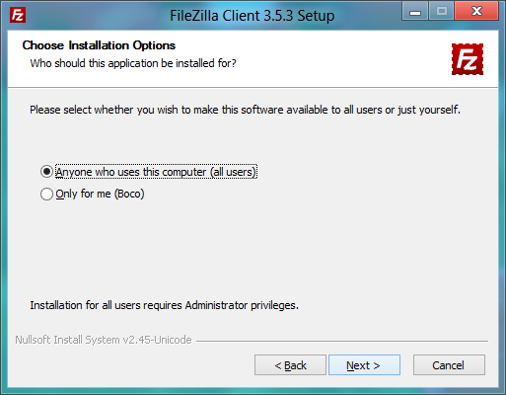
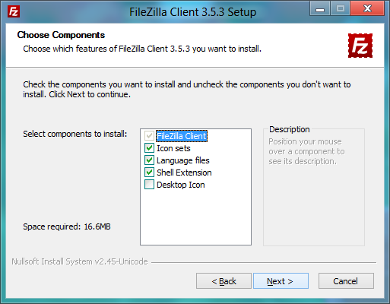
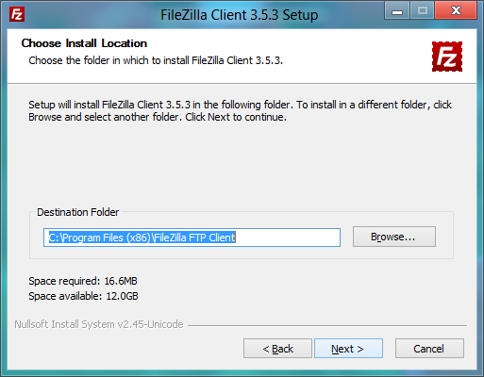

Slide 14
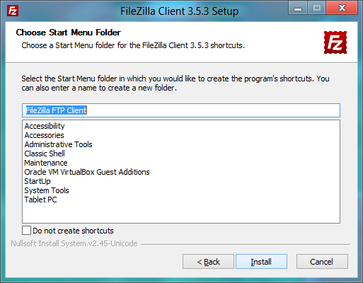
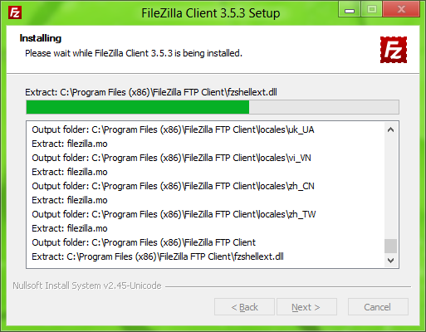
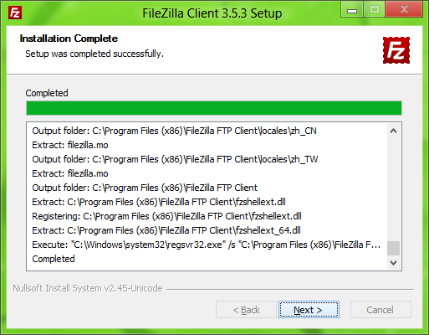
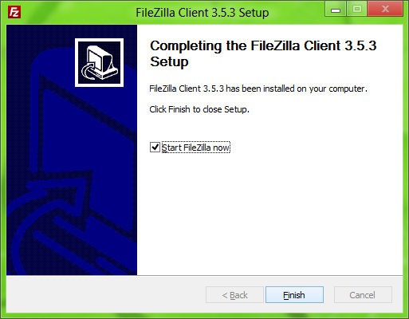

Slide 15
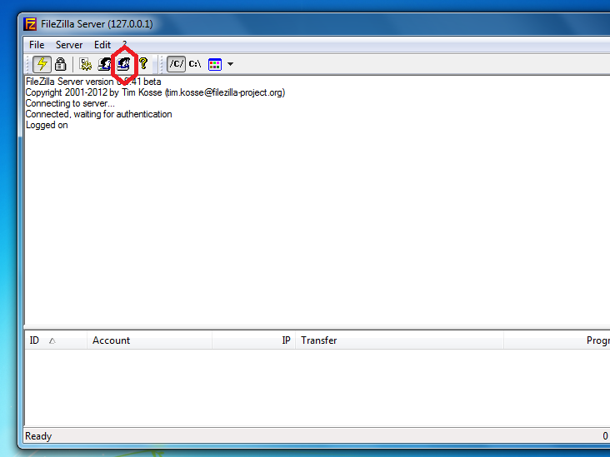

Slide 16
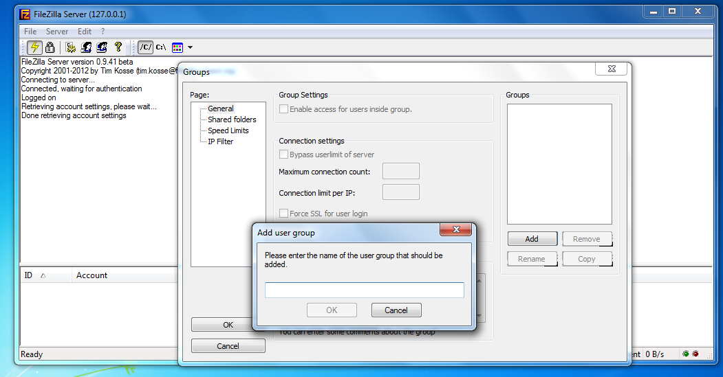

Slide 17
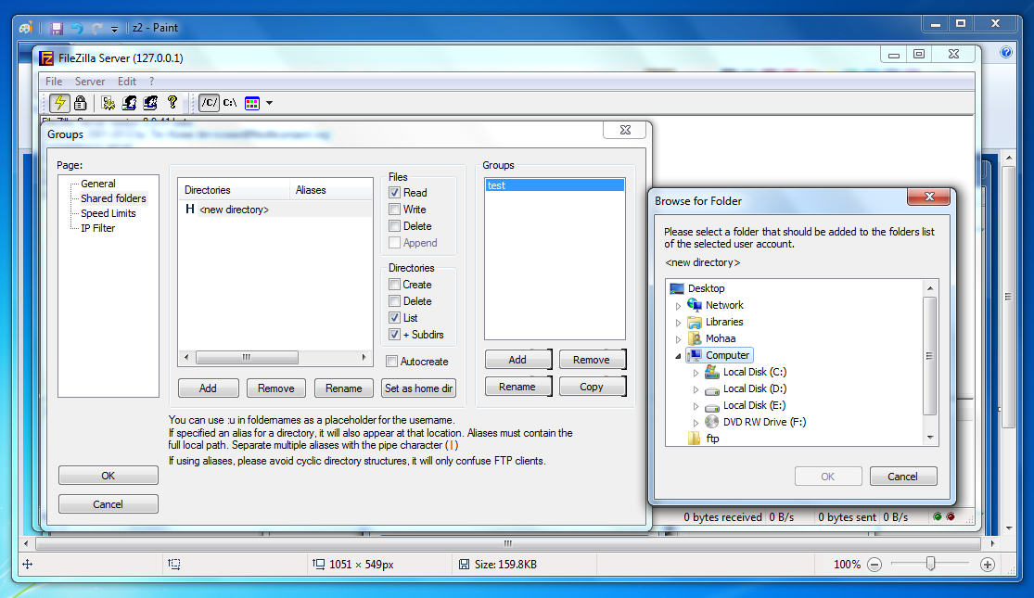

Slide 18
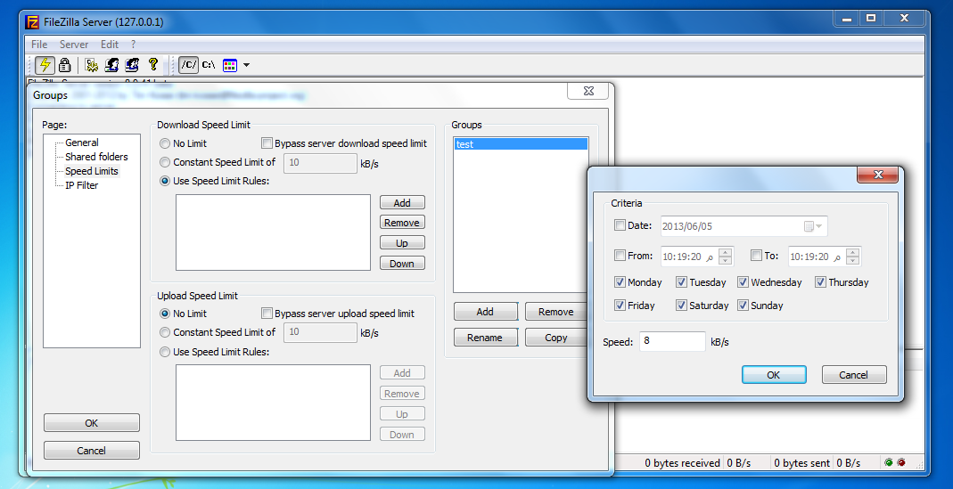

Slide 19
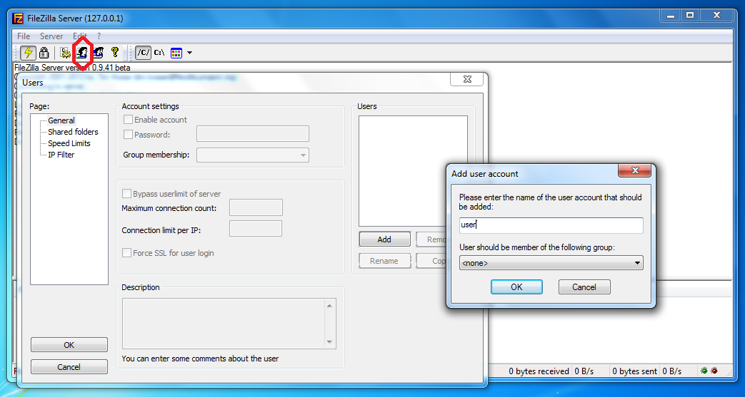

Slide 20
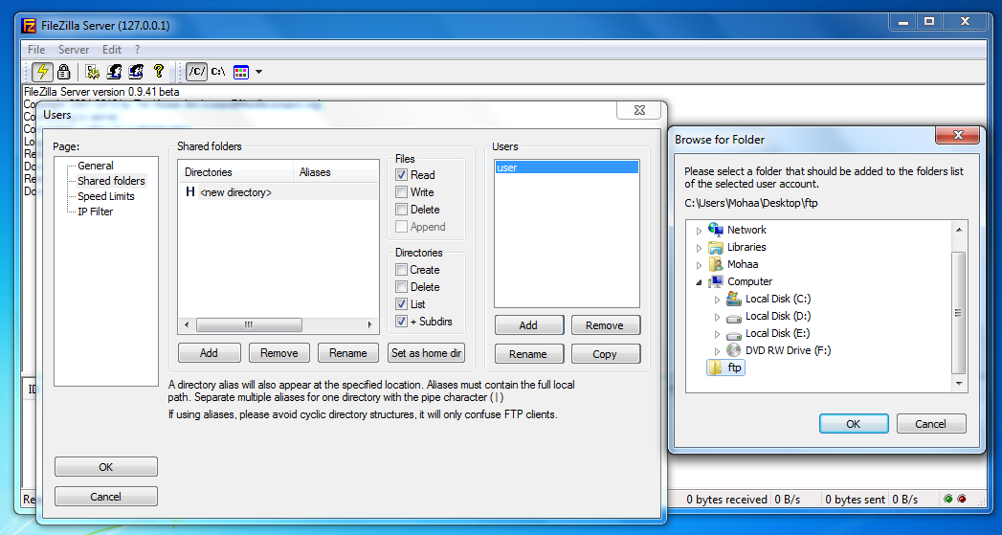

Slide 22
Access the FTP Server

Slide 23
Access the FTP Server

Slide 24
Access the FTP Server

Slide 25
Thank you for listening

