Slide 1


Slide 2
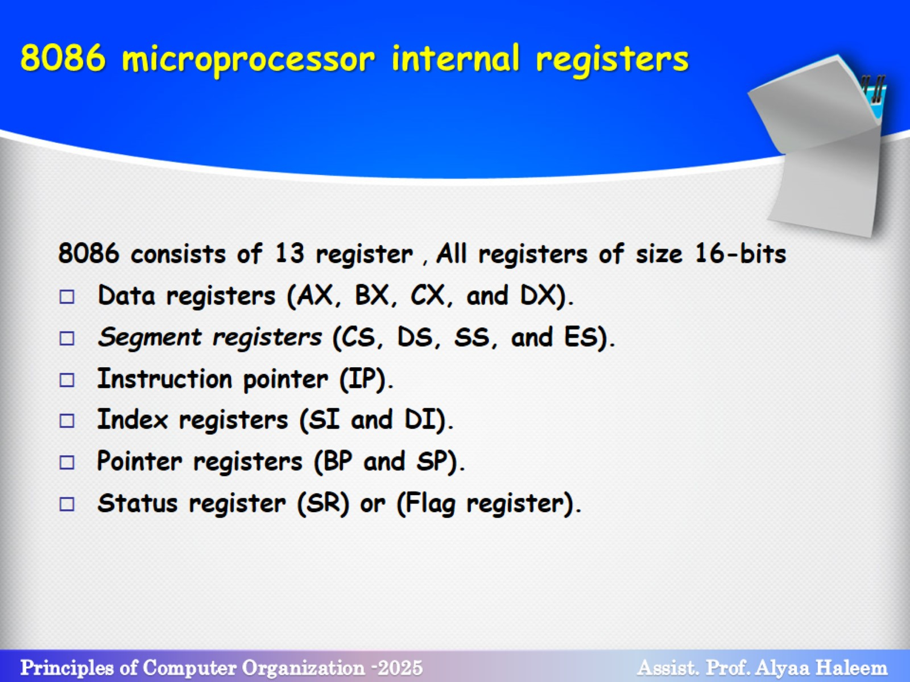
8086 microprocessor internal registers

Slide 3
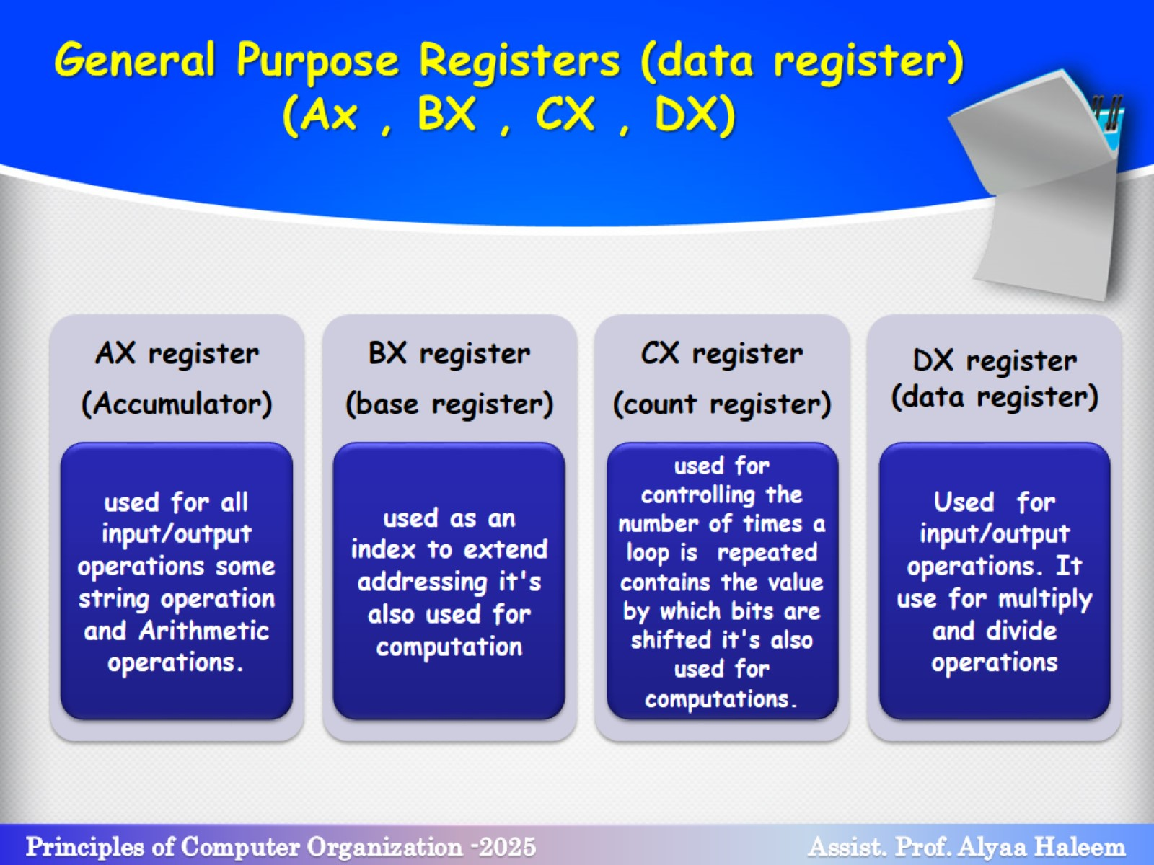
General Purpose Registers (data register)
(Ax , BX , CX , DX)

Slide 4
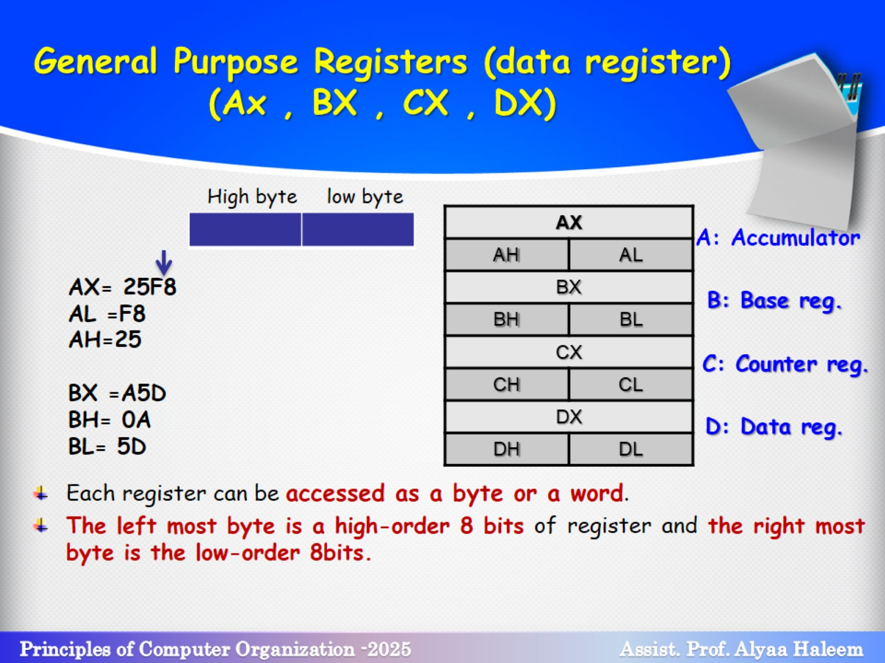
General Purpose Registers (data register)
(Ax , BX , CX , DX)

Slide 5
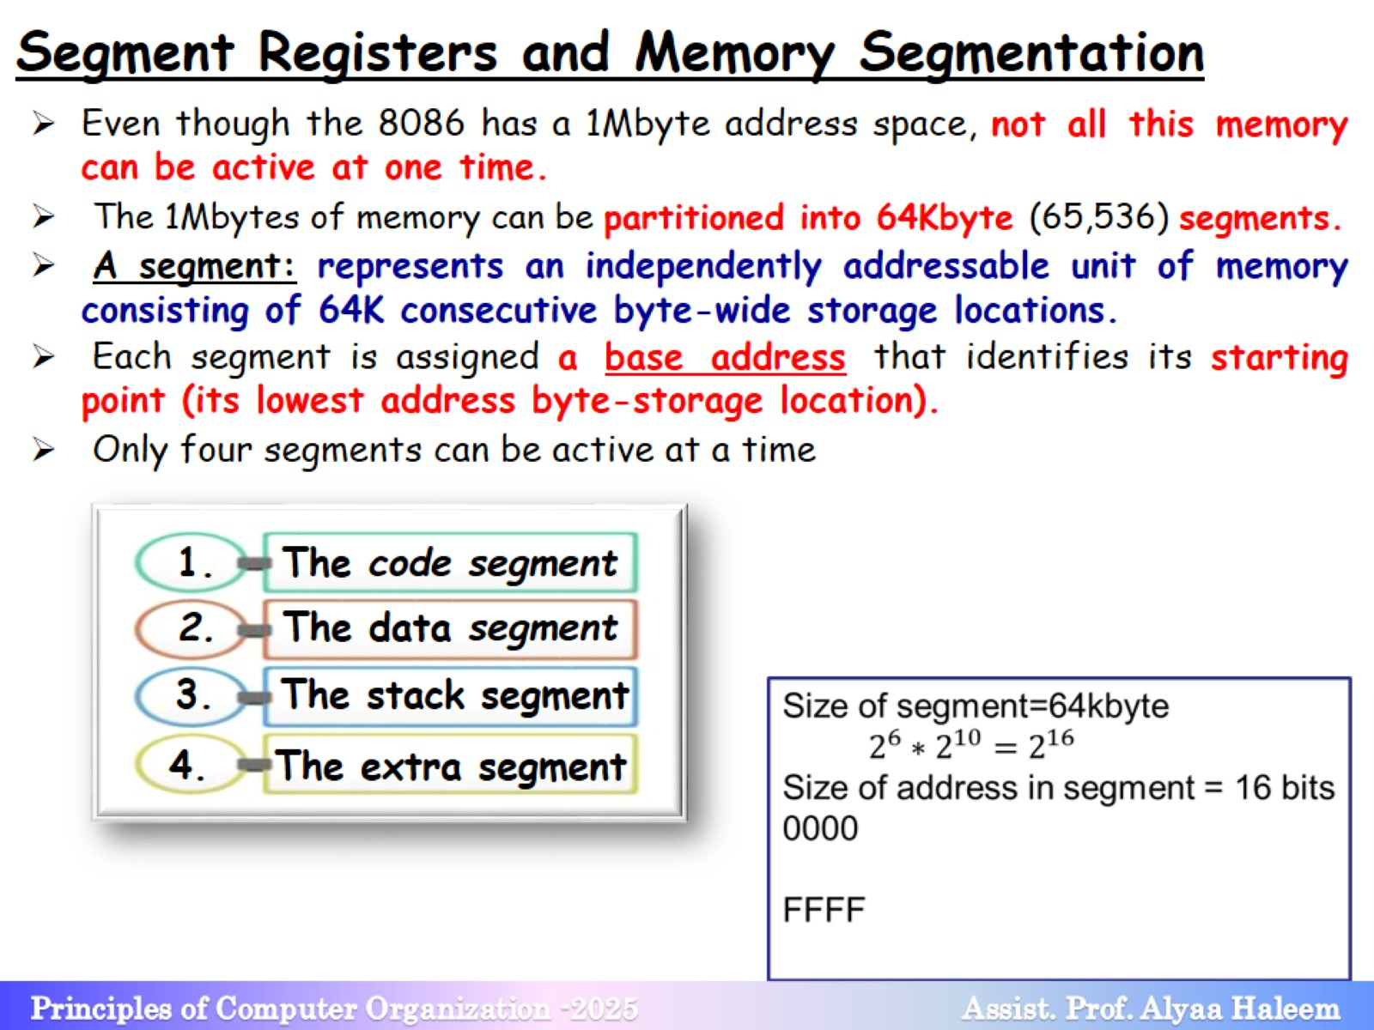
Segment Registers and Memory Segmentation

Slide 6
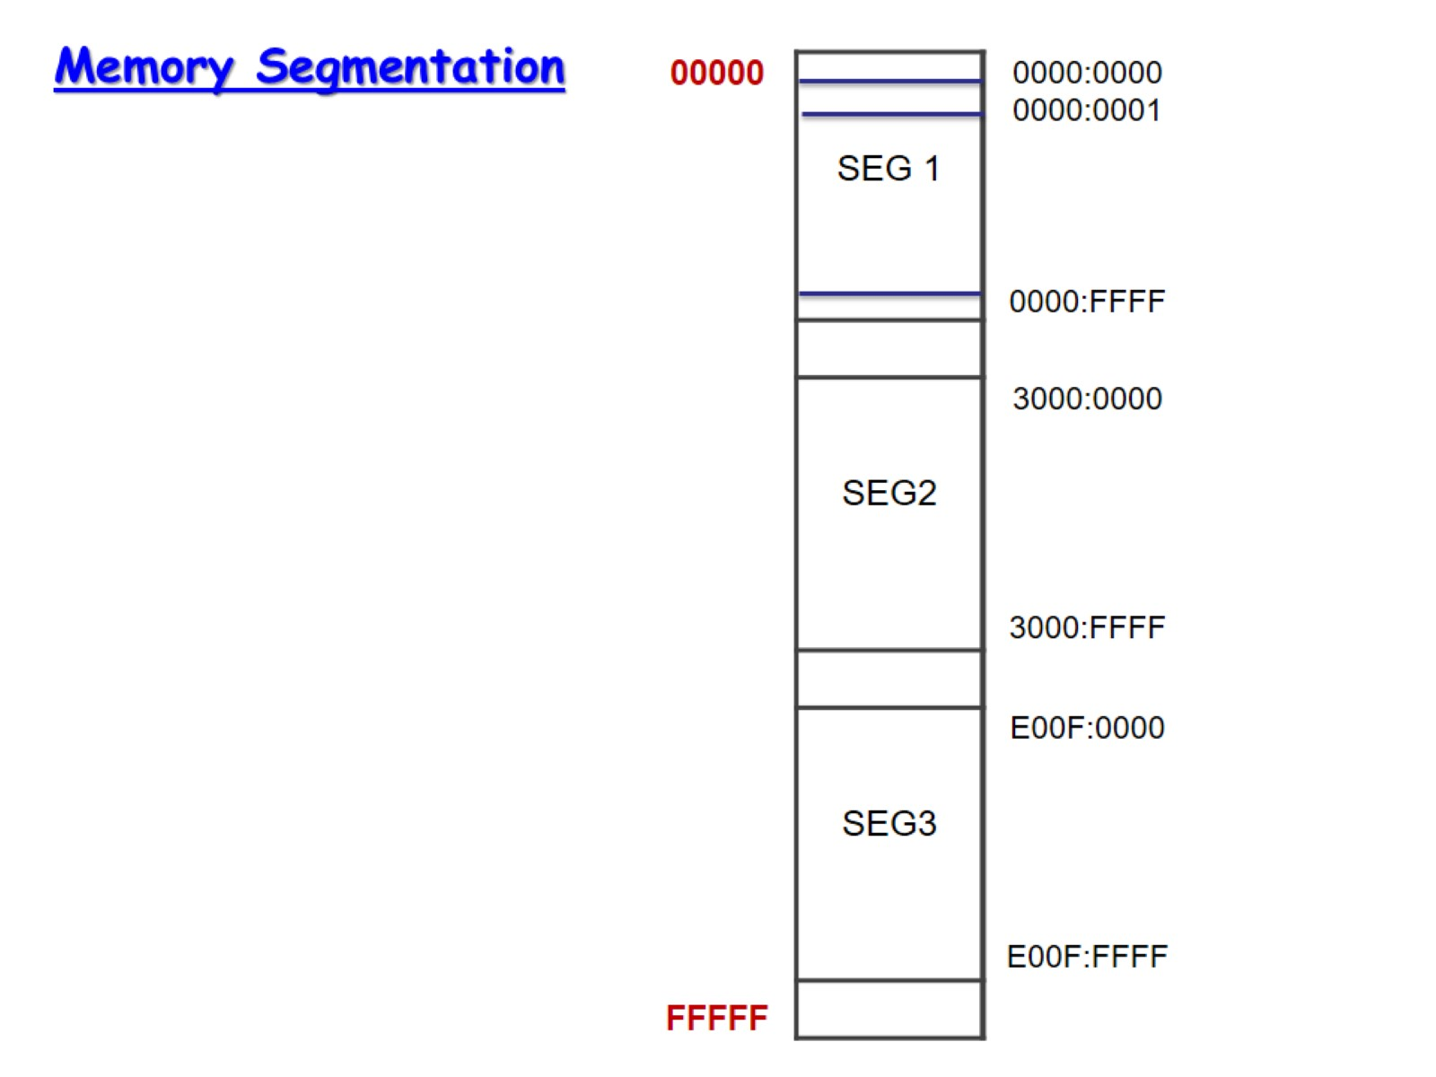

Slide 7
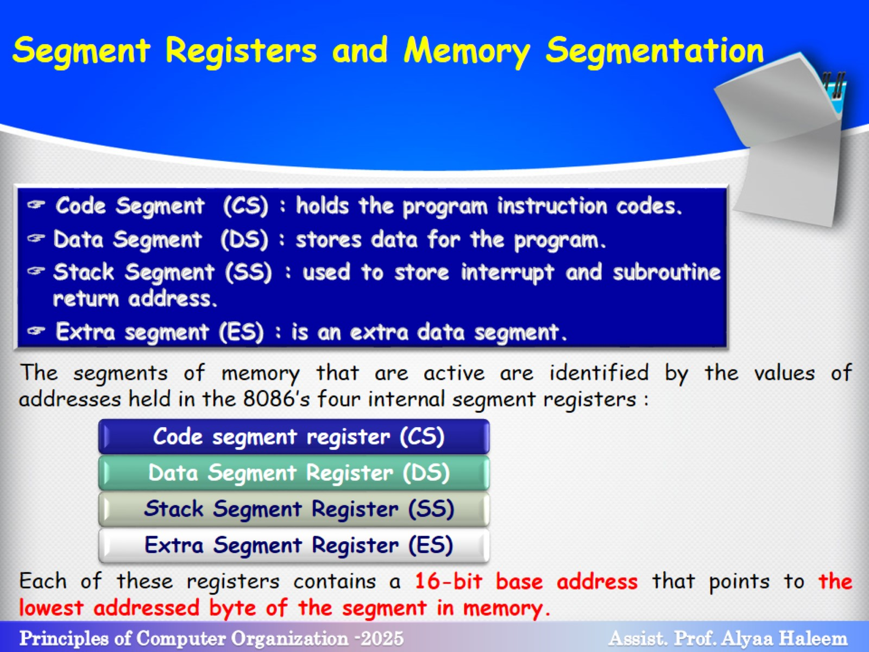

Slide 8
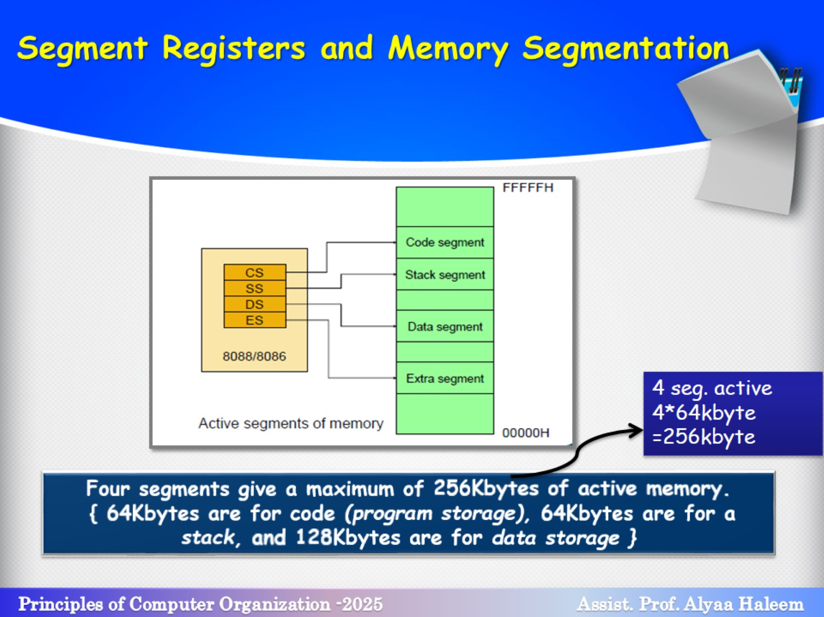

Slide 9
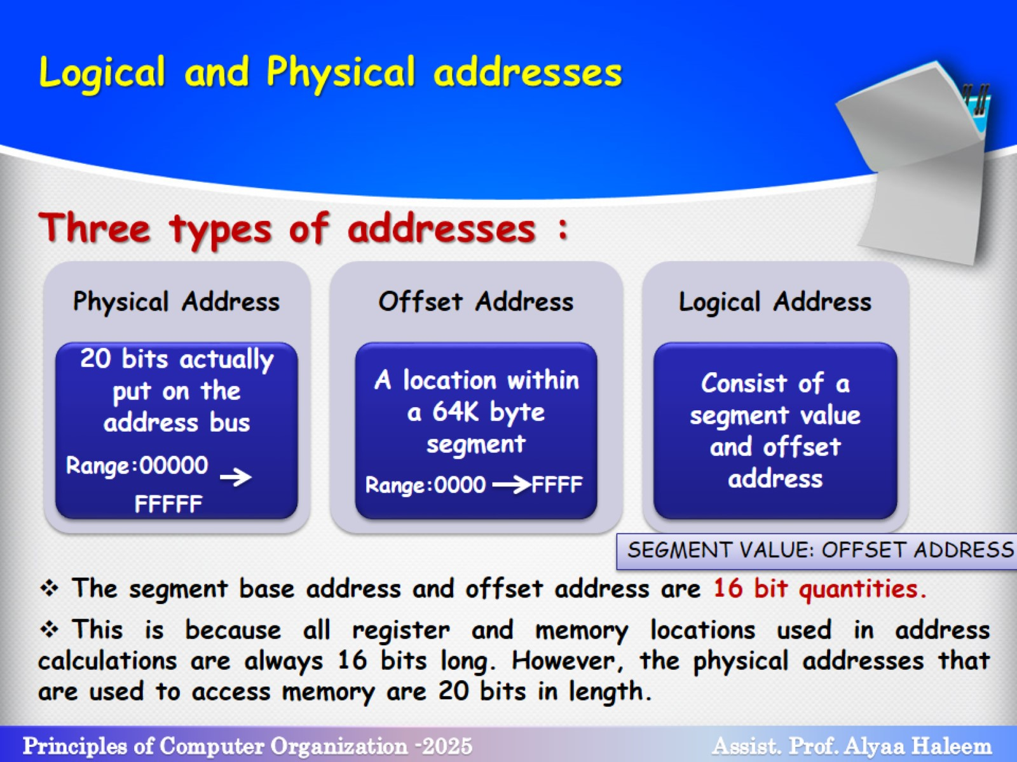

Slide 10
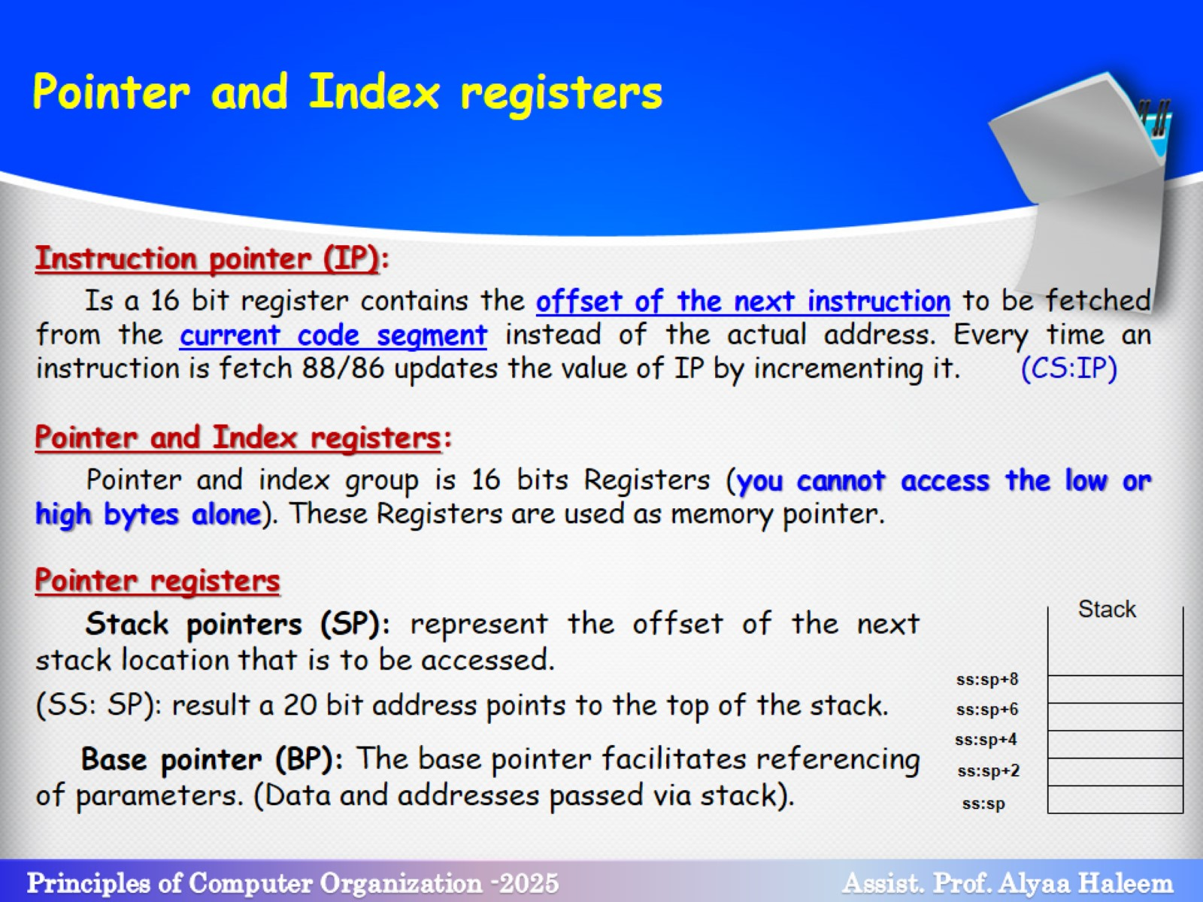
Pointer and Index registers

Slide 11
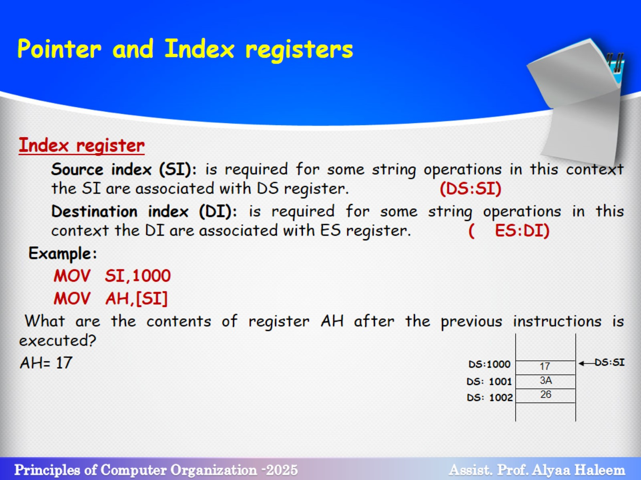
Pointer and Index registers

Slide 12
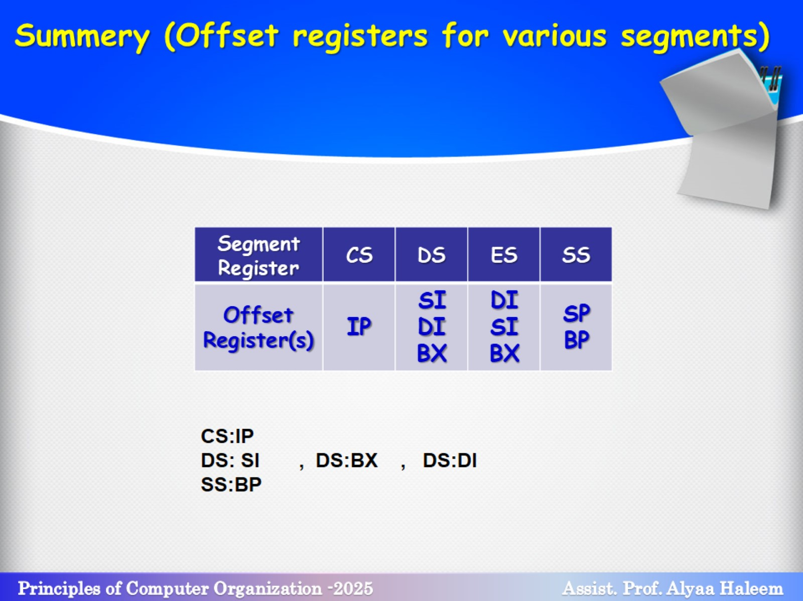
Summery (Offset registers for various segments)

Slide 13
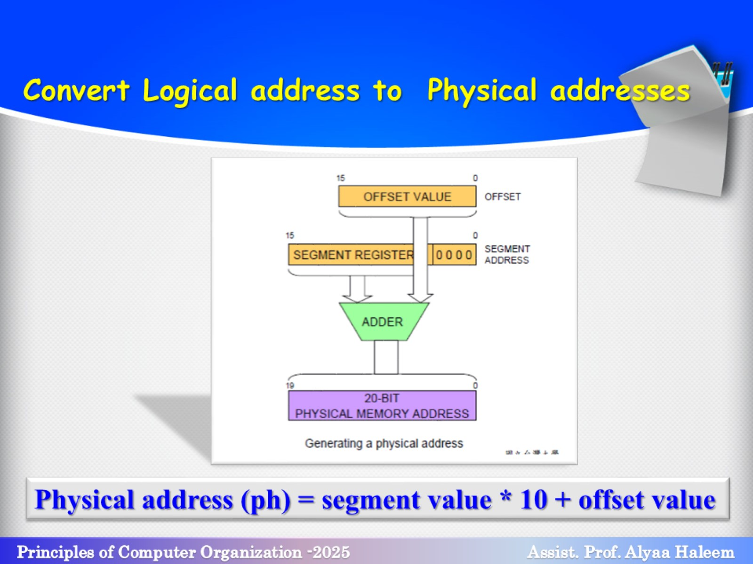

Slide 14
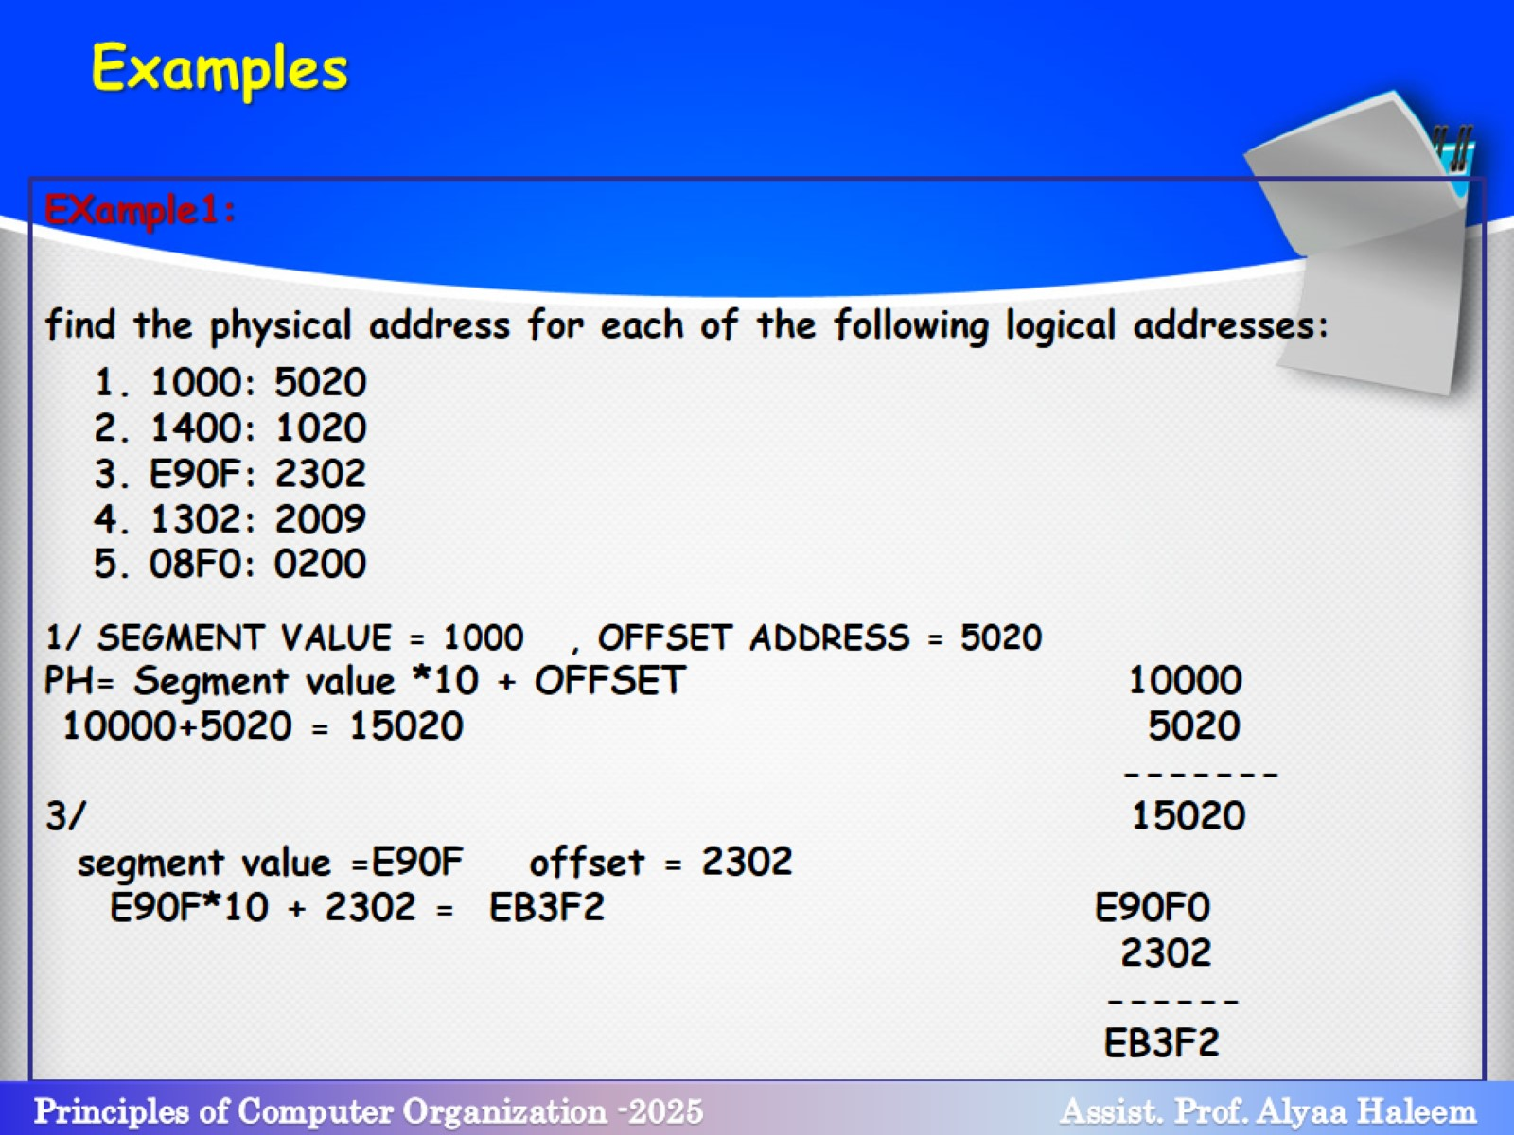
Examples

Slide 15
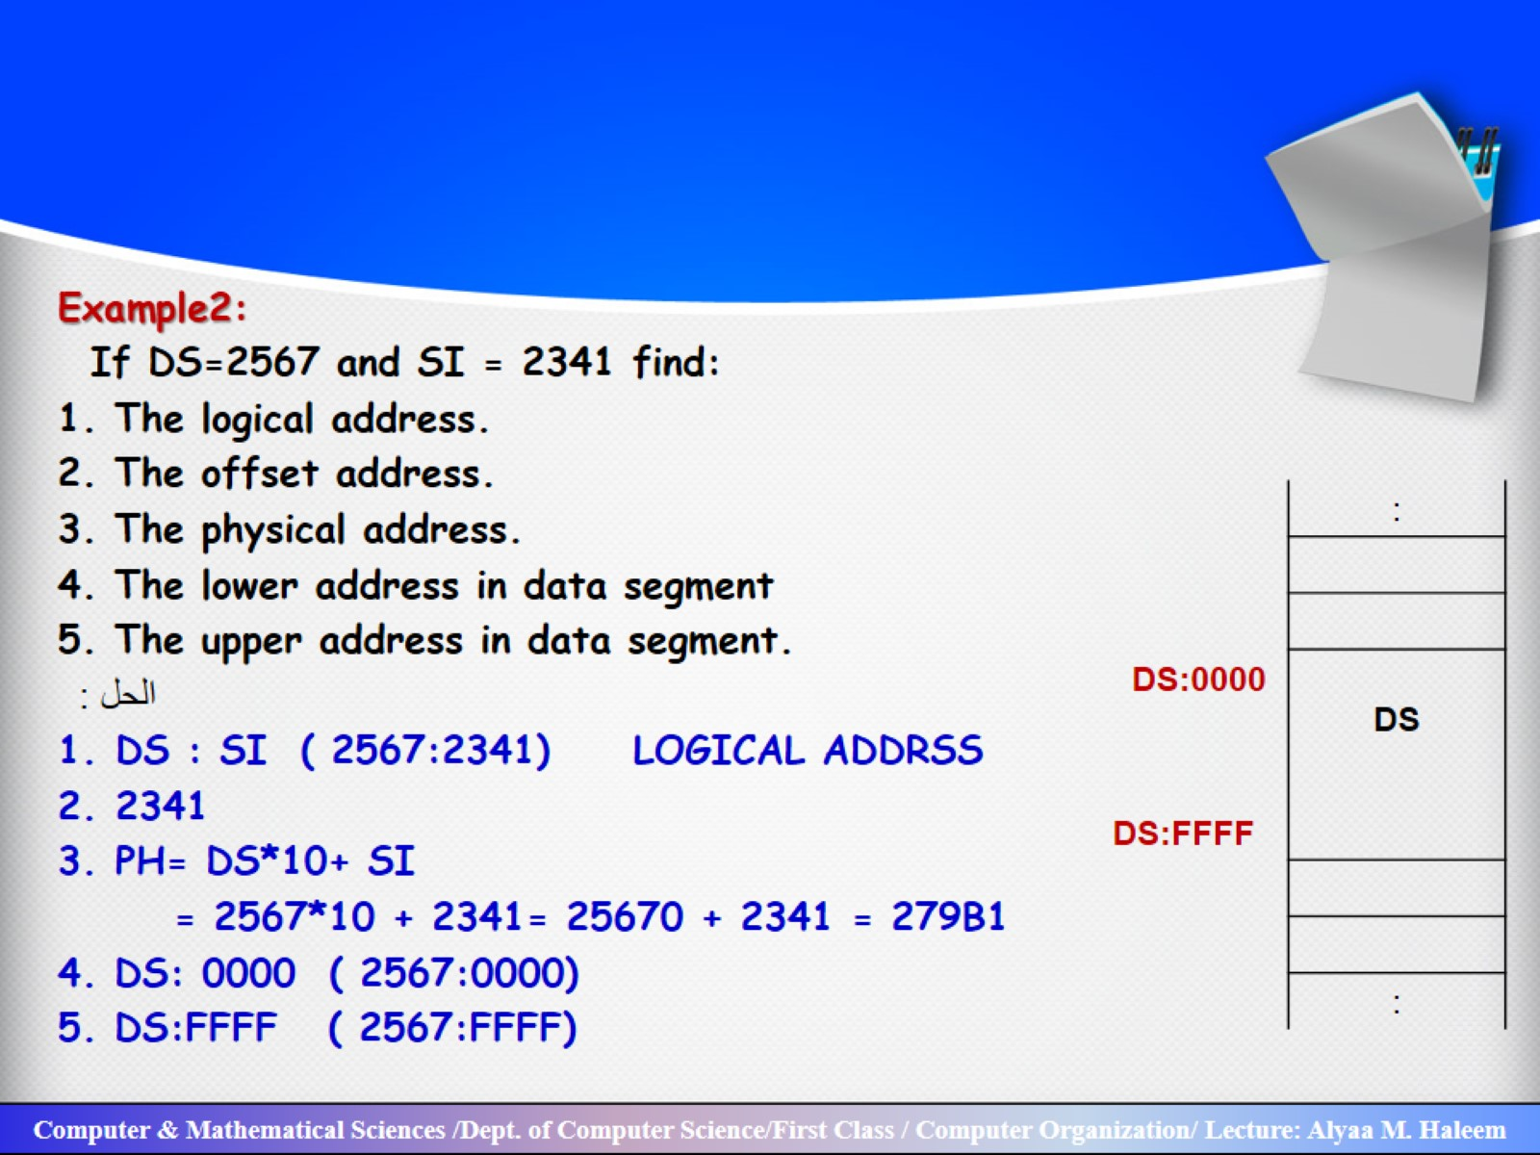

Slide 16
