Slide 1


Slide 2
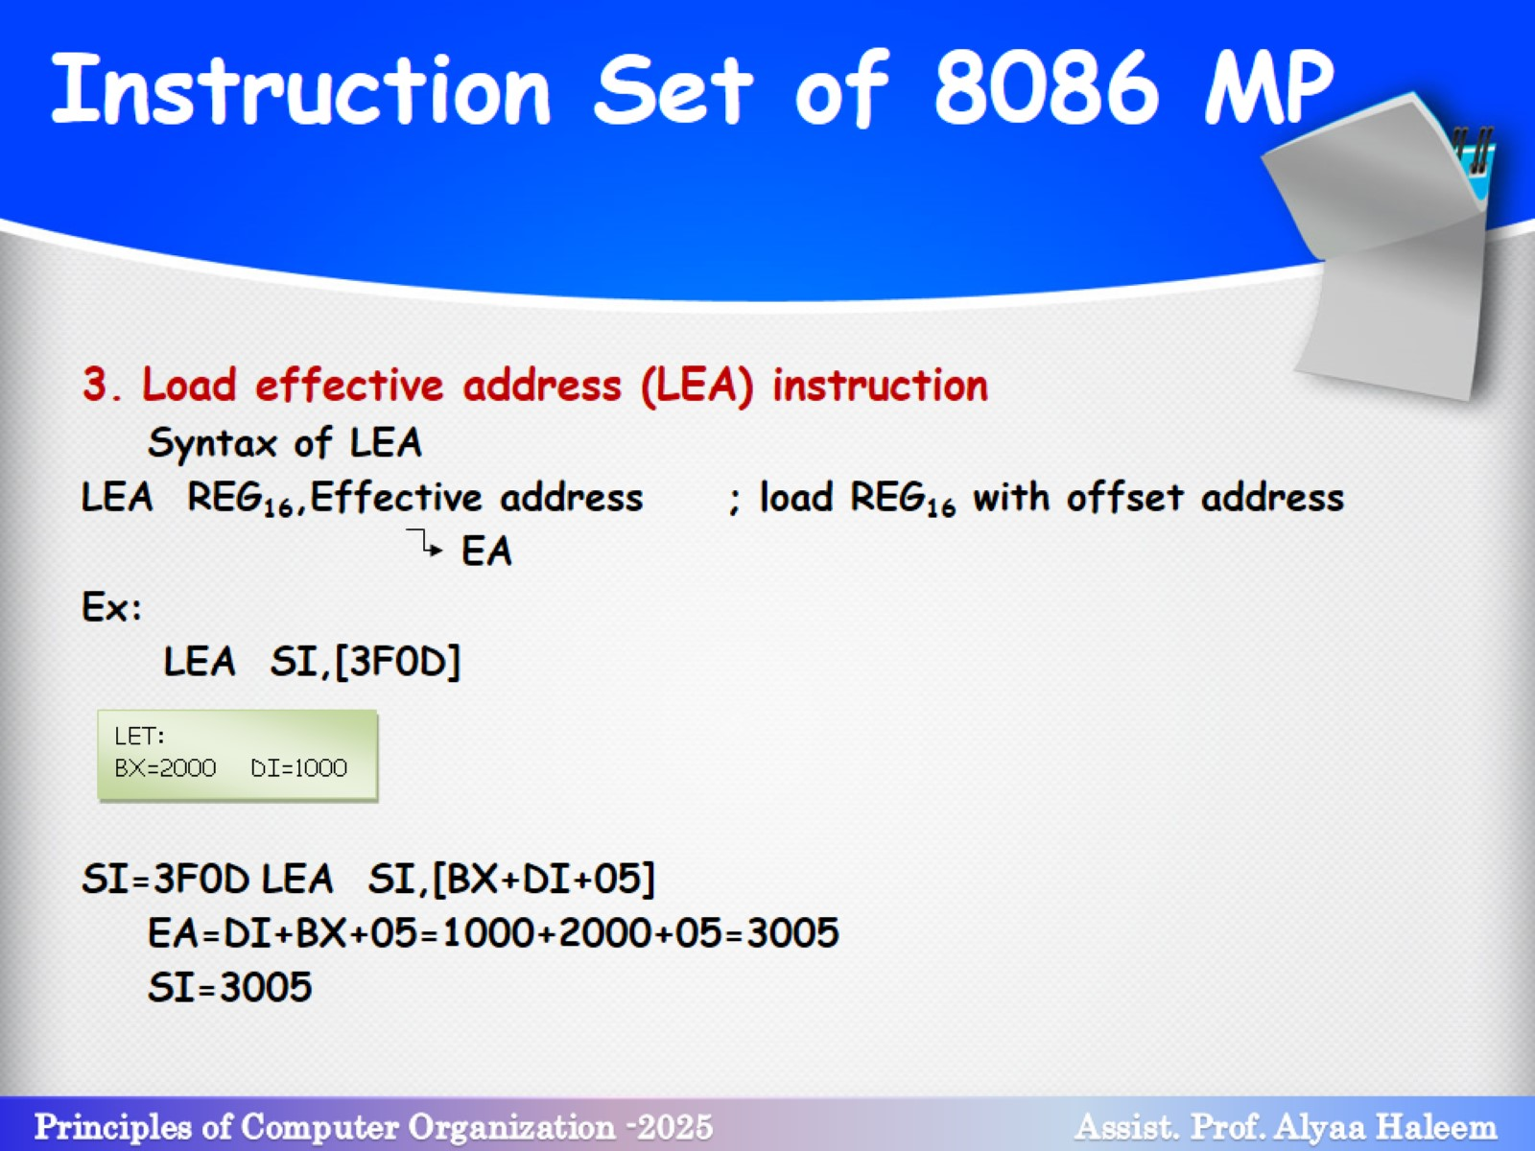
Instruction Set of 8086 MP

Slide 3
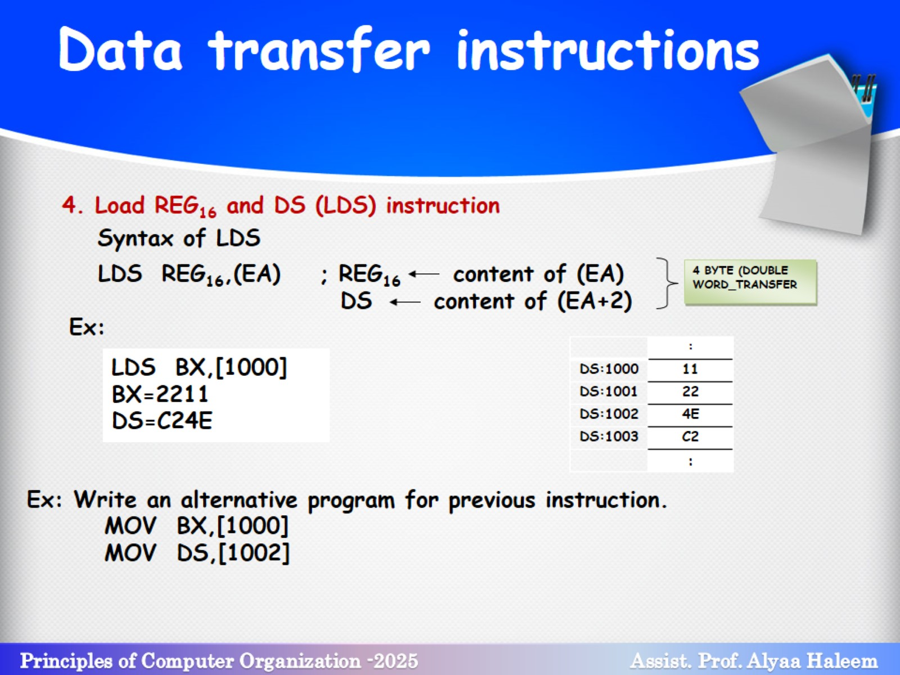
Data transfer instructions

Slide 4
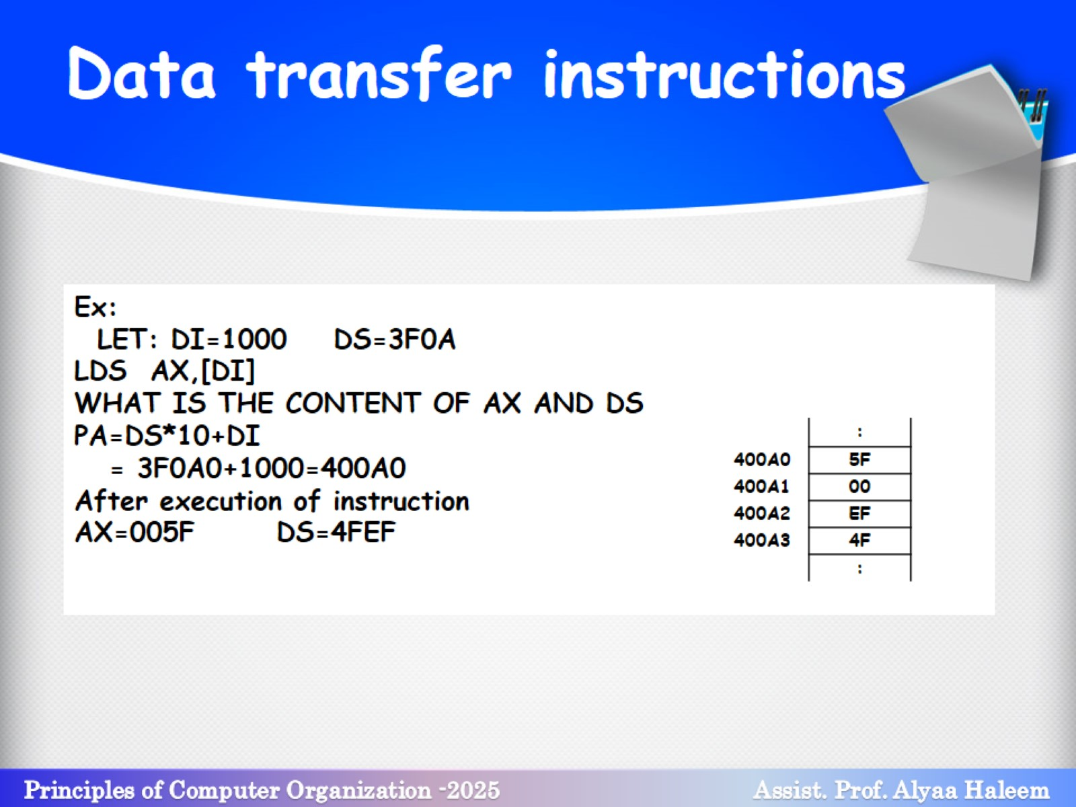
Data transfer instructions

Slide 5
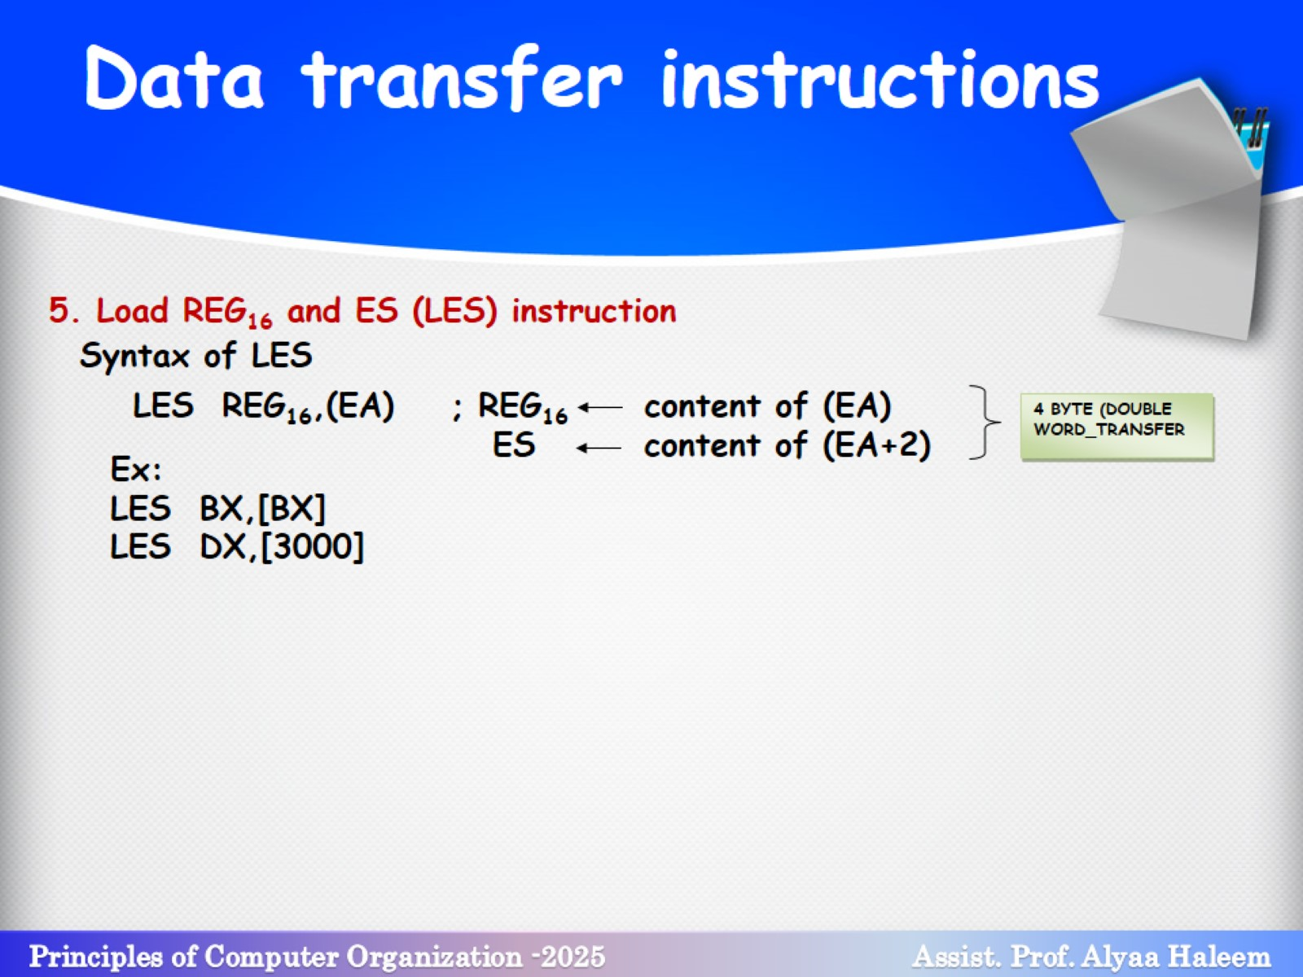
Data transfer instructions

Slide 6
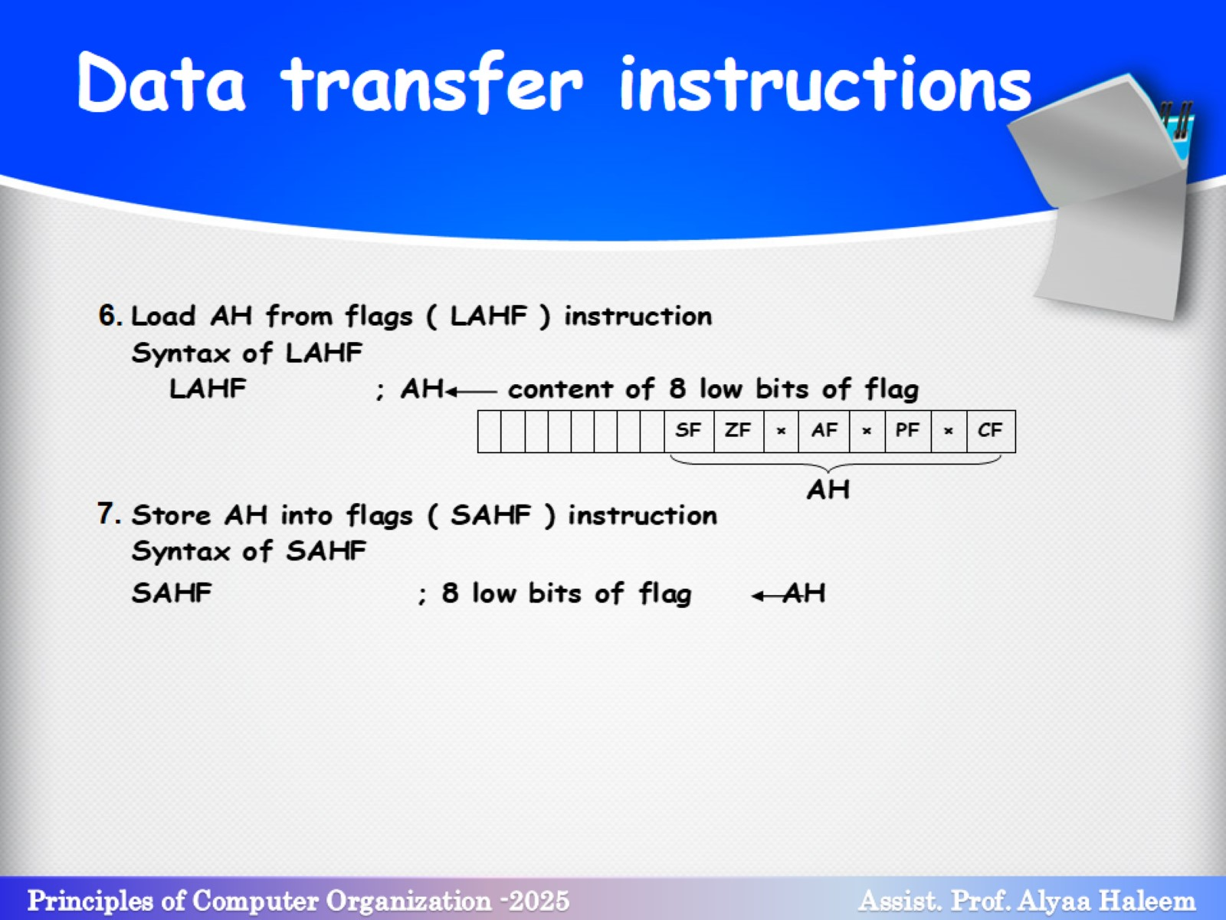
Data transfer instructions

Slide 7
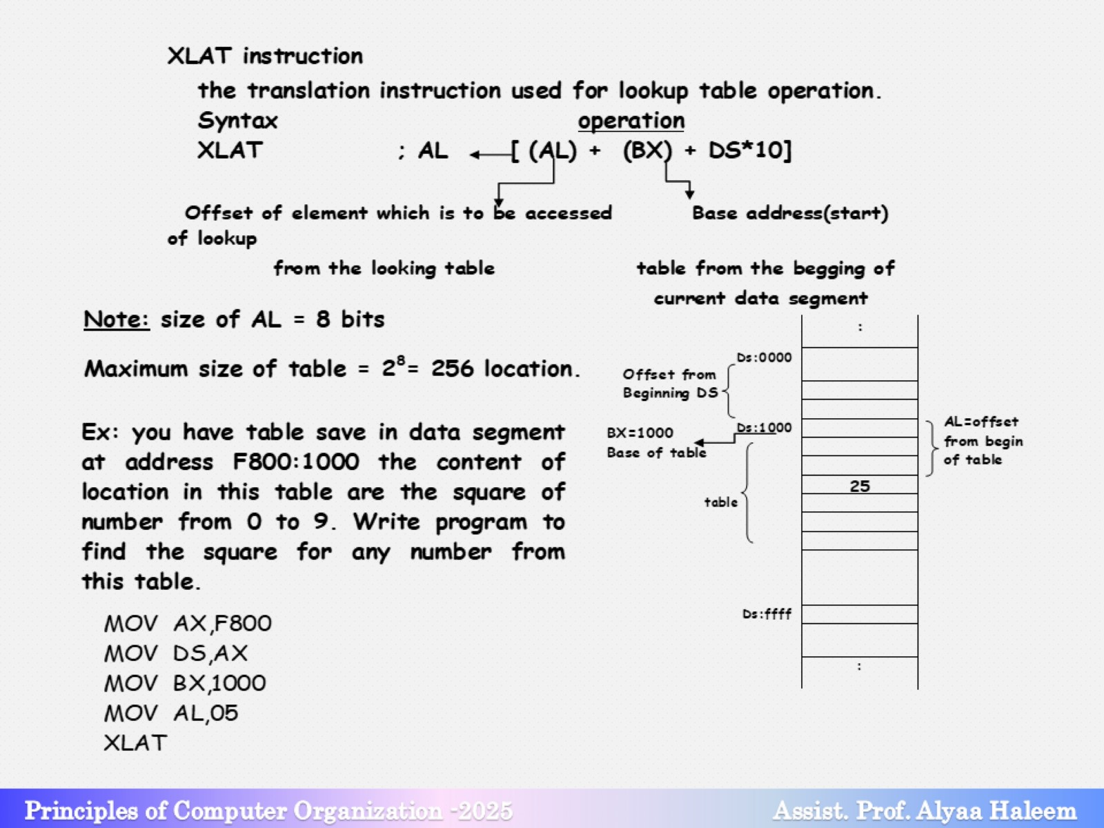

Slide 8

Data transfer instructions

