Slide 1
Lesson 4: Computer Systems
1st class

Slide 2
Table of contents
01
02
03
Computer Hardware:
Computer Software:
Describing computer hardware.
Describing computer software.
Working with Computers:
Describing tasks.

Slide 3
Computer Hardware

Slide 4
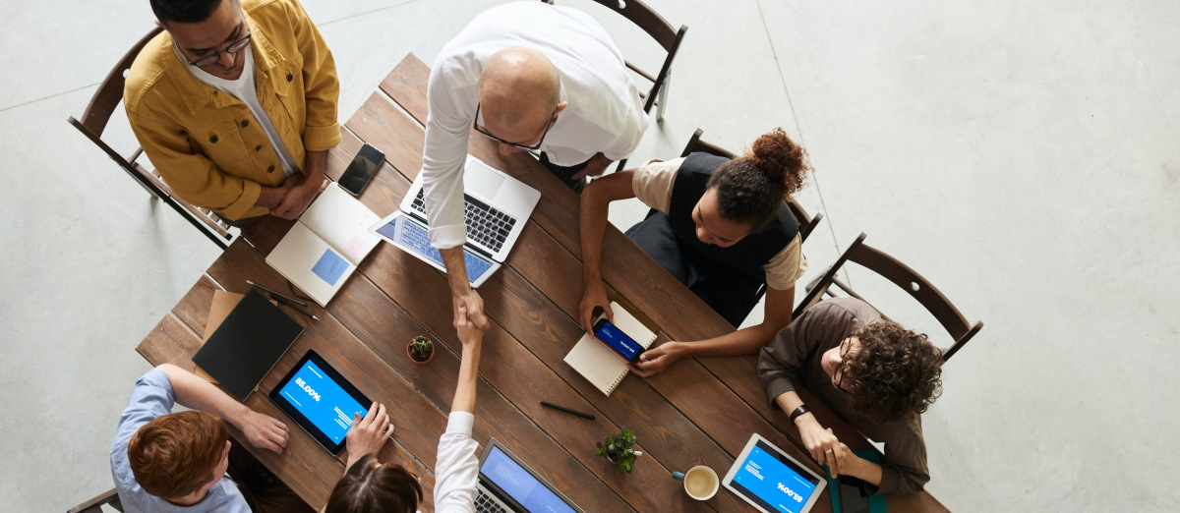
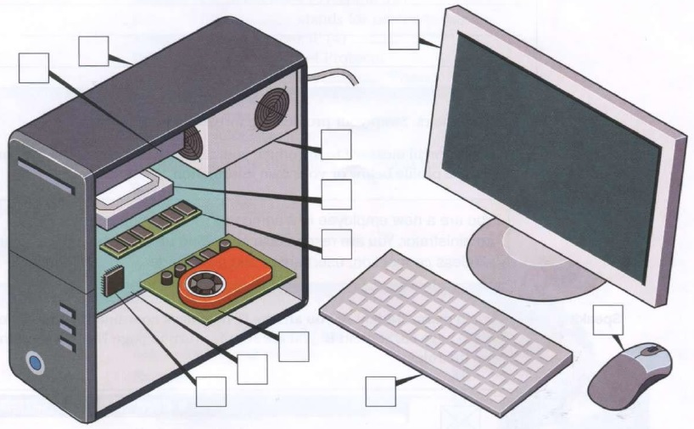
Vocabulary
1.Monitor 2.case 3.motherboard 4.processor (CPU)
5. main memory (RAM) 6.expansion cards 7.power supply unit
8.optical disk drive 9. Hard disk drive 10.keyboard 11.mouse
- Label the diagram with the correct items 1-11:

Slide 5

Listening
Bob: What do you think? Which ____________ is better for the sales team?
Daisy: I’m not sure. This computer has a ____________ memory and I think it has a ____________ processor.
Bob: And the other one?
Daisy: Well, it is ____________ .
Bob: And ____________ .
Daisy: Yes, you’re right. Lighter and smaller.
Bob: But the bigger one is ____________ .
Daisy: So what is our decision?
Bob: I’m not sure. Let’s go for a coffee and discuss this again.
-Listen to two colleagues and complete this dialogue:

Slide 6
Language
Comparatives
We use comparative adjectives to compare two people or things.
For short adjectives we add -er (than). Be careful of spelling. | big | bigger | The new monitor was bigger than the old monitor.
 | fast | faster | Your processor is faster than mine.
 | easy | easier | It’s easier to use than the other one.
For long adjectives we use more/less (than). | difficult | more/less difficult | This version is more difficult to use than the old version.
 | expensive | more/less expensive | His computer is less expensive than hers.
 | reliable | More/less reliable | I think you should buy that CPU. It is more reliable than the one you have.
Some comparatives are irregular. | bad | worse | That screen resolution is much worse than before!
 | good | better | I really like this mouse. It’s so much better than the old one.

Slide 7
Reading
Example: long → longer.
1. light → ____________ .
2. efficient → ____________ .
3. big → ____________ .
4. wide → ____________ .
5. heavy → ____________ .
6. fast → ____________ .
7. dark → ____________ .
8. soft → ____________ .
9. hard → ____________ .
10. durable → ____________ .
-Make the comparative form of these adjectives:

Slide 8
Computer Software

Slide 9
speaking
- Application software. -System software. -Programming software.
-Make a list of some of the computer software you use in your work or study. Think about:

Slide 10
Language
Superlatives
We use superlative adjectives to compare a person or thing with a number of other people or things.
For short adjectives we add the + -est. Be careful of spelling. | big | biggest | The new monitor was the biggest in the room.
 | fast | fastest | Your version of the software is the fastest.
 | easy | easiest | It‘s the easiest to use.
For long adjectives we use the most/ the least. | difficult | most/least difficult | This version is the most difficult to use.
 | expensive | most/least expensive | His computer is the least expensive.
 | reliable | most/least reliable | I think you should buy that. It is the most reliable.
Some superlatives are irregular. | bad | worst | That is the worst software I’ve ever used!
 | good | best | I really like this website. It’s the beast I’ve seen.

Slide 11
Listening
Tim: What do you think about these three photo imaging packages?
Simone: It’s a difficult choice. All three are very good but they have different strengths.
Tim: I agree.
Simone: Serif Image Plus has ____________ image ____________.
Tim: OK.
Simone: But Magic Extreme has the ____________ processing of images.
Tim: You’re right. Also, Serif has ____________ special ____________ . But what about Snap Pro?
Simone: Well, it has the ____________ dubbing options.
Tim: And Snap Pro is the best for ____________ photos.
Simone: I’m not sure. Serif has ____________ efficient ____________ .
Tim: Which is the most expensive?
Simone: Oh, Serif Image Plus.
Tim: And the cheapest?
Simone: Snap Pro.
Tim: Let’s get Snap Pro then.
Simone: I’m still not sure.
-Listen to two colleagues discussing software and complete this dialogue:

Slide 12
Language
Have (got)
Present tense of have (got)
We use have (got) to talk about possession. | I’ve/You’ve/We’ve/They’ve (got)… | I/You/We/They have (got)…
 | He’s/She’s/It’s (got)… | He/She/It has (got)…
 | I/You/We/They haven’t (got)… | I/You/We/They have not (got)…
 | He/She/It hasn’t (got)… | He/She/It has not (got)…
 | I/You/We/They don’t have … | I/You/We/They do not have …
 | He/She/It doesn’t have… | He/She/It does not have…
 | Have I/you/we/they got … ?
 | Has he/she/it got … ?
 | Do I/you/we/they have … ?
 | Does he/she/it have … ?

Slide 13
Writing
- Write five sentences comparing three software products you use or know.

Slide 14
Working with Computers

Slide 15
Listening
Paul: Hi, Brinitha.
Brinitha: Hi, Paul.
Paul: How’s it ____________?
Brinitha: Fine, fine.
Paul: What ____________ you ____________ at the moment?
Brinitha: Oh, I ____________ Nero.
Paul: How are you getting on?
Brinitha: Well, I ____________ a network. I ____________ Microsoft Server.
Paul: Right. Where is Jackie today? Do you know?
Brinitha: Yes. She is on a training course today. She ____________ about the new database system.
Paul: What about Mary and Imran? Where are they?
Brinitha: They ____________ in today. They have a day off.
- Listen and complete this dialogue:

Slide 16
Language
Present continuous
We use the present continuous to talk about things that take place at the time of speaking and are not permanent. | I’m installing the software.
 | He’s/She’s setting up a network.
 | We’re/They’re working at home today.
 | I’m not setting up the network.
 | He’s/She’s not installing the software.
 | We/They are not coming in today.
 | Are you installing it now?
 | What am I doing?
 | What are you/they doing?
 | What is he/she doing?

Slide 17
Reading
1. It ____________ going well.
2. I ____________ learning a new program.
3. She____________ working in the office today. She has a day off.
4. They ____________ installing the new software.
5. We ____________ setting up the network.
6. We ____________ using Word. We have a different word-processing program.
7. Where ____________ they working today?
8. What ____________ he installing on the computer?
9. I ____________ coming in today. I’m sick.
10. ____________ she working at home today?
-Complete these sentences with is/isn’t, am/am not or are/aren’t:

Slide 18
Vocabulary
1. Hanka is creating
2. Philip is inserting an
3. Rob is troubleshooting
4. We are running
5. Betty is connecting
6. They are burning
a) The software.
b) a check-up.
c) a file.
d) a device.
e) CDs.
f) image.
- Match the sentence halves 1-8 to a-h:

Slide 19
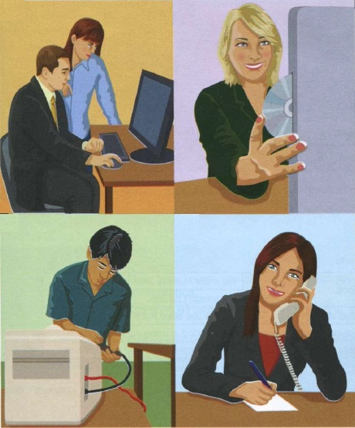
Vocabulary
(1)
(2)
- Look at the pictures A-F and describe what is happening:
(3)
(4)

Slide 20
Thanks
Do you have any questions?
Dena Rafaa Ahmed
Master of Science in Software Engineering
dinasalimagha@uomosul.edu.iq

