Slide 1
Lesson 1 :
Working in the IT industry
1st class
Unit One
Dr. ABAYAJE Furat

Slide 2
Table of contents
01
02
03
04
Meeting people:
Jobs in IT:
Introduce youself and others.
Describing your job.
Schedules:
Spelling:
Describing your daily routine and time.
Using the alphabet.

Slide 3
Meeting people

Slide 4
speaking
-How do you greet people in your country? -What do you say when you greet people in English?

Slide 5

Reading
all is meet name’s Nice
this too you Welcome What’s
Natasha: Hi, my ____________ Natasha.
Khalid: Pleased to ____________ you. I’m Khalid Ali.
Natasha: Pleased t o meet you, ____________ .
Philip: Good morning. ____________ your name?
Ahmed: I'm Ahmed. And ____________ are?
Philip: My name's Philip. ____________ to meet you.
Tim: Hi everybody, ____________ is Ingrid.
All: Hi!
Tim: Ingrid, this ____________ Ahmed, Linda, Mohammed
and Mansoor.
Ingrid: Nice meeting you ____________.
Linda: Likewise.
Tim: ____________ to the team and good luck.
-Complete these dialogues with the words in the box:

Slide 6

Listening
CD 2
-Listen and check your answers.

Slide 7
speaking
- Introduce yourself.
- Interduce a new team member.
-Work in small groups. Practice introductions. Follow the instructions below:

Slide 8
Listening
Kathryn: Karim, what do you do?
Karim: I’m a website developer/network administrator.
Who do you work for?
Kathryn: I work for CISCO. I’m a system analyst/website analyst
there. Where are you from, Karim?
Karim: I'm from Kuwait. I work for Microsoft there. And where are you
from, Kathryn?
Kathryn: I'm from the UK/US but now I live in Qatar. Do you know
where Glenda's from?
Karim: She's from the US.
Kathryn: And what's her job?
Karim: She works for IBM/Dell. Her job is t o set up new systems.
CD 3
-Listen to this dialogue and choose the correct answers:

Slide 9
Language
Present tense of be
الزمن الحاضر
We use be to say who somebody is OR what something is? | I’m Sam. | I am Sam.
 | You’re/We’re/They’re from the UK. | You/We/They are from the UK.
 | He’s/She’s a website developer. | He/She is a website developer.
 | It’s in the US. | It is in the US.
We use be to ask personal questions. | Where are you from?
 | What’s his name/job? | What is his name/job?
Notes:
The form of the verb to be is am (contracted to 'm), is ('s) and are ('re) in the present tense and was/were in the past. To be is used as an auxiliary verb, to form continuous tenses and the passive, and as a main verb.

Slide 10
Listening
H.W
CD 4
-Listen and repeat these words:
I’m , You’re , She’s , He’s , It’s , We’re , They’re

Slide 11
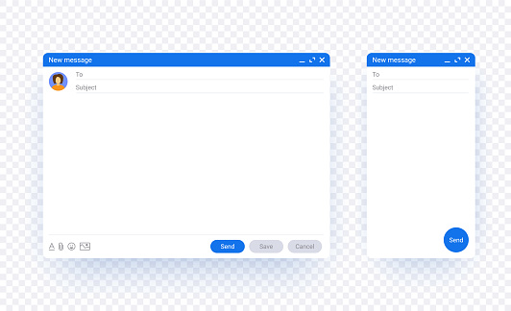

-Complete this email with:
Reading
H.W
my
our
their
are
is
am
Dear Colleagues
My name ____________ Mia Martin and I ____________ the IT Support team leader. The IT Support members ____________ : Mahmoud, Ibrahim and Peter. Mahmoud ____________ our network administrator. Ibrahim and Peter ____________ system maintenance officers. ____________ job is to keep our systems going. ____________ job is to support you.
____________ contact number ____________ 675 567 567.
Best regards
Mia Martin
Notes:
My name is Mia Martin and I am the IT Support team leader. The IT Support team members are : Mahmoud,Ibrahim and Pitteri. Mahmoud is our network administrator. Eli and Guido are system maintenance officers. Their job is to keep our systems going. Our job is to support you. My contact number is 675 567 567.
Best regards
Jessica Martin

Slide 12
Writing
-Write a reply to the previous email. Interduce yourself and three people in your group.
H.W

Slide 13
speaking
A: Where are you from?
B: I’m from …
H.W
-Work in pairs. Ask and answer questions about your jobs, companies and nationalities. Example:

Slide 14
Thanks
Do you have any questions?

