Slide 1
Boost converter
Dr. Ahmed Suhail

Slide 2
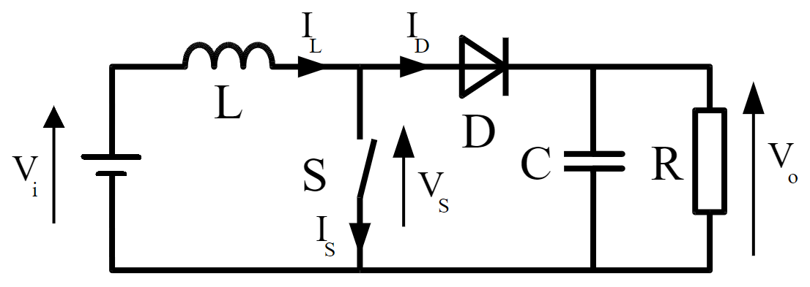
Boost converter (DC-DC converter)
A Boost converter ( or step-up converter) is a DC-to-DC power converter, which steps up voltage (while stepping down current) from its input (supply) to its output (load).
It is a type of Switched Mode Power Supply (SMPS).
The DC input can be obtained from a rectified AC or from a DC supply.

Slide 3

Components of Boost Converter
DC power supply.
The switching element, which is usually a power MOSFET, and it is switched on and off at high frequency by a separate square wave oscillator circuit.
An inductor (L), a diode (D) and capacitor (C).

Slide 4
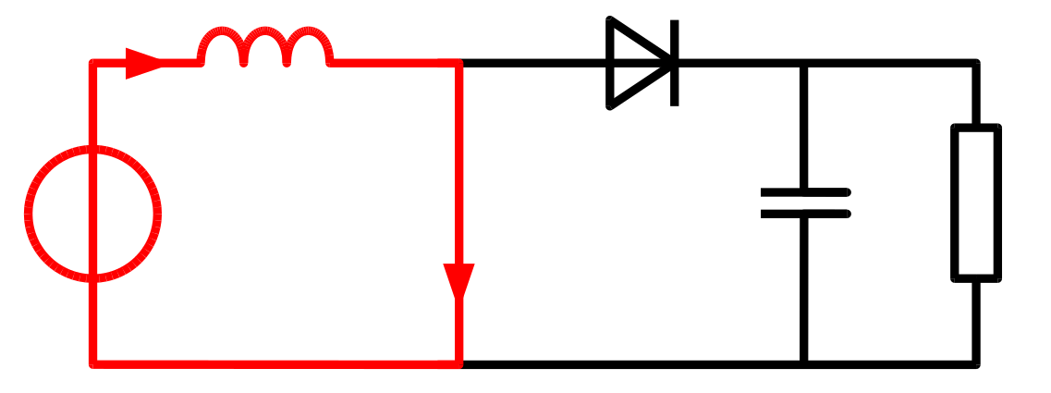
How does a Boost converter work in continuous conduction mode (CCM) of operation ?
Transistor ON
When switching transistor is on (switch is closed) a current is flowing through the inductor L as shown in the circuit. The action of any inductor opposes changes in current flow and also acts as a store of energy.
Polarity of the left side of the inductor is positive.

Slide 5
2. Transistor OFF
When switching transistor is off, current will be reduced as the impedance is higher. Therefore, magnetic field previously created will be destroyed to maintain the current towards the load.
Polarity of the left side of the inductor is negative. This means two sources will provide a higher voltage to the circuit.
During the OFF period, the diode will be in forward biased and therefore plays part in the action.

Slide 6



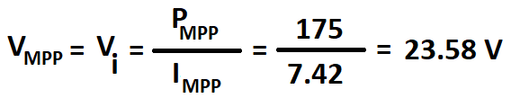


Exercise: Boost and buck converters are used separately with a solar panel that provides the MPP of 175 W with current of 7.42 A. Calculate the output voltages of a buck and boost converters if the ratio t_{ON}/t_{OFF} is fixed to be 1.5.
Solution:
Output voltage for the buck converter:

Slide 7

Output voltage for the boost converter:

Slide 8

Maximum Power Point Tracking (MPPT)
Dr. Ahmed Suhail
Ahmed.Suhail@Plymouth.ac.uk Plymouth University School of Engineering, Computing & Mathematics

Slide 9
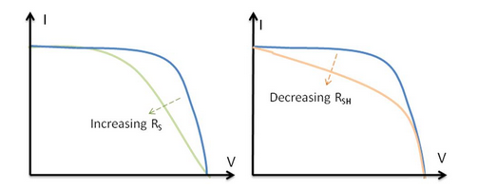
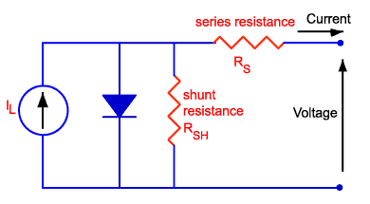
Effect of parasitic Resistances on maximum power point (MPP)
Series Resistance (R_{s}) obtains from a contact between the layers in Solar cells. For an ideal solar cell, R_{s} is closer to ??
Shunt Resistance (R_{s}) obtains from defects during the fabrication process. For an ideal solar cell, R_{s} is closer to ??
Parasitic resistances can be modelled as a parallel shunt resistance and series resistance.

Slide 10
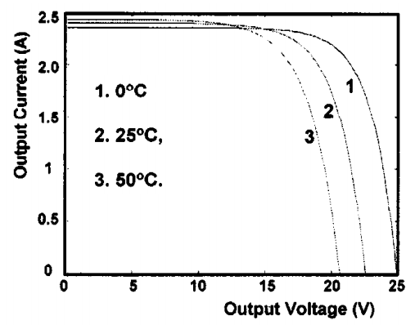
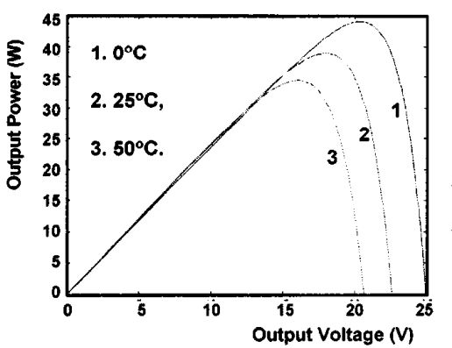
Effect of temperature on the MPP
The crystals used to make PV cells, like all semiconductors, are sensitive to temperature. When a PV cell is exposed to higher temperatures, I_{SC} increases slightly, while V_{OC} decreases more significantly, resulting in a decrease of P_{max}.

Slide 11
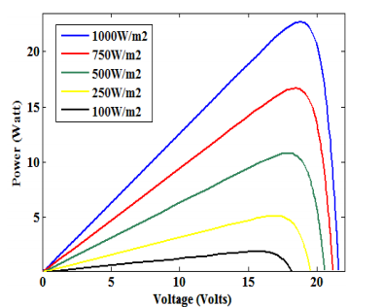
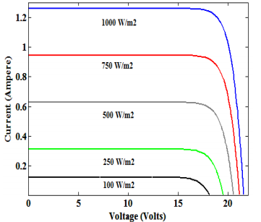
Effect of irradiance on the MPP
Reducing the illumination intensity results in lower current and voltage. So this indicates that the MPP will be changed.

Slide 12
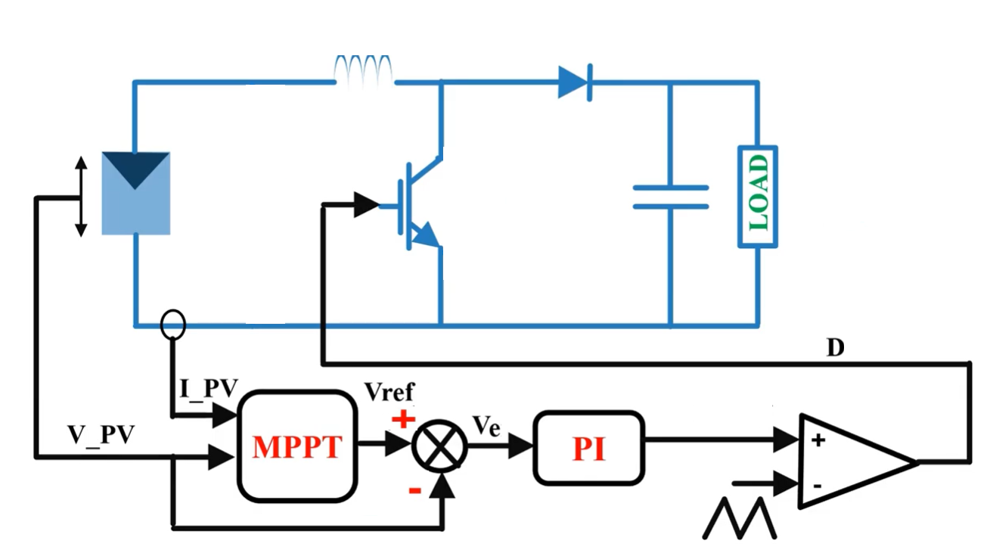
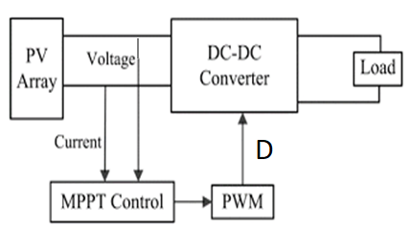

Maximum Power Point Tracking (MPPT)
Typical PV module produces MPP with maximum power voltage (V_{max}) of around 17 V when it is measured at a temperature of 25°C. However, the MPP is changed due to different reasons.
Maximum Power Point Tracking (MPPT), which is an algorithm method, is used for extracting maximum power point from a PV module.
Pulse width modulation (PWM) produces the proper value of duty cycle for DC-DC converter.

Slide 14
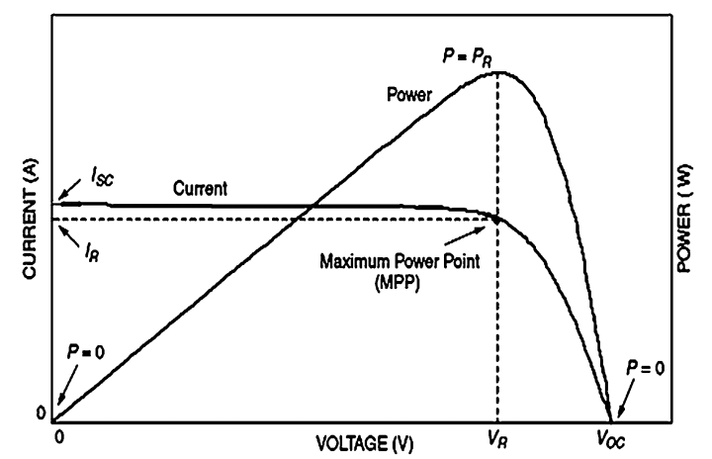
MPPT Tracking algorithm methods
There are around 62 methods. We will focus on two of them, which are:
Perturb and observe (P&O) method.
Incremental conductance (INC) method.
Both are depended on ‘Hill climbing’ principle, which bases on moving the operation point of the PV (right or left) until to detect the MPP as shown in figure.

Slide 15
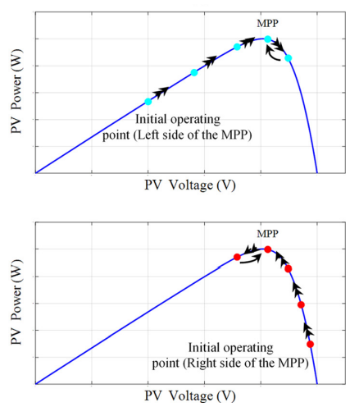
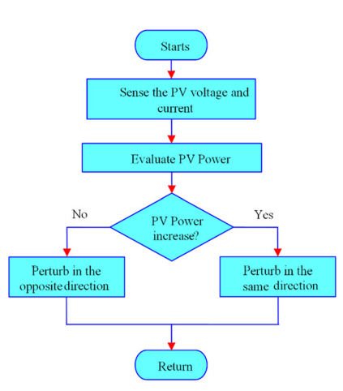
Perturb and observe (P&O) method
It is the most popular method.
It is broadly used in the commercial product of PV systems for extracting the MPP because of its simplicity and low cost.
If the operating power point is on the left side ( or right side) of the MPP, the algorithm moves it to the MPP as shown in Figs. a, b and c.
The fast changing in an irradiance affects the power tracking process.
a
c
b

