Slide 1
SAMPLING TECHNIQUES
Dr. Humam Ghanim Ibrahim Zubeer
Asst. Prof. in Community Medicine
Depart. of Family and Community Medicine
College of Medicine / University of Mosul September, 2023

Slide 2
When to do sampling ?
Definitions
Sampling frame:
It is a numerical list of all the units in the target population.
i.e. every member of the population has a unique identification number.
Sampling fraction: it is a sample size (n) divided on population size (N). Sampling fraction = n / N.

Slide 3
Advantages of sampling:
1- It reduces demands on resources such as finance, personnel and materials.
2- Providing time as results are obtained more quickly.
3- Sampling may be the only feasible method for collecting of the data; e.g blood, urine, etc are every day examples in medicine.

Slide 4
Disadvantages of sampling
If the sample is not representative of the population, the result will be biased (selection bias).
An estimate based on a sample will be subject to sampling error.
Sampling may create a feeling of discrimination within the population.

Slide 5
Methods of sampling
Probability sampling (random):
In probability sampling every member of the population has an equal chance of being included in the sample. The results of studying the sample are generalizable to the underlying population from which this sample had been drawn.
Non-probability sampling (non-random):
Every unit of population does not get an equal chance of participation in the investigation. The results of studying the sample can not be generalized to the underlying population from which this sample had been drawn.

Slide 6
Probability sample
The sample is drawn from the population in such a way that every member of the population has the same probability (chance) to be included in the sample.
Types of probability (random) samples:
Simple random sample.
Systematic random sample.
Stratified random sample.
Cluster random sample.
Multi-stage random sample.

Slide 7
Simple random sample
It requires:
Sample frame: a numerical list of all observations (or units) composing the population
Sample fraction: sample size to the total population
Selection of simple random sample from the population can be done by:
- Lottery method.
- Computer generated random sampling.
- Random number table (random digit).

Slide 8
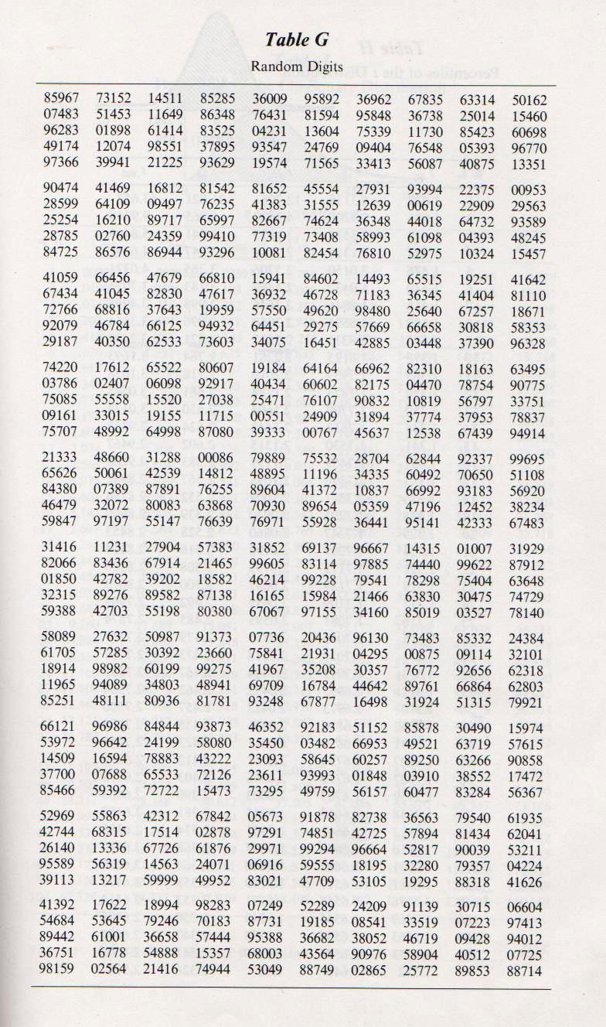

Slide 9
Simple random sample
Benefits:
There is no possibility of sampling biases.
The sample is a good representative of the population.
Crucial Issues/ Draw Backs:
It may be very costly and time consuming especially in those cases when the participants are widely spread geographically and difficult to approach.
It needs a lot of efforts especially for a large population.
In many circumstances it is not possible to get or prepare an exhaustive list of elements.

Slide 10
Simple random sample
If your population is not well defined and you do not know the constitution of the population, the members cannot have an equal chance of inclusion.
Homogenous Vs. Heterogeneous Population

Slide 11
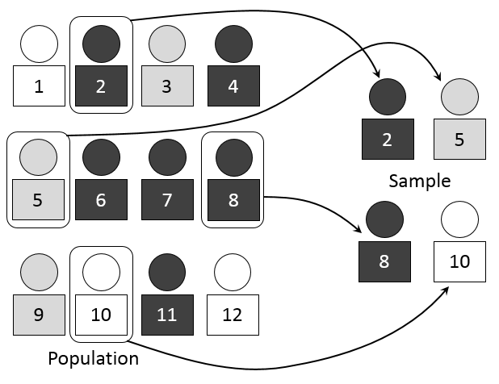
Simple random sample

Slide 12
Homogenous Vs. Heterogeneous Population
Variables that make a population heterogeneous vary greatly from research to research.
Common variables that make a population heterogeneous are sex, age, ethnicity, socioeconomic status etc.
Moreover, the homogeneity and heterogeneity of population depends on the goal and nature of your research.
Same population may be homogenous for one research project and heterogeneous for the other.
For instance, if the goal of a research is to investigate average IQ of the employs of XYZ Company. The population is homogenous which is composed of people who work at the company. It does not matter for the research purpose whatever socioeconomic, religious or sex group the workers may belong to.

Slide 13
Homogenous Vs. Heterogeneous Population
Now consider another research the purpose of which is to find if the environment of the Company is satisfactory for its employs. In this case, men and women are likely to keep different opinions (as our prior knowledge tells us women encounter issues of discomfort, gender indiscrimination etc. at work places). Now the population needs to be divided into two groups: male workers of XYZ Company and female workers of XYZ Company.
In this way, the same population that was homogenous for the former research becomes heterogeneous on gender basis for the later.

Slide 14
Systematic random sample
Choosing units or observations from the sample frame at regular interval (every n^{th} ).
To find the “system” we divide the population size by the required sample size.
e.g. If the population is composed of 1200 units & we want to select a sample of 100:
Sampling interval I = N/n, 1200/100 = 12
So we will choose every 12th person. The starting point can be chosen at random like 2, so the selected units will be 2nd , 14th , 26th , 38th,…
Or “Circular sample”

Slide 15
Advantages
The interval may be in terms of time, space or order. For instance, element appearing
after every 30 minutes, or present at a distance of two meters, or every 5th element present on a list.
Very easy to execute; when patients coming to clinic.

Slide 16
limitation
Simple random sample & systematic samples can't ensure that the structure of the sample will be similar to the structure of the underlying population regarding certain characteristics, as age, sex,…etc.

Slide 17
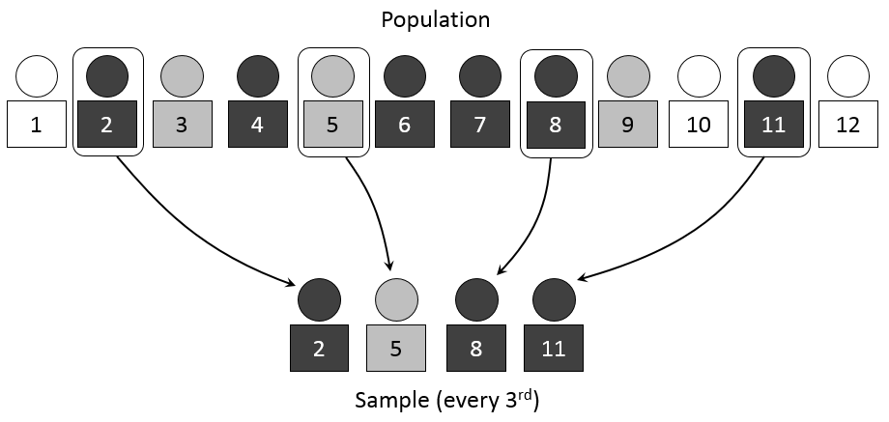
Systematic random sample

Slide 18
Stratified random sample Subgroups according to characteristics as age sex, race.
This type of sampling method is used when population is heterogeneous. The sample frame is divided into strata (or groups) according to certain characteristic (s), and then a simple random sampling will be applied on each stratum.

Slide 19
1000 population
[700 males + 300 females]
Sample
100 patients
Gender stratum
700 males
300 females
Simple random
Method from
each subgroup
70 males
+
30 females
Sample
100 patients

Slide 20
Stratified sample
The number of units included in the sample from each stratum be achieved by:
- Equal allocation from each stratum: Same number of participants are drawn from each stratum regardless of the number of elements in each stratum.
- Proportional allocation: The number from each stratum is proportional to the size of the stratum, this is possible only if we know the proportion of population in each stratum to the whole study population:
n/N= n₁/N₁= n₂/N₂ ….n_{k}/N_{k} .

Slide 21
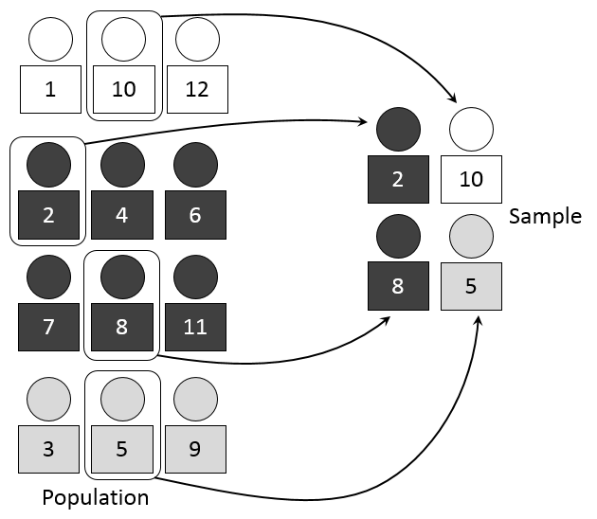
Stratified sample

Slide 22
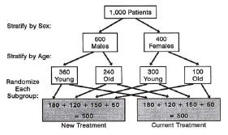
Stratified Sampling technique

Slide 23
Cluster random sample
The group of elements residing in one geographical region is called as cluster.
This sampling technique is used when the elements of population are spread over a wide geographical area.
The population is divided into sub-groups called as clusters on the basis of their geographical allocation.
The selection here will be of groups of units rather than individual units.

Slide 24
Cluster random sample
A sample frame of groups of study units (cluster) should be available,
Then a random sample of these clusters will be chosen.
After that the whole population of the chosen clusters will be included in our sample.
Its convenient when the number inside each cluster is relatively small.
Cluster could be schools, clinics, hospitals, villages, factories,…etc.

Slide 25
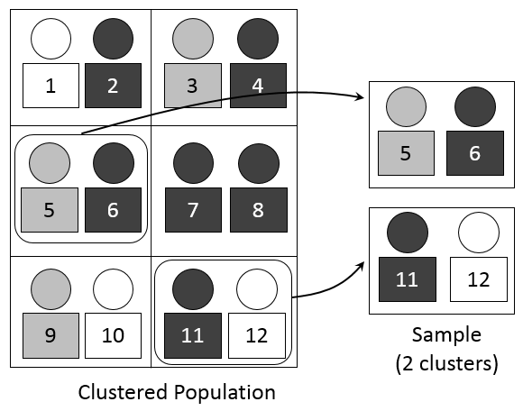
Cluster random sample

Slide 26
Multi-stage random sample
It is a sampling technique where two or more probability techniques are combined. This procedure is carried out in phases (stages). When the selection in each stage is random, this becomes multi-stage random sampling. Popular uses in prevalence studies. It can involve more than one of the above random sampling methods.
It is used for very large population & when the sample frame is not available for the whole population.

Slide 27
Advantages
It reduce the cost and time.
A full sample frame of the smaller units is not required.

Slide 28
Mosul City
Left health Sector
(13 PHCCs) (61 intermediate & secondary school )
Right health Sector (10 PHCCs)
(46 intermediate & secondary school
Geographic stratum
6 PHCCs (serving 49 school)
Simple random sample
5 PHCCs (serving 35 school)
Gender stratum
12 intermediate & secondary schools (6 for boy & 6 for girls)
10 intermediate &secondary schools (5 for boy & 5 for girls)
Simple random sample from each strata
1st grade
2nd grade
3rd grade
1st grade
2nd grade
3rd grade
1 class
1 class
1 class
1 class
1 class
1 class
Schematic diagram :Multistage random sampling technique of the studied population

Slide 29
Information Needed
1- list of schools (list of first stage units)
2- List of classes for the selected schools

Slide 30
It is also possible to have a scheme with more than two levels sampling e.g. Towns, districts , street , houses , individuals
Multi-stage sampling

Slide 31
Non- probability sampling
1. Convenient sampling
2. Volunteer sampling
3. Quota sampling
4. Snowball sampling
5. Matched Sampling
6. Purposive sampling

Slide 32
Non- probability sampling
1. Convenience sample:
It is also called as accidental sampling or opportunity sampling. The researcher includes those participants who are easy or convenient to approach i.e. any member of the target population who is available at the moment is approached. He or she is asked for participation in the research.
Convenience sample is not representative to the population we want to study.

Slide 33
Non- probability sampling
2. Volunteer Sampling
The members of the sample self-select themselves for being the part of the study.

Slide 34
Non- probability sampling
3. Quota sample:
This type of sampling method is used when population is heterogeneous. The composition of the sample regarding certain characteristic and the number of units having these characteristics are decided from the beginning, and the only requirement is to find the people fitting these quotas. The participants are selected non-randomly from each sub group on the basis of some fixed quota.

Slide 35
Non- probability sampling
4. Snowball Sampling:
It is also called as chain sampling. One element of the population is approached at a time and then is asked to refer the investigator to the other elements of the population.

Slide 36
Non- probability sampling
5. Matched Sampling (Non-RCT)
This technique is used in experimental researches. The main purpose of this sampling is to take a control group to assess the effects of an intervention.
Two groups of elements that resemble on a variety of variables are selected. Intervention is introduced on only one group. The other group is used to compare with the first one to see what impacts the intervention produced.

Slide 37
Non- probability sampling
The results of non probability sample are valid (to the studied sample) but are not generalizable to the underlying population.
So non probability sample are inappropriate if the aim is to generalize finding obtained from the sample to the total study population.

Slide 38
Sampling Error:
It is the difference between a sample measure and its corresponding population measure. Sampling error is not a mistake, but it is a calculated error that should be quantify.
The magnitude of this “error” depends primarily on 3 factors:
The size of the sample: the bigger the sample → the smaller the error.
Variability among the subjects in the population (precision of the data).
The method of sampling.

