Slide 1
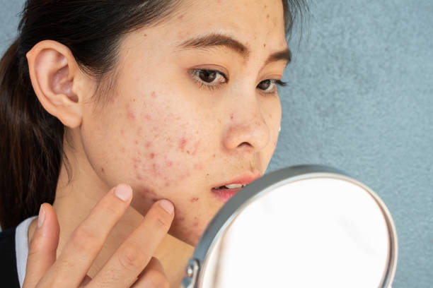
Integumentary disorders
Dr. Harith F, Al-Aubaidy
الدكتور
حارث فتحي العبيدي

Slide 2
Anatomy of the Skin, Hair, Nails, and Glands of the Skin
Skin
The skin is composed of three layers: epidermis, dermis, and subcutaneous tissue (Fig. 55-1). The epidermis is an outermost layer of stratified epithelial cells, composed predominantly of keratinocytes. It ranges in thickness from about 0.05 mm on the eyelids to about 1.5 mm on the palms of the hands and soles of the feet. Four distinct layers compose the epidermis; from innermost to outermost, they are the stratum germinativum, stratum granulosum, stratum lucidum, and stratum corneum. Each layer becomes more differentiated (i.e., mature and with more specific functions)

Slide 3
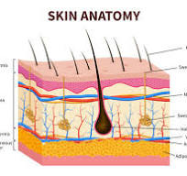

Slide 4
Epidermis
The epidermis, which is contiguous with the mucous membranes and the lining of the ear canals, consists of live, continuously dividing cells called keratinocytes, which differentiate and randomly migrate upward. These cells synthesize keratin; eventually they become metabolically inactive and form a thick and protective outer layer. This external layer, called the stratum corneum, is almost completely replaced every 3 to 4 weeks. The dead cells contain large amounts of keratin, an insoluble, fibrous protein that forms the outer barrier of the skin and has the capacity to repel pathogens and prevent excessive fluid loss from the body. Keratin is the principal hardening ingredient of the hair and nails.

Slide 5
Melanocytes are the special cells of the epidermis that are primarily involved in producing the pigment melanin, which colors the skin and hair. A person’s normal skin color is determined by the amount of melanin produced. Most of the skin of people who are dark skinned and the darker areas of the skin on people who are light skinned (e.g., the nipple) contain larger amounts of melanin and are not related to numbers of melanocytes
erythema (a pink or red skin shade caused by dilation of the capillaries) is seen when there is inflammation or fever

Slide 6
Dermis
The dermis makes up the largest portion of the skin, the connective tissue between the epidermis and subcutaneous tissue. It provides strength and structure in the form of collagen and elastic fibers. It is composed of two layers: papillary and reticular. Collagen fibers are loosely organized in the papillary dermis and are more tightly packed in the reticular dermis. The dermis also contains blood and lymph vessels, nerves, sweat and sebaceous glands, and hair roots

Slide 7
Subcutaneous Tissue
The subcutaneous tissue, or hypodermis, is the innermost layer of the skin. It is primarily adipose and connective tissue, which provides a cushion between the skin layers and the muscles and bones. This layer also protects the nerve and vascular structures that transect the layers. It promotes skin mobility, molds body contours, and insulates the body. The subcutaneous tissues and the amount of fat deposited are important factors in body temperature regulation.

Slide 8
Hair An outgrowth of the skin, hair is present over the entire body except for the palms and soles. The hair consists of a root formed in the dermis and a hair shaft that projects beyond the skin. It grows in a cavity called a hair follicle. Proliferation of cells in the bulb portion of the follicle causes the hair to form (see Fig. 55-1).

Slide 9
Hair color is supplied by varying amounts of melanin within the hair shaft. Gray or white hair reflects the loss of pigment. Hair quantity and distribution can be affected by endocrine conditions. For example, Cushing’s syndrome causes hirsutism (i.e., excessive hair growth), especially in women, and hypothyroidism (i.e., underactive thyroid) causes changes in hair texture. Various factors can cause localized or generalized loss of hair, or alopecia.

Slide 10
Nails
On the dorsal surface of the fingers and toes, a hard, transparent plate of keratin, called the nail, overlies the skin. The nail grows from its root, which lies under a thin fold of skin called the cuticle. Nail functions include scratching and protecting the highly developed sensory functions of fingers and toes to assist in grasping small items. The nails can also be of psychosocial importance as related to grooming and appearance (Nicol, 2016). Nail growth is continuous throughout life, with an average growth of 0.1 mm daily. Growth is faster in fingernails than toenails and tends to slow with aging. Complete regeneration of a fingernail takes about 6 months, whereas toenail regeneration takes approximately 18 months (Bolognia, Schaffer, & Cerroni, 2017).

Slide 11
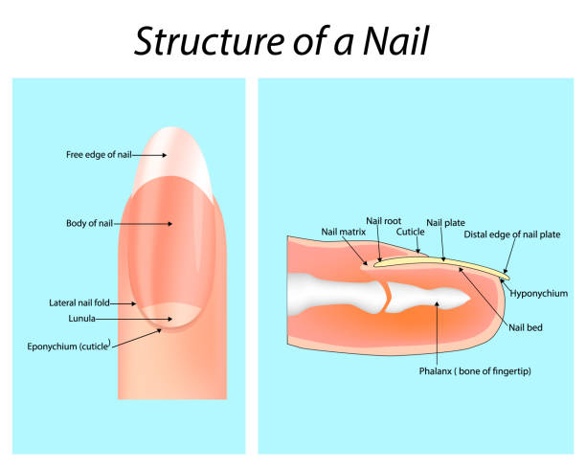

Slide 12
Glands of the Skin
There are two types of skin glands: sebaceous glands and sweat glands (see Fig. 55-1). The sebaceous glands are associated with hair follicles. The ducts of the sebaceous glands empty sebum (fatty secretions) onto the space between the hair follicle and the hair shaft, thus lubricating the hair and rendering the skin soft and pliable.
Sweat glands are found in the skin over most of the body surface, but they are most heavily concentrated in the palms of the hands and soles of the feet. Only the glans penis, clitoris, labia minora, the margins of the lips, the external ear, and the nail bed are devoid of sweat glands. Sweat glands are subclassified into two categories: eccrine and apocrine. The eccrine sweat glands are found in all areas of the skin. Their ducts open directly onto the skin surface. The thin, watery secretion called sweat is produced in the basal coiled portion of the eccrine gland and is released into its narrow duct

Slide 13
The apocrine sweat glands are larger than eccrine sweat glands and are located in the axillae, periumbilical area, nipple, anal region, scrotum, and labia majora. Their ducts generally open onto hair follicles. The apocrine glands become active at puberty. In women, they enlarge and recede with each menstrual cycle

Slide 14
Functions of the Skin
Protection
The skin covering most of the body is no more than 1 mm thick, but intact skin provides highly effective protection against invasion by bacteria and other foreign matter. The thickened skin of the palms and soles protects against the effects of the constant trauma that occurs in these areas. The stratum corneum—the outer layer of the epidermis—provides the most effective barrier to epidermal water loss and penetration of environmental factors such as ultraviolet radiation, chemicals, microbes, and insect bites.

Slide 15
The presence of lipids in the stratum corneum creates a relatively impermeable barrier for water loss and for the entry of toxins, microbes, and other substances that contact the surface of the skin. Some substances do penetrate the skin but meet resistance in trying to move through the channels between the cell layers of the stratum corneum.

Slide 16
Microbes and fungi, which are part of the body’s normal flora, cannot penetrate unless there is a break in the skin barrier. The basal layer, at the junction of the epidermis and dermis, is composed of collagen, anchoring fibers, and macromolecules. The basal layer serves four functions. It acts as a support structure for tissue organization and a template for regeneration; it provides selective permeability for migration of cells and proteins; it is a physical barrier between different types of cells; and it binds the epithelium to underlying cell layers (Bolognia et al., 2017).

Slide 17
Sensation
The receptor endings of nerves in the skin allow the body to constantly monitor the conditions of the immediate environment. The main functions of the receptors in the skin are to sense temperature, pain, light touch, and pressure (or heavy touch).
Fluid Balance
The stratum corneum—the outermost layer of the epidermis—has the capacity to absorb water, thereby preventing an excessive loss of water and electrolytes from the internal body and retaining moisture in the subcutaneous tissues. When skin is damaged, as occurs with a severe burn, large quantities of fluids and electrolytes may be lost rapidly, possibly leading to circulatory collapse, shock, and death

Slide 18
Temperature Regulation
The body, in the process of creating energy, continuously produces heat as a result of the metabolism of food. This heat is dissipated primarily through the skin.

Slide 19
Vitamin Production
Skin exposed to ultraviolet light can synthesize vitamin D (cholecalciferol). Vitamin D is essential for preventing osteoporosis and rickets, a condition that causes bone deformities and results from a deficiency of vitamin D, calcium, and phosphorus. Estimations vary on the amount of sunlight necessary for this synthesis to occur since numerous individual and environmental variables make a uniform recommendation difficult. In some projections, most people would need 5 to 30 minutes of sun exposure twice a week

Slide 20
Immune Response Function
The skin functions not only as a barrier defense against environmental hazards, but also produces immune responses. The skin has the capacity to generate innate and adaptive immune responses (Bolognia et al., 2017). Innate immune functions of the skin include the closely packed layers of the stratum corneum, the nonspecific inflammatory response of pattern recognition receptors, and a chemical environment that inhibits microbial colonization

Slide 21
Assessment
Health History
During the health history interview, the nurse asks about use of hair and skin products, as well as any family and personal history of skin allergies; allergic reactions to food, medications, and chemicals; previous skin conditions; and skin cancer (Weber & Kelley, 2018). The health history addresses the onset, signs and symptoms, location, and duration of any pain, itching, rash, or other discomfort experienced by the patient. The names of cosmetics, soaps, shampoos, and other personal hygiene products are obtained if there have been any recent skin conditions noticed with the use of these products

Slide 22
Physical Assessment
Assessment of the skin involves the entire skin area, including the mucous membranes, scalp, hair, and nails. The skin reflects a person’s overall health, and alterations commonly correspond to disease in other organ systems
Assessing Skin Color
The color gradations that occur in people with dark skin are largely determined by genetics; they may be described as light, medium, or dark. In people with dark skin, melanin is produced at a faster rate and in larger quantities than in people with light skin.
hypopigmentation (i.e., loss of pigmentation) may be caused by a fungal infection, eczema, or vitiligo (i.e., white patches); hyperpigmentation (i.e., increase in pigmentation) can occur after sun injury or as a result of aging

Slide 23
Assessing Rash In instances of pruritus (i.e., itching), the patient is asked to indicate which areas of the body are involved. The skin is then stretched gently to decrease the reddish tone and make the rash more visible.
Assessing Skin Lesion
Skin lesions are the most prominent characteristics of dermatologic conditions. They vary in size, shape, and cause and are classified according to their appearance and origin. Skin lesions can be described as primary or secondary. Primary lesions are the initial lesions and are characteristic of the disease itself. Secondary lesions result from changes in primary lesions resulting from external causes, such as scratching, trauma, infections, or changes caused by wound healing. Depending on the stage of development, skin lesions are further categorized by type and appearance

Slide 24
Primary Lesions
MACULE, PATCH
description
Flat, nonpalpable skin color change (color may be brown, white, tan, purple, red) Macule: 1 cm; may have irregular border
Example
Freckles, flat moles, petechia, rubella, vitiligo, port-wine stains, ecchymosis

Slide 25
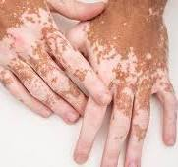
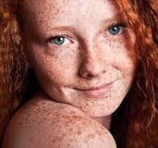

Slide 26
PAPULE, PLAQUE
Description
Elevated, palpable, solid mass with a circumscribed border Plaque may be coalesced papules with flat top Papule: 0.5 cm Papules:
Example
Elevated nevi, warts, lichen planus Plaques: Psoriasis, actinic keratosis

Slide 27
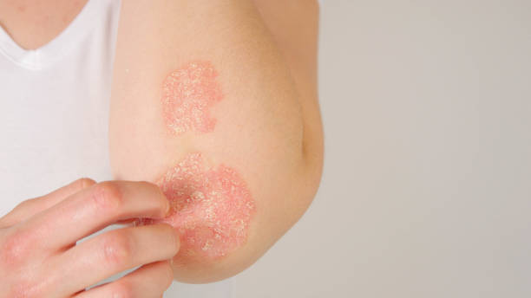
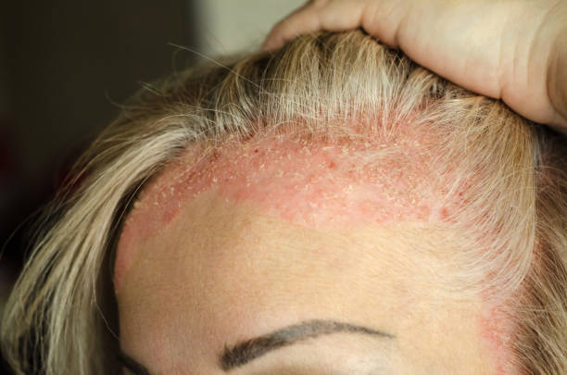

Slide 28
Secondary Lesions
EROSION
description
Loss of superficial epidermis that does not extend to dermis; depressed, moist area
Example
Ruptured vesicles, scratch marks

Slide 29
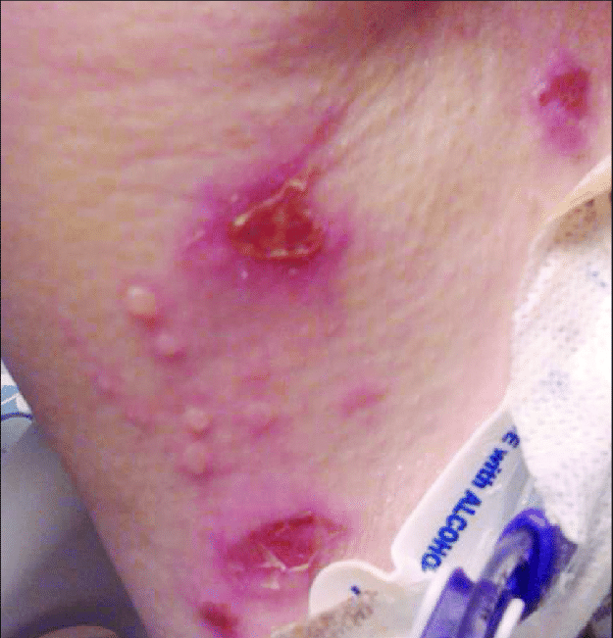

Slide 30
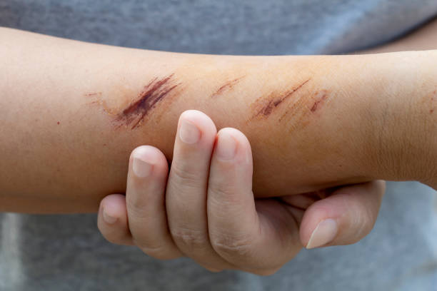

Slide 31
FISSURE
Description
Linear crack in the skin that may extend to dermis
Example
Chapped lips or hands, tinea pedis

Slide 32
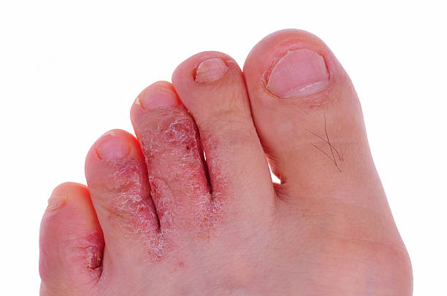

Slide 33
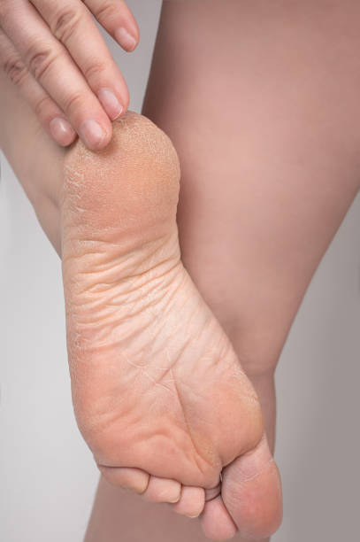

Slide 34
Figure 55-4 • Anatomic distribution of common skin disorders. A. Contact dermatitis (shoes). B. Contact dermatitis (cosmetics, perfumes, earrings). C. Seborrheic dermatitis. D. Acne. E. Scabies. F. Herpes zoster (shingles). مطلوب الشكل بالكتاب

Slide 35
Diagnostic Evaluation
Skin Biopsy
Performed to obtain tissue for microscopic examination, a skin biopsy may be obtained by shave, excision, or by a skin punch instrument that removes a small core of tissue. Biopsies are performed on skin nodules, plaques, blisters, and other lesions to rule out malignancy
Patch Testing
Performed to identify substances to which the patient has developed an allergy, patch testing involves applying the suspected allergens, such as nickel or fragrances, to normal skin under occlusive patches. Patients wear these occluded strips on their backs for 48 hours, and the area is assessed after 72 hours. The development of redness, fine elevations, or itching is considered a weak positive reaction; fine blisters, papules, and severe itching indicate a moderately positive reaction; and blisters, pain, and ulceration indicate a strong positive reaction.

Slide 36
Skin Scrapings
Tissue samples are scraped from suspected fungal lesions with a scalpel blade that has been moistened with oil so that the scraped skin adheres to the blade. The scraped material is transferred to a glass slide, covered with a coverslip, and examined microscopically. The spores and hyphae of dermatophyte infections, as well as infestations such as scabies, can be visualized.
Wood Light Examination
Wood light is a special lamp that produces long-wave ultraviolet rays, which result in a characteristic blue to dark purple fluorescence. The color of the fluorescent light is best seen in a darkened room, where it is possible to differentiate epidermal from dermal lesions and hypo- and hyperpigmented lesions from normal skin

Slide 37
Clinical Photographs
Photographs are taken to document the nature and extent of the skin condition and are used to determine progress or improvement resulting from treatment. They are sometimes used to track the status of moles to document if the characteristics of the mole are changing.

Slide 38
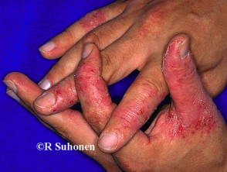

Slide 39
Dermatitis
Dermatitis is a general term that describes an inflammation of the skin.
Types of dermatitis
1. Contact dermatitis, a rash that results from either repeated contact with irritants or contact with allergy-producing substances, such as poison ivy.
2. Neurodermatitis. • a chronic itchy skin condition localized to certain areas of the skin. • Possible underlying factors include, Dry skin, Chronic irritation, and Eczema

Slide 40
3. Seborrheic dermatitis
a common scalp and facial condition that often causes dandruff.
• It's common in people with oily skin or hair, and it may come and go depending on the season of the year.
• It's likely that hereditary factors play a role in this condition.
• Possible underlying factors include, Physical stress, Neurological conditions, such as Parkinson's disease.
• In infants, this disorder is known as cradle cap

Slide 41
4. Stasis dermatitis
• a skin condition that's caused by a buildup of fluid under the skin of the legs due to a sluggish return of blood from the leg veins back to the heart.
• The extra fluid interferes with the ability of the blood to nourish the skin and places extra pressure against the skin from underneath.
• Possible underlying factors include, Varicose veins, Obesity, often extreme

Slide 42
5. Atopic dermatitis
• It usually begins in infancy and may vary in severity during childhood and adolescence. It tends to become less of a problem in adulthood, unless they exposed to allergens or irritants in the workplace.
• Possible underlying factors include a combination of:
Dry, irritable skin.
A malfunction in the body's immune system.
A genetic tendency for allergic conditions such as asthma, hay fever or eczema. a. Stress can exacerbate atopic dermatitis, but it doesn't cause it.

Slide 43
6. Perioral dermatitis
• a bumpy rash around the mouth.
• Possible underlying factors include, Makeup, Moisturizers, and Topical corticosteroids.
7. Allergic contact dermatitis : A delayed hypersensitivity reaction involving allergens and antibodies.
8. Irritant contact dermatitis : Exposure to irritating chemicals or detergents.
9. Autosensitization dermatitis : An itchy rash that occurs in response to an intense inflammatory process somewhere else on the body, especially fungal infections.

Slide 44
Causes of dermatitis
Allergies.
Genetic factors.
Physical and mental stressors, and ,
4. Irritants can cause dermatitis Common irritants include:
• Laundry soap. • Skin soaps or detergents. • Cleaning products. • Rubber. • Metals, such as nickel; jewelry. • Perfume and fragrances, and, • Cosmetics.
Symptoms 1. Redness. 2. Swelling. 3. Itching. 4. Skin lesions

Slide 45
Nursing Diagnoses
• Deficient knowledge about the disease process and treatment.
• Impaired skin integrity related to lesions and inflammatory response. • Disturbed body image related to embarrassment about appearance and self-perception of uncleanliness.

Slide 46
Nursing management
The nurse should encouraged he patients to:
Keep skin as moisturized as possible as dry skin causes cracks in the outer layer inhibiting the barrier function of the skin.
2. Reduce itching and scratching with topical medications or antihistamines.
3. Avoid irritating and drying substances such as perfumes or harsh detergents.
4. Treat other rashes, especially fungal infections, even though they may not seem related.

Slide 47
5. Avoid heat, soap, and rubbing, all of which are external irritants.
6. Choose bath soaps, laundry detergents, and cosmetics that do not contain fragrance.
7. Avoid using a fabric softener dryer sheet (Bounce, Cling Free). Fabric softeners that are added to the washer may be used.
8. Avoid topical medications, lotions, or ointments, except those specifically prescribed for some condition.
9. Wash the skin thoroughly immediately after exposure to possible irritants.
10.When wearing gloves (for example, for washing dishes or general cleaning), be sure they are cotton-lined. Do not wear them more than 15 or 20 minutes at a time.
11.Use cool compresses on pruritic areas of the skin.
12.Encourage the patient to keep fingernails trimmed short

Slide 48
Patient education
Study the pattern and location of your dermatitis and think about which things have touched your skin and which things may have caused the problem; try to avoid contact with these materials. Avoid heat, soap, and rubbing, all of which are external irritants. Choose bath soaps, laundry detergents, and cosmetics that do not contain fragrance.

Slide 49
Avoid using a fabric softener dryer sheet. Fabric softeners that are added to the washer may be used. Avoid topical medications, lotions, or ointments, except those specifically prescribed for your condition. Wash your skin thoroughly immediately after exposure to possible irritants. Ensure that when wearing gloves (such as for washing dishes or general cleaning), they are cotton lined. Do not wear them more than 15 or 20 minutes at a time.

Slide 50
Psoriasis
Psoriasis is a chronic inflammatory multisystem disorder of the skin that affects approximately 3.2% of Americans (Nicpon, 2017). Although the primary manifestation of this noncommunicable disease tends to involve the skin, psoriasis may involve the oral cavity, eyes (including the lids, conjunctivae, and corneas), and joints. Psoriasis is typically characterized by the appearance of silvery plaques that most commonly appear on the skin over the elbows, knees, scalp, lower back, and buttocks (Habashy & Robles, 2019).

Slide 52
Onset may occur at any age, with a median onset at 28 years. It is more prevalent among women and White Americans. It is thought that most patients with psoriasis have a genetic predisposition to develop the disease. Psoriasis is characterized by periods of remission and exacerbation throughout life

Slide 53
Pathophysiology
Current evidence supports an autoimmune basis for psoriasis. Periods of emotional stress and anxiety aggravate the condition, and trauma, infections, and seasonal and hormonal changes may also serve as triggers (Habashy & Robles, 2019). In this disease, the epidermis becomes infiltrated by activated T cells and cytokines, resulting in both vascular engorgement and proliferation of keratinocytes. Epidermal hyperplasia results. These epidermal cells tend to improperly retain their nuclei, crippling their ability to release lipids that encourage cellular adhesion. This results in rapid turnover of poorly matured cells that do not adhere well to each other, resulting in the classic presentation of plaquelike lesions that have a silvery, scaly, and flaky appearance (Habashy & Robles, 2019).

Slide 54
Clinical Manifestations
Psoriasis may range in severity from a cosmetic source of annoyance to a physically disabling and disfiguring disorder. Lesions appear as red, raised patches of skin covered with silvery scales. The scaly patches are formed by the buildup of living and dead skin (Fig. 56-7). If the scales are scraped away, the dark red base of the lesion is exposed, producing multiple bleeding points. The patches are not moist and may be pruritic.

Slide 55
In many cases, the nails are also involved, with pitting, discoloration, crumbling beneath the free edges, and separation of the nail plate (Habashy & Robles, 2019). Psoriasis is classified as mild if the plaques involve less than 5% body surface area (BSA), moderate if they involve between 5% and 10% of BSA, and severe if more than 10% BSA is affected by plaque formation

Slide 56
Complications
Asymmetric rheumatoid factor—negative arthritis of multiple joints occurs in up to 42% of people with psoriasis, most typically after the skin lesions appear (Nicpon, 2017). The most typical joints affected include those in the hands or feet, although sometimes larger joints such as the elbows, knees, or hips may be affected (Habashy & Robles, 2019). A rheumatologist should be consulted to assist in the diagnosis and long-term treatment of this disorder. See Chapter 34 for further discussion of spondyloarthropathies, including psoriatic arthritis. Generalized exfoliative dermatitis may also result from psoriasis.

Slide 57
Assessment and Diagnostic Findings
The presence of the classic plaque-type lesions generally confirms the diagnosis of psoriasis. If in doubt, the health care provider should assess for signs of nail and scalp involvement and for a positive family history. Biopsy of the skin is of little diagnostic value. The presence and extent of plaque should be assessed carefully, to calculate BSA involvement.

Slide 58
Medical Management
The goals of management are to slow the rapid turnover of epidermis, to promote resolution of the psoriatic lesions, and to control the natural cycles of the disease. There is no known cure. The therapeutic approach should be one that the patient understands; it should be cosmetically acceptable and minimally disruptive of lifestyle. Treatment involves the commitment of time and effort by the patient and possibly the family.

Slide 59
Any precipitating or aggravating factors are addressed. An assessment is made of lifestyle because psoriasis is significantly affected by stress. Management of emotional factors should be addressed as part of the overall treatment of psoriasis. The patient is informed that treatment of severe psoriasis can be time-consuming, expensive, and aesthetically unappealing at times

Slide 60
Pharmacologic Therapy
Three types of therapy are commonly indicated: topical, phototherapy, and systemic. Topical agents, possibly in tandem with phototherapy, are recommended for mild disease. Patients with moderate or severe disease should receive topical agents, phototherapy, and systemic treatment (Nicpon, 2017). Topical Agents Topically applied agents are used to slow the overactive epidermis..

Slide 61
Topical corticosteroids may be applied for their anti-inflammatory effects (see Table 56-3). Choosing the correct strength of corticosteroid for the involved site and choosing the most effective vehicle base are important aspects of topical treatment. In general, high-potency topical corticosteroids should not be used on the face and intertriginous areas, and their use on other areas should be limited to a 4-week course of twice-daily applications

Slide 62
Phototherapy
For patients who do not respond well to topical treatments, phototherapy using narrow-band ultraviolet-B (UVB) therapy may be effective as a single-therapy modality. However, phototherapy is generally more effective when it is given as ultraviolet-A (UVA) in conjunction with a photosensitizing oral medication (a combination referred to as PUVA). Here, the patient takes a photosensitizing medication (i.e., psoralen) in a 4880 standard dose and is subsequently exposed to long-wave UV light as the medication plasma levels peak. It is thought that when psoralen-treated skin is exposed to UVA light, the psoralen binds with DNA and decreases epidermal cellular proliferation

Slide 63
Nursing Management
Psoriasis may cause despair and frustration for the patient; observers may stare, comment, ask embarrassing questions, or even avoid the person. The disease can eventually exhaust the patient’s resources, interfere with their job, and negatively affect many aspects of life. The nurse assesses the impact of the disease on the patient and the coping strategies used for conducting normal activities and interactions with family and friends. Many patients need reassurance that the condition is not infectious, not a reflection of poor personal hygiene, and not skin cancer

Slide 64
The nurse can create an environment in which the patient feels comfortable discussing important quality of life issues related to their psychosocial and physical response to this chronic illness. The nurse explains with sensitivity that although there is no cure for psoriasis and lifetime management is necessary, the condition can usually be controlled.

Slide 65
Dermatitis Herpetiformis
Dermatitis herpetiformis is an intensely pruritic, chronic disease that manifests with small, tense blisters that are distributed over the extensor surfaces of the elbows and knees, as well as the buttocks and back. It most commonly occurs between 20 and 40 years of age but can appear at any age. It is more common in people of northern European heritage and is slightly more common in men. Patients with dermatitis herpetiformis have a defect in gluten metabolism; many have a concomitant diagnosis of celiac disease (Miller & Zaman, 2020)

Slide 66
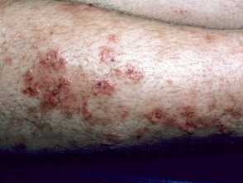

Slide 67
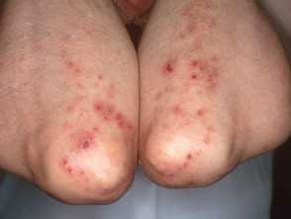

Slide 68
Assessment and Diagnostic Findings
Patients typically present with erythematous papules with small, clustered (i.e., herpetiform) vesicles that tend to have a symmetrical distribution on affected extensor surfaces of the skin. Erosions and crusts may also be present, which may result from excoriation and scratching as a reaction to the intense pruritus (Miller & Zaman, 2020). Immunofluorescent studies of skin biopsy specimens from patients with dermatitis herpetiformis reveal granular patterns of IgA deposits in the papillary dermis (Miller & Zaman, 2020)

Slide 69
Management
Most patients respond to dapsone and to a gluten-free diet. All patients should be screened for glucose-6-phosphate dehydrogenase deficiency because dapsone can induce severe hemolysis in those with this deficiency. Patients benefit from dietary counseling because the dietary restrictions are lifelong, and a gluten-free diet is often difficult to follow (see Chapter 41 for further discussion of gluten-free diets) (Miller & Zaman, 2020). Patients need emotional support as they deal with the process of learning new habits and accepting major changes in their lives.

Slide 70
Thank you

