Slide 1
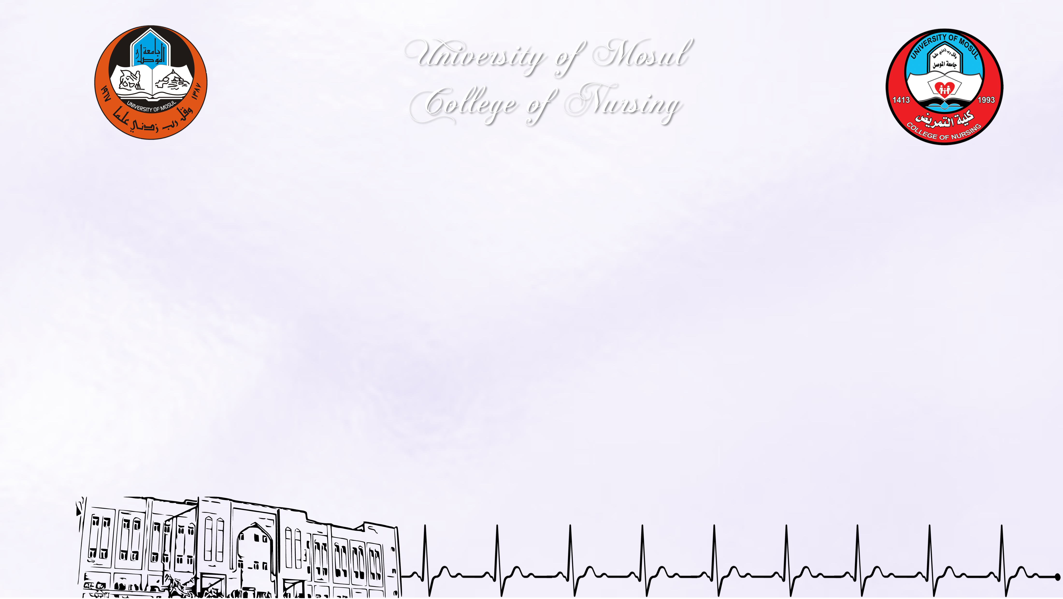
Knowledge on nosocomial infections among Nursing Students
By
Asia faisal Morshed |  | Taqwa Muhammad Nour
Asmaa Jomaa Jasim |  | Dalal Muhammad Saleh
Shahad meqdad jmeel
Supervised by
Rami Ramadhan Allo
Assistant Professor

Slide 2

Introduction
Nosocomial infections also referred to as healthcare-associated infections (HAI), are infection(s) acquired during the process of receiving health care that was not present during the time of admission. They may occur in different areas of healthcare delivery, such as in hospitals, long-term care facilities, and ambulatory settings, and may also appear after discharge. HAIs also include occupational infections that may affect staff.
Infection occurs when pathogen(s) spread to a susceptible patient host. In modern healthcare, invasive procedures and surgery, indwelling medical devices, and prosthetic devices are associated with these infections. The etiology of HAI is based on the source or type of infection and the responsible pathogen, which may be bacterial, viral, or fungal.

Slide 3
Study Objectives
To assess the Knowledge of Nursing Students about nosocomial infections

Slide 4
Methodology – Study Design
The study is intended to use a descriptive study design.

Slide 5
Methodology – Sample & Sampling
150 Nursing Students were selected from three grades (second, third, fourth), from each grade 50 students from college of nursing \ University of Mosul.

Slide 6
Methodology – Setting & Study tools
The tool used in the study was constructed checklist , Interview method was depended in collecting data from the samples of the study in order to complete the checklist sheet. Each interview lasts (15) minutes in the nursing college halls.

Slide 7
Study Results
table )1(demographical data of the study sample
Gender | No. | %
Male | 56 | 37.3%
Female | 94 | 62.7%
Total | 150 | 100.0%
Stage | No. | %
Second | 50 | 33.3%
Third | 50 | 33.3%
Fourth | 50 | 33.3%
Total | 150 | 100.0%
This table show the majority of the sample are female (62.7%)

Slide 8
Study Results
Table )2(Frequencies and percentages of answers from the study sample
No. | Questions | True answer | False answer | Doesn't know the answer
1 | Infection control measures are used for the care of all patients regardless of their diagnosis and perceived infection status | 132 (88.0%) | 10 (6.7%) | 8 (5.3%)
2 | Isolation precaution is one of the elements in infection control measures | 146 (97.3%) | 3 (2.0%) | 1 (7%)
3 | Washing hands after contact with the patient's environment is one of the elements in infection control measures | 137 (91.3%) | 12 (8.0%) | 1 (7%)
4 | Infection control measures are very important before and after patients’ management | 143 (95.3%) | 7 (4.7%) | 0%
5 | Performing hand hygiene is required before and after patient care. | 136 (90.7%) | 11 (7.3%) | 3 (2.0%)
6 | Hands should be washed with soap and water before and after handling potentially infectious materials irrespective of wearing gloves. | 123 (82.0%) | 25 (16.7%) | 2 (1.3%)
7 | Personal protective equipment (PPE) is important in infection control because it acts as a barrier between infectious materials such as viral and bacterial contaminants and your skin, mouth, nose, or eyes (mucous membranes). | 134 (89.3%) | 15 (10.0%) | 1 (7%)
8 | Gloves must be worn every time during handling potentially infectious materials. | 123 (82.0%) | 21 (14.0%) | 6 (4.0%)
9 | Gloves must be changed during patient care if you move hands from 'contaminated body site' to 'clean body site' | 131 (87.3%) | 13 (8.7%) | 6 (4.0%)
10 | Surgical masks can protect the nose and mouth when procedures and activities are likely to generate splashes or sprays of blood and body fluids | 123 (82.0%) | 19 (12.7%) | 8 (5.3%)

Slide 9
Study Results
Table )2(Frequencies and percentages of answers from the study sample
11 | The purpose of using a gown or apron is to protect clothes from splashes or sprays of blood and body fluids. | 124 (82.7%) | 14 (9.3%) | 12 (8.0%)
12 | Removed all personal protective equipment (PPE) before leaving the patient's environment | 118 (78.7%) | 27 (18.0%) | 5 (3.3%)
13 | Stationary, telephones kept in wards, and doorknobs can be sources of infections | 117 (78.0%) | 25 (16.7%) | 8 (5.3%)
14 | Segregation of clinical and non-clinical waste is important for preventing the spread of infection. | 100 (66.7%) | 33 (22.0%) | 17 (11.3%)
15 | All linen from an infectious patient should be thrown in a red linen bag even when it is free from visible blood or body fluids | 85 (56.7%) | 35 (23.3%) | 30 (20.0%)
16 | Ampoules injection that has been used must be disposed of in the clinical waste bin. | 122 (81.3%) | 22 (14.7%) | 6 (4.0%)
17 | Recapping of needles, in general, is not appropriate | 47 (31.3%) | 93 (62.0%) | 10 (6.7%)
18 | If you puncture hand with sharp instruments, you must report to the concerned authorities. | 121 (80.7%) | 21 (14.0%) | 8 (5.3%)
19 | Puncture-proof containers should be used for disposal of sharps objects | 134 (89.3%) | 12 (8.0%) | 4 (2.7%)
20 | Mask must be placed on coughing patients to prevent potential dissemination of infectious respiratory secretions from the patient to others | 128 (85.3%) | 20 (13.3%) | 2 (1.3%)
This table shows some weakness in nursing students’ knowledge about nosocomial infections

Slide 10
Conclusion & Recommendations
Conclusion:
The study concludes that there is a clear knowledge deficiency in some items about hospital acquired infections such as: Segregation of clinical and non-clinical waste is important for preventing the spread of infection, the linen from an infectious patient should be thrown in a red linen bag even when it is free from visible blood or body fluids and recapping of needles, in general, is not appropriate.
Recommendation:
The study recommends the need to focus on academic curricula related to prevent methods of hospital infections transmission and to hold ongoing courses and workshops on this field to increase awareness and knowledge of the nursing students.

Slide 11


