Slide 1
Fundamental of Nursing
Assist. Prof. Rami Ramadhan

Slide 2

Lecture Outline
Nurse
Nursing
Health, diseases and illness

Slide 3
Nurse
Is a person who is educated and licensed in the practice of nursing, concerned with the diagnosis and treatment of human responses to actual or potential health problems.

Slide 4
Nursing
Is autonomic and collaborative care of individuals of all ages, families, groups and communities, sick or well in all settings.
The unique function of nursing is to assist the individual, sick or well, in the performance of these activities contributing to health.

Slide 5
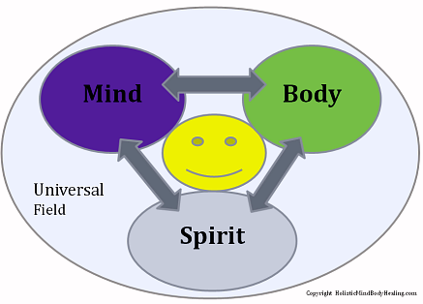
Health

Slide 6

Definition of Health
“Health is a state of complete physical, mental and social well being and not merely the absence of disease or infirmity”.

Slide 7
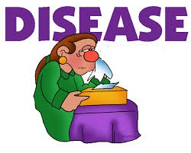

Slide 8
Diseases
Is a pathological change in the structure or function of the body or mind

Slide 9
Illness
Is a highly personal state in which the person’s physical, emotional, intellectual, social, developmental, or spiritual functioning is thought to be diminished
OR
Is the response of the person to diseases

Slide 10
Causes of disease

Slide 11
Causes of disease
Inherited defect
Developmental defect
Biologic, or toxin
Physical, chemical
Physiological and emotional
Injury or irritation
Hormone or enzyme

Slide 12
Aims of nursing
Promote health and eliminate health disparities.
Promote good health habits and maintain optimal functioning.
Restore health.
Facilitate coping with disability or death.
Meet needs.

Slide 13
Hospital
Is an institution for health care providing patient treatment by specialized staff and equipment, and often, but not always providing for longer-term patient stays.

Slide 14
Types
Outpatients
Patients go to a hospital just for diagnosis, treatment, or therapy and then leave, without staying overnight.
Inpatients
Patients are admitted to a hospital and stay overnight or for several weeks or months.

Slide 15
Types of Hospitals
A Public Hospital
Private Hospitals
Military Hospitals
Teaching Hospitals

Slide 16

Thanks for listening

