Slide 1

Vital Signs
Vital signs & importance
Normal ranges & general guidelines
Assess vital signs
Equipment & factors influencing
Assist. Prof. Rami Ramadhan

Slide 2
Vital Signs
Vital signs are measures of various physiological status, often taken by health professionals, in order to assess the most basic body functions.

Slide 3
Importance of Vital signs
Prognosis
Detecting or monitoring medical problems
Treatment and nursing care
Reaction to treatment
Diagnosis
Indicate is alive

Slide 4
Vital Signs
Temperature (T)
Pulse (P)
Respiration (R)
Blood Pressure (BP)

Slide 5
Variations Normal Ranges
Variations | Normal Reading | Vital Sign
<34.5 C Hypothermia >38 C Pyrexia | Axillary 36 C+ 0.5 C Tympanic 37C Oral 37 C Rectal 37C – 0.5 C | Temperature
<60 Bradycardia <100 Tachycardia | 60–100 beats/min. | Pulse

Slide 6
Variations Normal Ranges
Variations | Normal Reading | Vital Sign
<12 Bradypnea >20 Tachypnea | 12–20 resp./min. | Respirations
<90/70 Hypotension >140/90 Hypertension | 120 /80 mm/Hg | Blood pressure

Slide 7
1. Upon admission
2. Agency institutional policy
3. Change in health status
4. Before and after surgery or an invasive procedures
5. Before and after any nursing intervention
6. Before and after administering medications
When to Assess Vital Signs

Slide 8

Equipment Used for Vital Signs Measurement

Slide 9
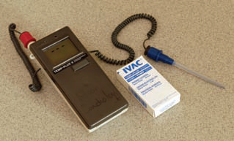
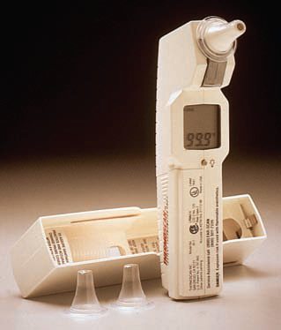
Electronic Tympanic Thermometer Thermometer

Slide 10
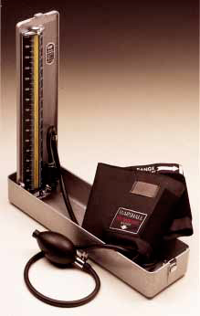
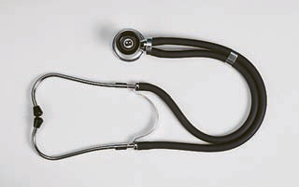
Stethoscope
Sphygmomanometer Mercury manometer

Slide 11
Body Temperature
Regulation and types of Body Temperature
Factors Affecting Body Temperature
Assessing Body Temperature
Sites for Assessing Body Temperature
Alterations in Body Temperature

Slide 12
Body Temperature
Body temperature is the balance between the heat production due to chemical activities by the body and heat lost from the body through radiation, conduction, convection, and vaporization( evaporation)
Heat production
Heat lost

Slide 13
Regulation of Body Temperature
Body temperature is maintained within a fairly constant range by the hypothalamus, which is located in the brain. The hypothalamus functions as the body’s thermostat.

Slide 14
Heat Production
Voluntary muscle
contractions
Fever
Strong emotional states
Involuntary muscle contractions
Cell metabolism

Slide 15
Heat Loss
Radiation
Perspiration
& Urine, feces
Convection
Conduction

Slide 16
Types of Body Temperature
Core Temperature
Surface Temperature

Slide 17
Surface Temperature | Core Temperature
Temperature of the skin, the subcutaneous tissue and fat | Temperature of deep tissues of the body, (Abdominal cavity)
Contrast rises and falls in response to the environmental changes. | Remains relatively constant ( 37Cº or 98.6 Fº).
Measured by (thermometer). | Measured by invasive means

Slide 18
Factors Affecting Body Temperature
1. Age
2. Diurnal variations
3. Exercise
5. Stress
6. Environment
4. Hormones

Slide 19
Assessing Body Temperature
The normal range of the body temperature is between (36.2 to 37.2 Cº).
The body temperature assessing by (Thermometer).
The body temperature is measured in units called degrees. Fahrenheit (F), or centigrade (C)

Slide 20
Types of Thermometers
Electronic thermometer.
Glass thermometer.
Paper thermometer.
Tympanic membrane thermometer.

Slide 21
Equivalent Fahrenheit and Celsius Temperature
Celsius | Fahrenheit
34 | 93.2
35 | 95
36 | 96.8
36.5 | 97.7
37 | 98.6
37.5 | 99.5
38 | 100.4
38.5 | 101.3
39 | 102.2
40 | 104
41 | 105.8
42 | 107.6
43 | 109.4
44 | 111.2

Slide 22
Sites for Assessing Body Temperature
Orally (common way)
Axillary (safe way)
Rectal (accurate reading)
Tympanic membrane

Slide 23
Orally (Common Way)
Common way
Temperature 37 C°
Time (3 – 5 min)
The sublingual artery
The thermometer is placed posteriorly into the sublingual pocket

Slide 24
Contraindications of oral thermometer
The child under 6 years
2. Unconscious patients
3. Psychiatric patients
4. Patient who cannot breath from nose
5. Mouth surgery or infection
6. Patient on oxygen mask

Slide 25
Axillary (Safe Way)
Safe way
Temperature 36 C° + 0.5 C°
Time (10 min)
Placing the thermometer in the central position and adducting the arm close to the chest wall
There are no main blood vessels around this area

Slide 26
Contraindications of axillary thermometer
Axillary surgery
Any axillary disorders

Slide 27
Disadvantages | Advantages | Site
Thermometers can break if bitten. Inaccurate if client has just ingested hot or cold food or fluid or smoked. Could injure the mouth following oral surgery. | Accessible and convenient | Orally
The thermometer must be left in place a long time to obtain an accurate measurement. | Safe and noninvasive | Axillary

Slide 28
Rectal (Accurate Reading)
Accurate reading
Temperature 37 C° – 0.5 c°
Time (2 – 3 min).

Slide 29
Contraindications of rectal thermometer
Rectal surgery
Any rectal disorders (hemorrhoids)
Complain from diarrhea

Slide 30
Tympanic Membrane
The tympanic membrane through a probe placed in the external auditory canal.
This method is quick (<1 minute)
Minimally invasive and easy to perform

Slide 31
Disadvantages | Advantages | Site
Inconvenient and more unpleasant. Could injure the rectum. Presence of stool. If the stool is soft, the thermometer may be embedded in stool rather than against the wall of the rectum. | Reliable measurement | Rectal
Can be uncomfortable and involves risk of injuring. Repeated measurements may vary. Right and left measurements can differ. Presence of wax can affect the reading. | Readily accessible; reflects the core temperature. very fast. | Tympanic membrane

Slide 32
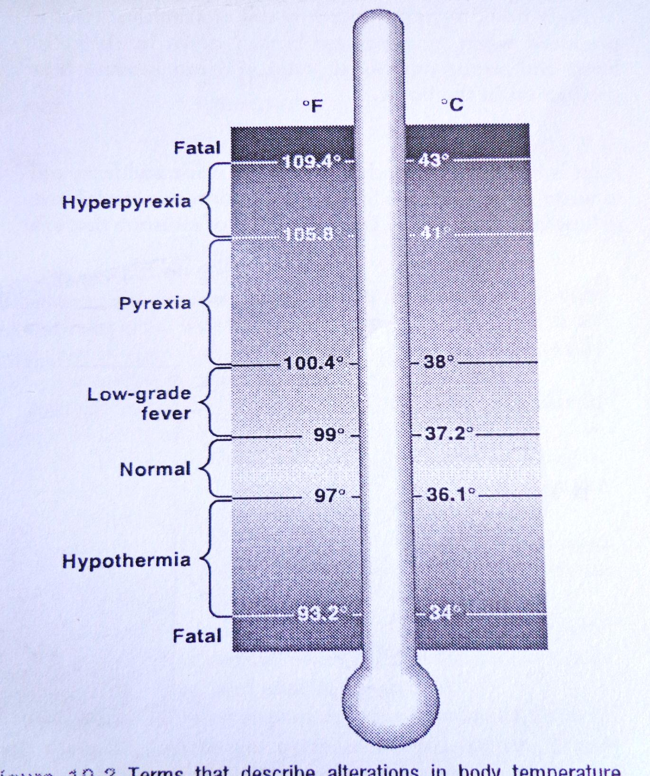
Alterations in Body Temperature
Hyperthermia, or Fever

Slide 33
Alterations in Body Temperature
Pyrexia: A body temperature greater than (38ºC), (100.4 ºF) also is called hyperthermia, or ( in lay terms) fever.
Hyperpyrexia: A body temperature reading greater than (41 ºC), ( 105 ºF).
Febrile: An individual who has a fever
Afebrile: An individual who does not have a fever.

Slide 34
Alterations in Body Temperature
Low-grade fever: A body temperature between (37.2-38°C), (99-100.4 ºF).
Hypothermia : A body temperature less than (36.1°C) (97°F)
Note
If the temperature greater than (43°C) (109.4°F) is generally fatal.
If temperature less than (34°C), (93.2°F), a person cannot survive

Slide 35
Alterations in Thermoregulation
Heat stroke
Frostbite

Slide 36
Heat stroke
Characteristics | Definition
Dry, hot skin Confused or delirious Experiences thirst Abdominal distress Muscle cramps Visual disturbances. Loss of consciousness occurs if untreated. | A critical increase in body temperature (41_C–42_C) resulting from exposure to high environmental temperature.

Slide 37
Frostbite
Characteristics | Definition
Circulatory impairment may be followed by gangrene. | Freezing of the body’s surface areas (earlobes, fingers, and toes) in extremely low temperatures.

Slide 38
Pulse
Pulse is a wave of blood created by contraction of the left ventricle of the heart.
A normal pulse rate for adults is between 60 and 100 beats per minute.

Slide 39
Systole and diastole = one heart beat = one cardiac cycle
Cardiac output = is the volume of blood flow into the arteries by the heart.

Slide 40
Types of Pulse
Peripheral pulse
Apical pulse
Is a pulse located away
From the heart, e.g., In the foot or wrist.
Is a central pulse, it is located at the Apex of the heart.

Slide 41
Characteristics of Pulse
Pulse Quality
Pulse Rate.
Pulse Rhythm
Pulse Volume (strength or amplitude).

Slide 42
Pulse Quality
Pulse quality refers to the ‘‘feel’’ of the pulse, its rhythm and forcefulness.

Slide 43
Pulse Rate
Pulse rate: is obtained by counting the number of peripheral pulse waves over a pulse point.
Bradycardia : is a heart rate less than 60 beats per minute in an adult.
Tachycardia : is a heart rate in excess of 100 beats per minute in an adult.

Slide 44
Pulse Rhythm
Pulse rhythm: is the regularity of the heartbeat.
Regular (the beats are evenly spaced)
Irregular (the beats are not evenly spaced).
Dysrhythmia (arrhythmia) is an irregular rhythm caused by an early, late, or missed heartbeat.

Slide 45
Pulse Volume
Pulse volume (strength or amplitude)
Is a measurement of the strength or amplitude of force exerted by the ejected blood against the arterial wall with each contraction.
Normal (full, easily palpable).
Weak (thready, and usually rapid)
Strong (bounding).

Slide 46
Pulse Volume Scale
Scale | Description
0 | Absent pulse
1 | Weak and thready pulse
2 | Normal pulse
3 | Bounding pulse

Slide 47
Pulse Deficit
Pulse deficit: Pulse deficit is the difference in the apical pulse and the radial pulse.
Should be taken at the same time.
Require that 2 people take the pulse.
One with a stethoscope and one at the wrist.
Count for 1 full minute.

Slide 48
Factors Contribute to Increase Pulse Rate
Pain.
Fever.
Stress, exercise .
Bleeding.
Decrease in blood pressure .
Some medications as (adrenalin, aminophylline).

Slide 49
Factors May Slow The Pulse
Rest .
Increasing age.
People with thin body size .
Some Medications.
Thyroid gland disturbances .

Slide 50

Pulse Point Assessment
Assessment Criteria | Anatomical location | Pulse Point
Accessible For infants When radial is inaccessible. | over temporal bone, superior and lateral to eye. | Temporal

Slide 51

Assessment Criteria | Anatomical location | Pulse Point
Accessible For infants During shock cardiac arrest when other peripheral pulses are weak Used to assess cranial circulation. | bilateral, under lower jaw in neck along medial edge of sternocleidomastoid muscle. | Carotid

Slide 52

Assessment Criteria | Anatomical location | Pulse Point
Used to auscultate heart sounds. Assess apical-radial deficit. | left midclavicular line at fourth to fifth intercostal space. | Apical

Slide 53

Assessment Criteria | Anatomical location | Pulse Point
In cardiac arrest for infants, to assess lower arm circulation To auscultate blood pressure. | inner aspect between groove of biceps and triceps muscles at antecubital fossa. | Brachial

Slide 54

Assessment Criteria | Anatomical location | Pulse Point
Accessible; used routinely in adults to assess character of peripheral pulse. | inner aspect of forearm on thumb side of wrist. | Radial

Slide 55

Assessment Criteria | Anatomical location | Pulse Point
Used to assess circulation to ulnar side of hand and to perform the Allen's test. | outer aspect of forearm on finger side of wrist | Ulnar

Slide 56

Assessment Criteria | Anatomical location | Pulse Point
Used to assess circulation to legs and during cardiac arrest. | in groin, below inguinal ligament (midpoint between symphysis pubis and anterosuperior iliac spine). | Femoral

Slide 57

Assessment Criteria | Anatomical location | Pulse Point
Used to assess circulation to legs and to auscultate leg blood pressure. | behind knee, at center in popliteal fossa. | Popliteal

Slide 58

Assessment Criteria | Anatomical location | Pulse Point
Used to assess circulation to feet. | inner aspect of ankle between Achilles tendon and tibia (below medial malleolus). | Posterior tibial

Slide 59

Assessment Criteria | Anatomical location | Pulse Point
Used to assess circulation to feet. | over instep, midpoint between extension tendons of great and second toe | Dorsalis pedis

Slide 60
Important Note
Never press both carotids at the same time because this can cause a reflex drop in blood pressure or pulse rate.

Slide 61
Respiration
Types of breathing
Mechanics and regulation of breathing
Factors affecting respiration
Assessing respirations
Altered breathing patterns and sounds

Slide 62
Respiration
Respiration: the process of exchanging oxygen and carbon Dioxide. Normal range: 12 – 20 breath / minute
Pulmonary ventilation (breathing ): movement of air in and out of the lungs.
Inspiration (inhalation) is the act of breathing in.
Expiration (exhalation ) _ is the act of breathing out .

Slide 63
Types of Breathing
Costal (thoracic) breathing
Diaphragmatic (abdominal) breathing
The external intercostal muscles
Other accessory
Muscles, as the sternocleidomastoid
Observed by the movement of the chest upward and outward
The contraction
Relaxation of the diaphragm
Observed by
The movement of the abdomen

Slide 64
Control of Breathing
Respiration is controlled by:
Respiratory center in the medulla oblongata and the Pons of the brain.

Slide 65
Mechanics and Regulation of Breathing
Inhalation
The diaphragm contracts (flattens)
Ribs move upward and outward
Exhalation
The diaphragm relaxes
Ribs move downward and inward
The sternum moves outward
Enlarging the thorax and permitting the lungs to expand
The sternum moves inward
Decreasing the size of the thorax as (lungs Compressed)
Lasts 2 to 3 seconds
Lasts 1 to 1.5 seconds

Slide 66
Factors Affecting Respiration
Pain, anxiety, exercise.
Medications.
Trauma.
Infection.
Respiratory and cardiovascular disease.
Alteration in fluids, electrolytes, acid- base balances.

Slide 67
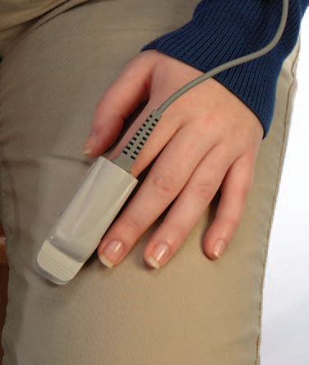
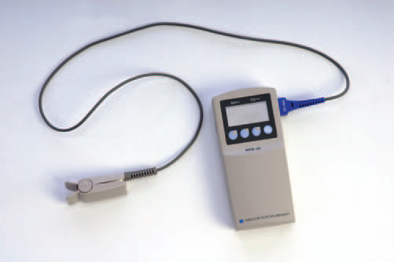
Assessing Respirations
Inspection
Listening with stethoscope
Monitoring arterial _ blood gas results
Using a pulse oximeter

Slide 68
A nurse should be aware of the following
The client's normal breathing pattern
The influence of the client's health problems on respirations
Any medications or therapies affect respirations
The relationship of the client's respirations to cardiovascular function

Slide 69
Assessment of respiration
Depth
Rhythm
Rate

Slide 70
Assessment of respiration
Depth :The depth of respiration indicates the amount of air that is inhaled or exhaled during the process of breathing. Respiratory depth is generally described as
Normal
Deep
Shallow

Slide 71
Assessment of respiration
Rhythm: Normally refers to the regularity of the expirations and the inspirations. Respiratory rhythm can be described as
Regular
Irregular.
Rate: the nurse observes a full inspiration and expiration when counting.

Slide 72
Sites of breathing measurement
Normal breathing is :
Slightly observable
Effortless
Quiet
Automatic
Regular.

Slide 73
Sites of breathing measurement
Assessed by observing chest wall expansion and bilateral symmetrical movement of the thorax.

Slide 74
Important Note
Nurse must not tell the patient that he or she will assess his respiration because the patient can control his breathing so that will give a wrong assessment.
A complete cycle of an inspiration composes one respiration.

Slide 75
Altered Breathing Patterns
Rate :(Tachypnea, Bradypnea, or Apnea)
Volume :(Hyperventilation, or Hypoventilation )
Rhythm: (Cheyne-Stokes breathing)
Ease or Effort: (Dyspnea , or Orthopnea )

Slide 76
Rate
Tachypnea
quick, shallow breaths
Bradypnea
abnormally slow breathing
Apnea
cessation of breathing

Slide 77
Volume
Hyperventilation
overexpansion of the lungs
Hypoventilation
Under-expansion of the lungs
characterized by shallow respirations
characterized by rapid and deep breaths

Slide 78
Apnea : is the absence of breathing
Dyspnea—difficult and labored breathing
Orthopnea-ability to breathe only in upright sitting or standing positions

Slide 79
Characteristics of Abnormal Breathing Sounds
Bradypnea: abnormal slow respiratory rate of 12 or fewer breaths per minute.
Tachypnea: is a respiratory rate greater than 20 breaths per minute.

Slide 80
Characteristics of Abnormal Breathing Sounds
Hypoventilation: is characterized by shallow respirations.
Hyperventilation: is characterized by deep, rapid respirations.

Slide 81
Blood Pressure
Types of blood pressure
Mechanism of Blood Pressure
Factors increasing blood pressure
Blood Pressure Sites

Slide 82
Blood Pressure
Blood pressure (BP) : is the force required by the heart to pump blood from the ventricles of the heart into the arteries.
It is measured in systolic and diastolic pressure.
The normal BP is 120/ 80 mmHg.

Slide 83
Types of blood pressure
Systolic pressure : is the pressure of the blood as a result of contraction of the ventricles, that is, the pressure of the height of the blood wave.
Diastolic pressure: is the pressure when the ventricles are at rest.

Slide 84
Mechanism of Blood Pressure
Systolic pressure
The ventricles contract
Blood is pushed out of the heart
Diastolic pressure
Heart relaxes between contractions
The cardiac cycle is known as diastole
Exerting pressure on the walls of the arteries
The cardiac cycle is known as systole

Slide 85
Factors increasing blood pressure
Age.
Exercise
Stress.
Obesity.
Sex.
Medications.
Disease process.

Slide 86
Classification of Blood Pressure
Category | Systolic BP (mmHg) | Diastolic BP (mmHg)
Normal | 120 (110-130) | 80 (70-90)
Hypertension, stage 1 | 130–139 | 90–99
Hypertension, stage 2 | 140-159 | 100-120
Hypertensive crisis | Over than 160 | Over than 120

Slide 87
Selected Conditions Affecting Blood Pressure
Possible Cause | Effect | Condition
Increases metabolic rate | Increase | Fever
Increases cardiac output | Increase | Stress
Decrease artery compliance | Increase | Arteriosclerosis
Increases peripheral resistance | Increase | obesity
Decreases blood volume | Decrease | Hemorrhage
Decreases blood viscosity | Decrease | Low hematocrit
Increases vasodilation and decreases peripheral vascular resistance. | Decrease | External heat
Causes vasoconstriction and thus increases peripheral vascular resistance. | Increase | Exposure to cold

Slide 88
Pulse Pressure
Pulse pressure is the numeric difference between the systolic and diastolic blood pressure . For example, if the resting blood pressure is 120/80 millimeters of mercury (mm Hg), the pulse pressure is 40 .

Slide 89
Pulse Pressure
A pulse pressure within 40 is the normal and healthy pulse pressure .
A pulse pressure greater than 40 mm Hg is abnormal. A high pulse pressure may be a strong predictor of heart problems (valve regurgitation), especially for older adults.
A pulse pressure lower than 40 may mean a patient have poor heart function.

Slide 90
Any questions?
Thanks for All

