Slide 1


وزارة التعليم العالي والبحث العلمي جامعة الموصل كلية التمريض -B-المرحلة الرابعة حالات حرجة نظري المحاضرة الثانية 2025-2024
Cardiogenic Shock
Lect. Ali Mohammed Fathi

Slide 2
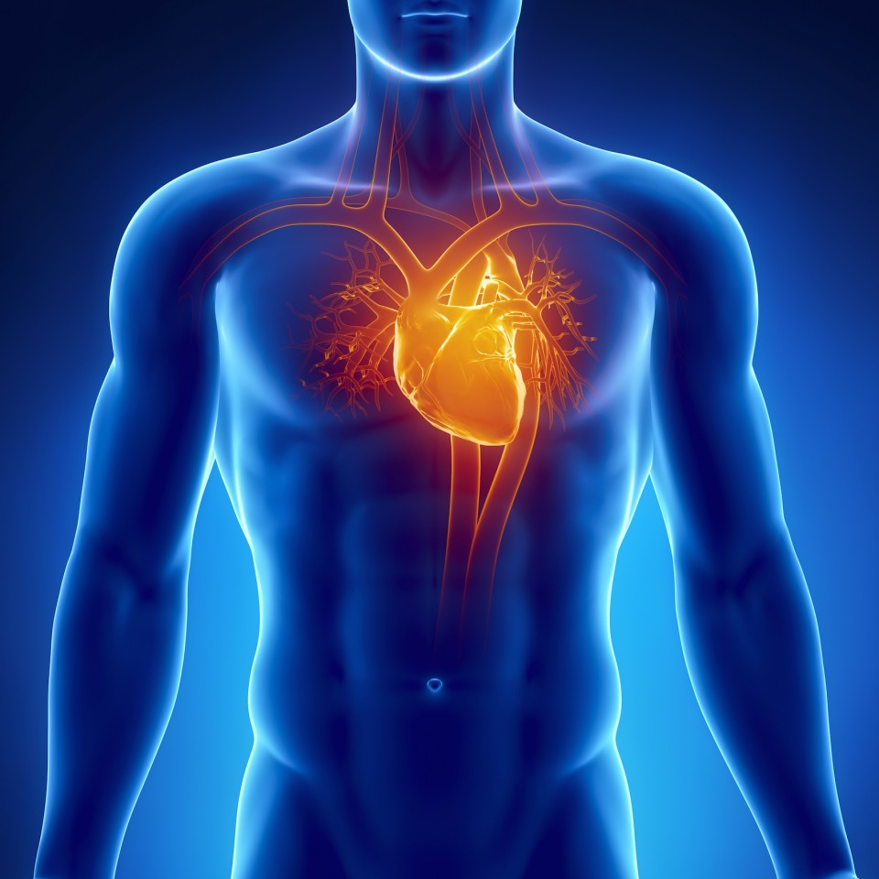
Cardiogenic Shock

Slide 3
Cardiogenic Shock
Cardiogenic shock is a clinical condition of inadequate tissue (end-organ) perfusion due to cardiac dysfunction.

Slide 4
Pathophysiology
The heart muscle loses its contractile power
↓
resulting in a marked reduction in SV and CO
↓
The decreased CO in turn reduces arterial blood pressure and tissue perfusion in the vital organs (heart, brain, lung, kidneys).
↓

Slide 5
Flow to the coronary arteries is reduced
↓
decreased oxygen supply to the myocardium, which increases ischemia and further reduces the heart's ability to pump
↓
Inadequate emptying of the ventricle
↓

Slide 6
leads to increased pulmonary pressures, pulmonary congestion, and pulmonary edema, exacerbating the hypoxia, causing ischemia of vital organs, and setting a vicious cycle in motion

Slide 7
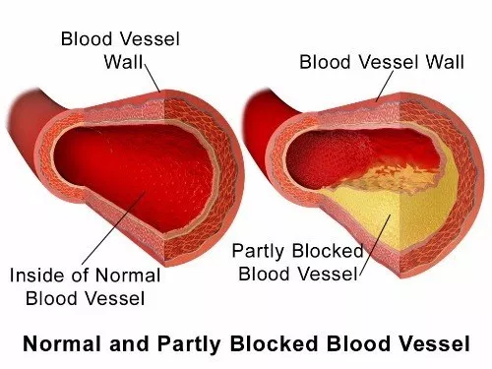
Etiology
Coronary artery disease

Slide 8
Cardiac arrhythmias
Systolic dysfunction
Diastolic dysfunction
Valvular dysfunction
Mechanical complications

Slide 9
Despite advances in treatment options, CS mortality remains high at ~35–50% and is a challenging condition to manage in acute care settings

Slide 10
Clinical Manifestations
The classic signs of cardiogenic shock are tissue hypoperfusion manifested as cerebral hypoxia (restlessness, confusion, agitation), low blood pressure, rapid and weak pulse, cold and clammy skin, increased respiratory crackles, hypoactive bowel sounds, and decreased urinary output

Slide 11
On Physical examination
Skin is usually ashen or cyanotic and cool; extremities are mottled.
Peripheral pulses are rapid and may be irregular if arrhythmias are present.
Jugular venous distention and crackles in the lungs are usually (but not always) present; peripheral edema also may be present.

Slide 12
The pulse pressure may be low, and patients are usually tachycardia.
Patients show signs of hypo perfusion, such as altered mental status and decreased urine output.
Ultimately, patients develop systemic hypotension (i.e., systolic blood pressure below 90 mm Hg or a decrease in mean blood pressure by 30 mm Hg).

Slide 13
Imaging studies
Echocardiography should be performed early to establish the cause of cardiogenic shock.
Chest radiographic findings are useful for excluding other causes of shock or chest pain (e.g., aortic dissection, tension pneumothorax, pneumomediastinum.
Coronary angiography is urgently indicated in patients with myocardial ischemia or MI who also develop cardiogenic shock

Slide 14
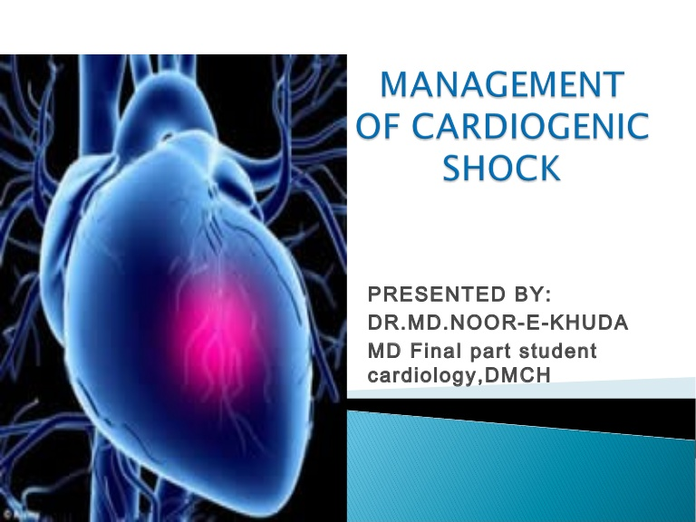
management

Slide 15
Fluid resuscitation to correct hyporvolemia and hypotension, unless pulmonary edema is present.
pharmacologic therapy to maintain blood pressure and cardiac output
Early restoration of coronary blood flow
Correction of electrolyte and acid-base abnormalities (e.g., hypokalemia, hypomagnesaemia, acidosis).

Slide 16
provide vascular access for multiple infusions, and allow invasive monitoring of central venous pressure .
An arterial line may be placed to provide continuous blood pressure monitoring.
An intra-aortic balloon pump may be placed as a bridge to percutaneous coronary intervention (PCI) or coronary artery bypass grafting (CABG) .

Slide 17
Complications of cardiogenic shock
Complications of the etiologic problem.
Complications of shock (generally end- organ destruction).
Brain. Ischemia, leaving neurologic deficits.
Kidney. Acute tubular necrosis.
Lungs. Adult respiratory distress syndrome.

Slide 18
complications associated with IABP include, insertion injuries, malposition of balloon, ischaemia of the leg in which the balloon is inserted, aortic embolism, aortic thrombus, aorto-iliac dissection, false femoral aneurysm, infection, thrombocytopenia, balloon rupture or leak with gas embolism and hemorrhage.

Slide 19
Nursing Care Plan for patients with cardiogenic shock
Assessment
Appearance
Restlessness progressing to unresponsiveness.
Chest pain.
Dysrhythmias.

Slide 20
Vital signs HR: >100 beats/min. BP: <80 mm Hg. RR: > 20 breaths/min.

Slide 21
Neurologic Agitation. Restlessness progressing to unresponsiveness, and changes in level of consciousness.

Slide 22
Cardiovascular
Weak thready pulses.
Rhythm may be irregular.
Pulmonary
Orthopnea
Crackles
Cough with increased secretions.

Slide 23
Nursing Diagnosis:
Impaired gas exchange related to increased left ventricular diastolic pressure (LVEDP) and pulmonary edema associated with severe left ventricular (LV) dysfunction.

Slide 24
Nursing Interventions
Continuously monitor oxygenation status with pulse oximetry.
Monitor for desaturation in response to nursing intervention.
Monitor fluid volume status.
Obtain HR, RR, and BP every 15 minutes to evaluate the patient’s response to therapy and detect cardiopulmonary deterioration.
Assess the patient’s respiratory status. The use of accessory muscles and inability to speak suggest worsening pulmonary congestion.

Slide 25
Review ABGs for decreasing trend in Pao2 (hypoxemia) or pH (acidosis). These conditions can adversely affect myocardial contractility.
Provide supplemental oxygen as ordered. If the patient develops respiratory distress, be prepared for intubation and mechanical ventilation.
Administer low-dose morphine sulfate as ordered to reduce preload in an attempt to decrease pulmonary congestion.
Minimize oxygen demand by maintaining bed rest and decreasing anxiety, fever, and pain.
Position the patient for maximum chest excursion and comfort.

