Slide 1

Assist. Prof. Rami Ramadhan

Slide 2
Nursing Assessment
Definition
Types of data
Collecting data (methods)
Organizing, Validating, Documenting and data
Components of nursing health history

Slide 3
Definition
Assessing is the systematic and continuous collection, organization, validation, and documentation of data (information)
A nursing assessment include:
Perceived needs
Health problems
Related experience
Health practices
Values
Lifestyles.

Slide 4
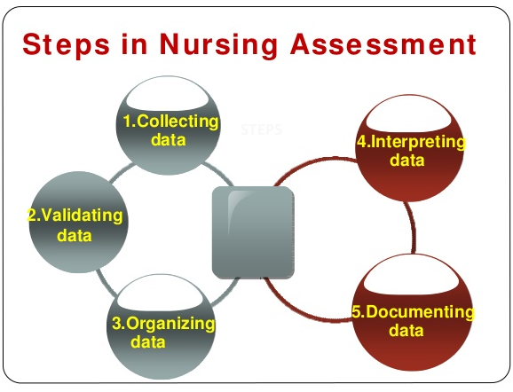

Slide 5
Collecting data (methods)
Data collection is the process of gathering information about a client’s health status. It must be both systematic and continuous to prevent the omission of significant data and reflect a client’s changing health status.

Slide 6
Types of data
Subjective data
Called symptoms or covert data
Data (what the client feels)
Objective data
Called signs or overt data
Data (seen, heard, felt, or smelled)
Described or verified only by that person
Detectable by an observer or can be measured or tested

Slide 7
Examples of data
Objective Data
Weight
Temperature
Skin color
Blood cell count
Vomiting
Bleeding
Subjective Data
Pain
Nausea
Depression
Fatigue
Anxiety
Loneliness

Slide 8
Sources of data
Primary Sources
The client is the primary source of data
Secondary Sources
Family members or other support persons
Health professionals records and reports
Laboratory and diagnostic analyses
Relevant literature

Slide 9
Observing
To observe is to gather data by using the senses.
Interviewing
An interview is a planned communication or a conversation with a purpose, for example, to get or give information, or identify problems.
Examining
The physical examination is a systematic data collection method that uses observation (i.e., the senses, hearing, smell, and touch(
Data collection methods

Slide 10
Validating data
Validation is the act of “double-checking” or verifying data to confirm that it is accurate and factuald

Slide 11
Validating data tasks
Ensure that assessment information is complete.
Ensure that objective and related subjective data agree obtain additional information that may have been overlooked.
Avoid jumping to conclusions and focusing in the wrong direction to identify problems.
Differentiate between cues and inferences.
Cues are subjective or objective data that can be directly observed by the nurse; that is, what the client says or what the nurse can see, hear, feel, smell, or measure.
Inferences are the nurse’s interpretation or conclusions made based on the cues

Slide 12
Organizing data
The nurse uses a written (or electronic) format that organizes the assessment data systematically. This is often referred to as a nursing health history, nursing assessment, or nursing database form.

Slide 13
Documenting data
Documenting Data
To complete the assessment phase, the nurse records client data. Accurate documentation is essential and should include all data collected about the client’s health status.

Slide 14
Components of a nursing health history
Biographic data
Chief complaint or reason for visit
History of present illness
Past history
Family history of illness
Lifestyle
Social data
Psychological data

Slide 15
Biographic data
Client's name
Address
Age and sex
Marital status
Occupation
Religious preference

Slide 16
Chief complaint or reason for visit
The answer given to the question
The chief complaint should be recorded in the client's own words.
What is troubling you?
OR
Can you tell me the reason you came to the hospital or clinic today?

Slide 17
Examples of chief complaints
Chest pain for 3 days.
Swollen ankles for 2 weeks.
Fever and headache for 24 hours.
Pap smear needed.
Physical examination needed for camp.

Slide 18
History of present illness
Gathering information relevant to the chief complaint, and the client's problem, including essential and relevant data, and self medical treatment.

Slide 19
History of present illness
Symptoms started, symptoms was sudden or gradual, how often the problem occurs, exact location of the distress, character of the complaint (e.g., intensity of pain or quality of sputum, emesis, or discharge), activity in which the client was involved when the problem occurred, and factors that aggravate or alleviate the problem

Slide 20
Past History
Illnesses, and other significant illnesses
Immunizations
Allergies
Accidents and injuries
Hospitalization for serious illnesses
Medications

Slide 21
Family history of illness
Particular attention should be given to disorders such as :
Heart disease and hypertension
Diabetes
Cancer
Obesity
Allergies
Arthritis
Tuberculosis
Bleeding
Alcoholism, and any mental health disorders.

Slide 22


Slide 23
Lifestyle
the amount, frequency, and duration of substance use (tobacco, alcohol, coffee, cola, tea, and illicit or recreational drugs)
Activities of daily living (ADL)
Instrumental activities of daily living: any difficulties experienced in food preparation, shopping, transportation, housekeeping, laundry, and ability to use the telephone, handle finances, and manage medications.
Diet
Sleep/rest patterns
description of a typical diet on a normal day or any special diet, number of meals and snacks per day, who cooks and shops for food, ethnically distinct food patterns, and allergies
usual daily sleep/wake times, difficulties sleeping, and remedies used for difficulties
Personal habits

Slide 24
Social Data
Family relationships/friendships
Ethnic affiliation
Educational history
Occupational history
Economic status
Home and neighborhood conditions

Slide 25
Psychological Data
Major stressors experienced and the client's perception of them
Usual coping pattern with a serious problem or a high level of stress
Communication style

