Slide 1


وزارة التعليم العالي والبحث العلمي جامعة الموصل كلية التمريض -B-المرحلة الرابعة حالات حرجة نظري المحاضرة الثانية 2025-2024
Heart attack
Lect. Ali Mohammed Fathi

Slide 2
Overview Heart attack A heart attack occurs when the flow of blood to the heart is blocked, most often by a build-up of fat, cholesterol and other substances, which form a plaque in the arteries that feed the heart (coronary arteries). The interrupted blood flow can damage or destroy part of the heart muscle. A heart attack, also called a myocardial infarction, can be fatal.

Slide 3
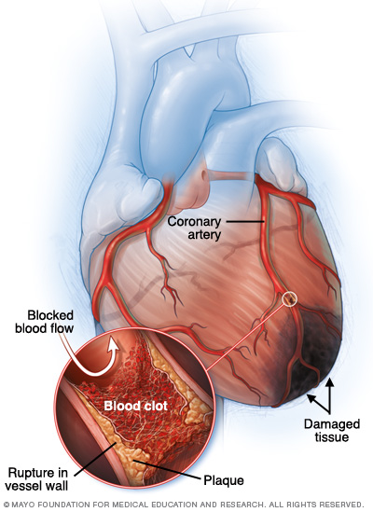

Slide 4
symptoms
Common heart attack signs and symptoms include:
Pressure, tightness, pain, or a squeezing or aching sensation in chest or arms that may spread to neck, jaw or back
Nausea, indigestion, heartburn or abdominal pain
Shortness of breath
Cold sweat
Fatigue
Lightheadedness or sudden dizziness

Slide 5
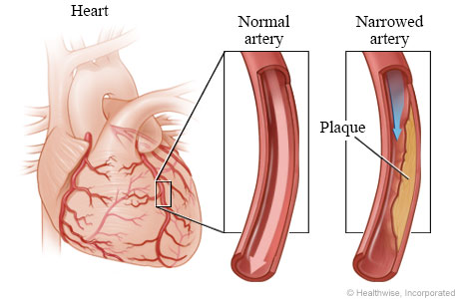
Causes
coronary arteries become blocked

Slide 6
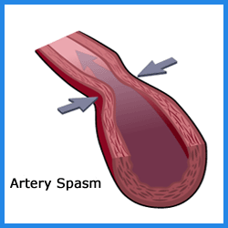
spasm of a coronary artery

Slide 7
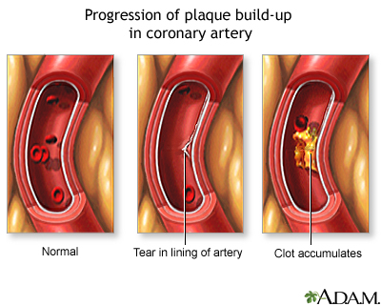
tear in the heart artery

Slide 8
Risk factors
Heart attack risk factors include:
Age. Tobacco.
High blood pressure.
High blood cholesterol or triglyceride levels.
Diabetes.
Family history of heart attack.
Lack of physical activity.
Obesity. Stress. Illegal drug use. A history of preeclampsia.

Slide 9
Complications
Complications are often related to the damage done to heart during an attack. Damage can lead to:
Abnormal heart rhythms (arrhythmias).
Heart failure.
Heart rupture.
Valve problems.

Slide 10
Prevention
Here are ways to prevent a heart attack.
Medications. Taking medications can reduce risk of a subsequent heart attack and help damaged heart function better.
Lifestyle factors.

Slide 11
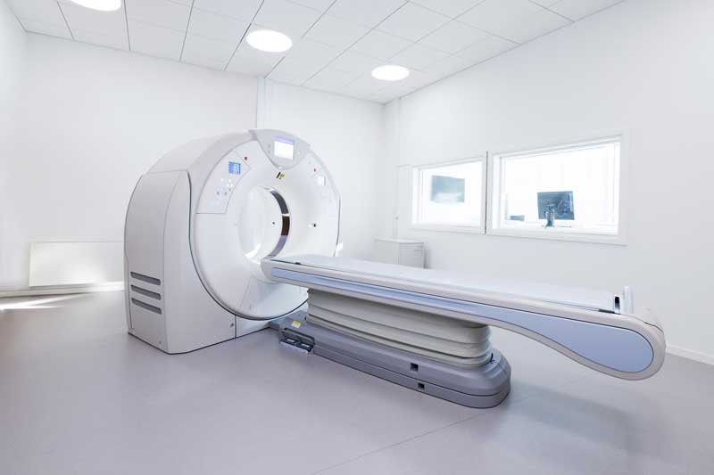
Diagnosis
Electrocardiography (ECG).
Blood tests.
Chest X-ray.
Echocardiogram.
Coronary catheterization (angiogram).
Exercise stress test.
Cardiac computerized tomography (CT)
Magnetic resonance imaging (MRI).

Slide 12
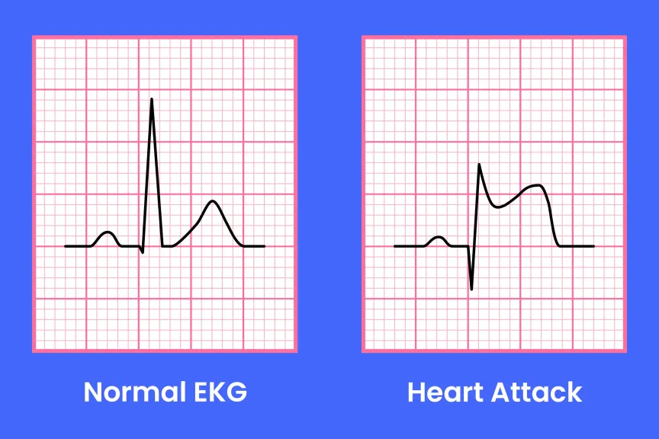

Slide 13
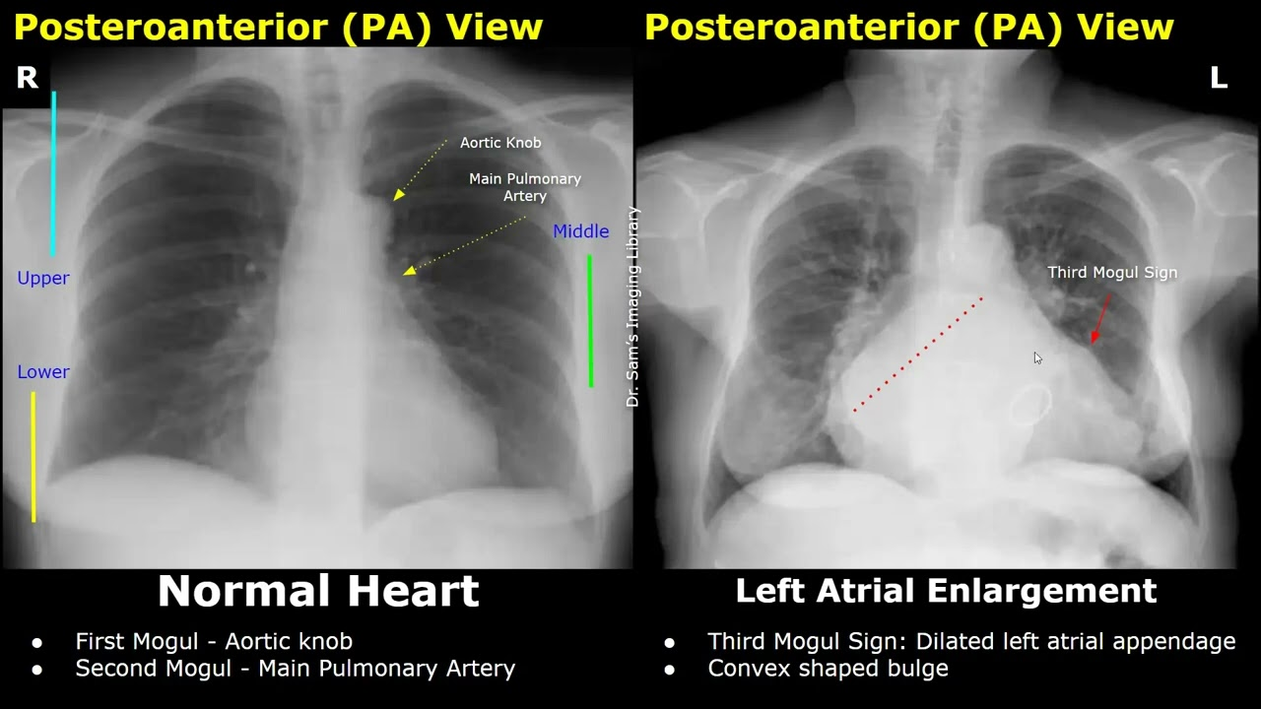

Slide 14
Treatment
Medical Management
The main goals in treating myocardial infarction are to increase blood flow to the coronary arteries which lead to:
decrease infarction size.
increase oxygen supply .
decrease oxygen demand to prevent myocardial death or injury, and ,
control or correct dysrhythmias .

Slide 15
Heart attack treatment at a hospital
Medications
Medications given to treat a heart attack include:
First Step Give Oxygen Therapy
Aspirin.
Thrombolytics.
Antiplatelet agents.
Pain relievers.
Nitroglycerin.
Beta blockers.
ACE inhibitors.

Slide 16
Surgical and other procedures
In addition to medications, may undergo one of the following procedures to treat heart attack:
Coronary artery bypass surgery.

Slide 17
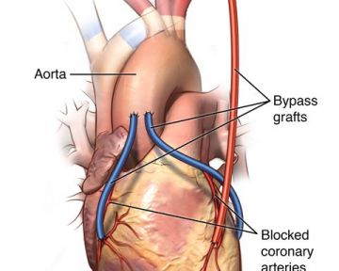

Slide 18
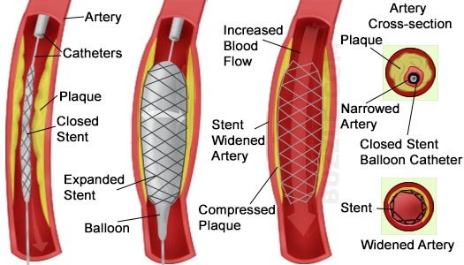
Coronary angioplasty and stenting.

Slide 19
Lifestyle and home remedies
lifestyle affects heart health. The following steps can help not only prevent but also recover from a heart attack:
Avoid smoke.
Control blood pressure and cholesterol levels.
Get regular medical checkups.
Exercise regularly.
Maintain a healthy weight.
Eat a heart-healthy diet.
Manage diabetes.
Control stress.
No drink alcohol, do so in moderation.

Slide 20
A doctor has ordered cardiac enzymes on a patient being admitted with chest pain. You know that _____________ levels elevate 2-4 hours after injury to the heart and is the most regarded marker by providers.*
A. Myoglobin
B. CK-MB
C. AST
D. Troponin T and I

Slide 21
---Which of the following physiologic conditions is usually present immediately before a heart attack? A.The blood supply to an area of the heart is suddenly cut off. B.The heart is not working hard enough to pump blood to the body. C.The hemoglobin count is low D.The blood is too thin. ---Three risk factors for heart disease can't be controlled. Which of these are they? A. Medicine use, vaccines, alcoholism B. Age, sex, heredity C. Diet, drug use, smoking D. None of the above

