Slide 1
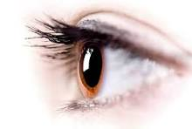
Ophthalmic disorders
Dr. Harith , F. Al-Aubaidy
الدكتور
حارث فتحي العبيدي

Slide 2
Anatomy of the eye
The eyeball, or globe, is situated in the bony protective orbit . Lined with muscle and connective and adipose tissues, the orbit is shaped like a four-sided pyramid, surrounded on three sides by the sinuses: ethmoid (medially), frontal (superiorly), and maxillary (inferiorly). The optic nerve and the ophthalmic artery enter the orbit at its apex through the optic foramen. The eyeball is moved through all fields of gaze by the extraocular muscles. The four rectus muscles and two oblique muscles are innervated by cranial nerves (CNs) III, IV, and VI. Normally, the movements of the two eyes are coordinated and the brain perceives a single image.

Slide 3
The eyelids contain multiple glands (sebaceous, sweat, and lacrimal). The upper lid normally covers the uppermost portion of the iris and is innervated by the oculomotor nerve (CN III). The lid margins contain meibomian glands,. With every blink, the eyelids wash the cornea and conjunctiva with tears.

Slide 4
Tears are vital to eye health. Formed by the lacrimal gland and the accessory lacrimal glands, tears are secreted in response to reflex or emotional stimuli.
The conjunctiva, a thin transparent mucous membrane, provides a barrier to the external environment extending under the eyelids (palpebral conjunctiva) and over the sclera (bulbar conjunctiva). The junction of the two portions is known as the fornix. The conjunctiva meets the cornea at the limbus on the outermost edge of the iris.

Slide 5
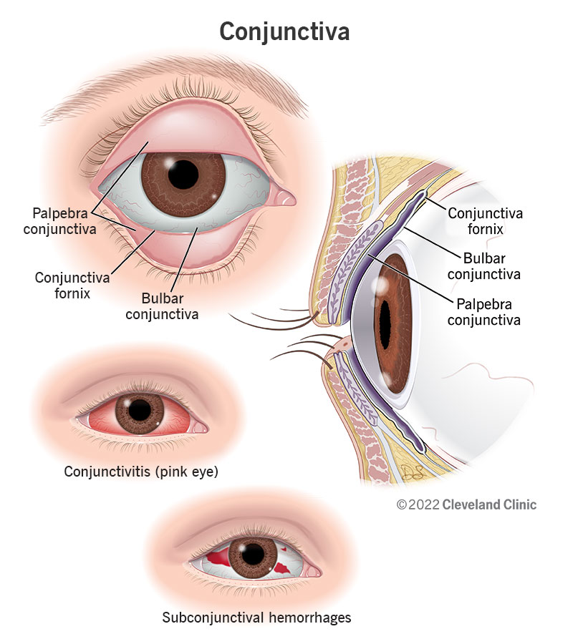

Slide 6
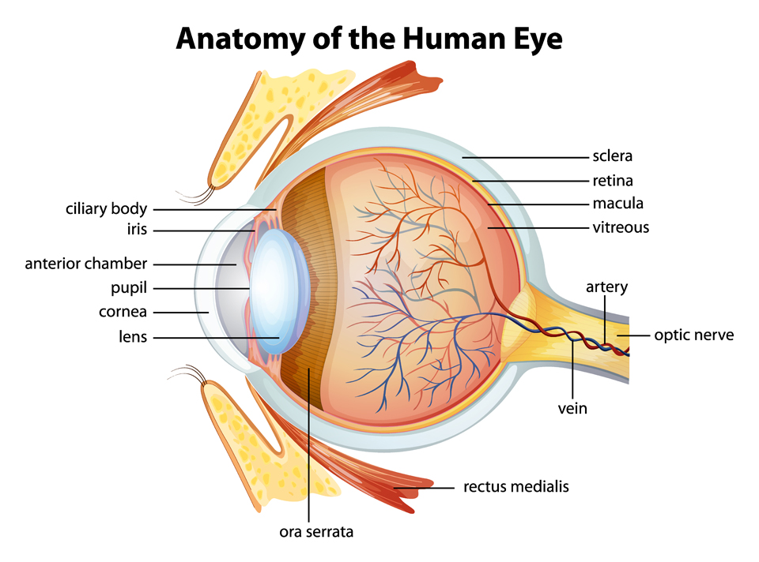

Slide 7
The eyeball is composed of the following three layers: The outer dense fibrous layer, including the sclera and transparent cornea The middle vascular layer, containing the iris, ciliary body, and choroid , The inner neural layer, including the retina, optic nerve, and visual pathway The eyeball is divided anatomically into two segments. The anterior segment is between the anterior cornea and posterior iris, including the anterior and posterior chambers. The posterior segment is between the posterior lens and the retina, including the vitreous chamber..

Slide 8
The aqueous-filled anterior chamber lies between the posterior cornea and the anterior iris and pupil. The posterior chamber is a small aqueous-containing space between the posterior iris and pupil and anterior lens. The vitreous chamber, containing clear gelatinous vitreous fluid, is the largest chamber in the ocular fundus between the lens and retina (see Fig. 58-3).

Slide 9
The aqueous humor is transparent, nutrient-containing fluid that fills the anterior and posterior chambers and helps give the eye its shape (Moore, Dalley, & Agur, 2018). The aqueous is produced in the posterior chamber by the ciliary body; it flows through the pupil into the anterior chamber and drains through the trabecular meshwork into the canal of Schlemm. Production of aqueous humor is related to the intraocular pressure (IOP). Normal IOP is less than 21 mm Hg (Sihota, Angmo, Ramaswamy, et al., 2018).

Slide 10
Vitreous humor, which is composed mostly of water and encapsulated by a hyaloid membrane, helps maintain the shape of the eye. The vitreous is attached to the retina by scattered collagenous filaments. The vitreous shrinks and shifts with age.

Slide 11
The sclera is the white avascular dense fibrous structure that helps maintain the shape of the eyeball and protects the intraocular contents. Scleral thinning and changes of the scleral collagen fibers can cause the underlying uveal pigment to be seen, resulting in a blue or gray sclera.

Slide 12
The cornea, a vulnerable transparent avascular domelike structure, forms the most anterior portion of the eyeball and is the main refracting surface of the eye. It contains high concentrations of nerve fibers and is extremely sensitive to pain. The epithelium, the outermost protective layer, absorbs oxygen and nutrients from the tear film nourishing the cornea. The epithelial cells readily regenerate, unlike the innermost endothelial cells, which do not regenerate and result in corneal edema when injured.

Slide 13
The uveal tract is the vascular middle layer of the eye consisting of the iris, ciliary body, and the choroid.
The iris surrounding the pupil is a highly vascularized pigmented collection of fibers that give the eye color. The dilator and sphincter muscles of the iris control pupil size. The dilator muscles are controlled by the sympathetic nervous system. The sphincter muscles are controlled by the parasympathetic nervous system. The ciliary body consists of ciliary processes, ciliary muscles.

Slide 14
Ocular History
Genetics may play a role in the causation and progression of eye and vision disorders (Singh & Tyagi, 2018).

Slide 15
Visual Acuity
Visual acuity is tested for both near (14 inches away) and distance (20 feet away) vision and is performed on each eye separately with a standardized Snellen chart for distance and a Rosenbaum pocket screener for near vision. A tumbling “E,” “illiterate E,” number, or picture chart is used if the person is illiterate or unable to read the English alphabet (Weber & Kelley, 2018).

Slide 16
What does the patient perceive to be the problem?
Is visual acuity diminished?
Is the patient experiencing blurred, double, or distorted vision?
Is there pain? Is it sharp or dull?
Is it worse when blinking?
Is the discomfort an itching sensation or more of a foreign-body sensation?
Are both eyes affected? Is there a history of discharge?
If so, inquire about color, consistency, and odor. Describe the onset of the problem (sudden, gradual). Is it worsening?
What is the duration of the problem? Is this a recurrence of a previous condition? How has the patient self-treated? What makes the symptoms improve or worsen?

Slide 17
Common abbreviations related to vision and eye health are derived from Latin terms; these include OD (oculus dexter, right eye), OS (oculus sinister, left eye), and OU (oculus uterque, both eyes). The following would be an example of visual acuity documentation:
A patient reads all five letters from the 20/20 line on the Snellen chart with the right eye (OD) and three of the five letters on the 20/30 line with the left eye (OS); the visual acuity is documented as OD: 20/20 and OS: 20/30 (Weber & Kelley, 2018).

Slide 18
External Eye Examination
symmetry and placement of eyelids, pupils, and muscles. CNs III, IV, and VI control movement and pupil size. The eyelids should rest just above and below the corneal limbus without exposure of the sclera. The nurse observes for ptosis (drooping of the eyelid), ectropion (turning out of the lower eyelid), or entropion (turning in of the lower eyelid). Entropion may involve trichiasis (turning in of the eyelashes). Eyelids and lashes should be free of drainage or scaling.

Slide 19
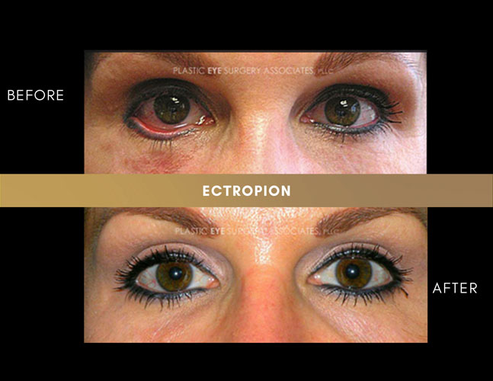
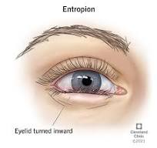

Slide 20
Gaze
The patient’s eyes are observed in primary or direct gaze, and any head tilt is noted. A head tilt may indicate CN palsy. The patient is asked to stare at a target; each eye is covered and uncovered quickly while the examiner looks for any shift in gaze. The examiner observes for nystagmus (involuntary oscillating movement of the eyeball). The extraocular movements of the eyes are tested by having the patient follow the examiner’s finger, pencil, or a hand light through the six cardinal directions of gaze (i.e., up, down, right, left, and both diagonals).

Slide 21
Diagnostic Evaluation
Direct Ophthalmoscopy
A direct ophthalmoscope is a handheld instrument with various plus and minus lenses (Weber & Kelley, 2018). The lenses can be rotated into place, enabling the examiner to bring the cornea, lens, and retina into focus sequentially. The examiner holds the ophthalmoscope in the right hand and uses the right eye to examine the patient’s right eye. The examiner switches to the left hand and left eye when examining the patient’s left eye. During this examination, the room should be darkened, and the patient’s eye should be on the same level as the examiner’s eye. The patient and the examiner should be comfortable, and both should breathe normally. The patient is given a target to gaze at and is encouraged to keep both eyes open and steady. When the fundus is examined, the vasculature comes into focus first. The veins are larger in diameter than the arteries. The examiner focuses on a large vessel and then follows it toward the midline of the body, which leads to the optic nerve

Slide 22
Indirect Ophthalmoscopy
The indirect ophthalmoscope is an instrument commonly used by the ophthalmologist to see larger areas of the retina, although in an unmagnified state. It produces a bright and intense light. The light source is affixed with a pair of binocular lenses mounted on the examiner’s head. The ophthalmoscope is used with a handheld, 20-diopter lens.

Slide 23
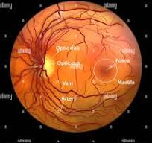

Slide 24
Slit-Lamp Examination
The slit lamp is a binocular microscope mounted on a table. This instrument enables the user to examine the eye with magnification of 10 to 40 times the real image. The illumination can be varied from a broad to a narrow beam of light for different parts of the eye. For example, by varying the width and intensity of the light, the anterior chamber can be examined for signs of inflammation. Cataracts may be evaluated by changing the angle of the light. When a handheld contact lens, such as a three-mirror lens, is used with the slit lamp, the angle of the anterior chamber may be examined, as may the ocular fundus.

Slide 25
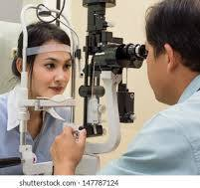

Slide 26
Tonometry
Tonometry is a common procedure to measure IOP. The device used for measuring IOP is an accurately calibrated applanation tonometer, which measures the pressure needed to flatten the cornea. This procedure is most commonly used to screen for and monitor IOP in glaucoma.
Nursing Interventions
Providing patient education prior to tonometry helps avoid possible errors in IOP measurement. Patients are cautioned to avoid squeezing the eyelids, holding their breath, or performing a Valsalva maneuver, because these may result in abnormally increased IOP.

Slide 27
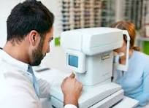

Slide 28
Color Vision Testing
The ability to differentiate colors has a dramatic effect on the activities of daily living (ADLs). For example, the inability to differentiate between red and green can compromise traffic safety. Some careers (e.g., commercial artist, [color] photographer, airline pilot, electrician) may be closed to people with significant color deficiencies. The photoreceptor cells responsible for color vision are the cones, and the greatest area of color sensitivity is in the macula —the area of densest cone concentration.

Slide 29
Color vision deficits can be inherited. For example, red–green color deficiencies are inherited in an X-linked manner, affecting approximately 8% of men and 0.5% of women . Acquired color vision losses may be caused by medications (e.g., digitalis) or pathology (e.g., cataracts).
A simple test, such as asking a patient if the red top on a bottle of eye drops appears redder to one eye than the other, can be an effective tool. A difference in the perception of the intensity of the color red between the two eyes can be a symptom of a neurologic problem and may provide information about the location of the lesion. Because alteration in color vision sometimes indicates conditions of the optic nerve,.

Slide 30
Amsler Grid
The Amsler grid is a test often used for patients with macular problems, such as macular degeneration. It consists of a geometric grid of identical squares with a central fixation point. The grid should be viewed by the patient wearing normal reading glasses. Each eye is tested separately. The patient is instructed to stare at the central fixation spot on the grid and report any distortion in the squares of the grid itself. For patients with macular disorders, some of the squares may look faded, or the lines may be wavy. Patients with age-related macular degeneration (AMD) are commonly given these Amsler grids to take home

Slide 31
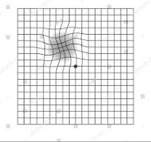

Slide 32
Ultrasonography
Lesions in the globe or the orbit may not be directly visible and are evaluated by ultrasonography. Ultrasonography is a valuable diagnostic technique, especially when the view of the retina is obscured by opaque media such as cataract or hemorrhage. An ultrasonography B-scan identifies pathology such as orbital tumors, retinal detachment, and vitreous hemorrhage. Ultrasonography A-scans are used to measure the axial length for implants prior to cataract surgery .

Slide 33
Optical Coherence
Tomography Optical coherence tomography is a technology that involves low-coherence interferometry (Gerstenblith & Rabinowitz, 2017). Light is used to evaluate retinal and macular diseases as well as anterior segment conditions. This method is noninvasive and involves no physical contact with the eye.
Fundus Photography
Fundus photography is used to detect and document retinal lesions. The patient’s pupils are usually widely dilated before the procedure. The resulting fundus photographs can be viewed stereoscopically so that elevations such as macular edema can be identified.

Slide 34
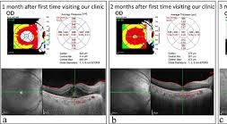

Slide 35
Laser Scanning
Various scanning techniques use laser light in the diagnostic evaluation of eye disorders. Confocal laser scanning ophthalmoscopy provides a three dimensional image of the optic nerve topography and is used alone or in conjunction with fundus photography to provide comparative data for suspected optic nerve disease such as glaucoma and papilledema (swelling of the optic disc due to increased intracranial pressure). Laser scanning polarimetry is used to measure nerve fiber layer thickness and is an important indicator of glaucoma progression.

Slide 36
Perimetry Testing
Perimetry testing evaluates the field of vision. Visual field testing (i.e., perimetry) helps identify which parts of the patient’s central and peripheral visual fields have useful vision. It is most helpful in detecting central scotomas (blind or partially blind areas in the visual field) in macular degeneration and the peripheral field defects in glaucoma and retinitis pigmentosa. Visual field evaluation and optic nerve assessment are major components of monitoring and detecting glaucoma progression.

Slide 37
Glaucoma
The term glaucoma is used to refer to a group of ocular conditions characterized by elevated IOP . If left untreated, the increased IOP damages the optic nerve and nerve fiber layer, but the degree of harm is highly variable . The optic nerve damage is related to the IOP caused by congestion of aqueous humor in the eye. A range of IOPs are considered “normal,” but these may also be associated with vision loss in some patients.

Slide 38
Glaucoma is estimated to affect three million Americans, approximately 50% of whom are undiagnosed (Moore et al., 2018). Glaucoma is more prevalent in people older than 40 years, and it is the third most common agerelated eye disease in the United States. There is no cure for glaucoma, but the disease can be controlled (Glaucoma Research Foundation, 2019).

Slide 39
Physiology
Aqueous humor flows between the iris and the lens, nourishing the cornea and lens. Most (90%) of the fluid then flows out of the anterior chamber, draining through the spongy trabecular meshwork into the canal of Schlemm and the episcleral veins (see Fig. 58-6). About 10% of the aqueous fluid exits through the ciliary body into the suprachoroidal space and then drains into the venous circulation of the ciliary body, choroid, and sclera (Norris, 2019).

Slide 40
Unimpeded outflow of aqueous fluid depends on an intact drainage system and an open angle (about 45 degrees) between the iris and the cornea. A narrower angle places the iris closer to the trabecular meshwork, diminishing the angle. The amount of aqueous humor produced tends to decrease with age, in systemic diseases such as diabetes, and in ocular inflammatory conditions.

Slide 41
RISK FACTORS
Black or Asian race
Cardiovascular disease
Diabetes
Family history of glaucoma
Migraine syndromes
Myopia (nearsightedness)
Obstructive sleep apnea
Older age
Previous eye trauma
Prolonged use of topical or systemic corticosteroids
Thin cornea

Slide 42
IOP is determined by the rate of aqueous production, the resistance encountered by the aqueous humor as it flows out of the passages, and the venous pressure of the episcleral veins that drain into the anterior ciliary vein. When aqueous fluid production and drainage are in balance, the IOP is between 10 and 21 mm Hg. When aqueous fluid is inhibited from flowing out, pressure builds up within the eye. Fluctuations in IOP occur with time of day, exertion, diet, and medications. IOP tends to increase with blinking, tight lid squeezing, and upward gazing. Systemic conditions such as diabetes and intraocular conditions such as uveitis and retinal detachment have been associated with elevated IOP. Glaucoma may not be recognized in people with thin corneas because measurement of the IOP may be falsely low as a result of this thinness.

Slide 43
Pathophysiology
There are two theories regarding how increased IOP damages the optic nerve in glaucoma. The direct mechanical theory suggests that high IOP damages the retinal layer as it passes through the optic nerve head. The indirect ischemic theory suggests that high IOP compresses the microcirculation in the optic nerve head, resulting in cell injury and death. Some glaucomas appear as exclusively mechanical, and some are exclusively ischemic types. Typically, most cases are a combination of both.

Slide 44
Classification of Glaucoma
There are several types of glaucoma. Forms of glaucoma are identified as wide-angle glaucoma; narrow-angle glaucoma; congenital glaucoma; and glaucoma associated with other conditions, such as developmental anomalies or corticosteroid use. Glaucoma can be primary or secondary, depending on whether associated factors contribute to the rise in IOP. The two common clinical forms of glaucoma in adults are wide- and narrow-angle glaucoma, which are differentiated by the mechanisms that cause impaired aqueous outflow (Norris, 2019).

Slide 45
Clinical Manifestations
Glaucoma is often called the “silent thief of sight” because most patients are unaware that they have the disease until they have experienced visual changes and vision loss. The patient may not seek health care until they experience blurred vision or “halos” around lights, difficulty focusing, difficulty adjusting eyes in low lighting, loss of peripheral vision, aching or discomfort around the eyes, and headache.

Slide 46
Assessment and Diagnostic Findings
The purpose of a glaucoma workup is to establish the diagnostic category, assess the optic nerve damage, and formulate a treatment plan. The patient’s ocular and medical history must be detailed to investigate the history of predisposing factors. The types of examinations used in glaucoma include tonometry to measure the IOP, ophthalmoscopy to inspect the optic nerve, and central visual field testing. The changes in the optic nerve related to glaucoma are pallor and cupping of the optic nerve disc.

Slide 47
Medical Management
The aim of all glaucoma treatment is prevention of optic nerve damage. Lifelong therapy is necessary because glaucoma cannot be cured. Treatment focuses on pharmacologic therapy, laser procedures, surgery, or a combination of these approaches, all of which have potential complications and side effects. The object is to achieve the greatest benefit at the least risk, cost, and inconvenience to the patient. Although treatment cannot reverse optic nerve damage, further damage can be controlled. The goal is to maintain an IOP within a range unlikely to cause further damage (Sheybani, Scott, Samuelson, et al., 2020).

Slide 48
Medications for glaucoma
Cholinergics (miotics) (pilocarpine, carbachol intraocular)
Action : Increase aqueous fluid outflow by contracting the ciliary muscle and causing miosis (constriction of the pupil) and opening of trabecular meshwork
Side effects : Periorbital pain, blurry vision, difficulty seeing in the dark
Nursing care : Caution patients about diminished vision in dimly lit areas. Pilocarpine can be stored at room temperature for up to 8 wks and then should be discarded.

Slide 49
Beta-blockers (timolol maleate)
Action : Decrease aqueous humor production
Side effects : Can have systemic effects, including bradycardia, exacerbation of pulmonary disease, and hypotension
Nursing care : Contraindicated in patients with asthma, chronic obstructive pulmonary disease, second- or third degree heart block, bradycardia, or heart failure; educate patients about punctal occlusion to limit systemic effects

Slide 50
Beta-blockers are the preferred initial topical medications because of their efficacy, minimal dosing (can be used once each day), and low cost. One eye is treated first, with the other eye used as a control in determining the efficacy of the medication; once efficacy has been established, treatment of the other eye is started. If the IOP is elevated in both eyes, both are treated. When results are not satisfactory, a new medication is substituted. The main markers of the efficacy of the medication in glaucoma control are lowering of the IOP to the target pressure, stable appearance of the optic nerve head, and the visual field.

Slide 51
Alpha-adrenergic agonists (apraclonidine, brimonidine)
Action : Decrease aqueous humor production
Side effects : Eye redness, dry mouth and nasal passages
Nursing care : Educate patients about punctal occlusion to limit systemic effects

Slide 52
Surgical Management
Surgery is reserved for patients in whom pharmacologic treatment has not controlled the IOP. This minimally invasive procedure is specifically designed to improve fluid drainage from the eye to balance IOP. By restoring the eye’s natural fluid balance, trabeculectomy surgery stabilizes the optic nerve and minimizes further visual field damage . The surgery is performed through a small incision and does not require creation of a permanent hole in the eye wall or an external filtering bleb or an implant.

Slide 53
In laser trabeculoplasty for glaucoma, a laser beam is applied to the inner surface of the trabecular meshwork to open the intratrabecular spaces and widen the canal of Schlemm, promoting outflow of aqueous humor and decreasing IOP. The procedure is indicated when IOP is inadequately controlled by medications, and it is contraindicated when the trabecular meshwork cannot be fully visualized because of a narrow angle.

Slide 54
The nurse instructs the patient to:
Know your intraocular pressure measurement and the desired range. Be informed about the extent of your vision loss and optic nerve damage. Keep a record of your eye pressure measurements and visual field test results to monitor your own progress. Review all of your medications (including over-the-counter and herbal medications) with your ophthalmologist, and mention any side effects each time you visit. Ask about potential side effects and drug interactions of your eye medications. Ask whether generic or less costly forms of your eye medications are available.

Slide 55
Review the dosing schedule with your ophthalmologist, and inform them if you have trouble following the schedule. Participate in the decision-making process. Let your primary provider know what dosing schedule works for you and other preferences regarding your eye care. Have the nurse observe you instilling eye medication to determine whether you are administering it properly

Slide 56
Be aware that glaucoma medications can cause adverse effects if used inappropriately. Eye drops are to be given as prescribed, not when eyes feel irritated. Ask your ophthalmologist to send a report to your primary provider after each appointment. Keep all follow-up appointments.

Slide 57
Cataract
is a lens opacity or cloudiness . Cataracts are responsible for visual disability in 18 million people worldwide (Norris, 2019). By 80 years of age, more than half of all Americans have cataracts. Cataracts are a leading cause of blindness in the world (Prevent Blindness America, 2020).

Slide 58
Pathophysiology
Cataracts can develop in one or both eyes at any age. The three most common types are traumatic, congenital, or senile cataract (Norris, 2019). There are a variety of risk factors, the most common one being age

Slide 59
Clinical Manifestations
Painless, blurry vision is characteristic of cataracts. The person perceives that surroundings are dimmer, as if their glasses need cleaning. Light scattering is common, and the person experiences reduced contrast sensitivity, sensitivity to glare, and reduced visual acuity. Other effects include myopic shift (return of ability to do close work [e.g., reading fine print] without eyeglasses), astigmatism (refractive error due to an irregularity in the curvature of the cornea), monocular diplopia (double vision), and color changes as lens becomes more brown in color

Slide 60
Assessment and Diagnostic Findings
Decreased visual acuity is directly proportionate to cataract density. The Snellen visual acuity test, ophthalmoscopy, and slit-lamp biomicroscopic examination are used to establish the degree of cataract formation. The degree of lens opacity does not always correlate with the patient’s functional status. Some patients can perform normal activities despite clinically significant cataracts. Others with less lens opacification have a disproportionate decrease in visual acuity; hence, visual acuity is an imperfect measure of visual impairment

Slide 61
Medical Management
No nonsurgical treatment (e.g., medications, eye drops, eyeglasses) cures cataracts or prevents age-related cataracts. Optimal medical management is prevention. Patients should be educated by primary providers about risk reduction strategies such as smoking cessation, weight reduction, optimal blood glucose control for patients with diabetes, and should be advised to wear sunglasses outdoors to prevent early cataract formation.

Slide 62
Surgical Management
In general, if reduced vision from cataract does not interfere with normal activities, surgery may not be needed. In deciding when cataract surgery is to be performed, the patient’s functional and visual status should be a primary consideration (Eliopoulos, 2018). Cataract removal is common, with more than one million such surgeries performed in the United States each year (Prevent Blindness America, 2020). Surgery is performed on an outpatient basis and usually takes less than 1 hour, with the patient being discharged in 30 minutes or less afterward.

Slide 63
Although complications from cataract surgery are uncommon, they can have significant effects on vision (see Table 58-6). Restoration of visual function through a safe and minimally invasive procedure is the surgical goal, which is achieved with advances in topical anesthesia, smaller wound incision (i.e., clear cornea incision), and lens design (i.e., foldable and more accurate intraocular lens [IOL] measurements).

Slide 64
Cataract Formation
Aging
Accumulation of a yellow-brown pigment due to the breakdown of lens protein
Clumping or aggregation of lens protein (which leads to light scattering) Decreased oxygen uptake
Decrease in levels of vitamin C, protein, and glutathione (an antioxidant)
Increase in sodium and calcium
Loss of lens transparency
Associated Ocular Conditions Infection (e.g., herpes zoster, uveitis) Myopia
Retinal detachment and retinal surgery
Retinitis pigmentosa

Slide 65
Toxic Factors
Alkaline chemical eye burns,
poisoning
Aspirin use
Calcium, copper, iron, gold, silver, and mercury, which tend to deposit in the pupillary area of the lens
Cigarette smoking
Corticosteroids, especially at high doses and in long-term use Ionizing radiation

Slide 66
Nutritional Factors :Obesity ,Poor nutrition, Reduced levels of antioxidants
Physical Factors :Blunt trauma, perforation of the lens with a sharp object or foreign body, electric shock, Dehydration associated with chronic diarrhea,
Systemic Diseases and Syndromes
Diabetes
Disorders related to lipid metabolism
Down syndrome
Musculoskeletal disorders
Renal disorders

Slide 67
Immediate Preoperative complications :
Retrobulbar hemorrhage —can result from retrobulbar infiltration of anesthetic agents
Effects : Increased IOP, proptosis, lid tightness, and subconjunctival hemorrhage with or without edema
Management : Emergent lateral canthotomy (slitting of the canthus) is performed to stop central retinal perfusion when the IOP is dangerously elevated. If this procedure fails to reduce IOP, a puncture of the anterior chamber with removal of fluid is considered. The patient must be closely monitored for at least a few hours. Postponement of cataract surgery for 2–4 wks is advised.
Complications such as iris prolapse, vitreous loss, and choroidal hemorrhage could result in a catastrophic visual outcome.

Slide 68
Intraoperative Rupture of the posterior capsule
Effects : May result in loss of vitreous Anterior vitrectomy is required if vitreous loss occurs. Suprachoroidal (expulsive) hemorrhage—profuse bleeding into the suprachoroidal space Extrusion of intraocular contents from the eye or opposition of retinal surfaces
Management : Anterior vitrectomy is required if vitreous loss occurs. Closure of the incision and administration of a hyperosmotic agent to reduce IOP or corticosteroids to reduce intraocular inflammation. Vitrectomy is performed 1– 2 wks later. Visual prognosis is poor; some useful vision may be salvaged on rare occasions.

Slide 69
Early Postoperative complications
Acute bacterial endophthalmitis— devastating complication that occurs in about 1 in 1000 cases; the most common causative organisms are Staphylococcus epidermidis, Staphylococcus aureus, Pseudomonas, and Proteus species
Effecs : Characterized by marked visual loss, pain, lid edema, hypopyon, corneal haze, and chemosis
Management : Managed by aggressive antibiotic therapy. Broad-spectrum antibiotics are given while awaiting culture and sensitivity results. Once results are obtained, the appropriate antibiotics are given via intravitreal injection. Corticosteroid therapy is also given.

Slide 70
Late postoperative complications :
Suture-related problems
Malposition of the IOL
Chronic endophthalmitis
Opacification of the posterior capsule— most common late complication of extracapsular cataract extraction

Slide 71
Phacoemulsification
In this method of extracapsular cataract surgery, a portion of the anterior capsule is removed, allowing extraction of the lens nucleus and cortex while the posterior capsule and zonular support are left intact. An ultrasonic device is used to liquefy the nucleus and cortex, which are then suctioned out through a tube. An intact zonular–capsular diaphragm provides the needed safe anchor for the posterior chamber IOL. The pupil is dilated to 7 mm or greater (Shaw & Lee, 2017). The surgeon makes a small incision on the upper edge of the cornea and a viscoelastic substance (clear gel) is injected into the space between the cornea and the lens. This prevents the space from collapsing and facilitates insertion of the IOL. Because the incision is smaller than the manual extracapsular cataract extraction, the wound heals more rapidly, and there is early stabilization of refractive error and less astigmatism.

Slide 72
Lens Replacement
After removal of the crystalline lens, the patient is referred to as aphakic (i.e., without lens). The lens, which focuses light on the retina, must be replaced for the patient to see clearly. There are three lens replacement options: aphakic eyeglasses, contact lenses, and IOL implants. Aphakic glasses, although effective, are rarely used. Objects are magnified by 25%, making them appear closer than they actually are. This magnification creates distortion. Peripheral vision is also limited, and binocular vision (i.e., ability of both eyes to focus on one object and fuse the two images into one) is impossible if the other eye is aphakic (without a natural lens).

Slide 73
Contact lenses provide patients with almost normal vision, but because contact lenses need to be removed occasionally, the patient also needs a pair of aphakic glasses. Contact lenses are not advised for patients who have difficulty inserting, removing, and cleaning them.

Slide 74
Insertion of IOLs during cataract surgery is the most common approach to lens replacement . After cataract extraction, or phacoemulsification, the surgeon implants an IOL. Cataract extraction and posterior chamber IOLs are associated with a relatively low incidence of complications (e.g., eye infection, loss of vitreous humor, slipping of the implant) (Eliopoulos, 2018). IOL implantation is contraindicated in patients with recurrent uveitis, proliferative diabetic retinopathy, neovascular glaucoma, or rubeosis iridis.

Slide 75
Providing Preoperative Care
The patient with cataracts receives the usual preoperative care for ambulatory surgical patients undergoing eye surgery. The standard battery of preoperative tests (e.g., complete blood count, electrocardiogram, urinalysis) commonly performed for most surgeries is prescribed only if indicated by the patient’s medical history. Alpha-antagonists (particularly tamsulosin, which is used for treatment of enlarged prostate) are known to cause a condition called intraoperative floppy iris syndrome. Alpha-antagonists can interfere with pupil dilation during the surgical procedure, resulting in miosis and iris prolapse and leading to complications.

Slide 76
Intraoperative floppy iris syndrome can occur even though a patient has stopped taking the drug. The nurse needs to ask patients about a history of taking alpha-antagonists. Surgical team members are then alerted to the risk of this complication (Comerford & Durkin, 2020). Dilating drops are given prior to surgery. Nurses in the ambulatory surgery setting begin patient education about eye medications (antibiotic, corticosteroid, and anti-inflammatory drops) that will need to be self administered to prevent postoperative infection and inflammation.

Slide 77
Providing Postoperative Care
Before discharge, the patient receives verbal and written education regarding eye protection, administration of medications, recognition of complications, activities to avoid, and obtaining emergency care . An eye shield is usually worn at night for the first week to avoid injury. The nurse also explains that there should be minimal discomfort after surgery and educates the patient about taking a mild analgesic agent, such as acetaminophen, as needed. Antibiotic, anti-inflammatory, and corticosteroid eye drops or ointments are prescribed postoperatively. Patients prescribed antiinflammatory or corticosteroid eye drops are monitored for possible increases in IOP

Slide 78
Thank you

