Slide 1
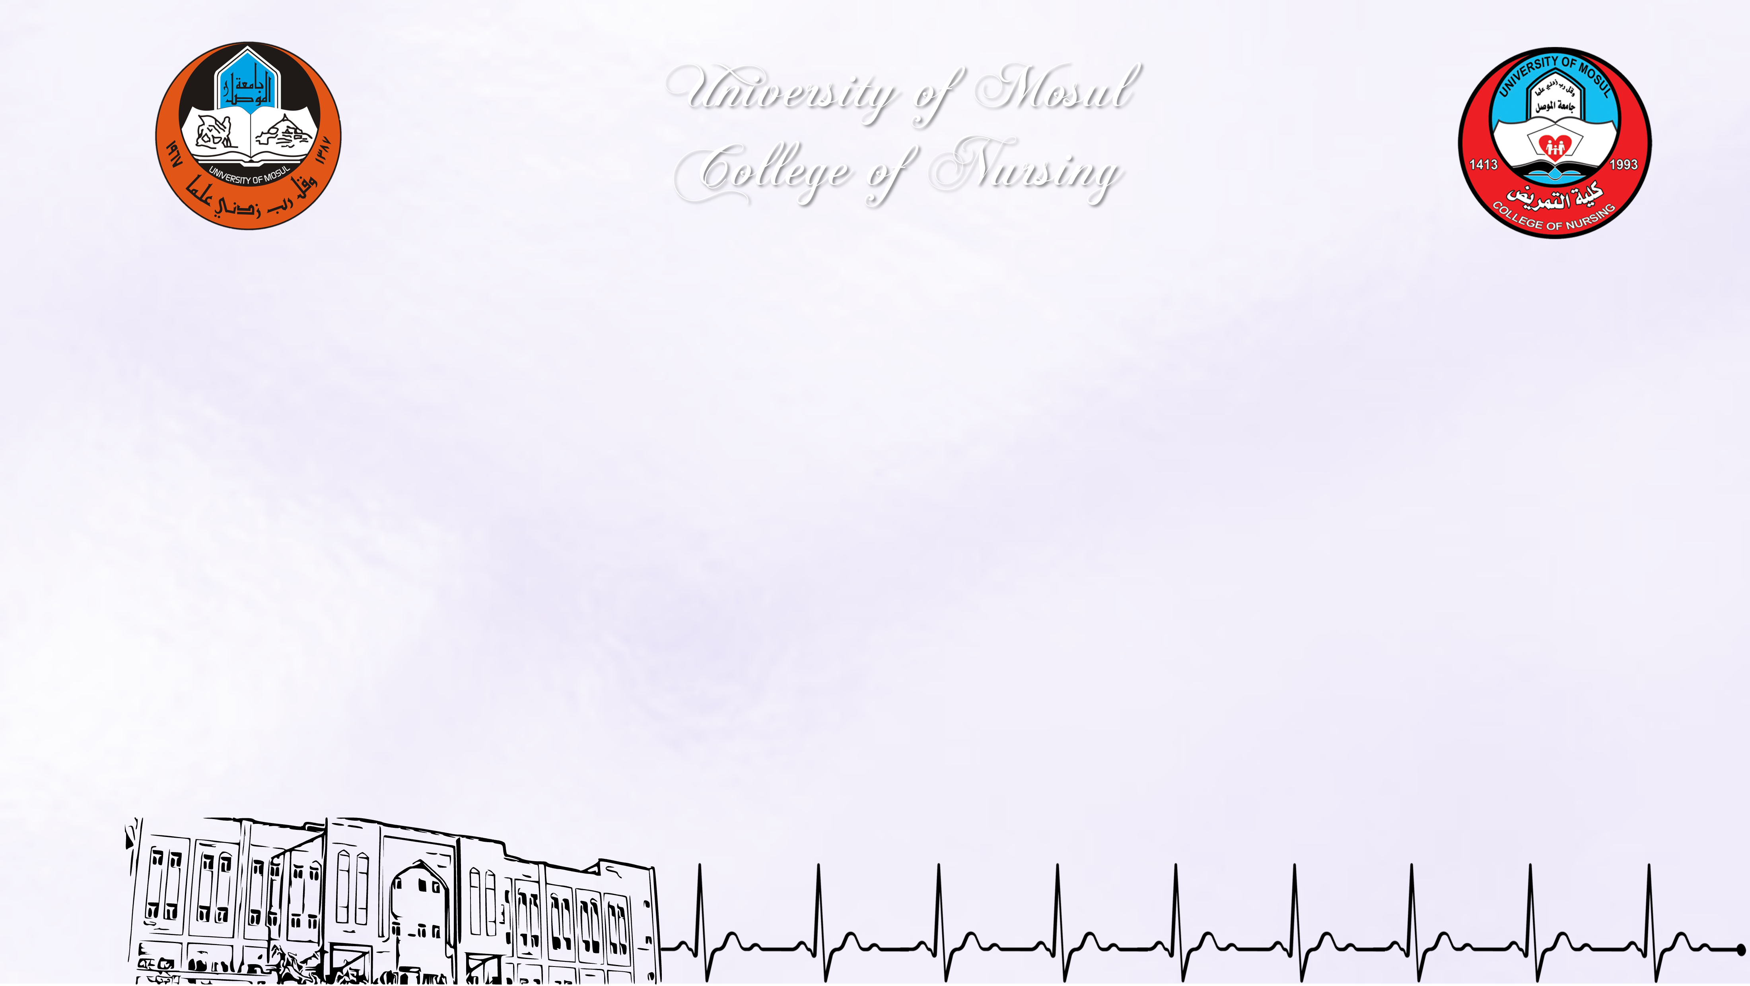
Evaluation of nursing college students’ knowledge about the signs and symptoms of vitamin D3 deficiency
By
Nebras Younis Mohammed |  | Yamama Azaam Hussein
Rahaf wahaab shihab |  | Maryam abdul jabbar
Eman dahham jassam
Supervised by
Rami Ramadhan Allo
Assistant Professor

Slide 2

Introduction
Vitamin D is a fat-soluble vitamin that plays an important role in calcium homeostasis and bone metabolism. Vitamin D deficiency can lead to osteomalacia and rickets in children and osteomalacia in adults. The fortification of milk with vitamin D in the 1930s was effective in eradicating rickets in the world. However, subclinical vitamin D deficiency is still widely prevalent in both developed and developing countries, with a worldwide prevalence of up to 1 billion.
This subclinical Vitamin-D deficiency is associated with osteoporosis, increased risk of falls, and fragility fractures. Many conflicting recent studies are now showing an association between vitamin D deficiency and cancer, cardiovascular disease, diabetes, autoimmune diseases, and depression.

Slide 3
Study Objectives
To assess the Knowledge of Nursing Students about vitamin D3 deficiency

Slide 4
Methodology – Study Design
The study is intended to use a descriptive study design.

Slide 5
Methodology – Sample & Sampling
150 Nursing Students were selected from three grades (second, third, fourth), from each grade 50 students from college of nursing \ University of Mosul.

Slide 6
Methodology – Setting & Study tools
The tool used in the study was constructed checklist , Interview method was depended in collecting data from the samples of the study in order to complete the checklist sheet. Each interview lasts (15) minutes in the nursing college halls.

Slide 7
Study Results
table )1(demographical data of the study sample
Gender | No. | %
Male | 96 | 64.0%
Female | 54 | 36.0%
Total | 150 | 100.0%
Stage | No. | %
Second | 50 | 33.3%
Third | 50 | 33.3%
Fourth | 50 | 33.3%
Total | 150 | 100.0%
This table show the majority of the sample are male (64.0%)

Slide 8
Study Results
Table )2(Frequencies and percentages of answers from the study sample
No. | Questions | True answer | False answer | Doesn't know the answer
1 | One of the most important sources of vitamin D is exposure to the sun. | 138 (92%) | 10 (6.7%) | 2 (1.3%)
2 | Food sources of vitamin D are fish, egg yolks, and beef liver. | 122 (81.3%) | 17 (11.3%) | 11 (7.3%)
3 | Malabsorption is not considered an obstacle to the level of vitamin D | 37 (24.7%) | 87 (58.0%) | 26 (17.3%)
4 | Some medications affect the level of vitamin D in the body | 123 (82.0%) | 18 (12.0%) | 9 (6.0%)
5 | Vitamin D is considered a fat-soluble vitamin. | 81 (54.0%) | 32 (21.3%) | 37 (24.7%)
6 | Vitamin D tablets, or supplements should be taken in the evening | 59 (39.3%) | 67 (44.7%) | 24 (16.0%)
7 | (20) thousand international units is the daily dose required for the adult human body | 33 (22.0%) | 45 (30.0%) | 72 (48.0%)
8 | The normal range for vitamin D levels in humans is 25 to 50 | 47 (31.3%) | 40 (26.7%) | 63 (42.0%)
9 | The best time to be exposed to the sun is noon for 15 minutes. | 56 (37.3%) | 85 (56.7%) | 9 (6.0%)
10 | Oily fish such as: salmon, tuna and sardines are full of vitamin D. | 117 (78.0%) | 22 (14.7%) | 11 (7.3%)
11 | Vitamin D is important and facilitates the absorption of calcium and phosphorus in the body. | 92 (61.3%) | 28 (18.7%) | 30 (20.0%)

Slide 9
Study Results
Table )2(Frequencies and percentages of answers from the study sample
12 | Vitamin D deficiency is linked to type 2 diabetes | 35 (23.3%) | 84 (56.0%) | 31 (20.7%)
13 | Vitamin D deficiency leads to weakness and hair loss. | 122 (81.3%) | 20 (13.3%) | 8 (5.3%)
14 | Vitamin D deficiency does not affect wound healing. | 66 (44.0%) | 60 (40.0%) | 24 (16.0%)
15 | Vitamin D deficiency leads to weak immunity and frequent infections | 97 (64.7%) | 42 (28.0%) | 11 (7.3%)
16 | Vitamin D deficiency does not affect the muscles and bones and their weakness | 33 (22.0%) | 109 (72.7%) | 8 (5.3%)
17 | One of the symptoms of vitamin D deficiency is feeling depressed. | 95 (63.3%) | 36 (24.0%) | 19 (12.7%)
18 | Symptoms of vitamin D deficiency include feeling constantly exhausted and tired | 128 (85.3%) | 12 (8.0%) | 10 (6.7%)
19 | Bone, muscle and joint pain is one of the most important symptoms of vitamin D deficiency. | 117 (78.0%) | 25 (16.7%) | 8 (5.3%)
20 | Vitamin D deficiency leads to weak teeth | 102 (68.0%) | 34 (22.7%) | 14 (9.3%)
21 | Vitamin D deficiency causes Osteomalacia and curvature of the legs in children | 108 (72.0%) | 22 (14.7%) | 20 (13.3%)
22 | Osteoporosis is an independent disease and is not related to vitamin D deficiency. | 56 (37.3%) | 83 (55.3%) | 11 (7.3%)
This table shows a general weakness in nursing students’ knowledge about vitamin D3 and the effects resulting from its deficiency in the body

Slide 10
Conclusion & Recommendations
Conclusion:
The study concluded that there is a general weakness in students’ knowledge regarding the causes, factors, and treatments for vitamin D3 deficiency.
Recommendation:
The study recommends the need to focus on academic curricula related to causes, sources, treatment and prevention of Vitamin D3 deficiency. and to hold ongoing courses and workshops on this field to increase awareness and knowledge of the nursing students.

Slide 11


