Slide 1
Relationships between basic and advanced sciences
Dr. Thamer Abduljabbar

Slide 2
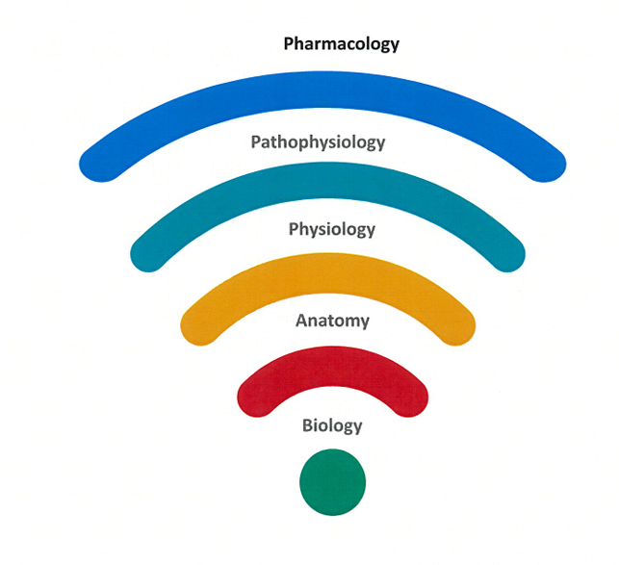

Slide 3
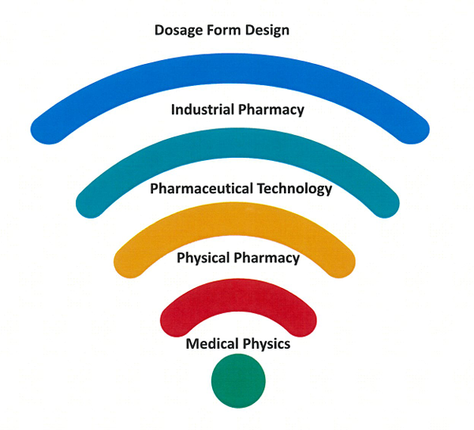

Slide 4
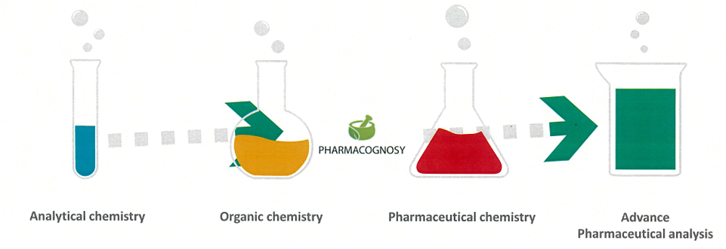

Slide 5
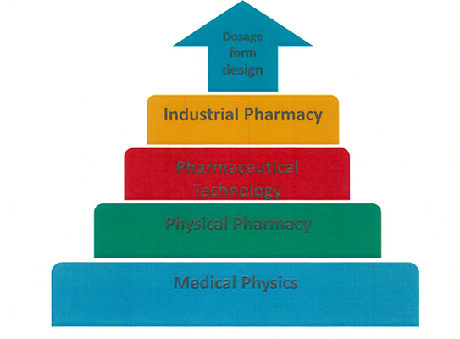

Slide 6
Interaction between basic and advanced sciences

Slide 7
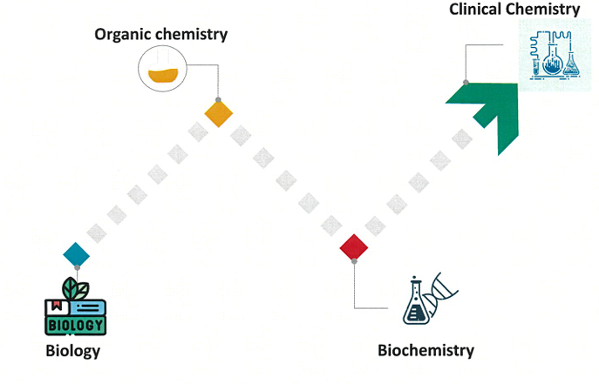

Slide 8
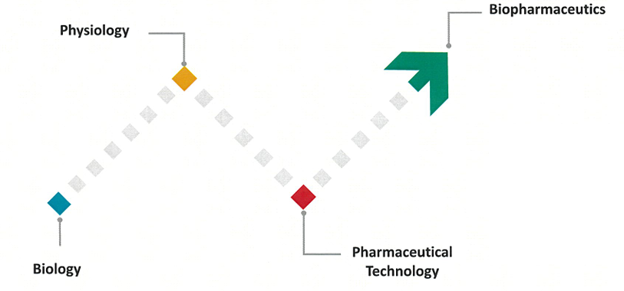

Slide 9
