Slide 1
Mosul University
College of science Energy Department
New & renewable
Circuit Analysis
New & renewable Energy Department 2nd class
Lecturer
Dr. Ibtisam Yahya Abdullah
2024-2025

Slide 2
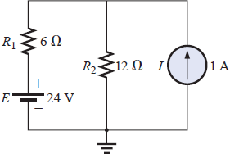
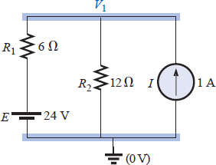
Since I₁ and I₂ are positive and flow in opposite directions through the 6-resistor and 10-V source, the total current in this branch is equal to the difference of the two currents in the direction of the larger:
I₂ > I₁ (2 A > 1 A)
Therefore,
IR₂ = I₂ - I₁ = 2 A - 1 A = 1 A in the direction of I₂
Nodal Analysis
Determine the number of nodes within the network.
Pick a reference node, and label each remaining node with a subscripted value of voltage: V₁, V₂, and so on.
Apply Kirchhoff’s current law at each node except the reference.
Assume that all unknown currents leave the node for each application of Kirchhoff’s current law. In other words, for each node, don’t be influenced by the direction that an unknown current for another node may have had. Each node is to be treated as a separate entity, independent of the application of Kirchhoff’s current law to the other nodes.
Solve the resulting equations for the nodal voltages.
EXAMPLE 3 Apply nodal analysis to the network of Fig. 63.
Figure 62 Example 3
Solution:
Steps 1 and 2: The network has two nodes, as shown in Fig. 64. The lower node is defined as the reference node at ground potential (zero volts), and the other node as V₁, the voltage from node 1 to ground.
Step 3: I₁ and I₂ are defined as leaving the node in
Fig. 65, and Kirchhoff’s current law is applied as follows:
Figure 63 Network of Fig. 63 with assigned nodes.

Slide 3
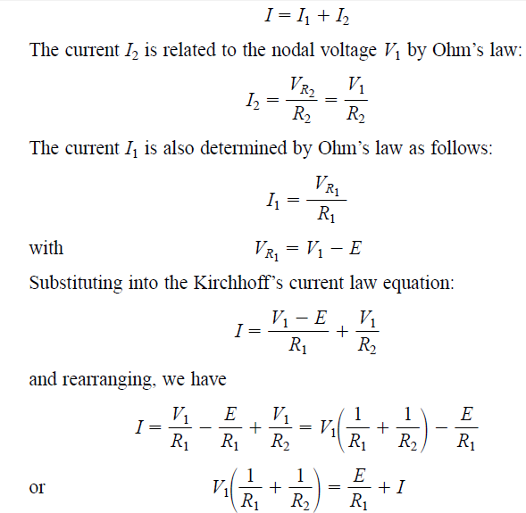
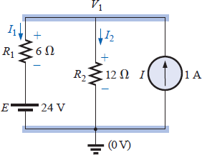
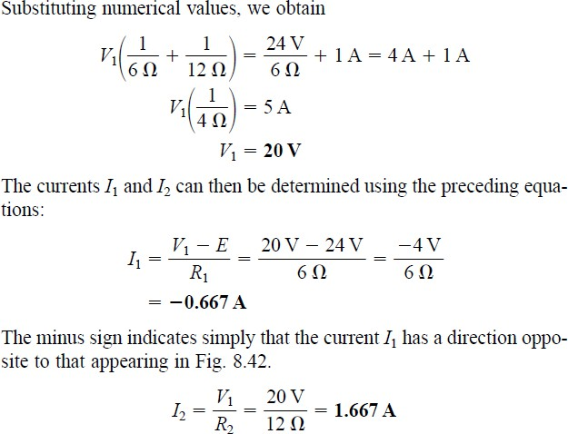
Figure 64 Applying Kirchhoff’s current law to the node V1.

Slide 4
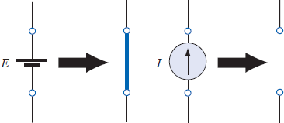
Superposition Theorem
The superposition theorem states the following:
The current through, or voltage across, an element in a linear bilateral network is equal to the algebraic sum of the currents or voltages produced independently by each source.
When one is applying the theorem, it is possible to consider the effects of two sources at the same time and reduce the number of networks that have to be analyzed, but, in general,
Number of networks Number of to be analyzed =independent sources
remove a voltage source when applying this theorem, the difference in potential between the terminals of the voltage source must be set to zero (short circuit); removing a current source requires that its terminals be opened (open circuit). Any internal resistance or conductance associated with the displaced sources is not eliminated but must still be considered.
Figure 66 reviews the various substitutions required when removing an ideal source, and Figure 67 reviews the substitutions with practical sources that have an internal resistance.
Figure 65 Removing the effects of ideal sources. R R_{int} I _{int}
Figure 66 Removing the effects of practical sources.
The total current through any portion of the network is equal to the algebraic sum of the currents produced independently by each source. That is, for a two-source network, if the current produced by one source is in one direction, while that produced by the other is in the opposite direction through the same resistor, the resulting current is the difference of the two and has the direction of the larger. If

