Slide 1
Mosul University
College of science Energy Department
New & renewable
Circuit Analysis
New & renewable Energy Department 2nd class
Lecturer
Dr. Ibtisam Yahya Abdullah
2024-2025

Slide 2
Circuit Analysis
In principle, three sets of equations are sufficient to perform circuit analysis for any circuit, which are Kirchoff’s current law (KCL), Kirchoff’s voltage law (KVL), and branch element equations (e.g., Ohm’s law). The KCL and KVL characterize the circuit topology, i.e., how the circuit elements are connected. In contrast, the branch element equation characterizes the circuit element's physical property, specifically, the current-voltage relation.
Series Circuits
A circuit consists of any number of elements joined at terminal points, providing at least one closed path through which charge can flow. The circuit of Fig. 3(a) has three elements joined at three terminal points (a, b, and c) to provide a closed path for the current I.

Slide 3
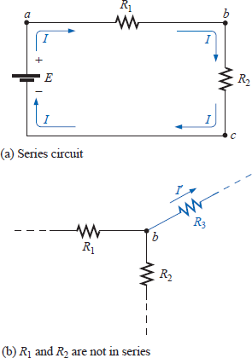
Figure 3 a. Series circuit, b. not series
Two elements are in a series if
They have only one terminal in common (i.e., one lead of one is connected to only one lead of the other).
The common point between the two elements is not connected to another current-carrying element.
In Fig. 3(a), the resistors R₁ and R₂ are in series because they have only point b in common. The other ends of the resistors are connected elsewhere in the circuit. For the same reason, the battery E and resistor R₁ are in series (terminal a in common), and the resistor R₂ and the battery E are in series (terminal c in common). Since all the elements are in series, the network is called a series circuit. Two common examples of series connections include the tying of small pieces of rope together to form a longer rope and the connecting of pipes to get water from one point to another.
If the circuit of Fig. 3(a) is modified such that a current-carrying resistor R₃ is introduced, as shown in Fig. 3(b), the resistors R₁ and R₂ are no longer in series due to a violation of number 2 of the above definition of series elements.
The current is the same through series elements.

Slide 4
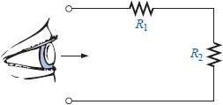
For the circuit of Fig. 3(a), therefore, the current I through each resistor is the same as that through the battery. The fact that the current is the same through series elements is often used as a path to determine whether two elements are in series or to confirm a conclusion.
A branch of a circuit is any portion of the circuit that has one or more elements in series. In Fig. 3(a), the resistor R1 forms one branch of the circuit, the resistor R₂ another and the battery E a third.
The total resistance of a series circuit is the sum of the resistance levels.
In Fig. 3(a), for example, the total resistance (R_{T}) is equal to R₁+ R₂. Note that the
total resistance is actually the resistance “seen” by the battery as it “looks” into the series combination of elements as shown in Fig. 4.
Figure 4 Resistance “seen” by source
In general, to find the total resistance of N resistors in series, the following equation is applied:
𝑅 = 𝑅1 + 𝑅2 + 𝑅3 ± ⋯ 𝑅N (ohm Ω)
Once the total resistance is known, the circuit of Fig. 3(a) can be redrawn as shown in Fig. 5, clearly revealing that the only resistance the source “sees” is the total resistance. It is totally unaware of how the elements are connected to establish R_{T}.

Slide 5
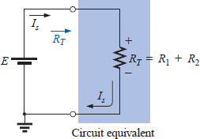
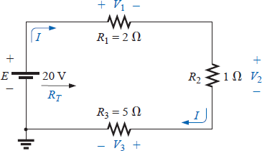
Figure 5 Total resistance.
Once R_{T} is known, the current drawn from the source can be determined using Ohm’s law, as follows:
𝐸
𝐼 = (A)
𝑠
𝑅_{𝑇}
Since E is fixed, the magnitude of the source current will be totally dependent on the magnitude of R_{T}. A larger RT will result in a relatively small value of Is, while lesser values of R_{T} will result in increased current levels.
The fact that the current is the same through each element of Fig. 3(a) permits a
direct calculation of the voltage across each resistor using Ohm’s law; that is,
𝑉1 = 𝐼𝑅1 , 𝑉2 = 𝐼𝑅, 𝑉N = 𝐼𝑅N
The power delivered to each resistor can then be determined using any one of three equations as listed below for R₁:
_{𝑉}2
𝑃₁ = 𝑉₁𝐼₁ = 𝐼²𝑅₁ =
1
𝑅₁
(Watt)
1
The power delivered by the source is
𝑃_{𝑑𝑒𝑙} = 𝐸𝐼 (Watt)
The total power delivered to a resistive circuit is equal to the total power dissipated by the resistive elements.
That is,
𝑃_{𝑑𝑒𝑙} = 𝑃₁ + 𝑃₂ + 𝑃₃ + ⋯ + 𝑃_{𝑁}
EXAMPLE 1
Find the total resistance for the series circuit of Fig. 6.
Calculate the source current Is.
Determine the voltages V₁, V₂, and V₃.
Calculate the power dissipated by R₁, R₂, and R₃.
Determine the power delivered by the source,
and compare it to the sum of the power levels of part (d).
Figure 6 Example 1

Slide 6
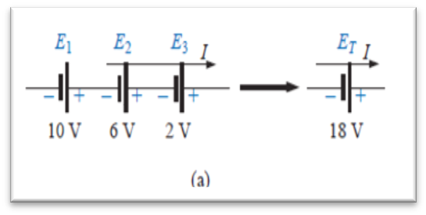
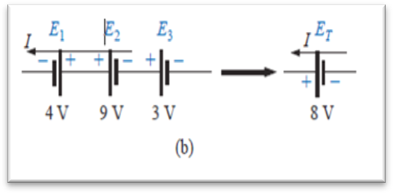
Solution:
a- 𝑅 = 𝑅1 + 𝑅2 + 𝑅₃ = 2 + 1 + 5 = 8 Ω
b-
c-
𝐸
𝐼 = = ^{20𝑉} = 2.5𝐴
𝑠
𝑅_{𝑇} 8 Ω
𝑉₁ = 𝐼𝑅₁ = 2.5 × 2 = 5𝑉
𝑉₂ = 𝐼𝑅₂ = 2.5 × 1 = 2.5𝑉
𝑉₃ = 𝐼𝑅₃ = 2.5 × 5 = 12.5𝑉
d- 𝑃₁ = 𝑉₁𝐼₁ = 5 × 2.5 = 12.5 𝑊
𝑃₂ = 𝐼²𝑅₂ = (2.5)² × 2 = 6.25 𝑊
2
_{𝑉}2
(12.5)²
𝑃 =
3 ₌
= 31.25 𝑊
3
𝑅₃ 5
e- 𝑃_{𝑑𝑒𝑙} = 𝐸𝐼 = 20 × 2.5 = 50 𝑊
𝑃_{𝑑𝑒𝑙} = 𝑃₁ + 𝑃₂ + 𝑃₃
50 𝑊 = 12.5 + 6.25 + 31.25 = 50 𝑊
Voltage Sources in Series
Voltage sources can be connected in series, as shown in Fig. 7, to increase or decrease the total voltage applied to a system. The net voltage is determined simply by summing the sources with the same polarity and subtracting the total of the sources with the opposite “pressure.” The net polarity is the polarity of the larger sum.
Figure 7 Voltage sources
In Fig. 7(a), for example, the sources are all “pressuring” current to the right, so the net voltage is
𝐸_{𝑇} = 𝐸₁ + 𝐸₂ + 𝐸₃ = 10 + 6 + 2 = 18 𝑉
as shown in the figure. In Fig. 5.10(b), however, the greater “pressure” is to the left, with a net voltage of
𝐸_{𝑇} = 𝐸₂ + 𝐸₃ − 𝐸₁ = 9 + 3 − 4 = 8 𝑉
and the polarity shown in the figure.

