Slide 1
Mosul University
College of science Energy Department
New & renewable
Circuit Analysis
New & renewable Energy Department 2nd class
Lecturer
Dr. Ibtisam Yahya Abdullah
2024-2025

Slide 2
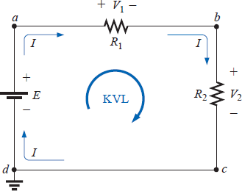
Kirchhoff’s Voltage Law
Kirchhoff’s voltage law (KVL) states that the algebraic sum of the potential rises and drops around a closed loop (or path) is zero.
A closed loop is any continuous path that leaves a point in one direction and returns to that same point from another direction without leaving the circuit. In Fig. 8, by following the current, we can trace a continuous path that leaves point a through R₁ and returns through E without leaving the circuit. Therefore, abcda is a closed loop. For us to be able to apply Kirchhoff’s voltage law, the summation of potential rises and drops must be made in one direction around the closed loop.
Figure 8 Applying Kirchhoff’s voltage law to a series dc circuit.
For uniformity, the clockwise (CW) direction will be used throughout the text for all applications of Kirchhoff’s voltage law. Be aware, however, that the same result will be obtained if the counterclockwise (CCW) direction is chosen and the law applied correctly.
A plus sign is assigned to a potential rise (- to +), and a minus sign to a potential drop (+ to -). If we follow the current in Fig. 8 from point a, we first encounter a potential drop V₁ (+ to -) across R₁ and then another potential drop V₂ across R₂. Continuing through the voltage source, we have a potential rise E (- to +) before returning to point a. In symbolic form, where Σ represents summation, the closed loop, and V the potential drops and rises, we have
∑ 𝑉 = 0 (Kirchhoff’s voltage law in symbolic form)

Slide 3
which for the circuit of Fig. 8 yields (clockwise direction, following the current I
and starting at point d):
+𝐸 − 𝑉₁ − 𝑉₂ = 0
or
𝐸 = 𝑉₁ + 𝑉₂
revealing that the applied voltage of a series circuit equals the sum of the voltage drops across the series elements.
Kirchhoff’s voltage law can also be stated in the following form:
^{∑ 𝑉}rises ^{= ∑ 𝑉}drops
which in words states that the sum of the rises around a closed loop must equal the
sum of the drops in potential. The text will emphasize the use of Eq. above, however.
If the loop were taken in the counterclockwise direction starting at point a, the following would result:
∑ 𝑉 = 0
−𝐸 + 𝑉₁ + 𝑉₂ = 0
or, as before,
𝐸 = 𝑉₁ + 𝑉₂
The application of Kirchhoff’s voltage law need not follow a path that includes
current-carrying elements.
For example, in Fig. 9 there is a difference in potential between points a and b, even though the two points are not connected by a current-carrying element. Application of Kirchhoff’s voltage law around the closed loop will result in a difference in potential of 4 V between the two points. That is, using the clockwise direction:

Slide 4
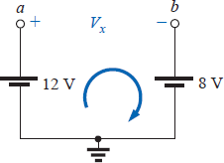
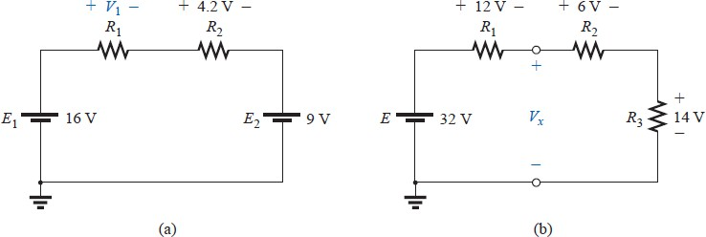
Figure 9 Demonstration that a voltage can exist between two points not connected by a current carrying conductor
+12𝑉 − 𝑉_{𝑥} − 8𝑉 = 0
𝑉_{𝑥} = 4 𝑉
and
EXAMPLE 2. Determine the unknown voltages for the networks of Fig. 10.
Figure 10 Example 2
Solution: When applying Kirchhoff’s voltage law, be sure to concentrate on the polarities of the voltage rise or drop rather than on the type of element. In other words, do not treat a voltage drop across a resistive element differently from a voltage drop across a source. If the polarity dictates that a drop has occurred, that is the important fact when applying the law. In Fig. 10(a), for instance, if we choose the clockwise direction, we will find that there is a drop across the resistors R1 and R₂ and a drop across the source E₂. All will therefore have a minus sign when Kirchhoff’s voltage law is applied. Application of Kirchhoff’s voltage law to the circuit of Fig. 10(a) in the clockwise direction will result in
+𝐸₁ − 𝑉₁ − 𝑉₂ − 𝐸₂ = 0
and
𝑉₁ = 𝐸₁ − 𝑉₂ − 𝐸₂ = 16𝑉 − 4. 2𝑉 − 9𝑉 = 2. 8𝑉

Slide 5
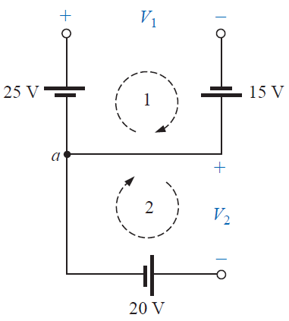
The result clearly indicates that there was no need to know the values of the resistors or the current to determine the unknown voltage. Sufficient information was carried by the other voltage levels to permit a determination of the unknown.
In Fig. 10(b) the unknown voltage is not across a current-carrying element.
However, as indicated in the paragraphs above, Kirchhoff’s voltage law is not limited to current-carrying elements. In this case there are two possible paths for finding the unknown. Using the clockwise path, including the voltage source E, will result in
+𝐸 − 𝑉₁ − 𝑉_{𝑥} = 0
and
𝑉_{𝑥} = 𝐸 − 𝑉₁ = 32𝑉 − 12𝑉 = 20𝑉
Using the clockwise direction for the other loop involving R₂ and R₃ will result in
+𝑉_{𝑥} − 𝑉₂ − 𝑉₃ = 0
and
𝑉_{𝑥} = 𝑉₂ + 𝑉₃ = 6𝑉 + 14𝑉 = 20𝑉
matching the result above.
EXAMPLE 3 Find V₁ and V₂ for the network of Fig. 11.
Solution: For path 1, starting at point a in a clockwise direction
+25𝑉 − 𝑉₁ − 15𝑉 = 0
and
:
𝑉₁ = 40𝑉
For path 2, starting at point a in a clockwise direction:
Figure 11 Example 3
−𝑉₂ − 20 = 0
and
𝑉₂ = −20𝑉
The minus sign simply indicates that the actual polarities of the potential difference are opposite the assumed polarity indicated in Fig. 11.

Slide 6
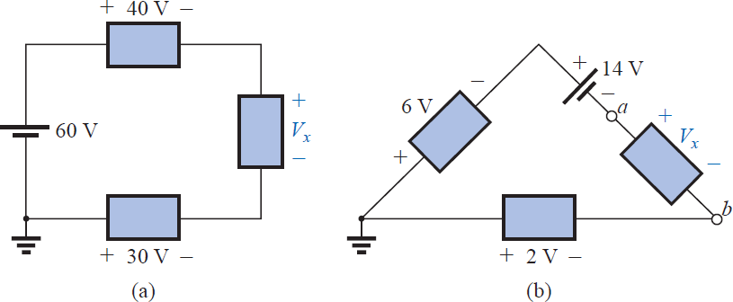
The next example will emphasize the fact that when we are applying Kirchhoff’s voltage law, it is the polarities of the voltage rise or drop that are the important parameters, and not the type of element involved.
EXAMPLE 4 Using Kirchhoff’s voltage law, determine the unknown voltages for the network of Fig. 12.
Figure 12 Example4
Solution: Note in each circuit that there are various polarities across the unknown elements since they can contain any mixture of components. Applying Kirchhoff’s voltage law to the network of Fig. 12 (a) in the clockwise direction will result in
60𝑉 − 40𝑉 − 𝑉_{𝑥} + 30𝑉 = 0
and
𝑉_{𝑥} = 60𝑉 + 30𝑉 − 40𝑉 = 90𝑉 − 40𝑉 = 50𝑉
In Fig. 5.16(b) the polarity of the unknown voltage is not provided. In such cases, make an assumption about the polarity, and apply Kirchhoff’s voltage law as before. If the result has a plus sign, the assumed polarity was correct. If it has a minus sign, the magnitude is correct, but the assumed polarity has to be reversed. In this case if we assume a to be positive and b to be negative, an application of Kirchhoff’s voltage law in the clockwise direction will result in
−6𝑉 − 14𝑉 − 𝑉_{𝑥} + 2𝑉 = 0
and
𝑉_{𝑥} = −20𝑉 + 2𝑉 = −18𝑉
Since the result is negative, we know that a should be negative and b should be positive, but the magnitude of 18V is correct.

Slide 7
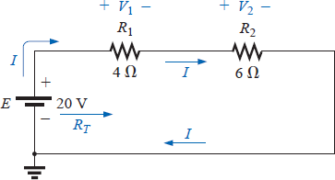
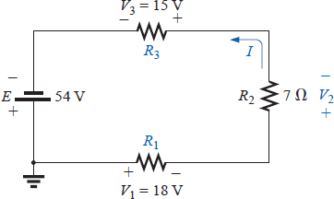
EXAMPLE 5 For the circuit of Fig. 13:
Find R_{T}.
Find I.
Find V₁ and V₂.
Find the power to the 4Ω and 6Ω resistors.
Find the power delivered by the battery, and compare it to that dissipated by the
4Ω and 6Ω resistors combined.
Verify Kirchhoff’s voltage law (clockwise direction)
Solutions:
.
a- 𝑅_{𝑇} = 𝑅₁ + 𝑅₂ = 4Ω + 6Ω = 10Ω
b- 𝐼 =
𝐸 ₌ 20𝑉 _{= 2𝐴}
Figure 13 Example 5
𝑅_{𝑇} 10Ω
c- 𝑉₁ = 𝐼𝑅₁ = (2𝐴)(4Ω) = 8𝑉
𝑉₂ = 𝐼𝑅₂ = (2𝐴)(6Ω) = 12𝑉
𝑉² 8²
d- 𝑃_{4Ω} = ¹ = = 16 w
𝑅₁ 4
𝑃_{6Ω} = 𝐼²𝑅₂ = 2² × 6 = 24 𝑊
e- 𝑃_{𝑒} = 𝐸𝐼 = 20 × 2 = 40𝑊
𝑃_{𝐸} = 𝑃_{4Ω} + 𝑃_{6Ω} ⇒ 40𝑊 = 16w + 24𝑊
40W = 40W
f- ∑ 𝑉 = +𝐸 − 𝑉₁ − 𝑉₂ = 0
𝐸 = 𝑉₁ + 𝑉₂
20𝑉 = 8𝑉 + 12𝑉 = 20𝑉
EXAMPLE 6 For the circuit of Fig. 14:
a. Determine V₂ using Kirchhoff’s voltage law.
Figure 14 Example 6

