Slide 1
Mosul University
College of science Energy Department
New & renewable
Circuit Analysis
New & renewable Energy Department 2nd class
Lecturer
Dr. Ibtisam Yahya Abdullah
2024-2025

Slide 2
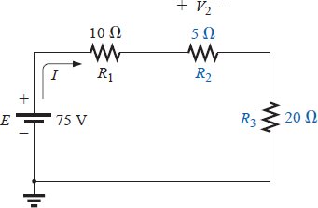
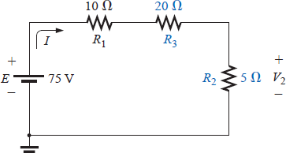
b. Determine I.
c. Find R₁ and R₃.
Solutions:
Kirchhoff’s voltage law (clockwise direction):
−𝐸 + 𝑉₃ + 𝑉₂ + 𝑉₃ = 0
or
𝐸 = 𝑉₃ + 𝑉₂ + 𝑉₃
and
𝑉₂ = 𝐸 − 𝑉₁ − 𝑉₃ = 54V − 18V − 15V = 21V
𝐼 =
𝑅 =
𝑉₂ ₌ 21𝑉 _{= 3𝐴}
𝑅₂ 7Ω
1
𝑉₁ ₌ 18𝑉 _{= 6Ω}
d. 𝑅 =
𝐼 3𝐴
𝑉₃ ₌ 15𝑉 _{= 5Ω}
𝐼 3𝐴
3
Interchanging Series Elements
The elements of a series circuit can be interchanged without affecting the total resistance, current, or power to each element. For instance, the network of Fig.15 can be redrawn as shown in Fig. 16 without affecting I or V₂. The total resistance R_{T} is 35Ω in both cases, and I =70 V/35Ω=2 A. The voltage V₂ =IR₂ = (2A)(5Ω)=10 V for both configurations
Figure 15 Series dc circuit with elements to be interchanged.
Figure 16 Circuit of Fig. 15 with R₂ and R₃ interchanged.

Slide 3
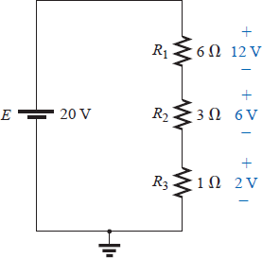
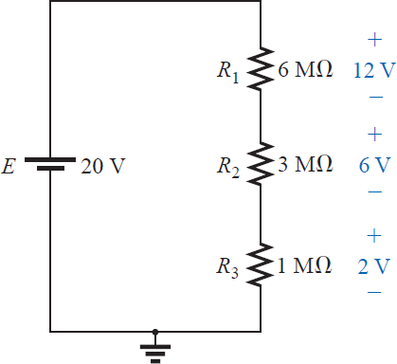
Voltage Divider Rule
In a series circuit, the voltage across the resistive elements will divide as the magnitude of the resistance levels.
For example, the voltages across the resistive elements of Fig. 17 are provided. The largest resistor of 6Ω captures the bulk of the applied voltage, while the smallest resistor R₃ has the least. Note in addition that, since the resistance level of R₁ is 6 times that of R₃, the voltage across R₁ is 6 times that of R₃. The fact that the resistance level of R₂ is 3 times that of R₁ results in three times the voltage across R₂. Finally, since R₁ is twice R₂, the voltage across R₁ is twice that of R₂. In general, therefore, the voltage across series resistors will have the same ratio as their resistance levels.
Figure 16 Revealing how the voltage will divide across series resistive elements.
It is particularly interesting to note that, if the resistance levels of all the resistors of Fig. 17 are increased by the same amount, as shown in Fig. 18, the voltage levels will all remain the same. In other words, even though the resistance levels were increased by a factor of 1 million, the voltage ratios remain the same. Clearly, therefore, it is the ratio of resistor values that counts when it comes to voltage division and not the relative magnitude of all the resistors. The current level of the network will be severely affected by the change in resistance level from Fig. 17 to Fig. 18, but the voltage levels will remain the same.
Figure 17 The ratio of the resistive values determines the voltage division of a series dc circuit

Slide 4
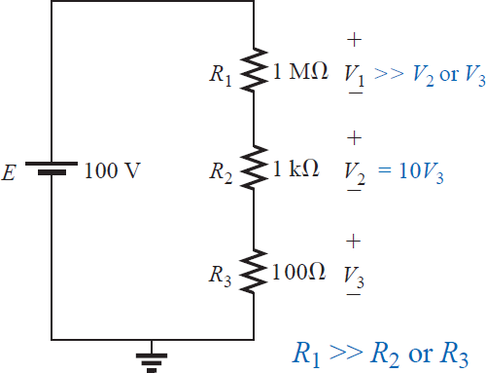
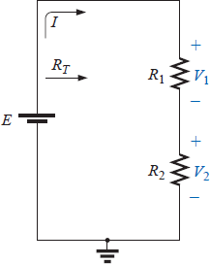
Based on the above, a first glance at the series network of Fig. 19 should suggest that the major part of the applied voltage will appear across the 1M Ω resistor and very little across the 100- Ω resistor. In fact, 1 M Ω = (1000)1 k Ω (10,000)100 Ω, revealing that V₁ = 1000V₂ = 10,000V₃.
Figure 20 Developing the voltage divider rule.
Figure 18 The largest of the series resistive elements will capture the major share of the applied voltage.
Solving for the current and then the three voltage levels will result in
𝐸
100𝑉
⁼ 1.001,100Ω ^{≅ 99.89𝜇𝐴}
𝐼 = _{𝑅}
𝑇
and
V₁ = IR₁ = (99.89 mA)(1 MΩ) = 99.89 V
V₂ = IR₂ = (99.89 mA)(1 kΩ) = 99.89 mV = 0.09989 V V₃ = IR₃ = (99.89 mA)(100 Ω) = 9.989 mV = 0.009989 V
clearly substantiating the above conclusions. For the future, therefore, use this approach to estimate the share of the input voltage across series elements to act as a check against the actual calculations or to simply obtain an estimate with a minimum of effort.
In the above discussion the current was determined before the voltages of the network were determined. There is, however, a method referred to as the voltage divider rule (VDR) that permits determining the voltage levels without first finding the current. The rule can be derived by analyzing the network of Fig. 20.

Slide 5
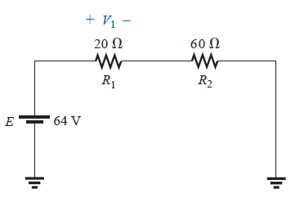
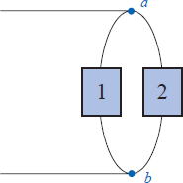
R_{T} = R₁ + R₂
and
𝐼 =
𝐸
𝑅_{𝑇}
Applying Ohm’s law:
𝐸
𝑉₁ = 𝐼𝑅₁ = _{𝑅} 𝑅₁
𝑇
𝐸
with 𝑉 = 𝐼𝑅 = 𝑅
2 2
𝑅_{𝑇}
2
Note that the format for V₁ and V₂ is
𝑅 𝐸
𝑉 =
𝑥
𝑅_{𝑇}
(voltage divider rule)
𝑥
where V_{x} is the voltage across R_{x}, E is the impressed voltage across the series elements, and RT is the total resistance of the series circuit.
In words, the voltage divider rule states that the voltage across a resistor in a series circuit is equal to the value of that resistor times the total impressed voltage across the series elements divided by the total resistance of the series elements.
EXAMPLE 7 Determine the voltage V₁ for the network of Fig. 21.
Solution:
𝑉 =
𝑅₁𝐸 ₌ 𝑅₁𝐸 ₌ 20 Ω ×64𝑉 _{= 16𝑉}
𝑥
𝑅_{𝑇} 𝑅₁+ 𝑅₂ 20Ω+60Ω
Parallel Elements
Figure 19 Example 7
Two elements, branches, or networks are in parallel if they have two points in common.
In Fig.22, for example, elements 1 and 2 have terminals a and b in common; they are therefore in parallel.
Figure 20 Parallel elements.

