Slide 1
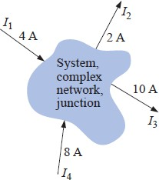
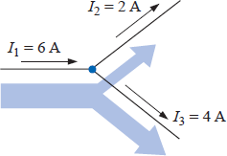
Kirchhoff’s Current Law
Kirchhoff’s voltage law provides an important relationship among voltage levels around any closed loop of a network. We now consider Kirchhoff’s current law (KCL), which provides an equally important relationship among current levels at any junction.
Kirchhoff’s current law (KCL) states that the algebraic sum of the currents entering and leaving an area, system, or junction is zero.
In other words, the sum of the currents entering an area, system, or junction must equal the sum of the currents leaving the area, system, or junction.
In equation form:
^{∑ 𝐼}entering ^{= ∑ 𝐼}𝑙𝑒𝑎𝑣𝑖𝑛g
In Fig. 30, for instance, the shaded area can enclose an entire system, a complex network, or simply a junction of two or more paths. In each case the current entering must equal that leaving, as witnessed by the fact that
Figure 29 Introducing Kirchhoff’s current law.
The most common application of the law will be at the junction of two or more paths of current flow, as shown in Fig. 31. For some students it is difficult initially to determine whether a current is entering or leaving a junction. One approach that may help is to picture yourself as standing on the junction and treating the path currents as arrows. If the arrow appears to be heading toward you, as is the case for I₁ in Fig. 31, then it is entering the junction. If you see the tail of the arrow (from the junction) as it travels down its path away from you, it is leaving the junction, as is the case for I₂ and I₃ in Fig. 31.
Applying Kirchhoff’s current law to the junction of Fig. 31:
Figure 30 Demonstrating Kirchhoff’s current law.

Slide 2
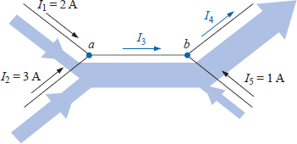
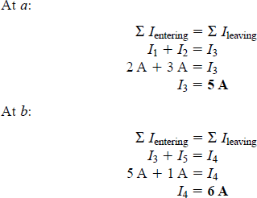
^{∑ 𝐼}𝑒𝑛𝑡𝑒𝑟𝑖𝑛g ^{= ∑ 𝐼}𝑙𝑒𝑣𝑖𝑛g
6𝐴 = 2𝐴 + 4𝐴
6𝐴 = 6𝐴 (𝑐ℎ𝑒𝑐𝑘𝑠)
In the next two examples, unknown currents can be determined by applying Kirchhoff’s current law. Simply remember to place all current levels entering a junction to the left of the equals sign and the sum of all currents leaving a junction to the right of the equals sign. The water-in-the-pipe analogy is an excellent one for supporting and clarifying the preceding law. Quite obviously, the sum total of the water entering a junction must equal the total of the water leaving the exit pipes.
In technology the term node is commonly used to refer to a junction of two or more branches. Therefore, this term will be used frequently in the analyses that follow.
EXAMPLE 10 Determine the currents I₃ and I₄ of Fig. 32 using Kirchhoff’s current law.
Figure 31 Example 10
Solution: We must first work with junction a since the only unknown is I₃. At junction b there are two unknowns, and both cannot be determined from one application of the law.

