Slide 1
Mosul University
College of science Energy Department
New & renewable
Circuit Analysis
New & renewable Energy Department 2nd class
Lecturer
Dr. Ibtisam Yahya Abdullah
2024-2025

Slide 2
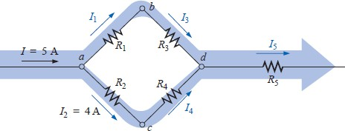
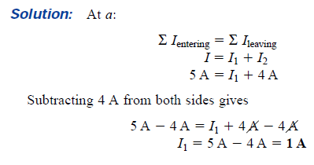
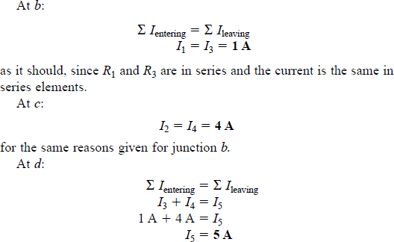
EXAMPLE 11 Determine I₁, I₃, I₄, and I₅
for the network of Fig. 33
Figure 32 Example 11
If we enclose the entire network, we find that the current entering is I = 5 A; the net current leaving from the far right is I₅ = 5 A. The two must be equal since the net current entering any system must equal that leaving.
Current Divider Rule
As the name suggests, the current divider rule (CDR) will determine how the current entering a set of parallel branches will split between the elements.
For two parallel elements of equal value, the current will divide equally.
For parallel elements with different values, the smaller the resistance, the greater the share of input current.
For parallel elements of different values, the current will split with a ratio equal
to the inverse of their resistor values.

Slide 3
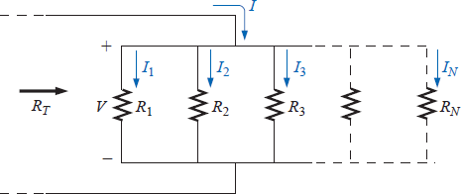
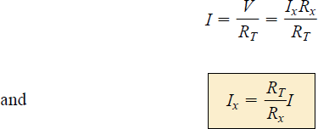
For example, if one of two parallel resistors is twice the other, then the current through the larger resistor will be half the other. In Fig. 34, since I₁ is 1 mA and R₁ is six times R₃, the current through R₃ must be 6 mA (without making any other calculations including the total current or the actual resistance levels). For R₂ the current must be 2 mA since R₁ is twice R₂. The total current must then be the sum of I₁, I₂, and I₃, or 9 mA. In total, therefore, knowing only the current through R₁, we were able to find all the other currents of the configuration without knowing anything more about the network.
Figure 33 Demonstrating how current will divide between unequal resistors.
For networks in which only the resistor values are given along with the input current, the current divider rule should be applied to determine the various branch currents. It can be derived using the network of Fig. 35.
Figure 34 Deriving the current divider rule.
The input current I equal V/R_{T}, where R_{T} is the total resistance of the parallel branches. Substituting V=I_{x}R_{x} into the above equation, where I_{x} refers to the current through a parallel branch of resistance R_{x}, we have
which is the general form for the current divider rule. In words, the current through any parallel branch is equal to the product of the total resistance of the parallel

Slide 4
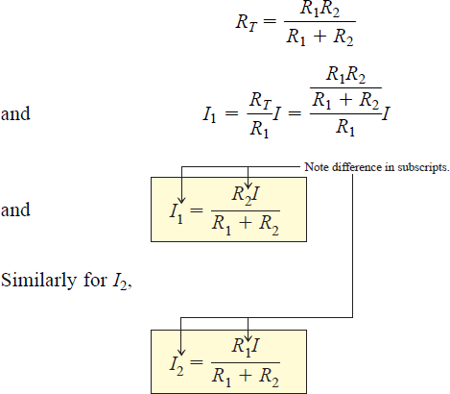
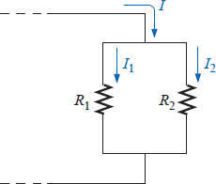
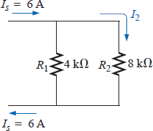
branches and the input current divided by the resistance of the branch through which the current is to be determined.
For the current I₁,
For the particular case of two parallel resistors, as shown in Fig. 36,
Figure 35 Developing an equation for current division between two parallel resistors.
In words, for two parallel branches, the current through either branch is equal to the product of the other parallel resistor and the input current divided by the sum (not the total parallel resistance) of the two parallel resistances.
EXAMPLE 12 Determine the current I₂ for the network of Fig. 37 using the current divider rule.
Solution:
Figure 36 Example 12

