Slide 1
Mosul University
College of science Energy Department
New & renewable
Circuit Analysis
New & renewable Energy Department 2nd class
Lecturer
Dr. Ibtisam Yahya Abdullah
2024-2025

Slide 2
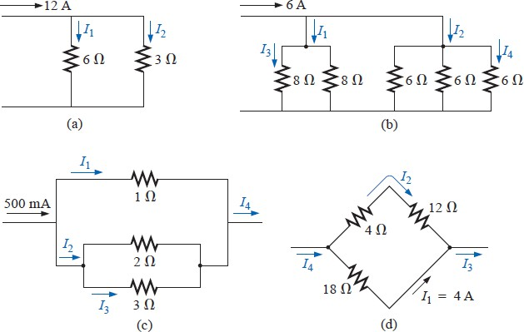
21. Using the current divider rule, find the unknown currents for the networks of Fig. 59.
Figure 58 Problem 21
Branch-Current Analysis
Assign a distinct current of arbitrary direction to each branch of the network.
Indicate the polarities for each resistor as determined by the assumed current direction.
Apply Kirchhoff’s voltage law around each closed, independent loop of the
network.
Apply Kirchhoff’s current law at the minimum number of nodes that will include all the branch currents of the network.
Solve the resulting simultaneous linear equations for assumed branch currents.
EXAMPLE 1 Apply the branch-current method to the network of Fig. 60.
Solution 1:
Step 1: Since there are three distinct branches (cda, cba, ca), three currents of arbitrary directions (I₁, I₂, I₃) are chosen, as indicated in Fig. 60. The current directions for I₁ and I₂ were chosen to match the “pressure” applied by sources E₁ and E₂, respectively. Since both I₁ and I₂ enter node a, I₃ is leaving.
Step 2: Polarities for each resistor are drawn to agree with assumed current directions, as indicated in Fig. 61.

Slide 3
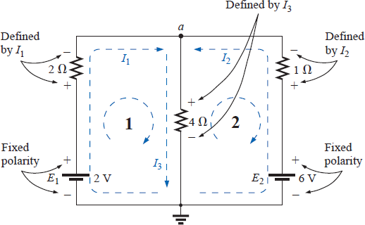
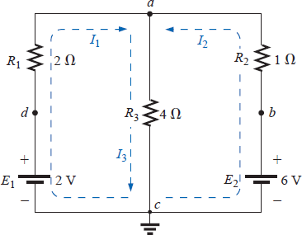
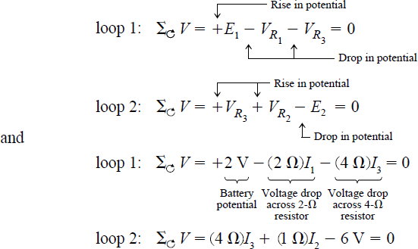
Figure 59 Example 1
Figure 60 Inserting the polarities across the resistive elements as defined by the chosen branch currents.
Step 3: Kirchhoff’s voltage law is applied around each closed loop (1 and 2) in the clockwise direction:
Step 4: Applying Kirchhoff’s current law at node a (in a two-node network, the law is applied at only one node),
I₁ + I₂ = I₃
Step 5: There are three equations and three unknowns (units removed for clarity):

Slide 4
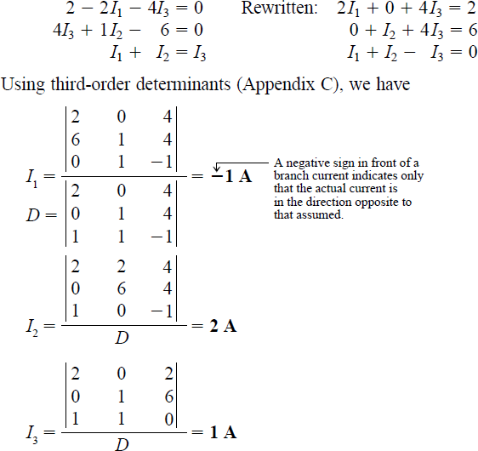
Mesh Analysis & super mesh Analysis
Assign a distinct current in the clockwise direction to each independent, closed loop of the network. It is not absolutely necessary to choose the clockwise direction for each loop current.
In fact, any direction can be chosen for each loop current with no loss in accuracy, as long as the remaining steps are followed properly. However, by choosing the clockwise direction as a standard, we can develop a shorthand method for writing the required equations that will save time and possibly prevent some common errors.
Indicate the polarities within each loop for each resistor as determined by the assumed direction of loop current for that loop.
Note the requirement that the polarities be placed within each loop. This requires, as shown in Fig. 62, that the 4Ω resistor have two sets of polarities across it.

Slide 5
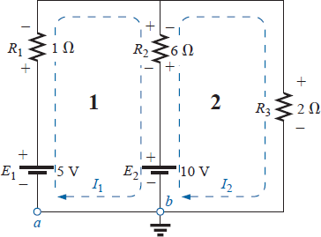
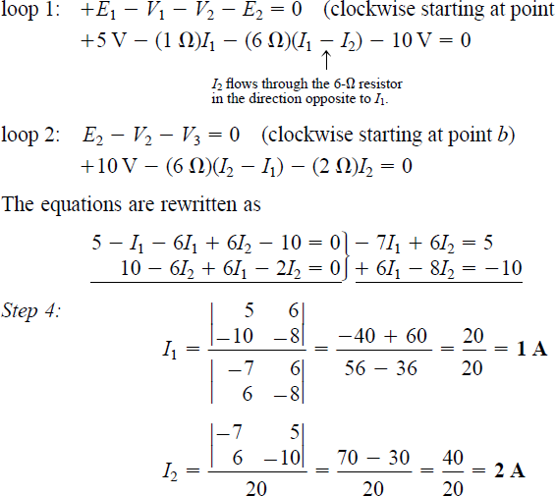
Apply Kirchhoff’s voltage law around each closed loop in the clockwise direction. Again, the clockwise direction was chosen to establish uniformity and prepare us for the method to be introduced in the next section.
If a resistor has two or more assumed currents through it, the total current through the resistor is the assumed current of the loop in which Kirchhoff’s voltage law is being applied, plus the assumed currents of the other loops passing through in the same direction, minus the assumed currents through in the opposite direction.
The polarity of a voltage source is unaffected by the direction of the assigned loop currents.
4. Solve the resulting simultaneous linear equations for the assumed loop currents.
EXAMPLE 2 Find the current through each branch of the network of Fig. 62.
Solution:
Steps 1 and 2 are as indicated in the circuit. Note that the polarities of the 6Ω resistor are different for each loop current.
Step 3: Kirchhoff’s voltage law is applied around
each closed loop in the clockwise direction:
Figure 61 Example 2

