Slide 1
The reality of the change in global energy consumption and the change in the type of sources supplied to it:
The history of global energy consumption has long been characterized by the dominance of one fuel, wood first, coal and oil. The invention of the internal combustion engine made the oil strategically important.
The world has revived by plenty and cheap supplies of oil, but the crisis of oil in 1973 has warned the consumer countries about the risks of relying upon Unisource of energy and out of its control. also the increasing of oil prices has motivated to seek for alternative materials.

Slide 2
Challenges facing the future of oil:
Wealth is fleeting and diminishing overtime.
Oil prices fluctuate.
The German experience in the field of renewable energy its success.
Concern over global warming and signs of climatic change.
Today, the world fuel is more divers than before. Therefore, the world has turned towards more diversified, abundant and less expensive energy.

Slide 5
Non-conventional energy sources: New and renewable types: New sources:

Slide 6
1: production of oil and natural gas by unconventional means: energy alternatives.
Tar Sands.
Oil Shales.
Heavy Crude Oil.
Liquid Petroleum Gas (LPG).
Gashydrate

Slide 7
Shale gas.
. Coal bed methane (CBM).
Gasification and liquefaction of coal.
New methods to stimulate the extraction of oil and gas from the fields.
2: Nuclear energy.
3: Hydrogen:

Slide 8
New Energy sources: Tar sands and oil shales:
Tar sands
Sometimes, it is called "Bituminous sands" they are either loos sands or partially consolidated sandstones containing a naturally occurring mixture of sand, clay, water and some heavy hydrocarbons.
Tar sands consist of high viscosity deposits, it cannot be transported by pipes, and the amount of hydrocarbons is estimated 1-30%.
It can be found in many countries, but in particular one found in extremely large amount in Canada.

Slide 9
The proven reserves of bitumen in deposits reaches 100 billion barrels, and must of them are found in Canada, Alberta (70.8%).
Oil produced from oil sands is often referred to "unconventional oil" to distinguish it from liquid hydrocarbons produced from traditional oil wells.
The largest project of the field of exploitation tar sand in Canada at cost 16×10⁹$ to produce 51,000 barrel synthesis oil daily.

Slide 13
Extraction:
Treatment with hot water to recover bitumen and this is high viscosity, so it is being upgrading.
Upgrading:
Cracking the materials into lighter compounds for easy processing.
Hydrogenation of the resulting compounds, then removed S,N (hydro desulfurization).
Refining to primary derivatives and production low sulfur oil.
H2S red. S (by product)

Slide 14
Oil Shale's
Its sediments spread in many parts of the world. These inorganic deposits contain varying proportions (4-8%) of a waxy organic matter called kerogen. This material is of a degree of complexity in its chemical composition, it cannot be dissolved in any solvent that dissolves conventional crude oil; therefore the only method used to recover oil from the shales is the pyrolysis process to reduce viscosity and simplify chemical composition.

Slide 15
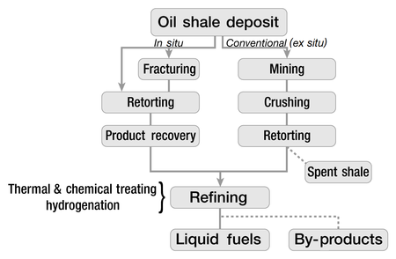
oil shale extraction
oil shale is first extracted from the earth by surface or underground mining

Slide 16
Environmental Effect
Global Warming
Greenhouse gas emission
Mined land disturbance
Effect on air and water quality
Cost is relatively high

Slide 17
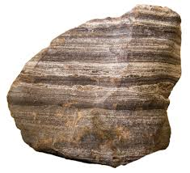

Slide 20
Heavy Oils:
Its highly viscous oil that can’t easily flow to production wells under normal reservoir condition .
It is referred to as heavy because its :
Low value of API
High percent of carbon content
High content of N, S, Asphaltene and Metals.
High Molecular weight and high viscosity
Low hydrogen content

Slide 21
Liquefied Petroleum Gas (LPG):
The light hydrocarbons fraction of the paraffin series, derived from refinery processes, which exist in the gaseous state under atmospheric ambient condition but can be converted to the liquid state under condition of moderate pressure and ambient temperature such as propane, butane, or some mixture of them. and lesser extend propylene or butylene result from cracking other hydrocarbons in petroleum refinery .

Slide 22
Gas hydrates:
Gas hydrates are naturally occurring, crystalline, ice-like substances composed of gas molecules (methane, ethane, propane, etc...) held in a cage-like structure.
The formation and stability in the subsurface (less than2000m. depth) of these structures are constrained by a relatively narrow range of high pressure and low temperature.
Hydrates are concentrated form of natural gas. It is estimated that a significant part of the earth's fossil fuel is stored as gas hydrates.

Slide 23
Gas hydrates formation:
These compounds contain clusters of gas-trapping polyhedral formed by pentagonal and hexagonal arranged hydrogen-bonded water molecules.
Vander walls interactions between the trapped "guest" molecules and the surrounding water cage walls stabilize and support the individual polyhedral.
The origin of the methane concentrated in naturally occurring hydrates is either:
Micro genic.
Thermogenic.
When hydrated are heated or depressurized, they become unstable and dissociate into water and natural gas.

Slide 24
Advantages:
Found in greater abundance than N.G.
Easy to release the gas.
Gas hydrates( high temp. + low P.) water + gas
It also does not produce harmful by-product (water).
Contains more energy than oil, coal and gas put together.
Releases about 170 m³ of methane when only 1 m³ hydrate is broken down.

Slide 25
Disadvantages:
Hostile environment such as deep oceans, making it hard to extract.
Little knowledge of the formation and concentration.
Non renewable energy sources.
Uses:
Natural gas production:
Methane extracted can be used for industrial purposes.
Useful in storing natural gas for transportation.

Slide 28
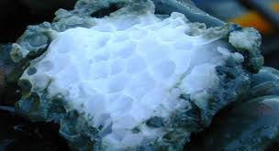
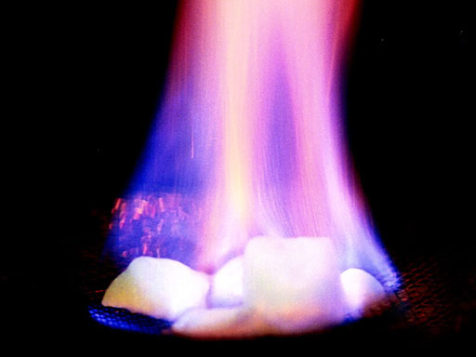
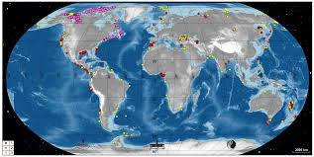

Slide 29
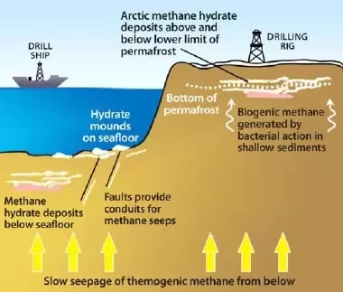

Slide 30
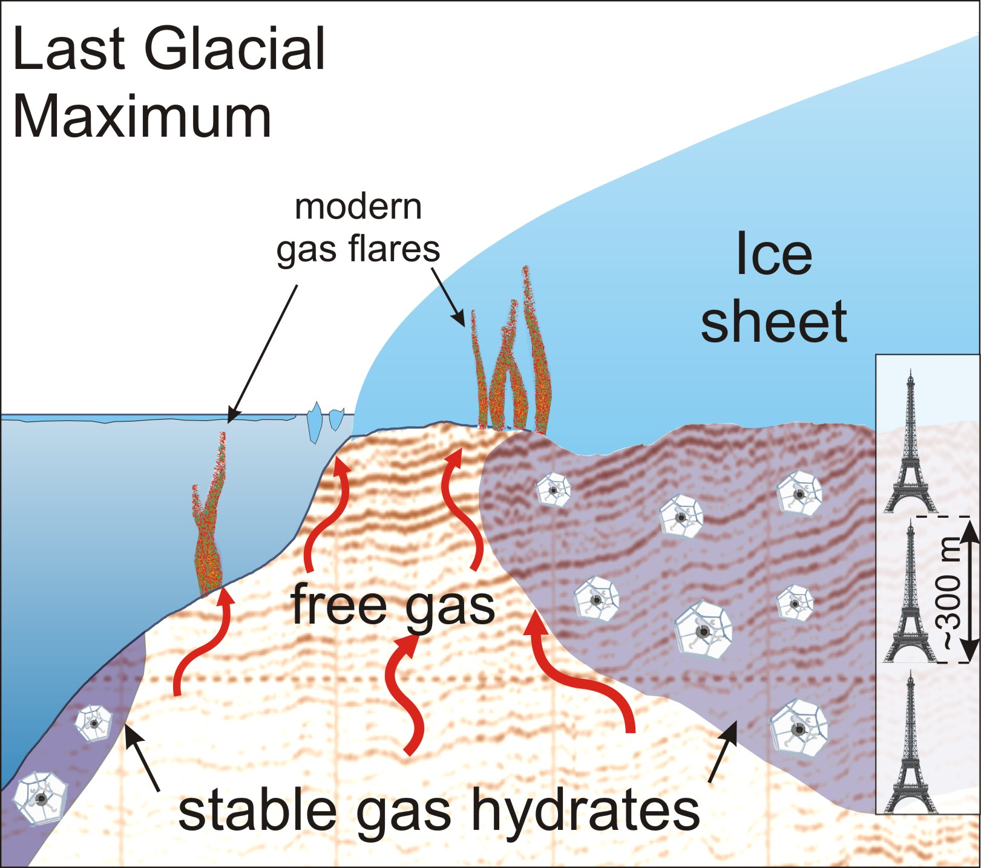

Slide 31
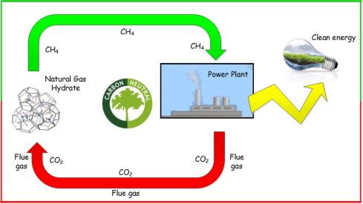
Produce Clean Energy from Gas Hydrate

Slide 32
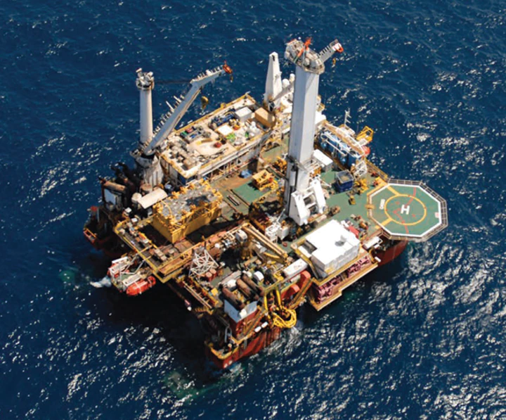

Slide 33
Coal as a fuel:
Coal can be used as it is as a solid fuel for the production of electricity in the generation stations. However, coal can be converted into gaseous and liquid fuels by gasification and liquefaction, respectively.

Slide 34
Gasification:

Slide 35
The synthesis gas was converted to different transportation fuels, such as gasoline and diesel via reaction called Fisher-Tropsch reaction, the latter represent an indirect method to convert coal into liquid fuels.

Slide 36
Liquefaction:
Coal can be converted into different liquids, which can be used as a source of chemicals and transportation fuels. Two pathways are used to convert coal into liquid fuels, as follow:

Slide 37
Direct liquefaction:

Slide 38
The difference between the oil produced by pathway (1) from that produced via pathway (2) is that the oil produced via hydrocracking (pathway 2) is lighter than that produced via (pathway 1) due to it's higher hydrogen content.

Slide 39
Indirect liquefaction of coal:
Different routes were applied to convert coal indirectly to liquids, as follows:
1. Crushing of coal into powder form and mixing it with oil produced by the pyrolysis of coal itself to form “slurry". Then, the slurry is mixed with a proton-donor solvent in a suitable reactor, so as to increase the hydrogen content of the coal.
2. The coal slurry (coal powder + oil) is pyrolysis at high temperature in the presence of high pressure of hydrogen gas.
3. Gasification of coal into synthesis gas and then the conversion of (CO + H₂) mixture to liquid hydrocarbons. through Fisher-Tropsch route.

Slide 41
New methods to promote oil extraction from the depleted fields:
Despite the progress made in the exploration and extraction of crude oil from the ground. A large part of this wealth remains without extraction because of the high viscosity and adhesion to rocks.
50% of the amount of oil discovered remains in oil wells, and cannot be extracted by conventional methods, therefor developed several enhanced oil recovery techniques.

Slide 42
Thermal processing:

Slide 43
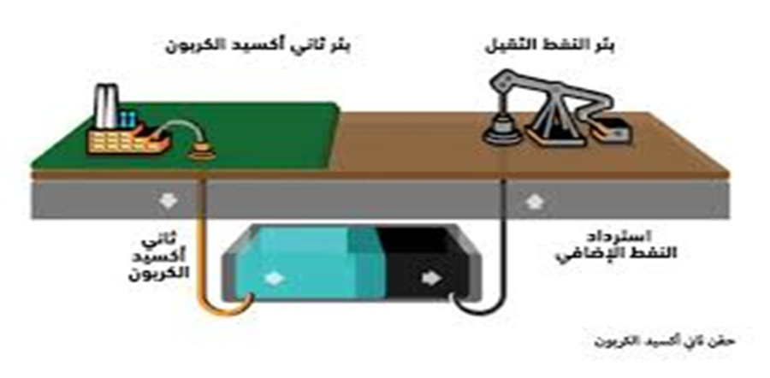
Pumping of CO2 gas:
to maintain the pressure inside the reservoir (it is pumped at very high pressure).

Slide 44
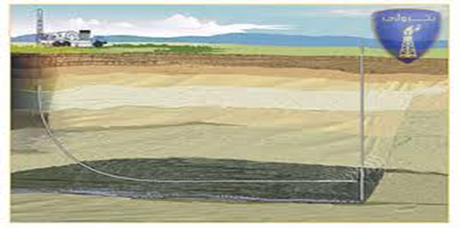
Chemical injection : (add some chemicals).
Drilling the wells horizontally : (producing quantities exceeding the method of drilling vertical).

Slide 45
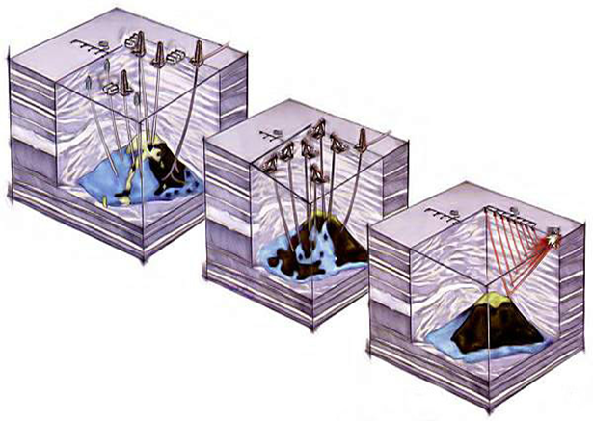
. Developing 3D imaging of subsoil:
as it accurately shows the interior structure of the field and the best drilling locations

Slide 46
Microbiological technology
The use of some types of bacteria that have been isolated from the oil sludge deposited in the wells.
Encourage the development of bacteria in private laboratories and then injected into the oil well (the well is closed for several days or weeks, during this period. Bacteria multiply on rock surfaces, pores and crack where heavy oil suspended). These organisms secrete some organic acids and gases that mix with petroleum oil, which reduces their viscosity and facilitates their release.
It is a save and does not use harmful chemicals.

Slide 47
Its unconventional gas resources –new resources
It’s the generic term given to methane gas held in under ground
The porosity of coal bed methane reservoir is very small
Coal bed methane is extracted from coal beds through the drilling of wells. However, unlike drilling for Natural gas. Large amounts of water must be pumped from the coal bed area in order to depressurize the bed. Once the water is removed, the methane is able to escape from the coal and flow into the well itself.

Slide 50
Shale Gas:
It is a natural gas that is found trapped within shale formation.
Its unconventional sources, found in certain types of shale, low permeability.
Extracted by hydraulic fracturing.
Benefits:
N.G is the cleanest of all fossil fuels
The main products of N.G combustion are carbon dioxide and water vapor.

