Slide 1
Second Course
Brittle Failure Structures(Fractures)
Joints and Faults

Slide 2
As Earth crust is full of joints, therefore their study and importance is very significance
FRACTURE:
Fractures are Surfaces along which rocks or minerals have broken; they are therefore surfaces across which the material has lost cohesion
The term fracture encompasses both joints and faults.
Joints: are fractures along which there has been little or no movement parallel to the fracture and only slight movement normal to the fracture plane.
Joints are most common of all structures present in all settings in all kind of rocks as well as consolidated and unconsolidated sediment .
Why geologists study joints?
-provide information on paleostress field.
-Joints control drainage. Study orientations of joints provide information on the drainage pattern.
-Joints and fractures serve as the plumping system for ground water flow in many area and they are the only routes by which ground water can move through igneous and metamorphic rocks.
-Joints and fractures porosity and permeability is very important for water supplies, dames, and hydrocarbon reservoirs.
-Joints orientations in road cuts greatly affect both construction and maintenance. Those oriented parallel to or dip into
a highway cut become hazardous during construction and later because they provide potential movement surfaces.
- Quarry operation, especially those involved in obtaining blocks of certain dimension and size, are obviously influenced by the joints

Slide 3
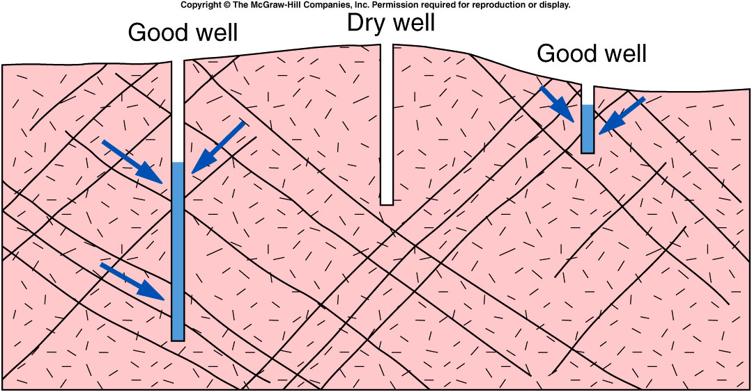
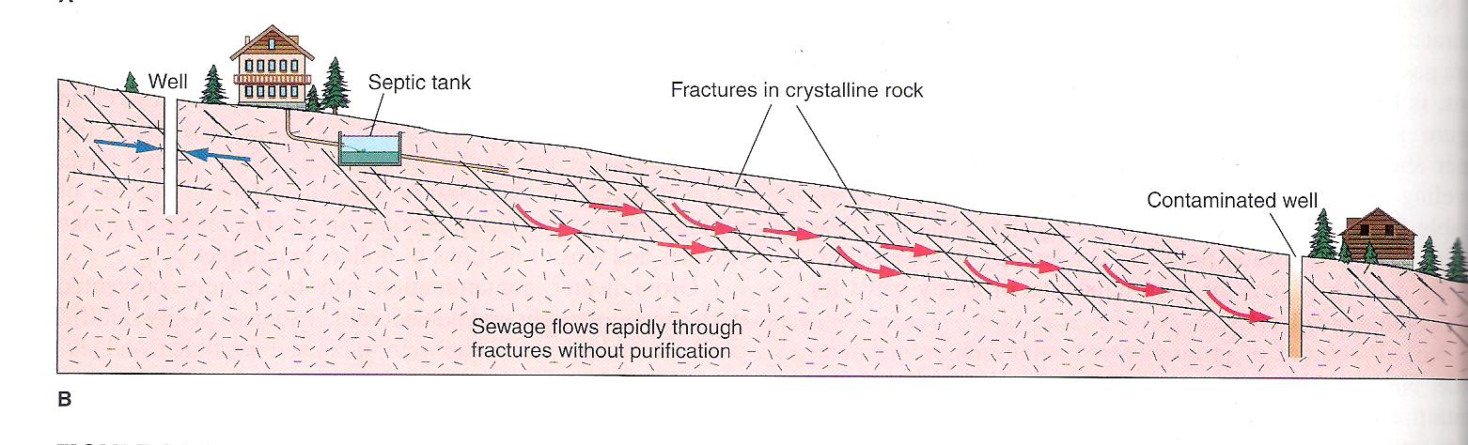
Bedrock Hydrogeology
Hydraulic Conductivity of bedrock is controlled by;
  Size of fracture openings-
  Spacing of fractures-
  Interconnectedness of fractures-

Slide 4
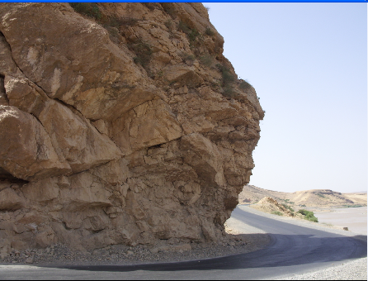
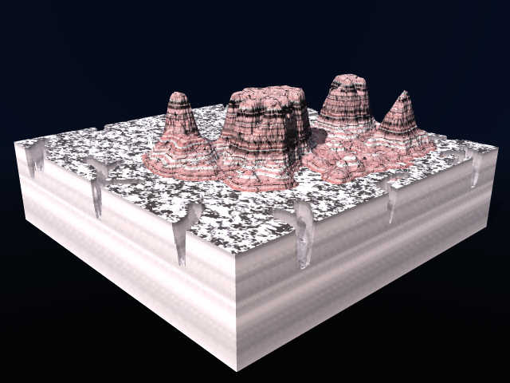
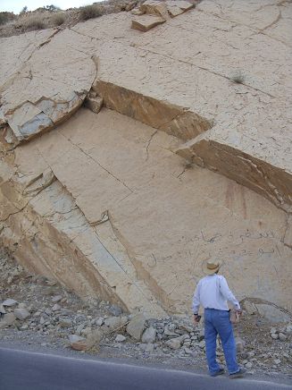
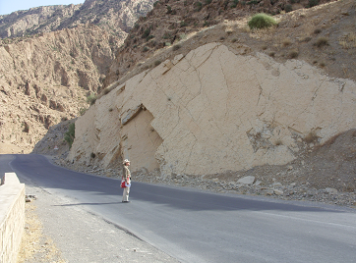
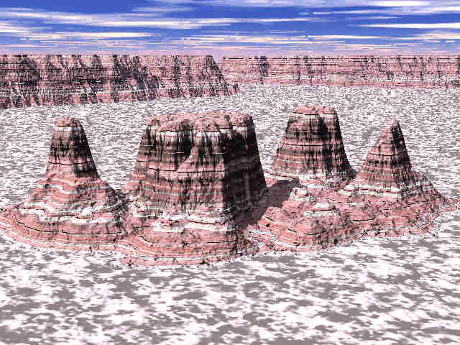
Joints orientations in road cuts
Joints and Geomorphology

Slide 5
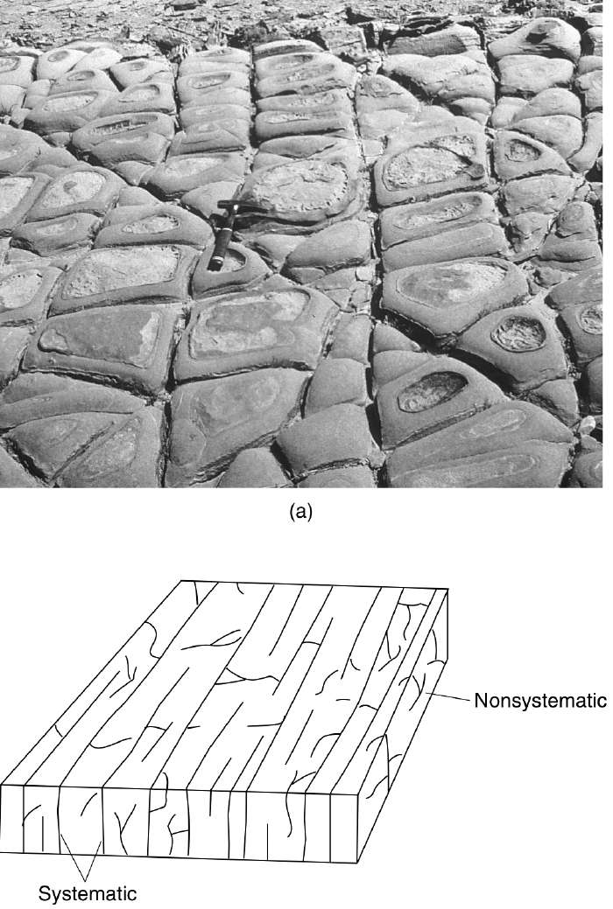
TYPES OF JOINT
Joint set:
Systematic joints: have a sub-parallel orientation and regular spacing.
Joint set: joints that share a similar orientation in same area.
Joint system: two or more joints sets in the same area
Nonsystematic joints: joints that do not share a common orientation and those highly curved and irregular fracture surfaces. They occur in most area but are not easily related to a recognizable stress.
Some times both systematic and nonsystematic joints formed in the same area at the same time but nonsystematic joints usually terminate at systematic joints which indicates that nonsystematic joints formed later.
Joint system
Nonsystematic joints

Slide 6
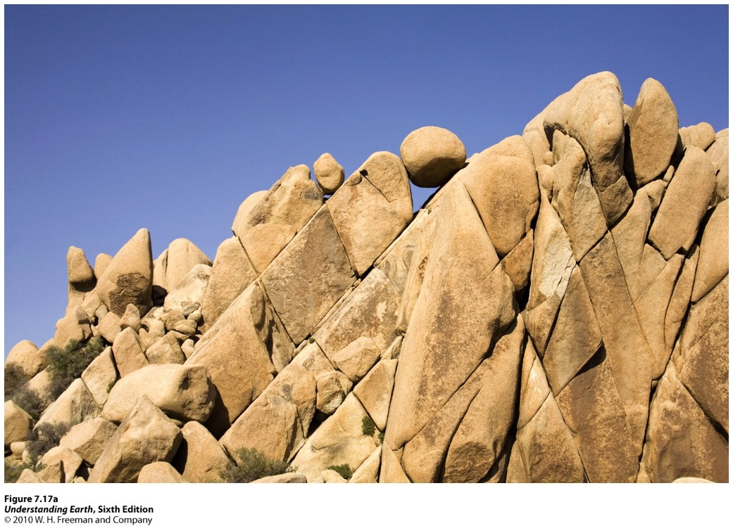
Systematic joints are planar joints that comprise a family in which all the joints are parallel or sub parallel to one another, and maintain roughly the same average spacing over the region of observation .
Nonsystematic joints have an irregular spatial distribution, they do not parallel neighboring joints, and they tend to be nonplanar.
Nonsystematic joints may terminate at other joints. You will often find both systematic and nonsystematic joints in the same outcrop
.

Slide 7
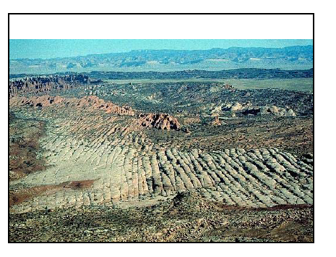
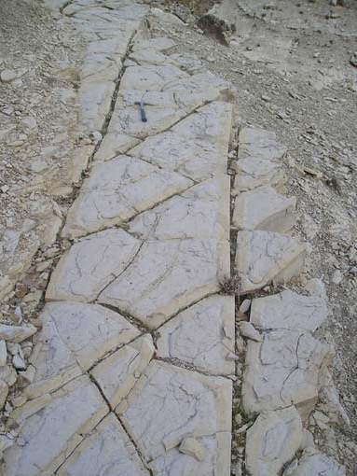
Joint sets
Joints that share a similar orientation in same area.
Fractures
(Joints, cracks)
Several sets

Slide 8
Attitude of joints
Joints may have any attitude ;some joints are vertical other are horizontal, and many are inclined at various angles.
Since the joints are planar structures ,the attitude (Strike and Dip) of their are measured in the same way as for bedding surface .
The strike is the direction of horizontal line on the surface of the joint.;
The dip , is the angle between a horizontal plane and the joint, measured in the vertical plane at right angles to the strike of the joint,

Slide 9
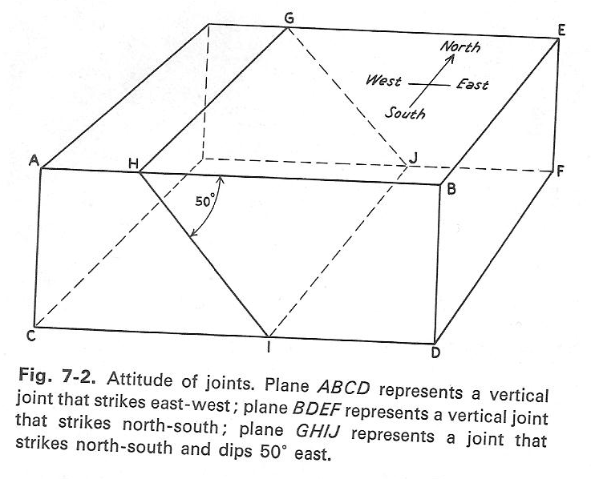
Joint Strike north- south
Dip 50⁰
Strike north- south
Dip is vertical.
Strike east- west
Dip is Vertical

Slide 10
Classification of joints:-
Joints may be classified either Geometrically or Genetically.
A Geometrical classification is strictly descriptive and comparatively easy to apply, but dose not indicate the origin of joints .
A Genetic classification is more significant, but ,as will be seen ,is not applied in many cases.
A-In a geometrical classification ,the joint may be classified on the basis of their attitude relative to the bedding or some similar structure in the rocks that they cut.
Fold Axis
1- according to its relationships with fold axis into:
Longitudinal joints: it is strike parallel to the fold axis.
Transversal joints: it is strike perpendicular to the fold axis.
Long.
Trans.

Slide 11
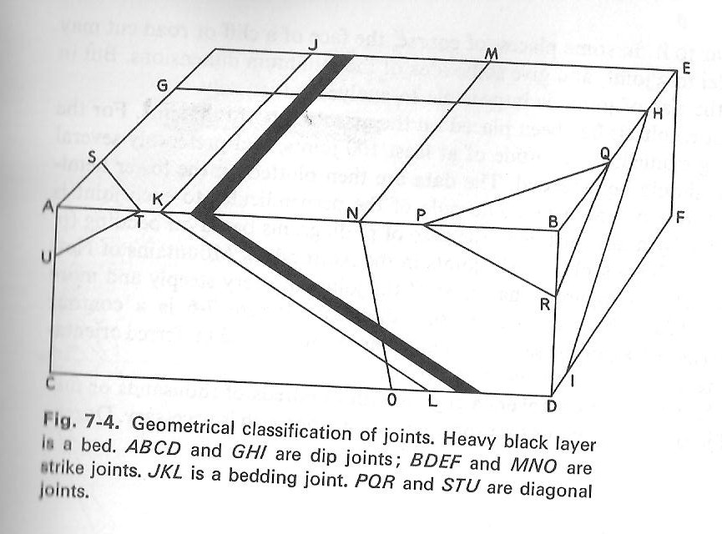
          2- joints can be designated on the basis of their attitude relative to the bedding in to:
Dip joints
Strike joints
Bedding joints
Oblique or Diagonal joints
Limestone bed

Slide 12
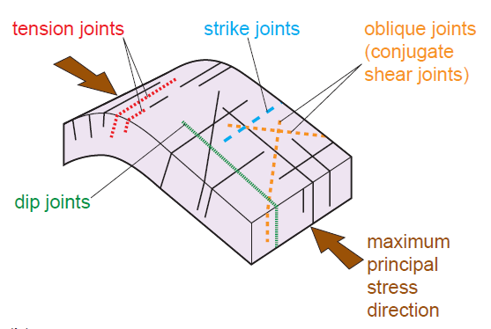
Longitudinal joints
Transversal joints

Slide 13
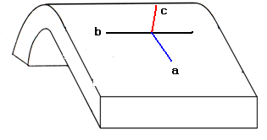
B- Second geometrical classification of joints, based on its relationships with imaginary orthogonal tectonics axes a,b,c as follow:
a is parallel to dip direction
b is parallel to the strike or fold axis
c is perpendicular to the plane containing a and b (bedding plane)
a - dip direction b - strike direction c – perpendicular to bedding

Slide 14
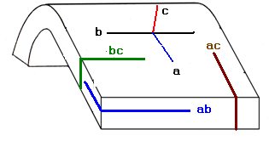
According to this classification ,joints can be classified into sets and systems.
Joints sets : that joint plane which containing any two tectonics axes and perpendicular to the third. Consequently there are three sets
ab= enclosing a and b axes . cross c axis.
ac= enclosing a and c axes. Cross b axis.
bc= enclosing b and c axes . Cross a axis.

Slide 15
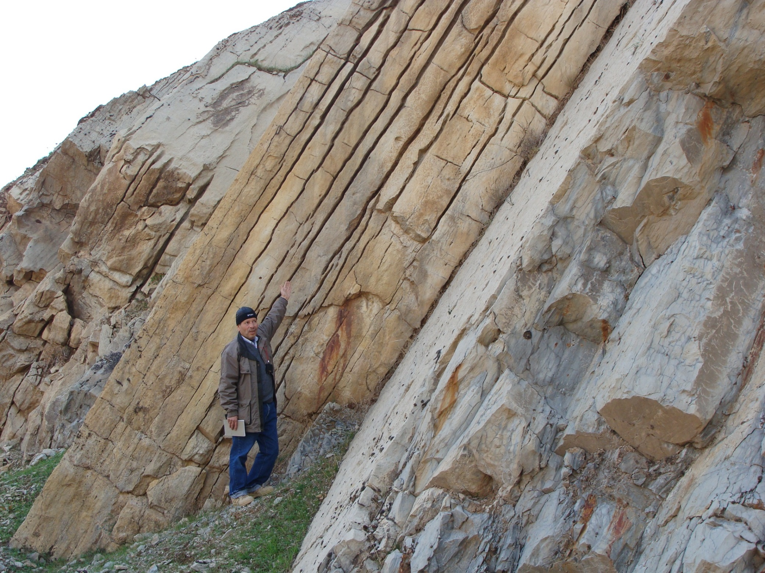
ac set joints
ab set joints
c
a
b

Slide 16
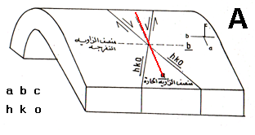
Joint system: that joint surface (or plane) enclosing only one of the three axes and crossing the others,
The joint surface is designated( h) when crossing a axis
(k ) when crossing b axis
( l )when crossing c axis
Letter O is given to the axis parallel (enclosing) to joints surface
consequently those joints containing one of the three reference(tectonic) axes a b c are systems designated as ; okl ,hol, and hko respectively.
According to the acute angle about the crossing axis, joints systems designated as;
hko–a & hko –b
hol – a & hol –c
okl –b & okl –c
hkl
( hko-a it mean make acute angle about a axis)

Slide 17
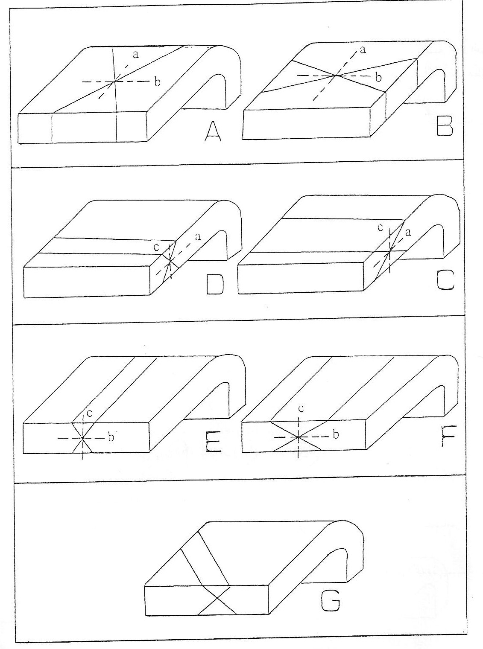
A
hko-a
B
hko-b
C
D
hol-c
hol-a
D
C
E
okl-c
F
okl-b
G
hkl

Slide 19
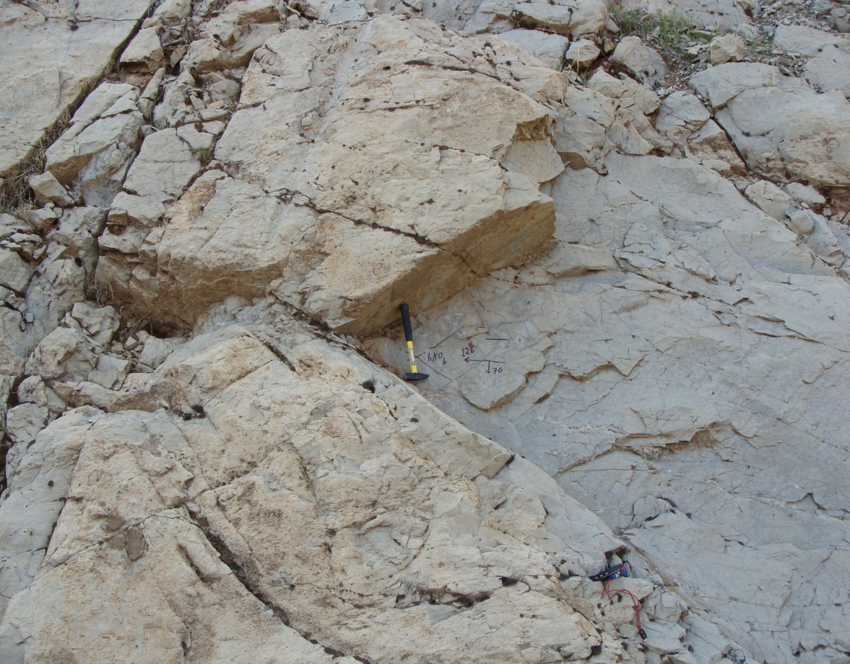
hko (b)
Strike =b
Dip=a
hko acute about b ---shiranish formation – perat anticline

Slide 20
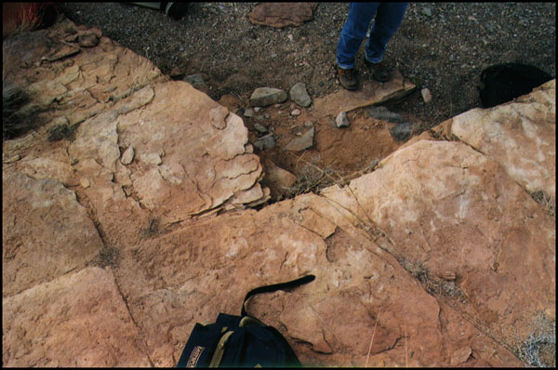
hko(b)
b
strike
a
dip
Conjugate joint system

Slide 21
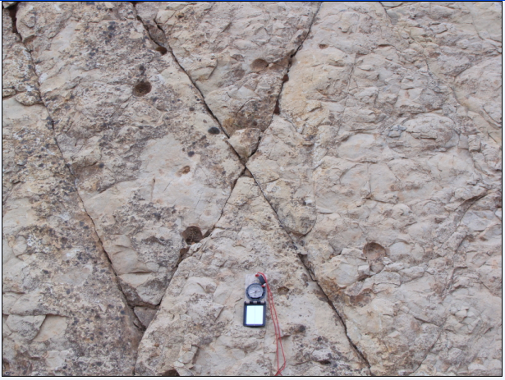
Which system of joint
strike
b
a
dip
hko-a-

Slide 22
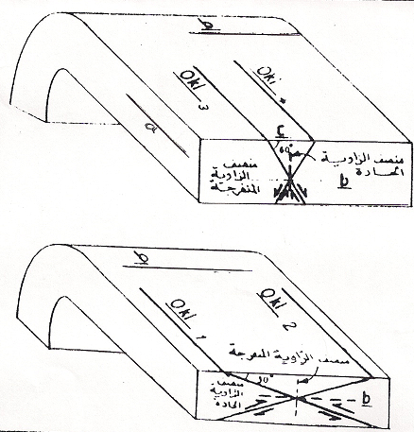
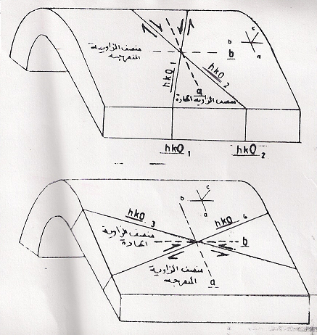
hko-a
okl-c
1
2
2
3
okl-b
hko-b
joints systems

Slide 23
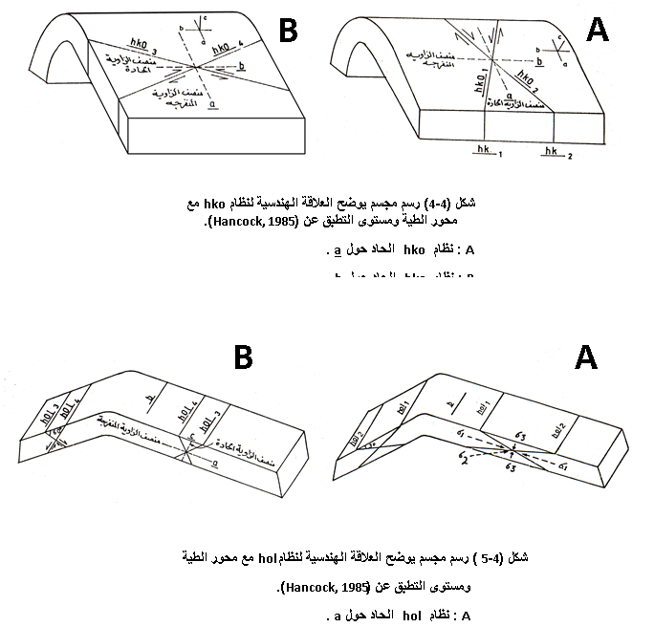
a
b
hol acute about c
hol acute about a
c
b
a

Slide 24
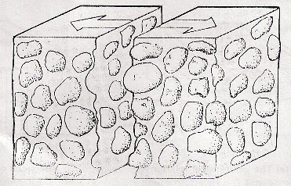
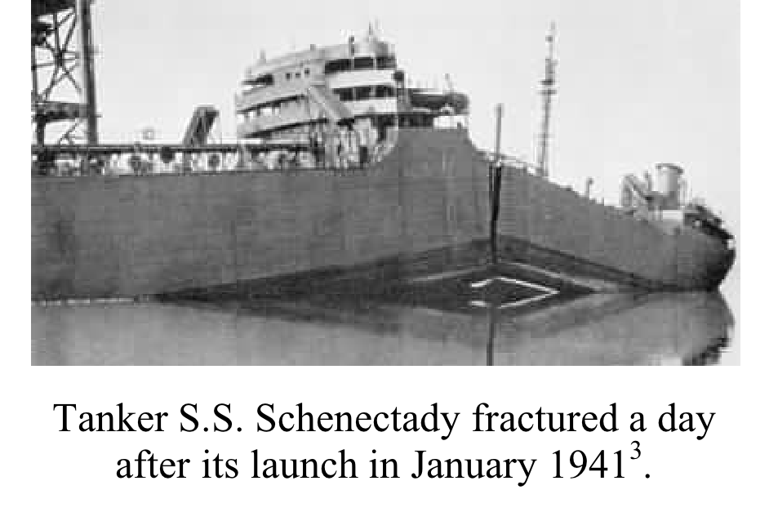
Genetic classification
Joints may be classified genetically as tension and shear
A-Tension joints; result from stress that tend to pull the specimen apart. when the specimen finally breaks, the two wall may move away from each other.
Tensile fracture

Slide 25
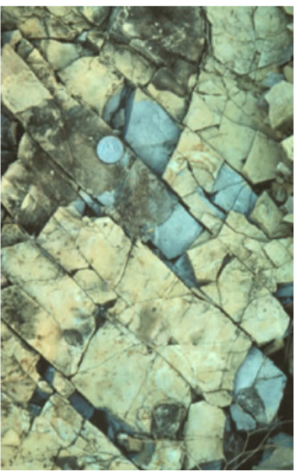
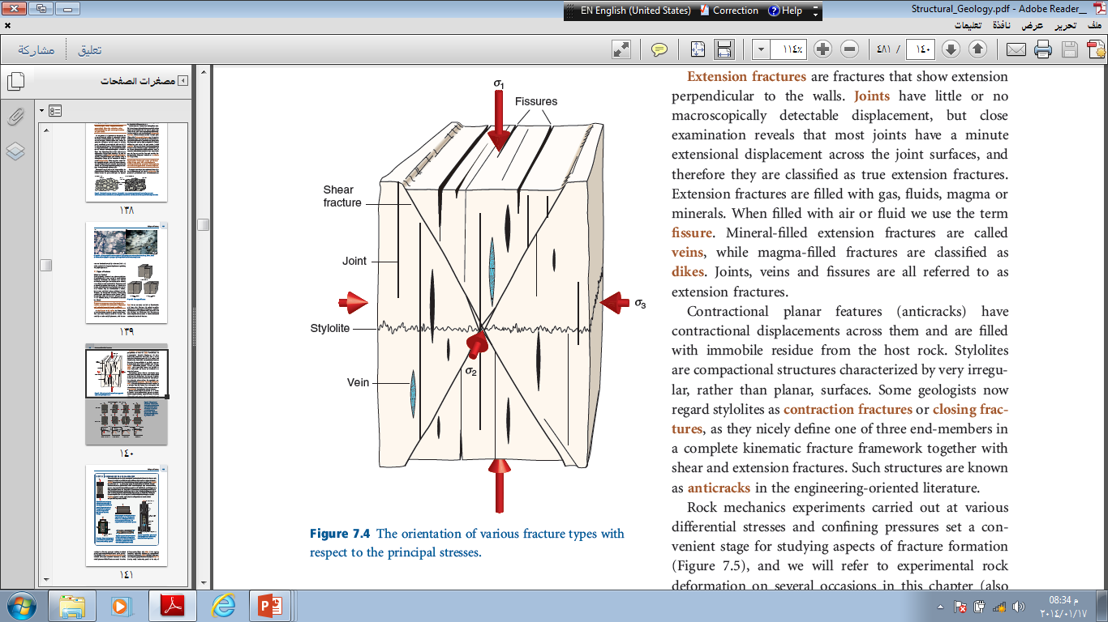
B-Shear joints:- result from stresses that tend to slide one part of the specimen past the adjacent part one another. shear joint often conjugate,
enclosing angles of 60° or more. The joint planes may show small amounts
of shear displacement
60°

Slide 26
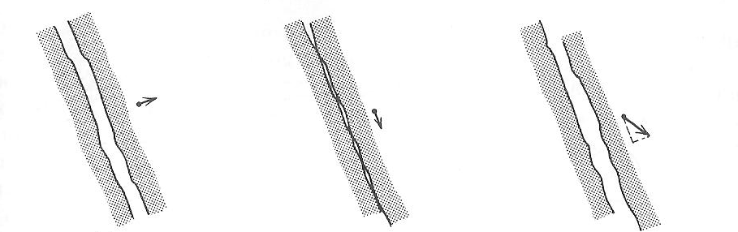
C - Combined shear and extension joints—termed hybrid joints which show components of both extension and shear displacement .
(A)
(B)
(C)
A-Tension joints
B-Shear joints
hybrid joints

Slide 27
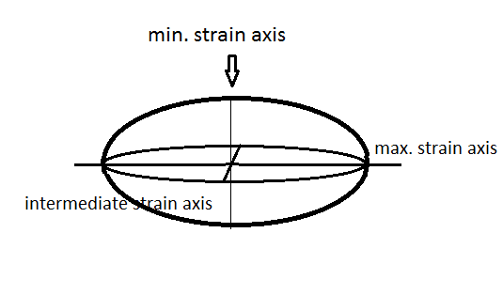
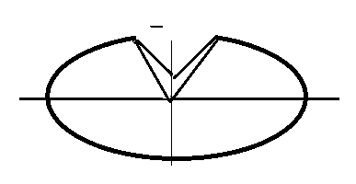
Rock mechanics experiments display constant relationship between ,tension and shear joint with the principals stress axes and consequently with axes of strain ellipsoids.
Max. stress axis bisect the acute angle of conjugate shear joint
Tension joints parallel to the max. stress or min. strain axis.
Max. stress axis
Max. stress axis
Min. strain axis
Tension joint
Shear joint
Max. strain axis
Intermediate strain axis

Slide 28
A consideration of the genesis of joints it must be remembered that the rock have different behavior under stress depending on the surrounding condition at time of stress subjected. Therefore,
Under atmospheric pressure and room temperature, most rock are brittle and fail by rupture at the elastic limit. But under high confining pressure and high temperature most rocks undergo plastic deformation above the elastic limit. But under sufficiently high stress they may be eventually fail by rupture.
As conclusion ,there is several factors concern with genetic of joints
1; the nature of the deformation preceding rupture.
2; physical condition at the time of rupture
3; the stress necessary to cause rupture.
4; the orientation of fractures relative to the causative stresses.
Under the utmost importance to distinguish between the character of the external force and the type of fracture.
Tension fracture may result not only from tension, but also from couple and even from compression; as well be shown later, however special name is given to tension fracture formed by compression.
Shear fracture may develop not only under compression ,but also from couples and from tension.

Slide 29
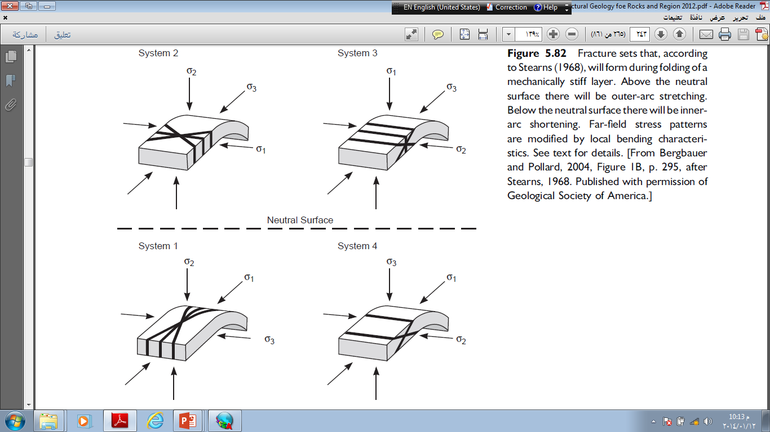
short test; identify joint system
hol-a-
c
b
a
hko -a-

Slide 30
short test; identify joint system
hol-a-
hko-b-

Slide 31
If joints are planar, and parallel to sub-parallel so that they form sets,the joints are said to be systematic.
Joints which can be traced tens and even hundreds of meters are termed master joints.
Joints which are an order of magnitude smaller but still well-defined, are called major joints.
Smaller joints occur at all scales down to microscopic.
The frequency of jointing is closely related to bed thickness and lithology —
thinner beds have closely spaced joints,
more competent beds tend to develop more widely spaced joints
Which lithology have more concentration(frequency) joint. Sandstone or dolomite?

