Slide 1
Main earth phenomena resulted from plate movement
1- sea floor spreading
2- The extruded basaltic magma from mid oceanic. Thus, the rocks are younger as they are near of this positions.
3- Creation of MOR along shear faults, which are forming volcanic islands over / below seawater.
4- High rate of volcanic, seismic activities and thermal leakage in MOR
5- Homogeneous characteristics (in topographical, lithological, and magnetic) along both sides of fault in MOR
6- Presence of Ophiolite complex rocks away of mid-oceanic ridges.
7-Developing at Passive margins (shelf, slope, and rise) in divergent continental margins
8- Subduction occurs(two or one side) due to subsiding of, denser oceanic crust (SiMa) below continental crust (SiAl) as a result of convergent state.
9- Active margins are developed (Trenches) at subduction zone.
11- Consuming of ocean floor accompanied with faults, earthquakes, and volcanic activities.
12- continent-continent collision occurs, finally thrust faults and high mountains are formed ,after consumption all of oceanic floor

Slide 2
Tectonic setting classification of sedimentary basins
All different tectonic settings are also areas where sediment can accumulate.
Three main settings of basin formation can be recognized:
A. basins associated with regional extension (within and between plates).
B. basins associated with convergent plate boundaries (subduction).
C. basins associated with strike-slip plate boundaries.
D. basins associated with crustal loading.
E. complex and hybrid basins

Slide 3
A- BASINS RELATED TO LITHOSPHERIC EXTENSION (DIVERGENT)
In the early stages of extension (stretching), rifts form and are typically sites of continental sedimentation. If the stretching continues, the continental lithosphere may rupture completely (brittle) and the injection of basaltic magmas to form a new oceanic crust within the extension zone, known as a ‘proto-oceanic trough’ , the remnant flanks of the rift become the passive margins of the ocean basin as it develops.
One tectonic setting where lithospheric extension occurs is associated with a ‘hot spot’, rupture of the continental lithosphere over a plume creates three branches , as can be seen today centered on the Afarica Triangle. These three extensional regimes are in different stages of development –continental rift (East African Rift valley), proto-oceanic trough (the Red Sea) and young ocean basin (the Gulf of Aden). On the other side of Africa, an older triple junction now centered on the Niger Delta had two arms forming the South Atlantic, while the third arm, the Benue Trough, was a ‘failed rift’ that subsequently became an area of intracratonic subsidence.
The continental rift basins may exist for long periods without rifting to forming an ocean basin, especially if the driving force for the extension fades.

Slide 4
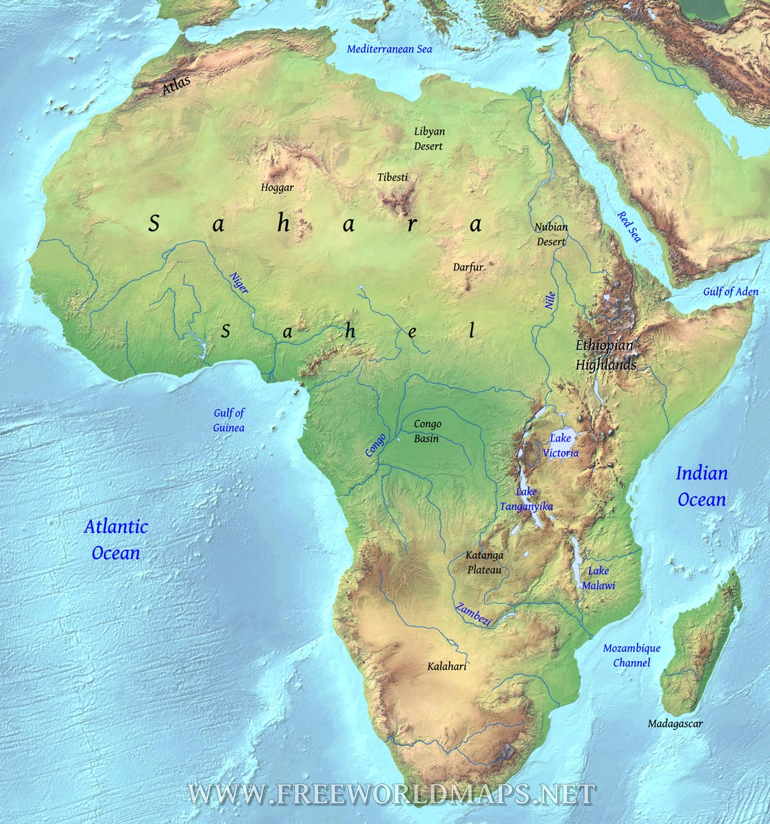


Slide 5
1- Rift basins (Fig.4)
Structural valleys bound by extensional (normal) faults in continental crust. The axis of the rift lies nearly perpendicular to the stress direction. The down-faulted blocks are (graben) and the up-faulted areas (horsts). The bounding faults may be planar or listric,
The crust structural weakness and high heat flow associated with rifting leading to volcanic activity. : regional high heat flow and the effect of relative movements on the rift-bounding faults leading to Uplift on the flanks that creates local sediment sources for rift valleys.
The controls on sedimentation in rift valleys are a combination of tectonic factors that determine the rift flank relief and hence availability of material, as well as the pathways of sediment into the basin, and climate, which influences weathering, water availability for transport and facies in the rift basin. Connection to oceans is also important. Death Valley, California, is a terrestrial rift valley, isolated from the sea and has an arid climate, such that alluvial fan, desert dune and evaporative lake environments are dominant. In contrast, the Gulf of Corinth, Greece, is a maritime rift and is the site of fan-delta and deeper marine clastic deposits.
Extensional basins with low clastic supply may be sites of carbonate deposition. The patterns of sedimentation in rifts evolve as the basins deepen
The best examples are: East African Rift and Gulf Of Suez Basins (fig:4), the anticlockwise divergent movement of Arabian pensula plate away of east Africa plate occurred in Miocene. The Oligocene rock may be eroded because doming uplift, fluvial silicaclastic rocks deposited on unconformable surface consequently and associated with volcanic rocks. Shallow marine carbonate facies during early Miocene indicating that the water covered the basin. The later silicaclastic formations referred to fandelta along faulted basin margins. The late Miocene evaporates rocks referred to restricted basin without connection to Mediterranean sea, this enhanced later after red sea opened due to continued movement along alaqba gulf.

Slide 6
Enhanced condition
Evaporites
Fandelta+volcanic
Shallow carbonate
Fluvial clastic+ volcanic
Unconformity

Slide 7
2-Intracratonic sag basins (Fig:5)
Areas of broad subsidence within a continental block (craton) away from plate margins . The cratonic crust is typically ancient, low relief: the area may be very large, with low amount and very slow rate of subsidence
The mechanism : some are apparently related to 1- antecedent rifting episodes, others are not. In early rifting phase, the crust is thinned and brings hotter mantle material closer to the surface. When rifting stops the geothermal gradient is reduced and the crust starts to cool, contract and sink by thermal subsidence. …. 2- Irregularities in the mantel temperature distribution associated with cold crustal relict slabs from long-extinct subduction zones create areas subject to subsidence and the formation of a broad, shallow basin in cratonic areas.3- Long-wavelength lithospheric buckling
Fluvial and lacustrine sediments are common in intracratonic basins, although flooding from an adjacent ocean may made a broad epicontinental sea.
Intracratonic basins in wholly continental settings are very sensitive to climate fluctuations as increased temperature may raise rates of evaporation in lakes and reduce the water level over a wide area.
Recent example of intracratonic basin is Chad lake basin western Africa. This basin related to antecedent arm of triple rifting episodes that are formed southern Atlantic ocean later.

