Slide 1
B- BASINS RELATED TO SUBDUCTION (CONVERGENT) At convergent margins, the oceanic lithosphere plate descends into the mantle beneath the overriding plate (piece of oceanic or continental margin lithosphere). As the descending slab subducted,it is heated and partially melts. The generated magmas rise to the surface across the overriding plate to create a line of volcanoes, a volcanic arc. The magmas formed when the downgoing slab reaches 90 to 150km depth. As the downgoing plate bends to enter the subduction zone, an ocean trench trough is created between the two plates.
The arc–trench gap (distance between the axis of the ocean trench and the line of the volcanic arc) will depend on the angle of subduction: at steep angles, the distance will be as little as 50 km and where subduction is at a shallow angle it may be over 200 km.

Slide 2
Arc–trench systems (forearc) are regions of plate convergence.
the plate of an active arc must be in extension in order for magmas to reach the surface. The amount of extension is governed by: the relative rates of plate convergence / subduction and this is in turn influenced by the angle of subduction.
If the angle of subduction is steep (if the downgoing plate consists of old, cold crust), then convergence is slower than subduction at the trench, the upper plate is in net extension and an extensional backarc basin forms.
not all backarc are under extension: some backarc are sites of the formation of a flexural basin due to thrust movements at the margins of the arc massif (retroarc basins).

Slide 3
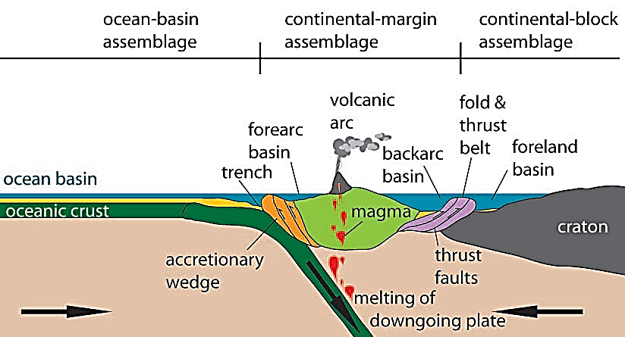

Slide 4
1- Trench basin (Fig. 10)
Elongate, narrow, very deep, gently curving, and starved troughs that form where an oceanic plate bends as it enters a subduction zone. The inner margin of the trench is formed by the overriding plate of the arc–trench system.
Trenches formed along margins flanked by continental crust tend to be filled with sediment derived from the adjacent land areas. Intra-oceanic trenches are often starved of sediment because the only sources of material (apart from pelagic deposits) are the islands of the volcanic arc.
Transport of coarse material into trenches is by mass flows, especially turbidity currents that may flow for long distances along the axis of the trench.
Modern trenches are up to 10 km below sea level, twice as deep as the average bathymetry of the ocean floors (passive margin). They are also narrow, sometimes as little as 5 km across, and may be thousands of kilometers long.

Slide 5
Chile trench in western coast of South America is good recent example of trench basin.
When the Pacific Ocean crust plate subducted downward beneath of South America overriding continent plate. Chile trench dimension is 2500 km in long, 30 km in width, and 8 km in depth.
The accumulated sediment thickness is various along this trench basin depending on source area relief. The sediment transported by turbidity currents by rivers across submarine canyons to forming submarine fans environments.

Slide 6
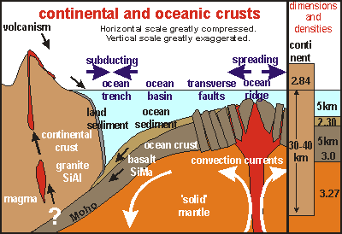

Slide 7
Obducted slabs (ophiolites complexes)
Most oceanic crust is subducted, but in some cases, it is obducted up onto the overriding continental or/ oceanic crust plate. Ophiolites may represent the stratigraphic succession formed in an ocean basin.
An ophiolite suite consists of::::
the ultrabasic and basic intrusive rocks of the lower oceanic crust (peridotites and gabbros),
a dolerite dyke swarm, the feeders to the basaltic pillow lavas that formed on the ocean floor.
deep-ocean deposites (micrite, mudstones, or cherts deposited at or close to the spreading center) depending on relation of CCD with spreading location.
Concentrations of metalliferous ores are common, formed as hydrothermal deposits close to the volcanic vents.

Slide 8
Accretionary complexes:
The strata accumulated on the ocean crust and in a trench are not necessarily subducted with destructive plate .
The mainly pelagic and turbidites sediments may be wholly or partly scraped off the downgoing plate and accrete on the overriding plate to form an accretionary complex or accretionary prism.
These prisms or wedges are best developed where there are thick successions of sediment in the trench.

Slide 9
2- Forearc basins (Fig.11)
The area between the volcanic arc- and -the edge of accretionary complex formed on trench.
The width of a forearc basin will therefore be determined by the dimensions of the arc–trench gap, which is in turn determined by the angle of subduction. The basin floor either oceanic crust or a continental margin (subduction type). The sediments thickness in a forearc setting is partly controlled by the height of the accretionary complex.
Subsidence here is due only to sedimentary loading.
The main source of sediment to the basin is the volcanic arc. Forearc basin succession will consist of deep-water deposits at the base, shallowing up to shallow marine, deltaic and fluvial sediments at the top. Volcaniclastic debris is likely to be present in almost all cases.
The good example is forearc basin between Sumatra island arc in Indonesia and Australian subducted plate.

Slide 10
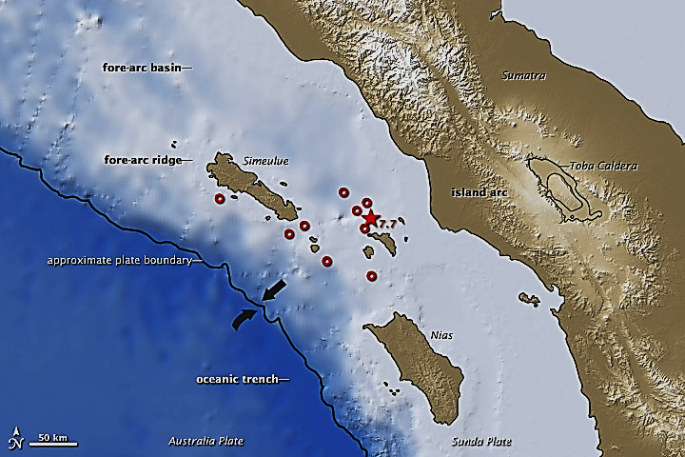

Slide 11
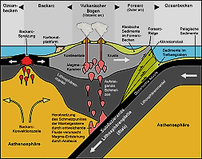

Slide 12
3- Backarc basins (Fig.12)
backarc basins form (in extension) where the rate of subduction is greater than the rate of plate convergence and the angle of subduction of the slab is steep. With further extension, the backarc basin may be developed to grow new ocean by spreading.
Extensional backarc basins can form in either oceanic or/ continental plates (subduction type).
The principal source of sediment in a backarc basin formed in an oceanic plate will be the active volcanic arc. More supplies are available if there is continental crust around the basin.
Backarc basins are typically starved basin, containing mainly deep-water sediment of volcaniclastic and pelagic origin.
Sea of Japan is the example.

Slide 13
