Slide 1
Igneous Petrology
(1)

Slide 2
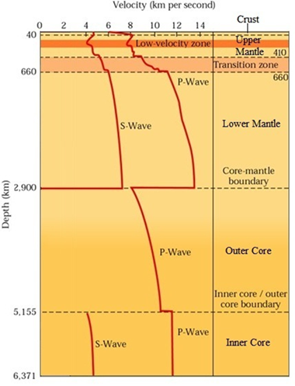
The Principal Subdivisions of the Earth's Interior
The Principal Subdivisions of the Earth's Interior are based on the depth distribution of seismic wave velocities (Fig. 1).
The crust is defined as the region extending from the surface to the Moho discontinuity (major first-order discontinuity), which lies at a depth of 30-50 km beneath most continents and about 10-12 km beneath most oceans.
The upper mantle is located under the crust and extends to a depth of about 410 km. This region is characterized by regional differences in the distribution of the velocities, where it was discovered from the observation of the spread of the low velocity (low velocity zone "LVZ"), especially for transverse velocity (Vs).
Fig. 1: Variation of seismic velocities in the Earth’s interior (velocity-depth profile).

Slide 3
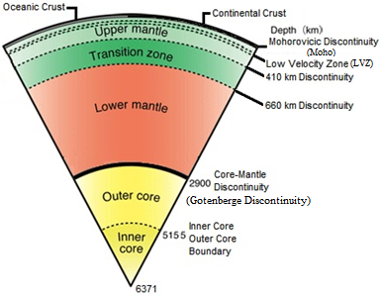
Transition zone is part of the Earth's mantle, and is located between the lower mantle and the upper mantle, between a depth of 410 and 660 km and is characterized by high-velocity gradients.
The lower mantle extending from 660 to 2900 km, is characterized by moderate and relatively uniform increase of seismic velocities with depth.
The earth's core is reached at a depth close to 2900 km. This is marked by major first-order discontinuity (Gotenberge discontinuity). The earth's core is divided into two regions: the outer core is characterized by slowdown of longitudinal seismic waves (Primary waves Vp) and stop transverse seismic waves (Secondary waves Vs), indicating that the outer core is in the liquid state. The inner core passes the transverse and longitudinal seismic waves, indicating that the inner core is a solid (see Fig. 1, 2).
Fig. 2: The Principal Subdivisions of the Earth's Interior.

Slide 4
Earth has a rigid outer layer, known as the lithosphere, which is typically about 100 km thick and overlies a plastic (partially molten) layer called the asthenosphere. As a result, seismic waves slow as they enter the asthenosphere.
Layer | Depth (km)
Crust | Surface - Moho discontinuity
Upper Mantle | Moho discontinuity - 410
Transition zone | 410 - 660
Lower Mantle | 660 - 2900
Outer Core | 2900 - 5155
Inner Core | 5155 - 6371

Slide 5
(1) Crust
Earth's crust is divided into:
(a) Continental crust: In most regions, the continental crust is about 40 kilometer thickness, but it may exceed 70 kilometers in areas of prominent mountains.
1) Upper crust
The longitudinal seismic velocities in the upper crust range between 5.8-6.8 km / s and these velocities are consistent with the velocities observed in the acidic igneous rocks and metamorphic rocks. Here we conclude that the upper crust consists of the granitic composition. A geological observation, geochemical analyses and densities showed that the upper crust rocks were closer to the granodiorite than to the granite.

Slide 6
2) Lower crust
The longitudinal seismic velocities in the lower crust range between 6.5-7.2 km / s and are similar to that measured in basic rocks. The conclusion that the rocks of the lower crust are consisting of basic rocks is actually unsupported. Laboratory experiments show that the mineral assemblages of the gabbro rocks are in fact not stable thermodynamically under pressure, heat and water pressure prevailing in the lower crust. Assuming that the lower crust consists of a basic composition, in dry conditions, the eclogite (Vp= 8.4 km / s) will be formed in low-heat flow zones. In the high-heat flow zones, we will have a garnet granulite (Vp= 8-7.3 km / s). From this we conclude that the lower crust rocks cannot have a basic composition.
Seismic velocities values (6.5-7.2 km / s) indicate the existence of large amounts of low seismic velocity minerals (e.g. quartz and alkali feldspar) for equation the garnet and pyroxene (high seismic velocity). The estimation of mineral assemblages, density, seismic velocity, which can be given by acidic and intermediate rocks in the eclogite facies, can best match with the physical properties of the lower crust.

Slide 7
(b) Oceanic crust: Oceanic crust differs from continental crust in several ways: it is thinner (10 km), denser and younger. The oceanic crust is destroyed in subduction zones.
Ocean basins
Mid oceanic ridges
Island Arcs
1) Ocean basins
Ocean basins consist of three layers: the first layer consists of unconsolidated sediments and the second layer consists mostly of unconsolidated basalt flows. The third layer represents the main layer and is located in the depths of the ocean basins above the mantle (average seismic velocity of 8.1 km / s).
There are two theories about the nature of this layer; Hess (1965) suggested that it consists of serpentinised peridotite, while Oxburgh and Turcotte (1968) considered this layer to be composed of basic rocks.

Slide 8
The Principal Subdivisions of the Earth's Interior
Discontinuity
The crust
The upper mantle
Transition zone
The lower mantle
The outer core
The inner core
Lithosphere
Asthenosphere
Earth's crust is divided into:
(a) Continental crust:
Upper crust
Lower crust
(b) Oceanic crust:
Ocean basins
Mid oceanic ridges
Island Arcs

