Slide 1
Igneous Petrology
(2)

Slide 2
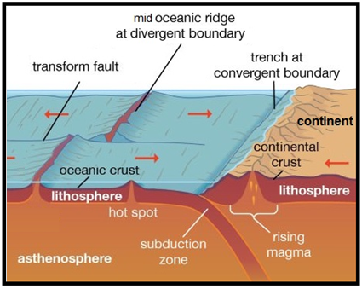
2) Mid oceanic ridges
A mid-ocean ridge (MOR) is a seafloor mountain system formed by plate tectonics. It typically has a depth of ~ 2,600 meters and rises about two kilometers above the deepest portion of an ocean basin (see Fig. 3-a). This uplifting of the seafloor occurs when ascending convection currents in the mantle beneath the oceanic crust. This feature is where seafloor spreading takes place along a divergent plate boundary (see Fig. 3-a, b).
The production of new seafloor and oceanic lithosphere results from mantle upwelling in response to plate separation. The melt rises as magma at the linear weakness in the oceanic crust, and emerges as lava, creating new crust (basalt) and lithosphere upon cooling.

Slide 3
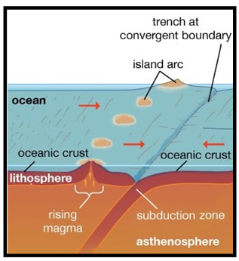
3) Island Arcs
Island arcs are long chains of active volcanoes with intense seismic activity found along convergent plate boundaries. Most island arcs originate on oceanic crust and have resulted from the descent of the lithosphere into the mantle along the subduction zone. They also possess a distinct curved form, a chain of active or recently extinct volcanoes and a deep-sea trench on the convex side of the volcanic arc. The trenches at the front of the island arcs are believed to represent the locations of descending convection currents (see Fig. 3-a, b).
Subduction zones involve the oceanic lithosphere of one plate sliding beneath the continental or oceanic lithosphere of another plate due to the higher density of the oceanic lithosphere. Subduction zones are sites that usually have a high rate of volcanism and earthquakes, this zone is also called Benioff zone and extends to a depth of 700 km (see Fig. 3-a, b). The volcanic rocks forming these mountains are mostly of Andesitic pyroclastic.

Slide 4
Fig. 3: (a): The Plate Tectonic Cycle. (b): A model of convection within Earth’s mantle.

Slide 5
(2) Mantle
a) The Upper Mantle
The upper mantle extends from the Moho discontinuity to a depth of about 410 km (see Fig 1, 2). The longitudinal wave velocity in most regions of the upper mantle is about 8.2 km / s. From this longitudinal velocity, in addition to chemical and petrological studies, the mineralogical composition of the upper mantle rocks was determined: olivine, pyroxene and garnet. The two principal rock types carrying these minerals are peridotite (olivine – pyroxene) and eclogite (pyroxene – garnet). So the upper mantle rocks consist either of peridotite or eclogite. In the following we will explain the physical and petrological evidence.

Slide 6
1) Diagonstic Physical Criteria:
a) Pisson's Ratio
Although longitudinal and transverse velocities of peridotite and eclogite have been overlapping and cannot be used for differentiation, there is a possibility that the relationship between these velocities (Vp/Vs) may be a more sensitive indicator.
The Pisson's ratio of the mantle was calculated under continental stable regions and was found to be between 0.245-0.260 and the Pisson's ratio of olivine (Mg-rich), which ranged from 0.245-0.255. On the other hand, the values of this ratio for the eclogite rocks ranged from 0.3-0.32. Accordingly, it is concluded that the peridotite rocks are the strongest candidate for the upper mantle.

Slide 7
b) Anisotropy
Hess (1964) has suggested that anisotropy can be explained by the preferred orientation of olivine crystals, where each crystal has a very high anisotropy. The anisotropy is common feature in peridotite rocks. On other hand the eclogite rocks contains 50% garnet, which is isotropy. These notes indicate the upper mantle consists of peridotite and not eclogite.
c) Density
The density of the peridotite rocks proposed as main components of the upper mantle is between 3.25-3.4 g/cm³. On the other hand, the density of eclogite rocks ranges between 3.4-3.6 g/cm³. Using gravitational and seismic methods, the density contrast between the crust and the mantle was found to be 0. 43 g/cm³ and the density of the continental crust were between 2.8-2.9 g/cm³ so the expected density of the upper mantle ranged between 3.23-3.33 g/cm³, indicating that the upper mantle consists of peridotite preferred it to eclogite.

Slide 8
2) Mid oceanic ridges
(divergent plate boundary)
3) Island Arcs
(convergent plate boundary)
Subduction zones
a) The Upper Mantle
1) Diagonstic Physical Criteria:
a) Pisson's Ratio
b) Anisotropy
c) Density

