Slide 1
Igneous Petrology
(3)

Slide 2
2) Petrological Evidences:
a) Alpine Peridotites and Ophiolite Complexes
Hess (1964) noted that the alpine peridotite rocks are characterized by an adjacent intrusion to the axes of deformation along the orogenic belts and island arcs. Hess and other researchers concluded that the alpine peridotite rocks were derived from the mantle by the tectonic processes that were emplaced into the crust. The alpine peridotite rocks have a tectonic contact with the adjacent rocks, and the effect of the contact metamorphism on along the edge between the alpine peridotite rocks and adjacent rocks is limited or non-existent. The structures and textures of alpine peridotite rocks indicate that these rocks have strongly deformed by solid state flow processes.
Alpine peridotite is divided into two main groups depending on the mineralogical and chemical properties:
1) Harzburgite type: (Harzburgite and dunite).
2) Lherzolite type: (garnet, spinel or plagioclase lherzolite with minor pyroxenite).

Slide 3
Spray (1982) concluded that the classification of alpine peridotite rocks to primitive lherzolite (which is characterized by high temperature and pressure) and depleted harzburgite (low temperature and pressure) is a simplification of the thing. Spray (1982) concluded that there was a gradient between the two types.
There is a long discussion on the origin of alpine peridotite rocks by petrology scientists:
1) Hess, 1938 supported the presence of low-temperature hydrous ultramafic magmas.
2) Coleman, 1971 suggested that the alpine peridotite rocks represent solid pieces that were emplaced from the upper mantle to high levels of the crust by obduction as a result of a continent collision with a continent or a continent collision with arc.
3) Some of the alpine peridotites climb up to the top in a hot dipper (Loomis, 1972).

Slide 4
b) Xenoliths of Mantle Origin-Inclusions in Kimberlite Pipes
Kimberlite pipes containing diamonds are found in a large area in South Africa. These pipes contain several xenoliths of the crust rocks (sediments, schists, granite, basalt etc.), which are known to have overlapped with them on their way towards the top. In addition, the kimberlite contains a large number of xenoliths that are supposed to not exist in the vicinity, especially peridotite rocks, and least common pyroxenite and eclogite xenoliths. It has been observed that the diamonds are found in the peridotite and eclogite xenoliths. The presence of diamonds in xenoliths and pipes indicates that they originate from the depths of the upper mantle.
Studies have shown that peridotite xenoliths consist of garnet lherzolite, which is composed of olivine (Fo), orthopyroxene (enstatite), clinopyroxene (diopside) and garnet. The chemical composition of the garnet lherzolite rocks indicates that Al₂O₃, CaO and K₂O+Na₂O are low in these rocks, and therefore these rocks will produce very low amounts basaltic magma if subjected to partial melting. We conclude from this that the upper mantle is composed of depleted rocks.
On the other hand, eclogite xenoliths are composed of two essential minerals: clinopyroxene (omphacite) and garnet. The equilibrium temperature of the eclogite (1185 - 940 °C) and the pressure (40-50 Kbar) indicate that the origin of these rocks the mantle.

Slide 5
How is eclogite formed?
1) Eclogite xenoliths be formed of basaltic magma in the depths of the mantle due to the partial melting of the mantle peridotite, and part of the magma does not reach the surface and is trapped in the mantle and crystallizes to eclogite.
2) Eclogite xenoliths can be derived from oceanic crust rocks that are subducted to the upper mantle.

Slide 6
c) Peridotite Xenoliths in the Alkali Basalt Suite-Mantle Origin
There are more than 200 known sites in the world where they found peridotite xenoliths in alkali basalts. In most places these xenoliths are spinel lherzolite. Spinel lherzolite is composed of olivine (Fo), orthopyroxene, clinopyroxene and spinel (accessary). The mineral composition of spinel lherzolite is very similar to alpine peridotites, and this texture can be formed by complex metamorphic processes involving comprehensive deformation in solid state (tectonic textures).
When comparing the chemical composition between spinel lherzolite and garnet lherzolite, it was observed that the first rocks contain basalt components (Al₂O₃, CaO) more concentrated than in the garnet lherzolite, Thus, the spinel lherzolite xenoliths is more primitive than the garnet lherzolite. Their aluminous phases change with pressure, with plagioclase present at low pressures, spinel at intermediate pressure and garnet at high pressure, thus, the spinel lherzolite turns to garnet lherzolite at a depth of 70-100 km.

Slide 7
Spinel lherzolite xenoliths are always present with alkaline basaltic magma and rarely in tholitic basalt.…?
Alkaline basalt is rich in volatile components, which helps to contribute to the rise of the xenoliths from the mantle.
Studies have shown that mineral assemblages of lherzolite xenoliths are unstable in tholitic basalt.
From this we conclude that the upper mantle components consist of peridotite rocks with little amounts of eclogite.

Slide 8
Pyrolite Model
Pyrolite is a theoretical rock considered to be the best approximation of the composition of the primodal mantle (upper mantle) proposed by Ringwood (1962). The composition of primodal mantle (olivine + pyroxene + garnet) can be produced by mixing three parts alpine peridotite and one part of tholitic basalt. Pyrolite is capable of produce basaltic melts by partial melting leaving a solid residual peridotite (olivine, pyroxene).
‏Most ultrabasic rocks (alpine peridotite and peridotite xenolith) are generally solid residues and depleted to varying degrees due to partial melting of the mantle pyrolite.

Slide 9
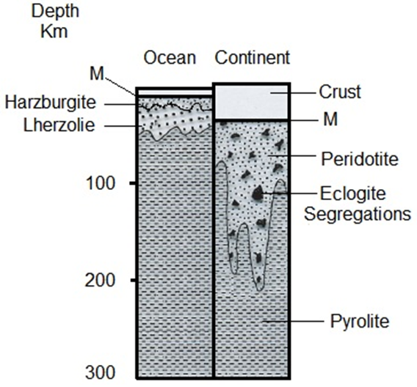
So the upper mantle consists of primitive mantle pyrolite (basaltic magma is not extracted from it) and is located at the bottom of the solid residual peridotite. From this, the researchers concluded a chemically zoned model for the upper mantle as shown in Figure 4.
Fig. 4: A chemical zoned model for the upper mantle.
The mineral assemblages of pyrolite:
Plagioclase Pyrolite (olivine + orthopyroxene +clinopyroxene + plagioclase).
Pyroxene Pyrolite (olivine + orthopyroxene +clinopyroxene ± spinel).
Garnet Pyrolite (olivine + orthopyroxene +clinopyroxene + garnet).

Slide 10
2) Petrological Evidences:
a) Alpine Peridotites and Ophiolite Complexes
b) Xenoliths of Mantle Origin-Inclusions in Kimberlite Pipes
c) Peridotite Xenoliths in the Alkali Basalt Suite-Mantle Origin
Pyrolite Model

