Slide 1
Igneous Petrology
(4)

Slide 2
b) Transition Zone
Transition zone a part of the Earth’s mantle located between the lower mantle and the upper mantle. This zone extends from a depth of 410 - 660 km. The main discontinuity (in the density and seismic velocities) at about 410 km and 660 km, where it was concluded that the discontinuity is due to chemical and phase changes.
c) Lower Mantle
The lower mantle represents approximately 56% of the Earth's total volume, and is the region from 660 to 2900 km below the Earth's surface; between the transition zone and the outer core. Studies have shown a lack of discontinuity in the lower mantle, indicating a little change in the phases and chemical composition.
3) The Core
At a depth of 2900 km there is major discontinuity of seismic velocity, and this depth determines the borders of the earth's core. Under this depth the transverse velocity waves stop moving, confirming the liquid state of the outer core. The outer core composed of liquid iron and nickel, while the inner core is composed of solid iron and nickel under very high pressure.
The seismic velocity discontinuities include: (1) crust/mantle boundary (Moho discontinuity), (2) low velocity zone (asthenosphere), (3) mantle/outer core boundary (Gotenberge discontinuity), (4) outer core/inner core boundary.

Slide 3
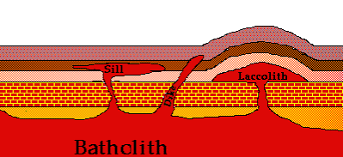
Forms and Structures of Intrusive Rocks
Structures of Intrusive Rocks are classified into:
Basic Intrusion into Continental Crust (Dykes and Sills).
Ophiolite Complexes.
Deep Seated Granitic Rocks.

Slide 4
Ophiolite Complexes
An ophiolite is a section of the Earth's oceanic crust and the underlying upper mantle that has been uplifted and exposed above sea level and often emplaced onto continental crustal rocks. Steinmann (1927) described the ophiolite as rock association, consisting of peridotite (partially alteration to serpentinite), gabbro, diabase and spilite. The ophiolite has been uplifted and emplaced in deep sea sediments (radiolarian chert, pelagic clays, and pelagic limestone). Thus Steinmann's trinity consists of (from bottom to top) peridotite, diabase-spilite and then radiolarian chert (see Fig. 5).
The ophiolite sequence (from bottom to top):
Ultramafic complex (tectonite): It consists of different proportions of lherzolite, harzburgite and dunite (partially alteration to serpentinite), and usually contains tectonic textures.
Gabbroic complex: Usually consists of cumulate textures.
Mafic sheeted dyke.
Pillow lava: mafic volcanic complex.
Sediments of deep sea: radiolarian chert, pelagic clays and pelagic limestone.

Slide 5
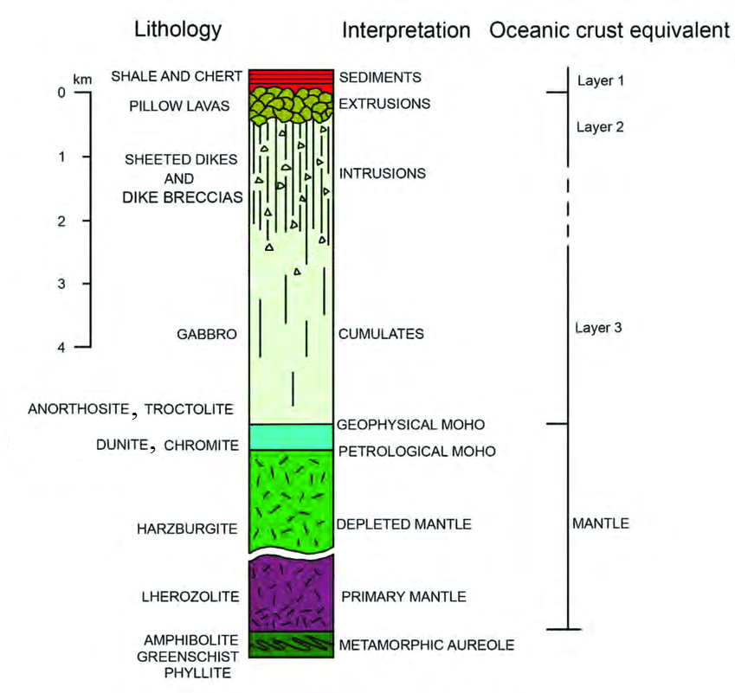
The ophiolite complexes are either tectonically called autochthonos (not moved) as the California ophiolite complex in USA, or allochthonous (moved) as Penjween and Mawat ophiolite complexes in Iraq.
The lower part of the complex occur thermal contact metamorphism at the bottom of the tectonite peridotite. The heat source of this metamorphism is mainly the residual heat of the new oceanic crust formed, and partly as a result of the frictional heat resulting from the emplacement of the ophiolite.
Fig. 5: General section of an idealized allochthonous ophiolite sequence.

Slide 6
Petrogenesis and Tectonic Emplacement:
There are two different opinions about the petrogenesis relationship between tectonite peridotite rocks and cumulate basic rocks:
Ringwood (1975) explained this relationship by partial melting of the primary mantle at the top of the upper mantle, generating basaltic magma and solid residues (dunite and Harzburgite). The basalt melt (complementary to peridotite) is then separated from the tectonite peridotite and crystallized (due to fractional crystallisation) at high crust levels to form layered stratiform complexes.
Coleman (1977) explained that the rocks of the mantle exposed to partial melting and emplaced in the crust, and later came basic magma from another source and formed the cumulate rocks (magma differentiation).
There are several different ways of emplacement the ophiolite, including the Diapir method and second way emplacement the ophiolite is related to plate tectonics (obduction-subduction).

Slide 7
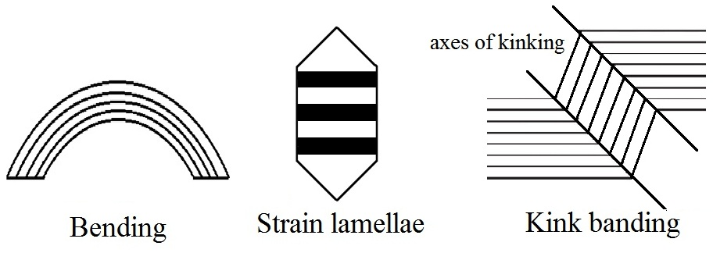
Tectonite peridotite rocks
The tectonite peridotite rocks are characterized by deformed tectonic textures such as Porphyroclastic and Mylonitic textures. As a result of the emplacement of these rocks in a subsolidus state, the mineral components are affected by several deformations:
Wavy extinction, Bending, Strain lamellae and Kink banding
Cumulated Rocks
The cumulated rocks are characterized by a non-deformed cumulate texture resulting from the process of magma differentiation such as the crystallization of the basic magma resulting from the crystallization of minerals such as olivine and pyroxene and depositing it in the bottom of the magma chamber, forming ultrabasic cumulate rocks.

Slide 8
b) Transition Zone
c) Lower Mantle
3) The Core
a) The outer core
b) The inner core
Ophiolite Complexes
The ophiolite sequence :
Ultramafic complex.
Gabbroic complex.
Mafic sheeted dyke.
Pillow lava.
Sediments of deep sea.
Tectonite peridotite rocks
Cumulated Rocks

