Slide 1
Igneous Petrology
(6)

Slide 2
b) Feldspar proportion
Feldspars are the commonest minerals in igneous rocks, in which they constitute, on the average, over 50 vol.%. The feldspars of igneous rocks fall into two distinct mineralogical grouping, plagioclase and alkali feldspar. Pyrogenetic plagioclase is generally optically homogeneous. Alkali feldspar is much more variable in appearance and comprises optically homogeneous sanidine and anorthoclase in young volcanic rocks, cryptoperthices in older volcanic rocks, and orthoclase and microcline that are frequently perthitic in plutonic rocks.
Granite | Granodiorite | Diorite | Gabbro
A.K>Plag. | A.K ≤ Plag. | A.k < Plag. | A.k < Plag.
Albite | Oligoclase | Andesine | Labradorite-Bytownite

Slide 3
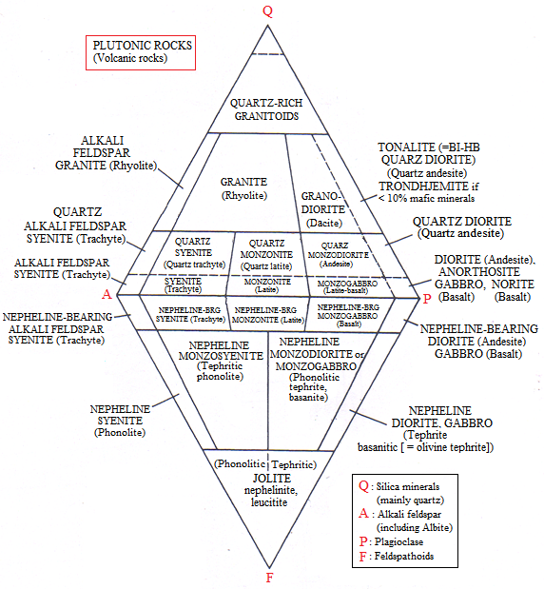
However the Internation Union of Geological Sciences (IUGS) petrology has published igneous rocks classification (Streckeisen, 1976). This classification is based on the actual mineral content (modal minerals) of the rock (in volume percent). The corners of the classification are quartz, alkali feldspar, plagioclase, or feldspathoids, alkali feldspar, plagioclase Q-A-P-F (see Fig. 1). Rocks in which M= 60 to 90 are designated mafic rocks such as gabbro (see Fig. 2). Rocks in which M>90 are classified according to the predominant mafic minerals such as peridotite and pyroxenite (see Fig 3).
Acidic rocks: M ˂ 30.
Intermediate rocks: M 30-60.
Basic rocks: M 60-90.
Ultrabasic rocks: M > 90.
Fig 1: IUGS classification of plutonic and volcanic rocks in the double triangle Q-A-P-F, according to their actual mineral content, (After Streckeisen, 1973, 1976, 1979).

Slide 4
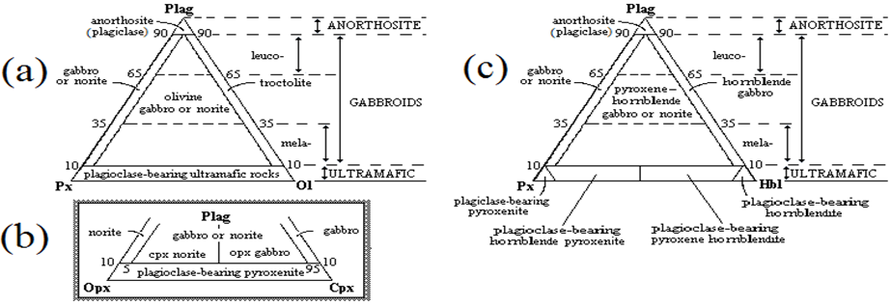
Fig 2: Classification and nomenclature of gabbroic rocks, (a) Gabbroic rocks composed of plagioclase, pyroxene and olivine. (b) Subdivision of gabbroic rocks into gabbro, Opx gabbro and Cpx norite, and norite. (c) Gabbroic rocks that contain hornblende, (Streckeisen, 1976).

Slide 5
Fig. 3: Classification and nomenclature of ultramafic rocks, (a) Ultramafic rocks composed of olivine, orthopyroxene and clinopyroxene. (b) Ultramafic rocks that contain hornblende (Streckeisen, 1976).

Slide 6
4) Grain Size and Occurrence (textural classification)
Igneous rocks can be either extrusive or intrusive, the latter comprising both hypabyssal and plutonic rocks. Thus three names could be applied to rocks of the same chemical composition, depending on their mode of eruption. Very common terms basalt, diabase and gabbro. Terms applicable to grain size are more specifically defined as follows:
(1) Phaneritic - visibly crystalline, with aid of hand lens if necessary:
(a) Very coarse-grained >30 mm
(b) Coarse-grained 5-30 mm
(c) Medium-grained 1-5 mm
(d) Fine-grained <1 mm, but crystallinity discernible using
microscope.
(2) Aphanitic - crystallinity not discernible even with aid of hand lens:
(a) Microcrystalline: crystals visible under microscope.
(b) Cryptocrystalline: crystals too small to be capable of being resolved optically.
(c) Glassy or hyaline: material is glass.

Slide 7
The textural classification depending on grain-size displays the three types of igneous rocks:
Plutonic or Intrusive Rocks: That rocks which are formed at relatively deep regions. They contain crystals formed at slow cooling enough to give sufficient time for crystallization (phaneritic).
Hypabyssal Rocks: Those of intermediate depth. They have mixed texture of both phaneritic (plutonic) and aphanitic (volcanic) rocks and they are characterized by porphyriyic texture indicating two stages of cooling first slow then followed by rapid cooling.
Volcanic or Extrusive Rocks: Those rocks that are formed after ejection of the magma over the Earth's surface. Texturally, they have either fine grain due to rapid cooling, or glass "hyaline" due to sudden cooling that gives no time at all even to form nuclei of grain, cryptocrystalline (aphanitic).

Slide 8
b) Feldspar proportion
(1) Alkali Feldspars :
Orthoclase, microcline, anorthoclase and sanidine.
(2) Plagioclase :
Albite - oligoclase - andesine - labradorite - bytownite - anorthite.
Internation Union of Geological Sciences (IUGS)
Classification of plutonic and volcanic rocks
Classification of gabbroic rocks
Classification of ultramafic rocks
4) Grain Size and Occurrence
a) Plutonic or Intrusive Rocks
b) Hypabyssal Rocks
c) Volcanic or Extrusive Rocks

