Slide 1
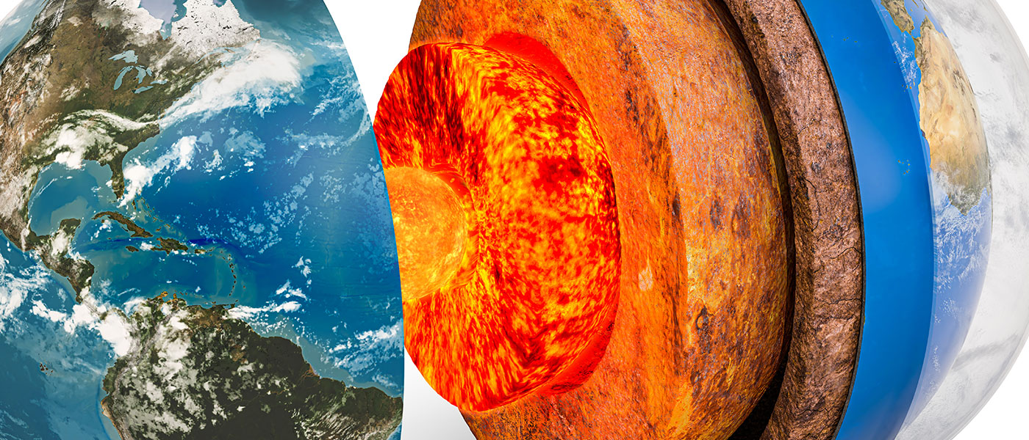
General geology
University of Mosul/ College of Science/ Department of Geology

Slide 2
Sedimentary Rocks
INTRODUCTION :
1- About 75% of sedimentary rocks are exposed at the earth’s surface yet sedimentary rocks make up 5% by volume of the earth's crust.
2- Sedimentary rock is formed by processes that occur mainly at or near Earth’s surface on the floor of oceans or other bodies of water or land at the earth's surface.
3- Consist of the accumulation or deposition of mineral solid particles derived(resulting) from mechanical weathering, as well as minerals, precipitated from solution by chemical weathering. and minerals secreted تفرز by organisms to build their skeletons produced by biochemical weathering.
تتكون من تراكم أو ترسب الجسيمات المعدنية الصلبة المشتقة من التجوية الميكانيكية ، وكذلك المعادن ، المترسبة من المحلول بواسطة التجوية الكيميائية. والمعادن التي تفرزها الكائنات الحية لبناء هياكلها العظمية التي تنتجها التجوية الكيميائية الحيوية

Slide 3
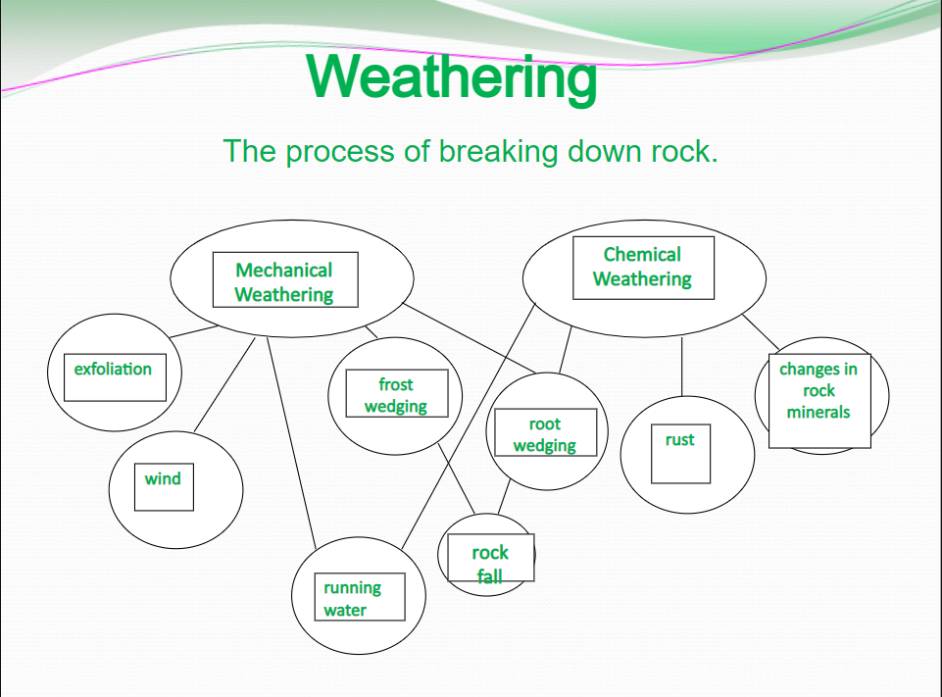
الصدأ

Slide 5
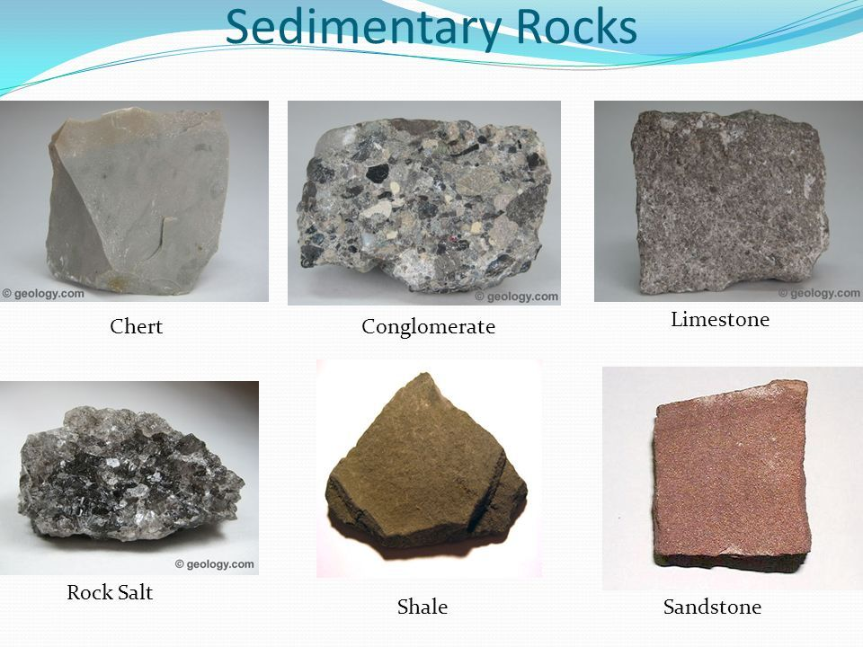

Slide 6
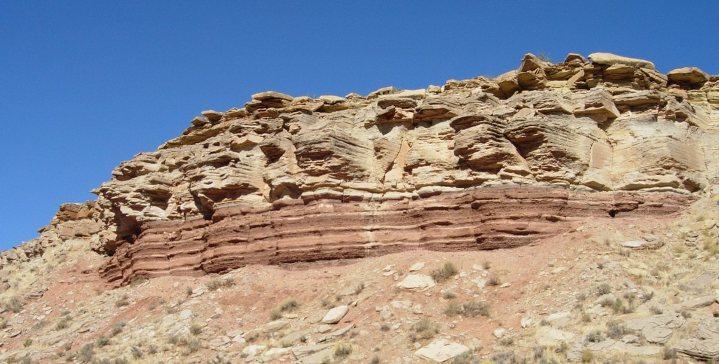

Slide 7
Metamorphic Rocks
INTRODUCTION:
Metamorphic rocks result from the transformation of other rocks (igneous rocks, sedimentary rocks, or other formerly metamorphic rocks) by a metamorphic process that usually occurs beneath (under) the Earth's surface in the solid-state
THE TYPE OF METAMORPHIC ROCK FORMED DEPENDS ON:
1- The original and texture of the rock
2- The agents of metamorphism (The agents of metamorphism include heat, pressure (stress), and chemically active fluids)
3- The amount of time the parent rock was subjected to the effect of metamorphism

Slide 8
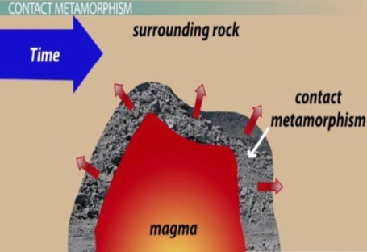
TYPES OF METAMORPHISM:
The two most common types of metamorphism :
1- Contact metamorphism
2- Regional metamorphism

Slide 10
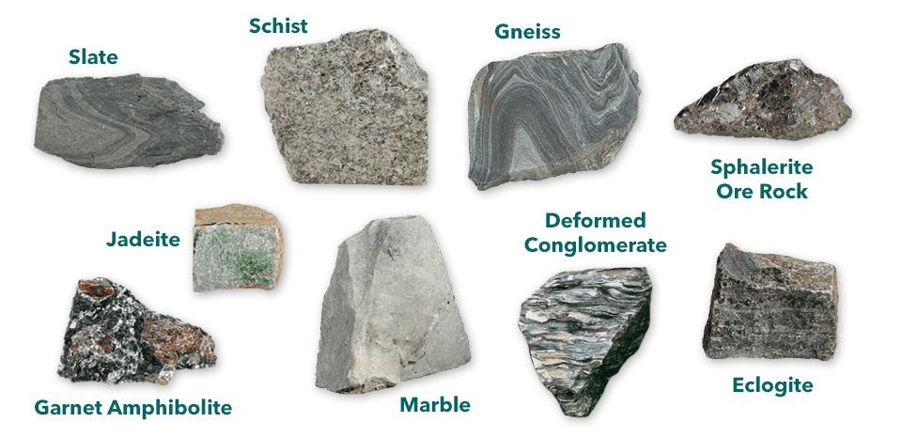
Metamorphic Rocks

Slide 11
INTRODUCTION IN HYDROLOGY
'Hydro' means Water
'Logy' means Science
Hydrology means the science of water.
Definition: It is the science that deals with the occurrence, circulation, and distribution of water on the earth and the earth’s atmosphere.
Hydrological Cycle
The term hydrologic cycle refers to the constant movement of water above, on, and below the Earth's surface.

Slide 12
1- Precipitation
Precipitation occurs in several forms, including rain, snow, and drizzle.
2- Evaporation
Evaporation of water from the (a) surface sources like rivers, lakes, and oceans, (b) from the surface of the soil (c) plants through transpiration. Through this process, water is converted into vapor.
3- Transpiration
Is the process where water contained in liquid form in plants is converted to vapor and released into the atmosphere.
4- Runoff
It means the draining/flowing of precipitation from the catchment area channeled through a surface.

Slide 13
5- Percolation
Water flows vertically through the soil and rocks under the influence of gravity and capillary forces.
6- Infiltration
Some of the precipitation that falls on land seeps into the ground where it is stored and transported to surface water (river - lake -etc.).
7- Condensation
The transformation of waters vapor to liquid water droplets in the air.

Slide 14
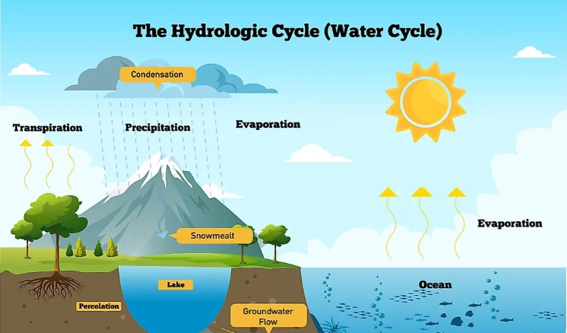

Slide 15
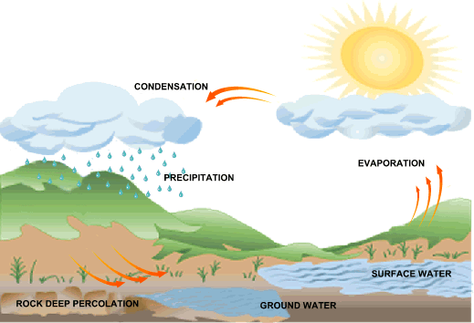
Climatic elements
1-Rainfall
2- Temperature
3- Wind speed
4- Sunshine duration
6- Evaporation
5- Relative humidity
Sunshine duration

Slide 16
One of the most important factors affecting water loss is evapotranspiration, which is an important part of evaporation in general, the amount of evaporated water is inversely proportional with the increase in water.
Rainfall is the major input parameter in the water balance of the any area
Groundwater
Groundwater is a significant not only on a local level, but also globally, as more than 2 billion people depend on it on a daily basis.
Despite the importance of water for life, whether for drinking, irrigation or for industry, it is widely used in many other areas, find that human activity harms many of them and increases their pollution.

Slide 17
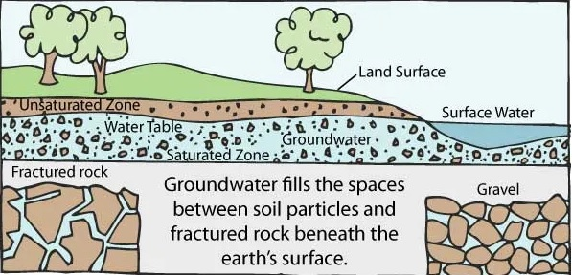
How groundwater is formed?
Most groundwater comes from precipitation. Precipitation infiltrates below the ground surface into the soil zone. When the soil zone becomes saturated, water percolates downward.

