Slide 1
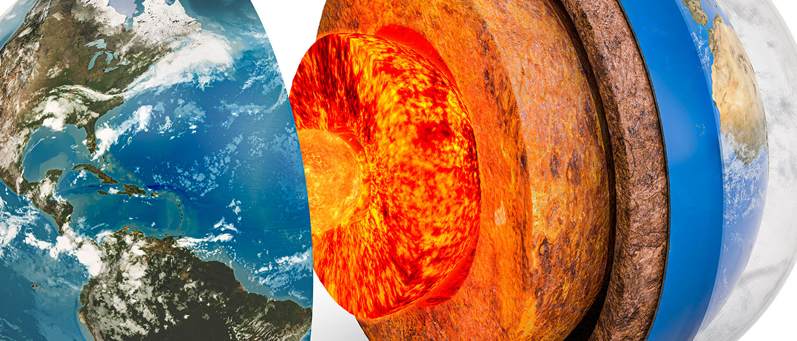
General geology
University of Mosul/ College of Science/ Department of Geology

Slide 2
Introduction
Definition of Geology
The science dealing with the physical nature and the history of the earth, including the structure and development of its crust, the composition of its interior, the types of rocks, the forms of life found as fossils
The term Geology
A Greek words consists of two parts Geology
Geo means the earth
Logy means the science

Slide 3
The importance of geology:
There are three main areas of geology that are important to people:
1. Natural Resources:
Includes minerals, groundwater, fossils, also the materials we use in construction like gravel and stone.
2. Natural Hazards:
Includes volcanoes, and earthquakes and how to mitigate the risks of these.
3. Engineering:
Is about how geology affects the buildings we build.
Branches of geology
1- geochemistry, 2- geophysics , 3- hydrogeology 4- Petrology, 5- Mineralogy,
6-Paleontology 7- Structural Geology 8- Sedimentology 9- Environmental Geology 10- Petroleum Geology etc.…

Slide 4
(The Spheres of the Earth)
1. The Atmosphere
The atmosphere is the body of gasses that surrounds our planet, held in place by earth's gravity. It is composed of nitrogen (78 %), oxygen (21 %), argon (0.9 %), carbon dioxide (0.04 %) and small amount remaining is composed from other gasses.
2. The Hydrosphere
The hydrosphere is composed of all of the water on or near the planet's surface. This includes oceans, rivers, and lakes, as well as underground water. More than 97 % of the earth's water is found in oceans.

Slide 5
(The Spheres of the Earth)
3. The Biosphere
Includes organisms living in the atmosphere, water, and on the earth's surface. Geology study the organisms that play important roles in geological processes, such as bacteria that have a role in the organic weathering as well as in organic sedimentation.
4. The Geosphere
The lithosphere is consider a part from Geosphere , and thickness of lithosphere (100-150) km refers to all the rocks of the earth. The lithosphere is divided into 7 Major tectonic plates and 14 minor tectonic plates that fit together around the earth. They’re slowly moving.
There are three types of tectonic margins between these plates, which are as follows:
1 - Convergent margins (Destructive margins)
2 - Divergent margins (Constructive margins)
3 - transform faults margins (Conservative margins)

Slide 7
(Structure of the earth’s interior)
Geosphere
Geosphere Physical / Mechanical and Rheology Behavior
Four spheres :
Lithosphere , thickness 100-150 km
Asthenosphere, thickness 250-300 km
Mesosphere, thickness ~ 2500 km
Endosphere, thickness 3471 km
The Earth has a radius of about 6371 km.

Slide 8
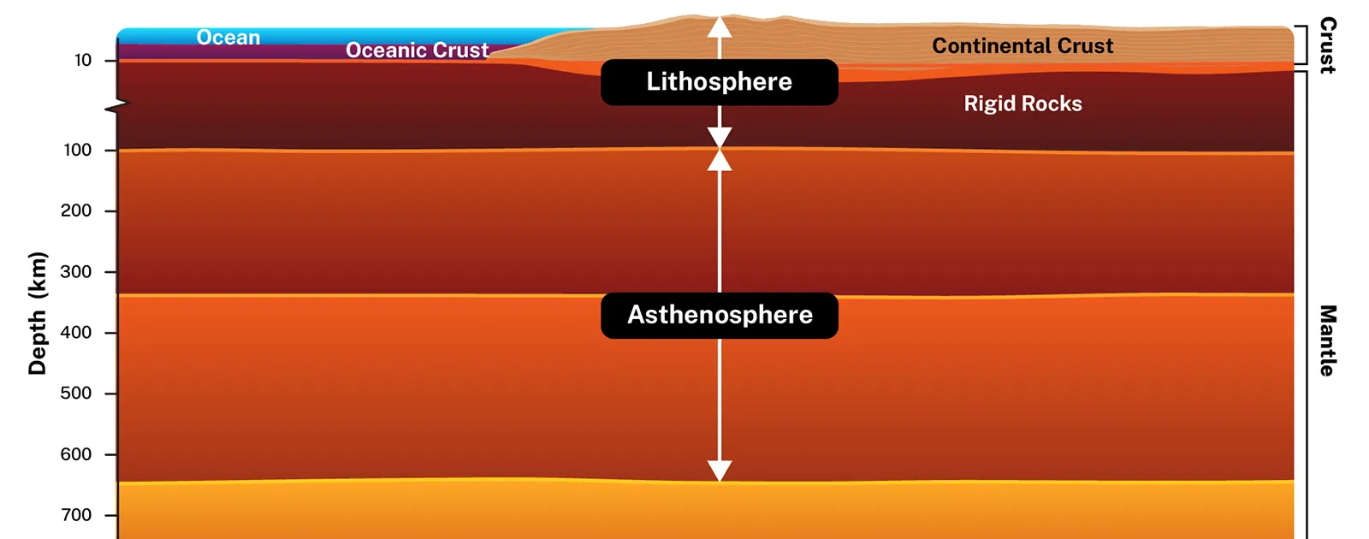
(Structure of the earth’s interior)
The upper mantle and crust called lithosphere.

Slide 9
Chemical structure
Geosphere
Physical / Mechanical
Compositional
Crust
Mantle
Core
The radius of earth 6371 km

Slide 10
(Structure of the earth’s interior)
According to their chemical properties:
Structure of earth’s interior divided to:
1- crust (Continental , Oceanic)
2- Mantle (upper mantle, transition zone , lower mantle)
3- Core (outer core and inner core).
The Three layers of Earth vary in size, composition, temperature and pressure.
Age of the earth is estimated to be 4.54 billion years old
The Earth has a radius of about 6371 km.

Slide 11
Chemical structure
Geosphere
Physical / Mechanical
Compositional
Crust
Mantle
Core
The radius of earth 6371 km

Slide 12
properties Layers of Earth
1. Crust
•There are two types of crust: the continental crust and the oceanic crust. Approximately 35% of the Earth’s crust is continental, while 65% is oceanic crust.
• The crust is only about (0-10 km) thick under the oceans (oceanic crust) and about (10-70 km) thick under the continents (continental crust)
There are discontinuity between continental crust and the oceanic crust called Conrad
Major elements of crust
The Silicon (Si) and Aluminum (Al), therefor the Continental crust often is termed as (SIAL).
The Silicon (Si) and Magnesium (Ma), therefor the Oceanic crust often is termed as (SIMA).

Slide 13
2. Mantle
1- The mantle divided to three layers: the upper mantle, the transition zone, and the lower mantle. The mantle separated from the crust by Moho discontinuity.
2- Magma usually forms in the upper mantle causes partial milting of result from convection Current and Subduction Zone.
3- Mantle convection is the very slow creep of Earth's solid silicate mantle as convection currents carry heat from the interior to the planet's surface. Mantle convection causes tectonic plates to move around the Earth's surface.

Slide 14
3. Core
1- The temperature increases towards earth's center where it may up to 6700 °C.
2- The Core consists of the liquid outer core and the solid inner core.
3- The inner core is solid because it is under very high pressure. The outer core is liquid because of the heat produced by the breakdown of radioactive elements in the inner core.
• The core separated from the mantle by Gutenberg's Discontinuity.
The outer core separated from inner core by Lehman Discontinuity
• The core composed mainly from iron (Fe) and nickel (Ni) and phosphor (P) in outer core.

Slide 15
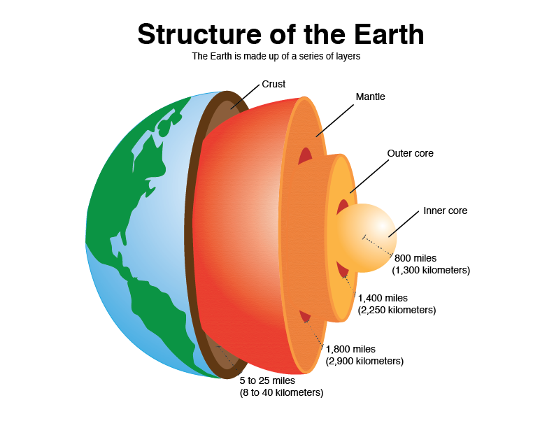
The radius of earth 6371 km

