Slide 1
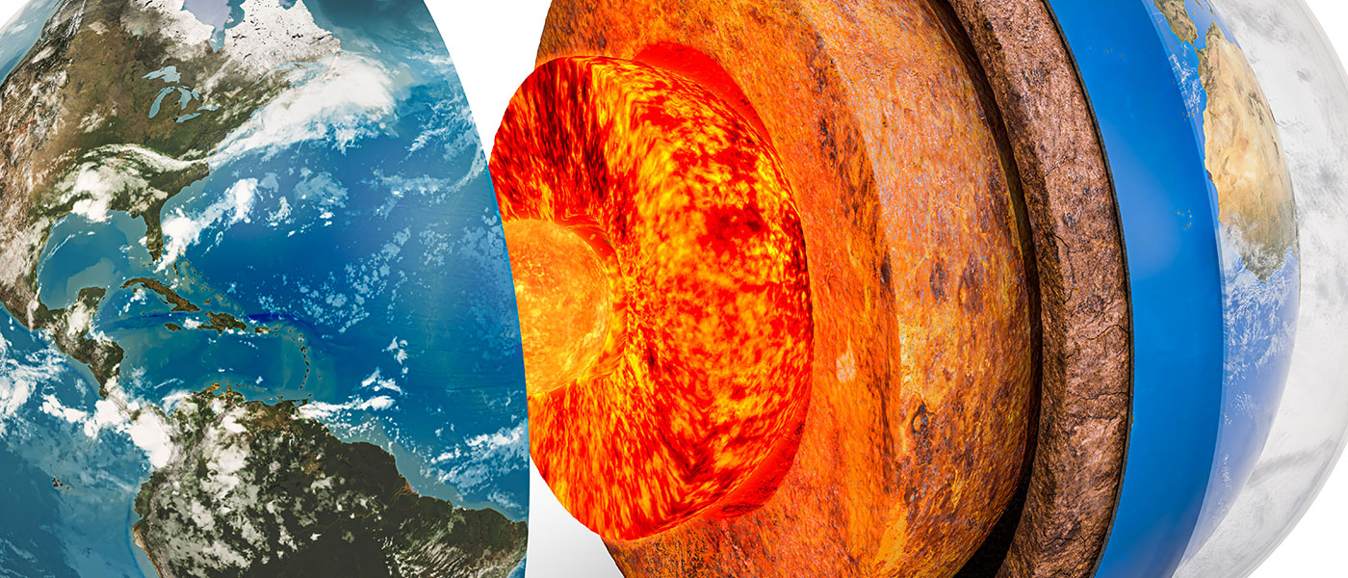
General geology
University of Mosul/ College of Science/ Department of Geology

Slide 2
Minerals
Definition
Minerals are naturally occurring inorganic solid substances and they have unique crystal structures and definite chemical compositions.
A mineral must have all of the following characteristics: صفات المعادن
1. Must be naturally occurring (not man‐made)
2. Must be a solid (not liquid or gas) without Mercury
3. Must have chemical composition
4. Must be inorganic
5. Must have a crystalline structure
There are nearly 3500 minerals available on earth. Out of this, about 20 are common minerals. Minerals may be composed of a single element or a combination of elements. Minerals composed of more than one element are bound together by electrical bonding.

Slide 3
Formation of Minerals The minerals form when atoms bond together in a crystalline arrangement. The ways for the formation of minerals are: 1) Precipitation directly from a water solution with a temperature change. 2) Crystallization from magma with a temperature change. 3) Biological precipitation.
Minerals properties:
Minerals are distinguished by various chemical and physical properties.
تتميز المعادن بخصائص كيميائية وفيزيائية مختلفة.
Differences in chemical composition and crystal structure distinguish various species, and they are influenced by the mineral's geological environment of formation.
الاختلافات في التركيب الكيميائي والبنية البلورية تميز الأنواع المختلفة ، وتتأثر بالبيئة الجيولوجية للمعدن.
Changes in a rock mass's temperature, pressure, or bulk composition cause changes in its minerals.
تؤدي التغيرات في درجة حرارة كتلة الصخور أو ضغطها أو تركيبها الكتلي إلى تغيرات في معادنها.

Slide 4
A- Chemical properties:
Some minerals consist of one element, such as gold (Au), graphite (C), and sulfur (S). Some of the other minerals components of the union of two elements such as quartz (SiO2) and magnetite (Fe3O4). While most of the minerals in natural components of the union of three elements or more such as calcite (CaCO3) and olivine (MgFe)2SiO4
B- Physical Properties:
1. Color
The color of a mineral is a physical property that is easy to observe. for example, the color of sulfur is yellow, and the color of magnetite is black.
2. Streak
It is the color of a mineral in its powdered form For example hematite has a reddish‐brown streak.

Slide 5
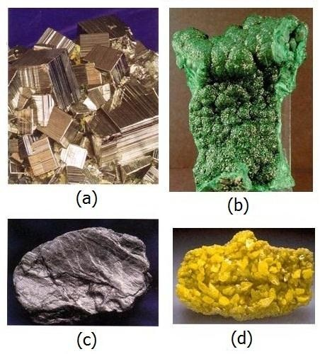
Some minerals have distinctive colors. (a) Pyrite yellow. (b) Malachite green. (c) Graphite dark- grey. (d) Sulfur yellow.

Slide 6
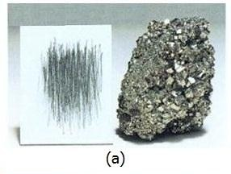
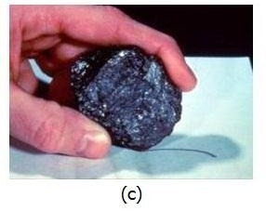
The streak of a mineral is the color of its powder and may be quite different from that of a mineral (a) Bronze yellow pyrite gives a black streak, (c) black magnetite gives a black streak

Slide 7
3. Luster
Luster refers to the general appearance of a mineral surface to reflected light. there are two general types of luster :
•Metallic
Looks shiny لامع like metal. For example metallic minerals such as gold and silver
•Non‐metallic
For non‐dark or transparent minerals, this type contains most minerals, for example:
Adamantineماسي : such as in diamond and zircon, Vitreous lusterزجاجي : such as in Quartz
4. Transparency : The ability of light to pass through the mineral. It can be divided into several types:
A- Transparent. such as quartz mineral
B- Translucent. such as opal mineral
C- Opaque معتم . such as galena mineral

Slide 8
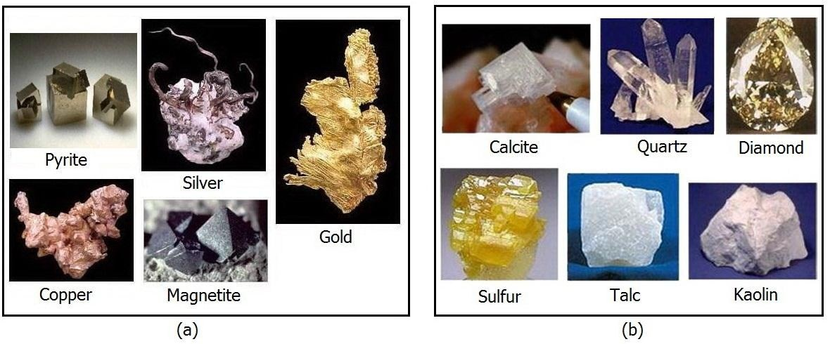
Types of luster. (a) Minerals have the appearance of metal and is said to have a metallic luster.
(b) Minerals have nonmetallic luster.

Slide 9
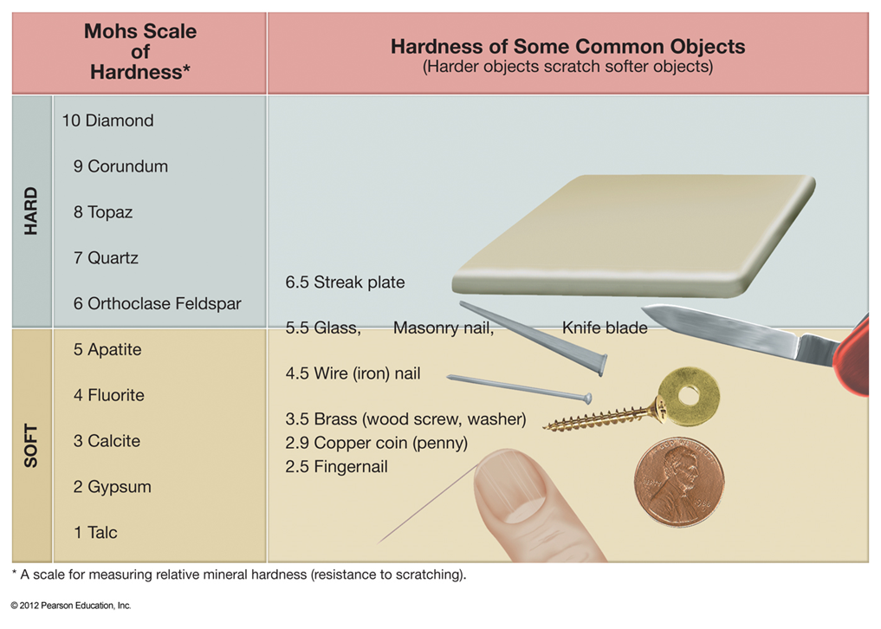
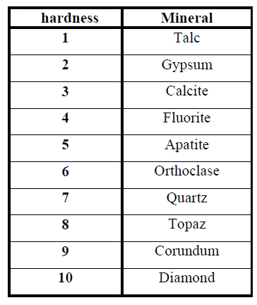
5. Hardness
One of the essential diagnosticتشخيص properties of a mineral is hardness. It is determined with the Mohs hardness scale. Mohs scale is Defined by ten indicators, a mineral with a higher index scratches those below it. The Mohs scale ranges from talc to diamond.
6. Fracture : It is mineral breakage along irregular surfaces, indicating that planes of weakness are absent. It can be divided into several types:

Slide 10
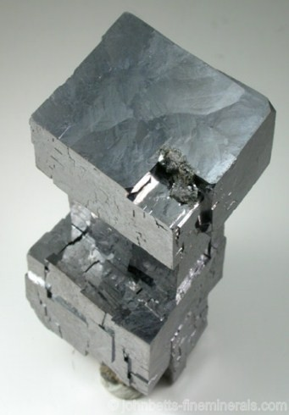
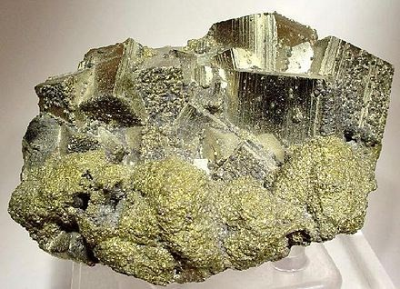
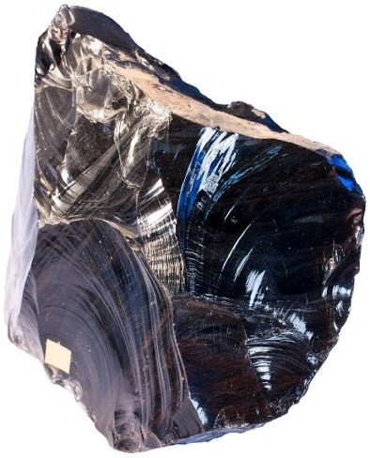
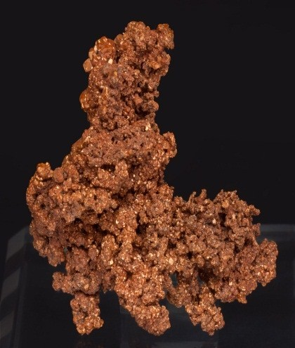
a. Irregular fracture. Such as most of minerals.
b. Conchoidal محاري fracture. Such as Quartz.
c. Hackly مسنن مدببfracture. Such as Copper.
a
a
b
c

Slide 11
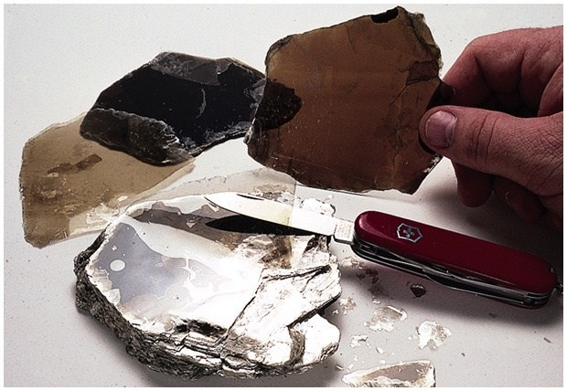
7. Cleavage
Weakness in crystalline structure causes planes of weakness, and the breakage of minerals along such planes is termed cleavage.
8. Specific gravity : It is the ratio of the weight of a mineral to the weight of an equal volume of water. For example, the specific gravity of Quartz (2.7) Galena (7.5), and Gold (20). Most common minerals have a specific gravity of between (2.5 - 3).

Slide 12
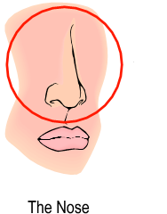
OTHER DIAGNOSTIC PROPERTIES :
Other properties can be used to identify some minerals. For example:
a- Halite tastes salty
b-Talc has a distinctive soapy feel
c- Graphite has a soapy feel and writes on paper
d-Magnetite is magnetic
e-Calcite react with hydrochloric acid (HCL)
f- Sulfur has a distinctive smell

Slide 13
Mineralogy
Classification of minerals :-
1- Native elements group :-
Examples :- Copper (Cu) ,Graphite (C)
2- Sulfides group :-
Examples :- Pyrite (FeS2) , Galena (PbS)
3- Sulfates group :-
Examples :- Gypsum (CaSo4.2H2o) , Anhydrite (CaSo4)

Slide 14
4- Oxides group :-
Examples :- Hematite (Fe2o3) , Corundum (Al2o3)
5- Carbonates group :-
Examples :- Calcite (CaCo3) , Dolomite (CaMg(Co3)2)
6- Halides group :-
Examples :- Halite (NaCl) , Fluorite (CaF2)
7- Silicates group :-
Examples :- Quartz (Sio2) , Orthoclase (KAlSi3O8)

