Slide 1
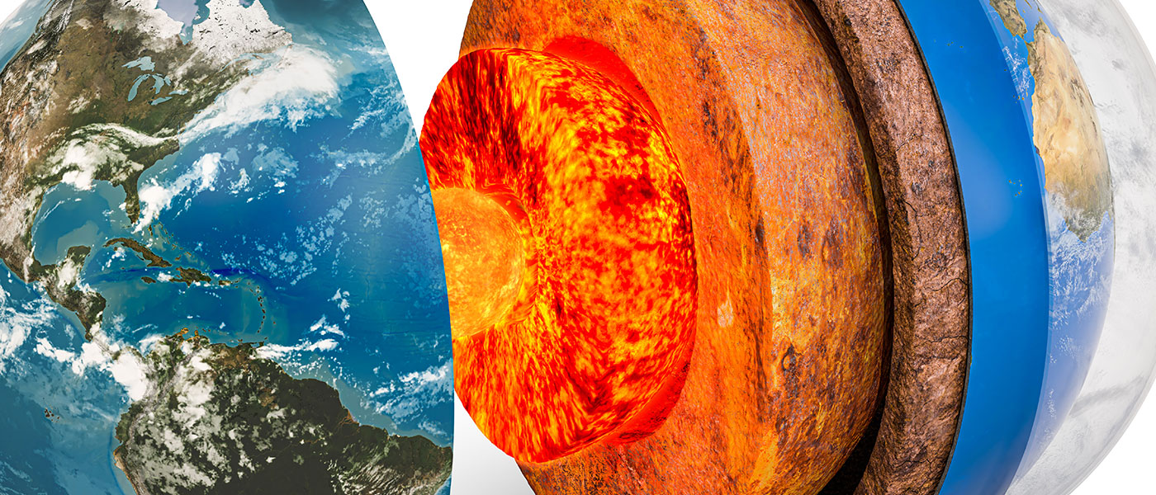
General geology
University of Mosul/ College of Science/ Department of Geology

Slide 2
Petrology
Scientific study of rocks that deals with their composition, texture, structure, their occurrence and distribution; and their origin in relation to physicochemical conditions and geologic processes.
Rock :
Is a natural substance, a solid aggregate of one or more minerals, rocks can be divided into three major types based on the process of their formation. These are; Igneous rocks, sedimentary rocks and metamorphic rocks.
Operations responsible for rocks formation:العمليات المسؤولة عن تشكيل الصخور
For the purpose of understanding the major divisions or classes of rocks, the processes responsible for their formation must be understood. These processes are also called genetic classification or also called deposition environments:

Slide 3
Types of Rocks
Igneous Rocks
They are formed by the cooling of magmatic material or molten rock material
Sedimentary Rocks
Formed by the “cementation” of loose (Soft) grains of sediment found on the surface of Earth
Metamorphic Rocks
They are formed by the geological environment changes (heat , pressure)

Slide 4
1- Igneous processes : include crystallization of minerals from high temperature silicate melt known as magmas.
2- Metamorphic processes :
Include re-crystallization of minerals and their interaction in the original rocks are in the solid state under high temperature and pressure conditions provided there is no melting.
تشمل إعادة بلورة المعادن وتفاعلها في الصخور الأصلية التي تكون في الحالة الصلبة تحت ظروف ضغط ودرجة حرارة عالية بشرط عدم وجود ذوبان.
3. Sedimentary processes : These processes occur on rocks of any type (igneous, metamorphic or sedimentary rocks) starting with the process of weathering which results in the sediments, and through the process of transportation of the sediments (the weathering products) and then the process of sedimentation or deposition and finally the lithification.

Slide 5
Rocks cycle
When a rock crystallizes from melt (magma or lava), it is an igneous rock. This rock can be weathered , eroded and then deposited and lithified into a sedimentary rock, or be turned into a metamorphic rock due to heat and pressure that change the mineral content of the rock.
The sedimentary rock can be turned into a metamorphic rock due to heat and pressure.
metamorphic rock can be weathered, eroded, deposited, and lithified, and then becoming a sedimentary rock.
All three types of rocks may be re-melted; when this happens, a new magma is formed, and then an igneous rock may once again crystallize.

Slide 6
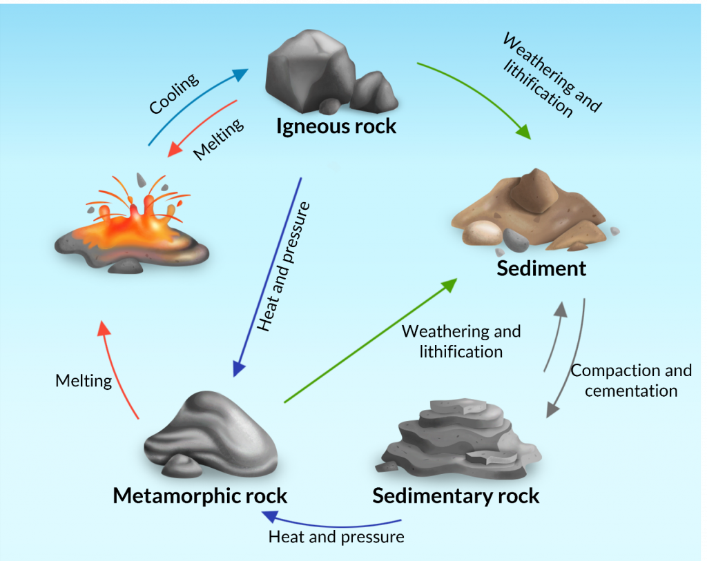
Rocks cycle

Slide 7
Igneous Rocks
Magma Composition magma: is the molten rock material (in whole (total) or in part) in the depths of the earth, under the earth's crust, and at the top of the upper mantle.
•
Silica is the most abundant component in magma. السيليكا هي المكون الأكثر وفرة في الصهارة
The bulk chemical composition of magma is (O - Si - Al - Fe - Ca - Mg - Na - K ), These major elements occur as oxides.
Magma means: molten rock within the Earth
Lava means: molten rock on the Earth’s surface.

Slide 8
•
Magmatic crystallization: The process of crystallizing the minerals from the melt .
Bowen's reaction series : The sequence of minerals crystallize from a magma . It is important because it forms basis for explaining igneous mineral and textures.
Bowen's reaction series divided to two branches, the continuous and the discontinuous.
In discontinuous series the minerals were arranged according to the priority of their crystallization from the melt, at high temperatures (about 1200 C°) starting with olivine and pyroxene, and then finally crystallized quartz at relatively low temperatures (about 500 C°).
Crystallization of Magma
Crystallization of Magma
Magmatic crystallization: The process of crystallizing the minerals from the melt .

Slide 9
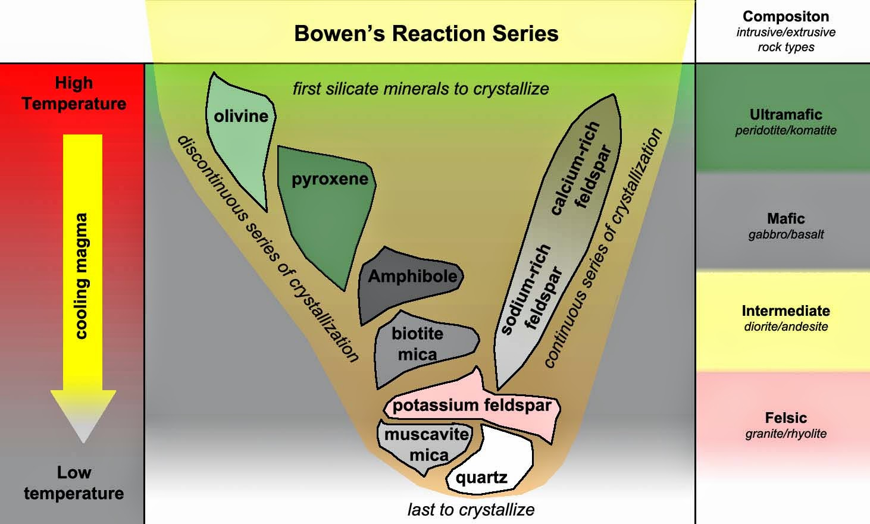

Slide 10
Igneous Rocks
Igneous Rocks are Classified depending on their chemistry to:-
Acidic Igneous Rocks
It is a rock in which the ratio SiO2 > 66% and the ratio of Felsic minerals > Mafic minerals
Examples: Granite , Rhyolite , Obsedian
b) Intermediate Igneous Rocks
It is a rock in which the ratio SiO2 between 52-66% and the ratio of Felsic minerals = Mafic minerals
Examples : Diorite , Andesite

Slide 11
c) Basic Igneous Rocks
It is a rock in which the ratio SiO2 between 45-52% and the
Ratio of Felsic minerals < Mafic minerals
Examples : Gabbro , Basalt
d) Uttra basic Igneous Rocks
It is a rock in which the ratio SiO2 < 45% and the ratio up to 100% Mafic only
Examples : Dunite , Pyroxenite

Slide 12
THE TEXTURE OF THE IGNEOUS ROCK :
The rate of cooling greatly affects both the size and arrangement of the crystals, rapid cooling produced smaller crystals and slower cooling allows time for larger crystals to form.
TEXTURE: It is the size, shape, and arrangement of mineral grains or crystals in the rock. The texture of igneous rocks can be described as follows .
1- Fine-Grained (Aphanitic) Textures: Igneous rocks that form at the surface, which are characterized by rapid cooling have a fine-grained texture that cannot be seen with the naked eye (figure a, b ).
2- Coarse-Grained (Phaneritic) Textures: Igneous rocks that form at the depth, which are characterized by slow cooling have a coarse-grained texture that can be seen with the naked eye. The diameter of the grains or crystals is range from about 1 mm to more than 5mm(figure c, d).

Slide 13
A, B: FINE-GRAINED TEXTURE AND C, D: COARSE-GRAINED TEXTURE.

Slide 14
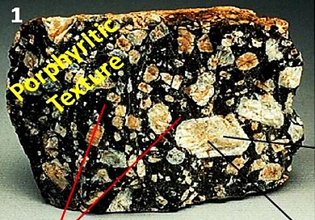
3- Porphyritic Texture: Igneous rocks contain large crystals are embedded مغروسةin a matrix of smaller crystals in the same rocks
4- Glassy texture : Igneous rocks contain a glassy texture as a result of the rapid cooling of lava so that the atoms of its components do not have the time required to form an organized crystalline structure .
النسيج الزجاجي: تحتوي الصخور النارية على نسيج زجاجي نتيجة التبريد السريع للحمم البركانية بحيث لا يكون لدى ذرات مكوناتها الوقت اللازم لتشكيل هيكل بلوري منظم.
Glassy texture

Slide 15
5- Vesicular textureنسيج حويصلي : Igneous rocks contain a vesicular texture as a result of gas bubbles that escaped as lava solidifiesتصلب الافا and thus formed many small holes or cavities known as vesicles
6- Pyroclastic (fragmental texture) : Igneous rocks contain a pyroclastic texture formed by explosive volcanic activity. Ash may be discharged high into the atmosphere and eventually settle to the surface where it accumulates and becomes pyroclastic igneous rock
البيروكلاستيك (نسيج مجزأ): تحتوي الصخور النارية على نسيج حممي يتكون من نشاط بركاني متفجر. قد يتم تصريف الرماد عالياً في الغلاف الجوي ويستقر في النهاية على السطح حيث يتراكم ويصبح صخورًا نارية من الحمم البركانية
Vesicular texture
Pyroclastic (fragmental texture)

Slide 16
