Slide 1
INVERTEBRATE
Bryozoa Phylum (LEC. 5)

Slide 3
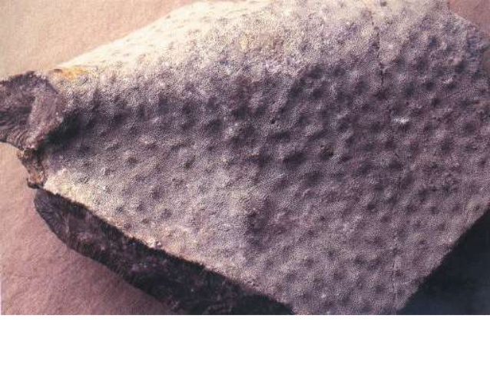

Slide 7
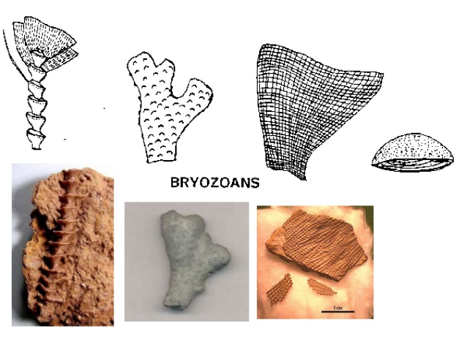

Slide 10
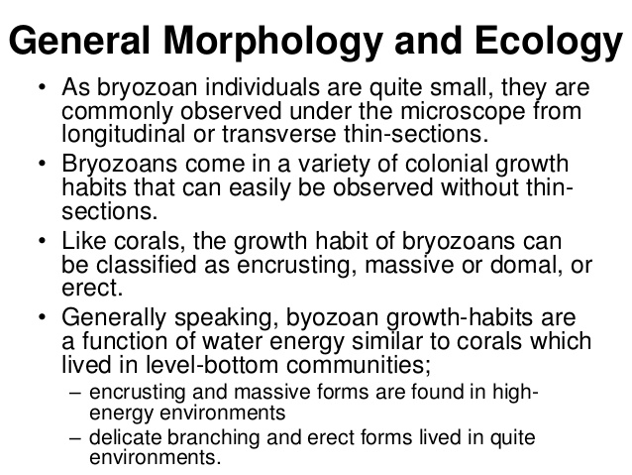

Slide 20
