Slide 1
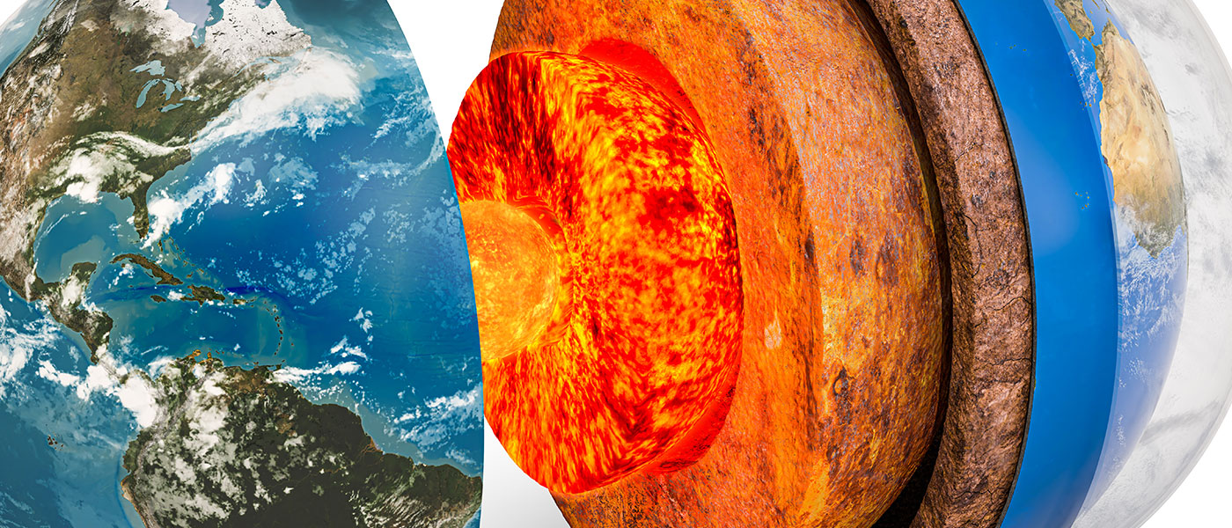
General geology
University of Mosul/ College of Science/ Department of Geology

Slide 2
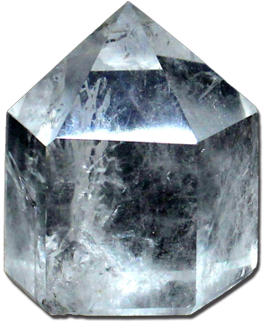
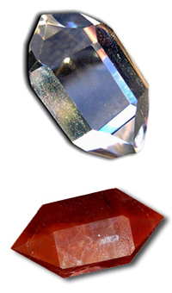

Crystallography
Crystal:- A Crystal is a polyhedral solid bounded by smooth surfaces of definite geometric shapes arranged symmetrically around its central point.
the symmetrical arrangement of the parts of a crystal is an external expression of a regular internal three dimensional arrangement of atoms or molecules.

Slide 3
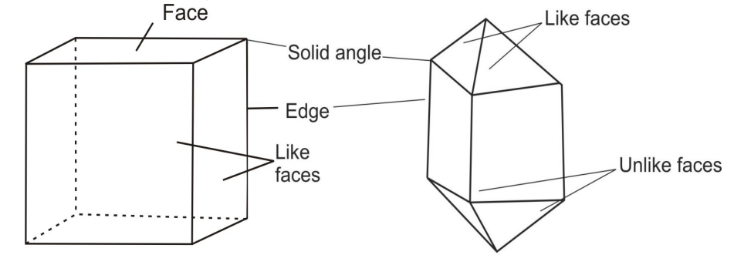
Parts of crystal (elements of crystal):
1-Face:- The smooth planar surface of some definite geometric shapes.
2- Edge:- The meeting line of two adjacent faces.
3- Solid angle:- (The vertex) the external intersection point of three or more edges.
4- Interfacial angle:- The angle between the columns to the two adjacent faces.

Slide 5
-Crystallographic axes:-
These axes are imaginary reference lines and generally taken parallel to the intersection edges of major crystal faces.
a-axis = front to back aɅb = ɣ
b-axis = side to side aɅc = β
c-axis = top to bottom bɅc = α

Slide 7
-Crystal symmetry :-
A)Planes of symmetry:-
An imaginary plane that divides the crystal into two mirror image halves.
B)Axes of symmetry :-
An imaginary line through a crystal about which the crystal may be rotated and repeat itself in appearance 2,3,4 or 6 times during a complete rotation (360⁰).

Slide 8
C)Center of symmetry:-
It is the central point of the crystal about which similar parts are arranged in opposite directions at exactly equal distances in corresponding positions.

Slide 9
Crystal Systems :-
Classified the crystal systems according to:-
1-Length of crystallographic axes.
(a , b , c)
2-Intersection of crystallographic axes.
(α , β , γ)

Slide 10
1- Cubic system (Isometric): النظام المكعبي (متساوي الابعاد)
a = b = c Planes of symmetry = 9
α = β = γ = 90 Axes of symmetry = 13 (3⁴ , 4³ , 6² )

Slide 11
2- Tetragonal System: النظام الرباعي
a = b ≠ c Planes of symmetry = 5
α = β = γ = 90 Axes of symmetry = 5 (1⁴ , 4² ⁽

Slide 12
3- Orthorhombic system: النظام المعيني القائم
a ≠ b ≠ c Planes of symmetry = 3
α = β = γ = 90 Axes of symmetry = 3 ( 3² )

Slide 13
4- Monoclinic system: النظام احادي الميل
a ≠ b ≠ c Planes of symmetry = 1
α = γ = 90 Axes of symmetry = 1 (1² )
β ˃ 90

Slide 14
5- Triclinic system: النظام ثلاثي الميل
a ≠ b ≠ c Planes of symmetry = absent
α ≠ β ≠ γ Axes of symmetry = absent

Slide 15
6- Hexagonal system: النظام السداسي
a1 = a2 = a3 ≠ c Planes of symmetry = 7
c (a1 , a2 ,a3) Axes of symmetry = 7 (1⁶ , 6²(
a1 ᴧ a2 = 120 a1 ᴧ a3 = 120 a2 ᴧ a3 = 120

