Slide 1
Fractures (Joints)from Experimental Data
المحاضرة رقم2
A- In the simplest type of tension :-
the opposite ends of a rod are pulled apart.
After elastic and plastic deformation, the specimen fails by rupture.
The nature of the rupture depends upon the brittleness of the material.
In brittle substance ,such piece of blackboard chalk a single tension fracture forms at right to the tension force direction( Ϭ3). (A)

Slide 2
In more ductile substances , rupture may preceded by”necking” that is ,the central part of the rod thins more than the ends.(B)
If the tension continued, conical shear fracture developed.in this case the specimen has failed along shear frctures.in some material the rupture is a combination of shear and tension fracture.(c)
النهاية المثلمه
As conclusion. The same substance behave as brittle near the surface and making a tension fracture at right angle to the tension force direction .where as in depth behave as ductile and making shear fracture

Slide 3
B-In the simplest type of compression.
The test specimen ,usually cylinder or a square prism, is subjected to a compressive force at two opposite ends, and the side are free to expand outward. If the block is a square prism, unconfined on the sides, four sets of shear fracture develop. The four planes parallel to which the fracture form are illustrated in the fig. below.
₁Ϭ
As the compressive force increased, the fracture increase in number and size until one fracture eventually cuts all the way across the specimen and the block collapse.
Some sets may be much more extensively developed than others, especially if the specimen lacks homogeneity.
₃Ϭ⁼ ₂Ϭ

Slide 4
the angle that is bisected by the compressive force is always less than 90⁰, generally about 60⁰ .. That is ,the angle between the compressive force and shear fracture is about 30⁰
₁Ϭ
30⁰

Slide 5
If the square prism is confined on two opposite sides of the specimen, two set of fractures dip toward the unconfined sides of the specimen
₁Ϭ
₂Ϭ
0=₃Ϭ

Slide 6
if the front and back of the block were confined, only two sets of fractures dip left and right.
₁Ϭ
0=₃Ϭ
₂Ϭ

Slide 7
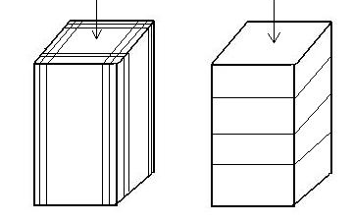
In many case , specimen under compression fail along fracture parallel to the sides of the prism, from one point of view these are tension fractures, on the principles that the active compression in one direction sets up tensional forces at right angles. This fracture called extension fractures.
After load released there are numerous fractures formed at right angle to the axis of compression which called release fracture
Ϭ₁
Ϭ₁
extension fractures
extension fractures
release fracture at right angles to Ϭ₁
It is tension fractures caused by expansion upon the release. But because there is no active tension ,the called release fracture

Slide 8
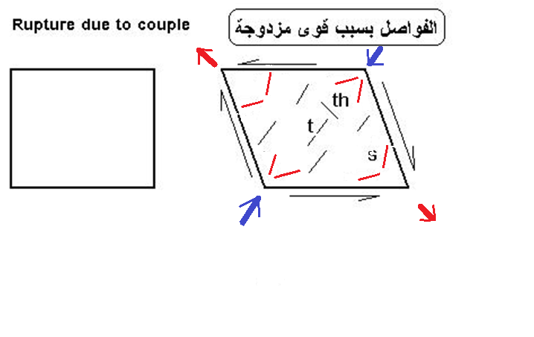
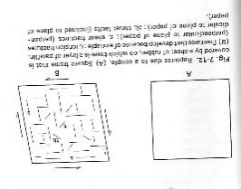
C-the relation of ruptures to couples
Fractures develop under couples force are t tension fractures s shear fractures, th thrust faults.
t tension ,parallel to diagonal of shortening
th thrust faults in the last step of the deformation their strike parallel to long diagonal of the parallelogram.

Slide 9
Orientation of the maximum paleostress axes
Orientation of the maximum paleostress axes can be
determined from both conjugate and extension joint sets .
Extensional joints form under maximum and minimum principal-stress axes oriented parallel and perpendicular, respectively, to the joint surface (Figure A)
; For conjugate and hybrid joints, the maximum principal-stress axis intersects the acute angle between the two joints, as illustrated in Figure( B,C)

Slide 10
Diagram showing maximum and minimum principal stress axes for (A) extension joints (B)
conjugate shear fractures and (C) conjugate hybrid fractures. List of symbols: 2θ, conjugate shear angle; σ and σ , maximum and minimum principal stress direction, respectively.

Slide 11
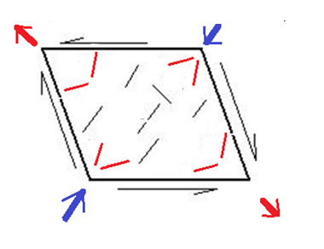
1-Tension fracture at right angle to the tension force direction.
2- IN confined square prism, two set of fractures developed and dip toward the unconfined sides of the specimen.
3-Release fracture developed at right angle to minimum stress axis.
4-The direction of σ1 is the pole to the joint plane which contains the σ1 and σ3 axes.
5- Name the fractures type in the figure tension ,shear, and thrust fractures

