Slide 1
Relation of Joints with Folds
Many joints are systematically disposed about folds and it has generally been assumed that they have resulted from the same compressive forces as that produced the folds.
Joints perpendicular to the axis of folds called extension joints, resulting from slight elongation parallel to the axis of the folds, they would be analogous to the raptures that form parallel to the sides of specimen under compression.
extension joints
extension fractures
Fold axis
extension fractures

Slide 2
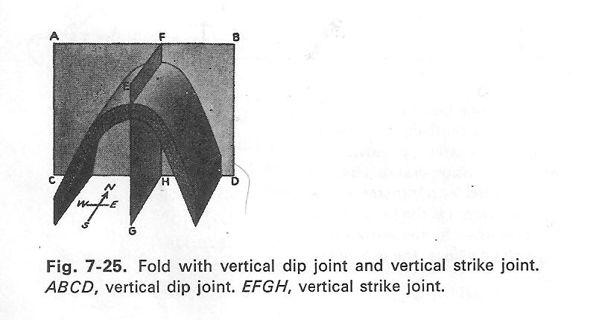
Joints parallel to the axial plane of folds may be release joints similar to those that form at right angles to the axis of compression when the load is released.
Release joints
Release joints
axial plane
Formed parallel to top of prism
Fold axis
Release joints
Force direction
extension fractures

Slide 3
Two sets of joints that intersect at a high angle to form a conjugate system are often considered shear fractures, especially if they are symmetrically disposed about the strain axis.
shear fractures
shear fractures
Easiest relief in a north –south direction
Easiest relief in upwards

Slide 4
Jointing Associated with Large Individual Folds
Stearns Model.
When geologists imagine patterns of jointing that would develop in a thick
mechanically stiff bed during the formation of a large anticline, they commonly begin by thinking about what Stearns (1968) concluded decades ago.
Folding of a stiff rock layer will be marked by stretching on the outer arc of the fold, and shortening on the inner arc, with these two regions separated by what is known as a neutral surface (along which there is neither shortening or stretching) (Figure 5.81). Stearns(1968) underscored that the location of the neutral surface separates (above and below) distinctively different joint-forming environments.
In speciﬁc, he proposed that four joint systems could be expected to form due to bending, with each consisting of two conjugate shear joint sets and one mode I joint set(Figure 5.82). The four systems correspond to four distinctive stress-ﬁeld environments (see Figure 5.82).
Systems 1 and 2 are marked by conjugate strike-slip shear fracture sets (and faults) and mode I joints; the systems are differently oriented above and below the neutral surface.
System 3 is composed of conjugate normal shear fracture sets (and faults) and mode I joints.
System 4 is composed of conjugate thrust shear fracture sets (and faults) and mode I joints . Stearn’s model underscores tight symmetry correspondence between the attributes of folding and the orientations of jointing and fracturing. He recognized that this is an idealized portrayal, and that in practice the joint patterns will not generally be as “clean,” especially when considering that some joints in folded strata may have formed before the folding, and some may have formed afterwards.
Notes:
يؤكد نموذج ستيرن على التوافق الوثيق بين سمات الطي واتجاهات الفواصل والتشقق. وقد أدرك أن هذا تصوير مثالي، وأن أنماط الفواصل في الممارسة العملية لن تكون "نظيفة" عمومًا، وخاصة عند الأخذ في الاعتبار أن بعض الفواصل في الطبقات المطوية ربما تكون قد تشكلت قبل الطي، وربما تكون بعضها الآخر قد تشكل بعده.

Slide 5
يؤكد نموذج ستيرن على التوافق الوثيق بين سمات الطي واتجاهات الفواصل والتشقق. وقد أدرك أن هذا تصوير مثالي، وأن أنماط افلواصل في الممارسة العملية لن تكون "نظيفة" عمومًا، وخاصة عند الأخذ في الاعتبار أن بعض الفواصل في الطبقات المطوية ربما تكون قد تشكلت قبل الطي، وربما تكون بعضها الآخر قد تشكل بعده.

Slide 6
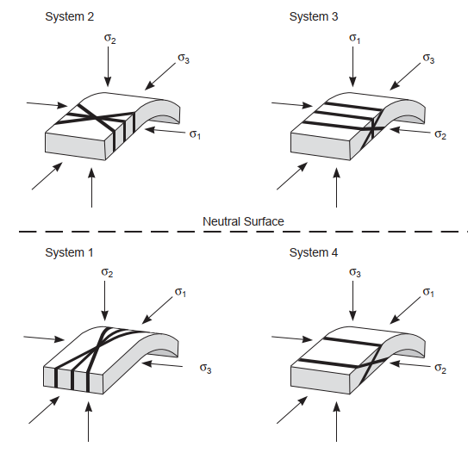
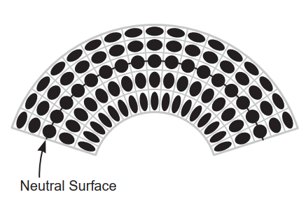
Figure 5.81 During folding of a mechanically stiff layer, layer-parallel stretching takes place on the outer arc of the fold whereas layer-parallel shortening takes place on the inner arc. Within the layer there will be a neutral surface separating regimes of stretching and shortening, and along which there is no change in layer-parallel length.
Figure 5.82 Fracture sets that, according to Stearns (1968), will form during folding of a mechanically stiff layer. Above the neutral surface there will be outer-arc stretching.
Below the neutral surface there will be inner-arc shortening. Far-ﬁeld stress patterns are modiﬁed by local bending characteristics.

Slide 7
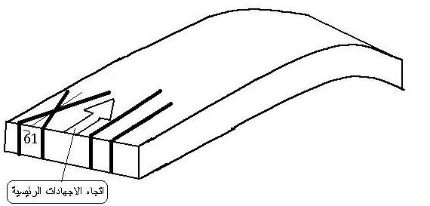
We can divide the relation ships between joints and folds into three stages:
1-In the beginning of folding: bedding subject to horizontal stress so δ1 is horizontal ,and δ2 vertical , δ3 is horizontal also but perpendicular to δ1. consequently tension joints develop parallel to δ1 and δ2(i.e δ1 and δ2 lies within joint plane ). Also shear joint system making acute angle about δ1 direction.
ac joint set
hko acute about a
c
b
a
c
a
b
hko-a-1
ac
hko-a-2
δ1
Main stress

Slide 8
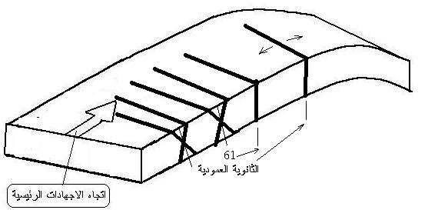
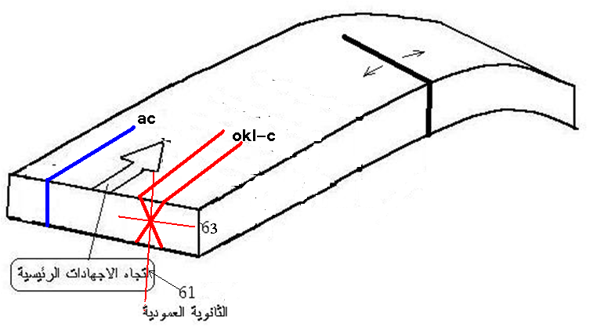
2- During folding progress:-
Bedding are gradually tilted so the main stress resolve into secondary horizontal stress and secondary vertical stress. The first go on formed the same joints as in the previous stage. The second causes tension joints( bc set) perpendicular to those (tension joints)already formed.
Aslo shear joints system hol acute about c. and okl-c- develop.
c
b
a
hol-c-
bc
c
okl-c-
secondary vertical
Main stress
secondary vertical

Slide 9
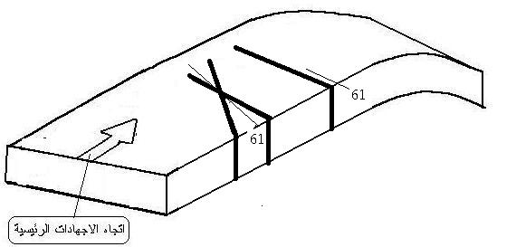
3-The ultimate stage of folding:
stage of vanish effect of main stresses shaped a fold. Consequently the fold affected by released stresses ,this stresses formed extension joints(bc set) parallel to those already formed(previous stage) but δ1 in a horizontal direction. also shear joints system hko acute about b develop.
hko- b-
bc
hko- b-
bc ste

Slide 10
Joints Studies in Field : A- Descriptive Study: include variety of joints character such as :
1- Joint surface; planar or sinuous, distribution, continuity, and dimensions,,
2- Joint aperture : joint close or open
3- Filling material : nature of infill
4- Frequency(joint spacing) as the average distance between adjacent members of a joint set, measured perpendicular to the surface of the joint:
Joint spacing depends on four parameters:
bed thickness, stiffness,tensile strength, and strain .
All other parameters being equal, joints are more closely spaced in thinner beds, and are more widely spaced in thicker beds.
The stiffer layers (dolomite) develop more closely spaced joints.
Other factors being equal, rocks with smaller tensile strength develop more closely spaced joints.
A bed that has been stretched more, contains more joints than a bed that has been stretched less.

Slide 11
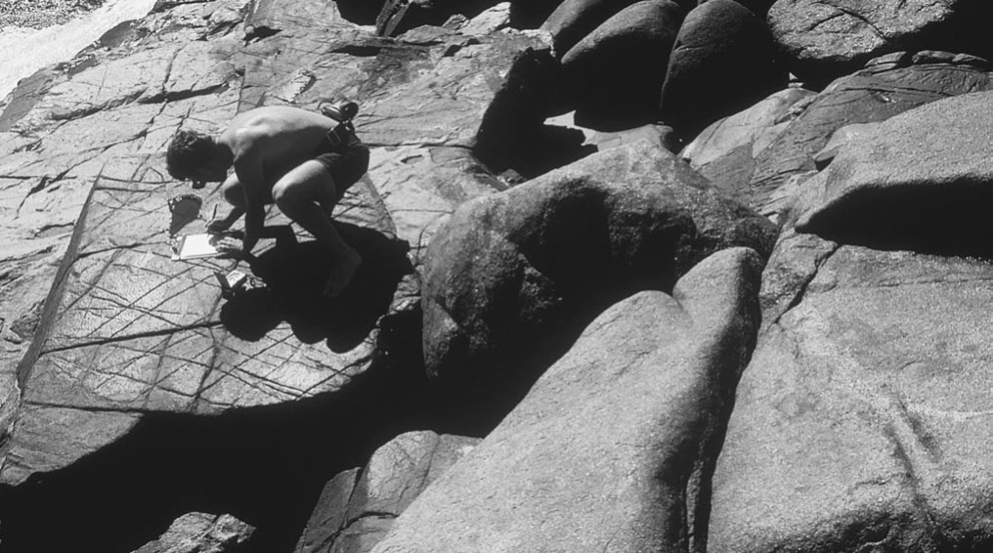
Because joint spacing depends on bed thickness and lithology, joint spacing varies from bed
to bed. Weak, thinly bedded shales contain such closely spaced joints that they break into tiny frag-
ments, and, as a consequence, they tend to form slopes.In contrast, thick sandstone beds develop only widely spaced fractures, so thick sandstone beds typically protrude and hold up high cliffs.
A geologist measuring fractures in an outcrop, near Tuross Point on the southeastern coast of Australia. The more intensely fractured rock is a fine-grained mafic intrusive and the less fractured rock is a coarse-grained felsic intrusive.

Slide 12
Determine relative ages of joint sets.
It is also important to assess spatial relationships of joints to determine relative
ages of joint sets. The three important relationships to determine the relative age of
spatially related joints are:
(1) A joint that is offset by a fault, vein or stylolite ,propagated first (Figure A);
(2) A joint that terminates at another joint is younger (Figure B,C);
(3) a large joint with a long trace that cuts traces of small sealed joints is the youngest (Figure D).
However, within a non-homogeneous rock mass,
age relationships between joint sets can be very difficult to determine as illustrated
In Figure E,F.
Age relationships of joint sets can be further constrained by studying
packages of rock and sediment with variable ages.

Slide 13
Diagram and photographs depicting criteria used to determine age relationships of joints, where:
(A) the offset joint is older; (B) the joint that terminates at another is younger;
(D) the larger joint that cuts across smaller sealed joints
is younger;
(E) cross cutting joints lead to an unknown sequence of jointing; field photographs illustrating;
and (F) cross-cutting joints that are interpreted to have
an unknown chronology .
(C) the sequence of
jointing where the youngest joint (J1) terminates at an older joint (J2), which in
turn terminates at an older joint (J3).
(J3).
(J2).
(J1).

Slide 14
B-Analysis of joints
The largest number of joints lead to a result closer to reality.
this analysis, depend on the following steps:
1 - How to collect readings (the attitude of joints) from the field.
2 - Stereographic projection (in the laboratory).
3 - Geometrical Classification (in the field+ laboratory).
4 - Interpretation

Slide 15
b-Analysis of joints
1-Extension joints can be simply analyzed by plotting the trace of the joint plane and its pole on a stereographic projection. The direction of σ3 is the pole to the
joint plane which contains the σ1 and σ2 axes .
The largest number of joints lead to a result closer to reality
Extension joints alone will not give σ1, and σ2 orientations—other dynamic indicators such as vein fibre orientations are needed.

Slide 16
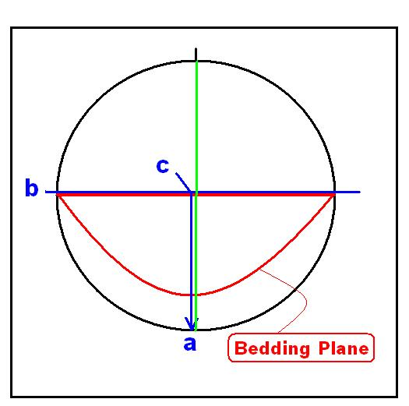
2 -Shear joints commonly form conjugate arrays whose angle of intersection (a) is greater than 60°. Plotting these on the stereographic projection .
shows that the line of intersection of the planes is the σ2 axis. σ1 bisects the acute angle between
the joint planes ana σ3 is at 90° to both σ1 and σ2 .
Fig.
The stereographic projections show the projections of the joint planes, the
projections of the principal stress directions and the movement directions on the shear joints —
solid half circle indicates hanging-wall down.

Slide 17
اربط الاشكال المتشابهة

