Slide 1

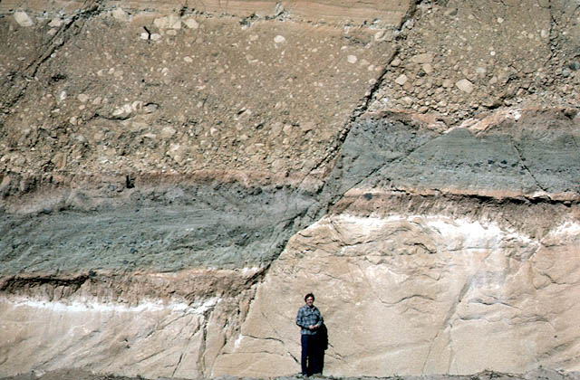
Faults: fractures with slip
المحاضرة رقم 4

Slide 2
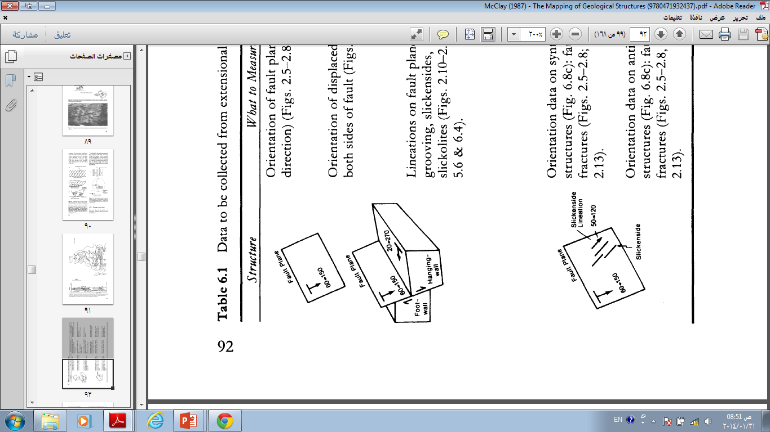
General characteristic:-
Fault: a break in the rocks along which movement has taken place.
Faults: are ruptures along which opposite walls have moved past each other.
Brittle to semi-brittle faults are planar discontinuities along which significant displacement has
occurred.
-They generally form in the upper 10-15 km of the crust.
-The essential feature is differential movement parallel to the surface of the fractures.
-Fault displacement ranging from a few centimeters to tens of meters and sometimes tens of kilometers.
Attitude of faults; since faults are planar structures, the strike and dip are measured in the same way as they are for bedding or jointing.

Slide 3
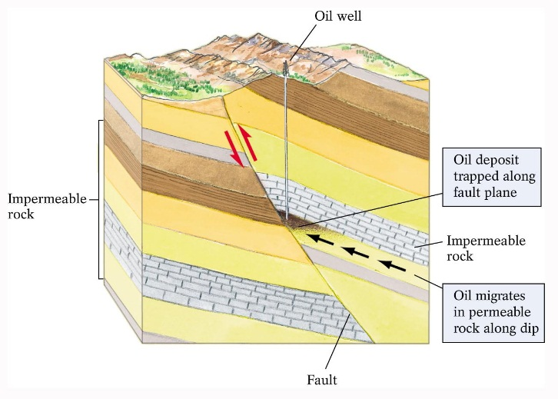
but, why study faults?
-Affect topography and modify landscape
-Affect distribution of economic resources (oil fields, ores)
-Control permeability (affect the distribution of oil, underground water, and mineral resources. )
- Studying faults can help to better understand how both the Earth's crust and the surface landscape formed
-Active faults generate earthquakes. Geologists study them to better understand where and when future earthquakes will occur.
-Geologists also study faults because they can Faults also can serve as conduits for volcanic eruptions. .
-To deduced the Paleostress Analysis:-Stress field at the time of faulting
and fracturing, based on the orientation and nature of the faults and fractures

Slide 4
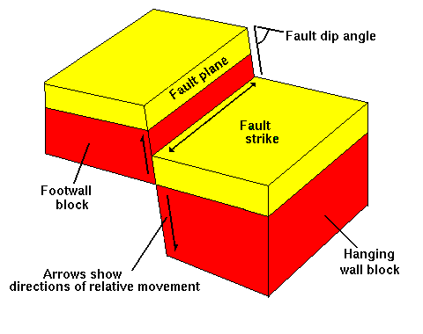
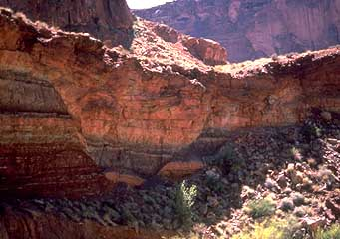
Parts of the Fault
Fault plane: Surface that the movement has taken place within the fault.On this surface the dip and strike of the fault is measured.
Hanging wall: The rock mass resting on the fault plane.
Footwall: The rock mass beneath the fault plane.

Slide 5
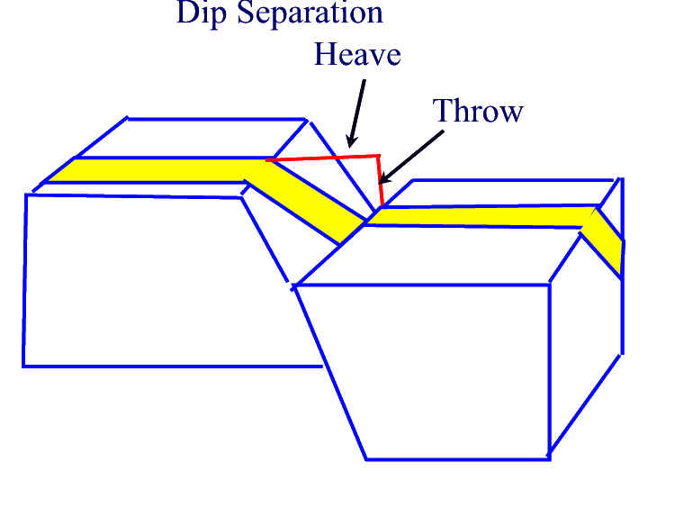
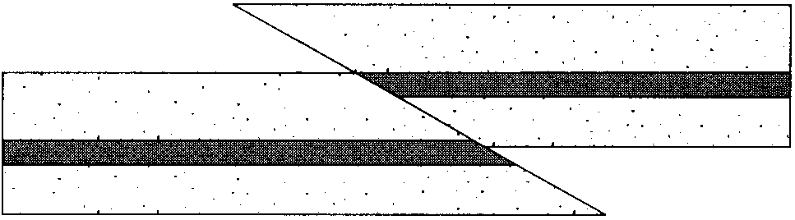
Separation: The amount op apparent offset of a faulted surface, measured in specified direction. There are strike separation, dip separation, and net separation.
Heave: The horizontal component of dip separation measured perpendicular to strike of the fault.
Throw: The vertical component measured in vertical plane containing the dip.
Strike of fault
Heave
Throw

Slide 6
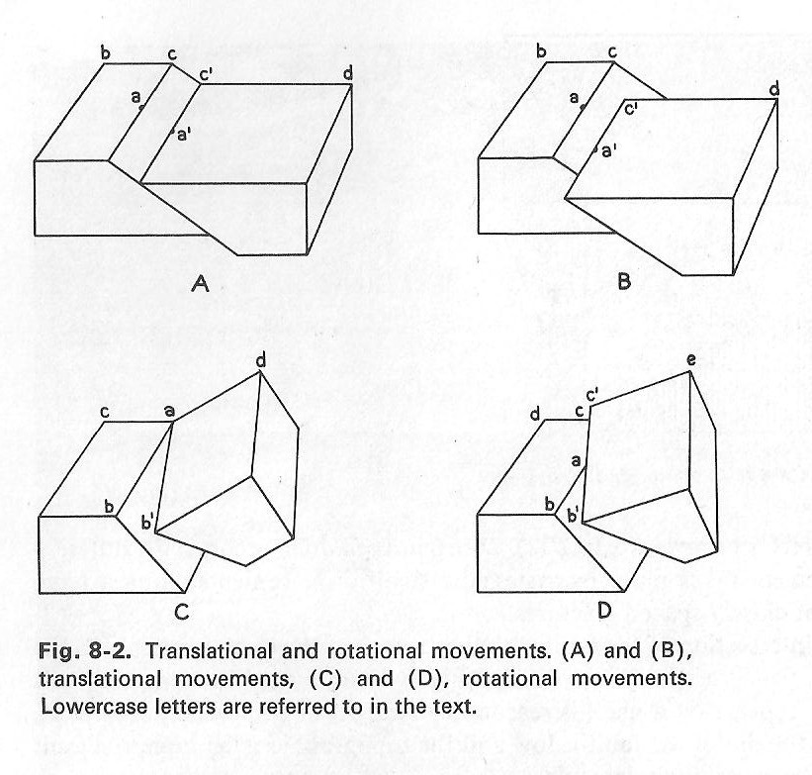
Nature of movement along faults
The movement along faults may be translational or rotational
Translational;
Rotational.
No rotation of blocks relative each other.
All straight line on opposite sides of the fault that were parallel before are parallel afterwards.
Parallel Line are no longer parallel afterwards.
Slip amounts varies from points to another.
(Center of rotation is min. slip) .
hinge point
scissors fault

Slide 7
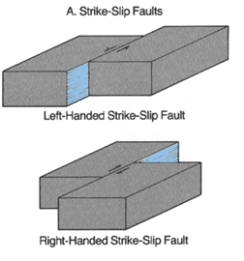
  Various kinds of relative movement(slip).
  the term slip is used to indicate the relative movement of formerly adjacent points on opposite sides of the fault.
  Slip: Describes the movement parallel to the fault plane.
A - Strike slip: Applies where movement is parallel to strike of the fault plane
opposite side to left:
left-lateral (sinistral)
opposite side to right:
right-lateral (dextral)

Slide 8
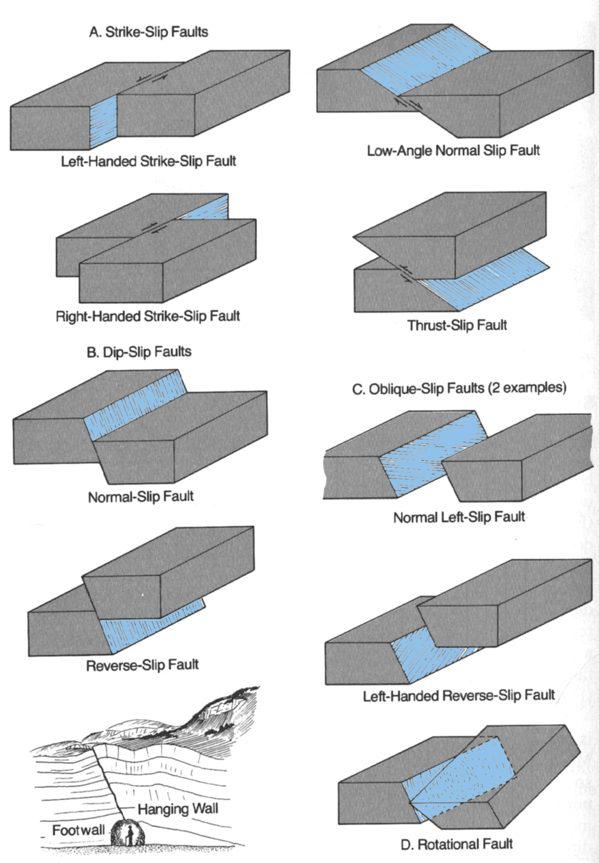
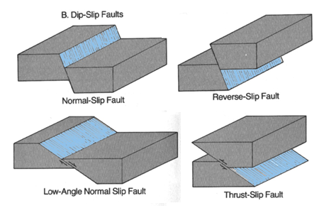
B- Dip slip: Describes the up and down movement parallel to the dip direction of the fault.
C-Oblique slip: Is a combination of strike slip and dip slip.
Net slip (true displacement): Is the total amount of motion measured parallel to the direction of motion.

Slide 9
Normal fault
Hanging wall
Foot wall

Slide 10
Hanging wall
Foot wall
Reverse fault

Slide 11
Normal left lateral slip

Slide 12
Reverse right lateral slip

Slide 13
Classification of faults
A--Geometrical classification
The are five different geometrical classification on the basis of
1-the net slip
2-the attitude of the fault relative to the attitude of adjacent rocks
3-the pattern of faults
4-the angle at which the faults dip
5- the apparent movement on the fault.

Slide 14
1-The net slip;
Strike- slip fault
Dip- slip fault
Diagonal –slip fault

Slide 15
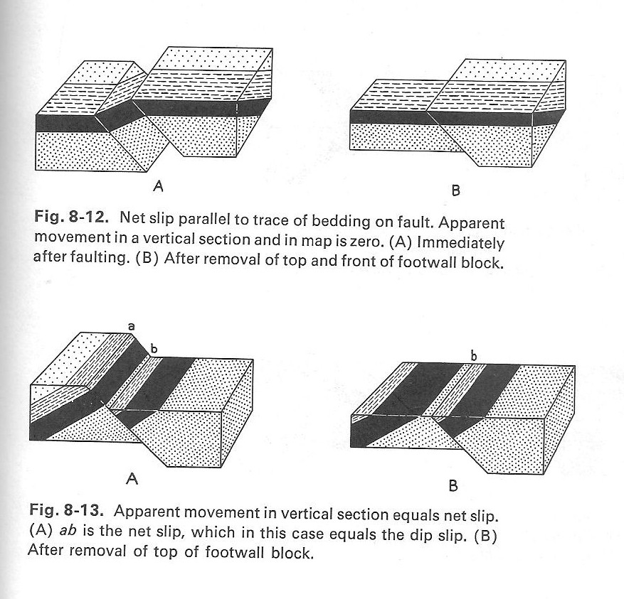
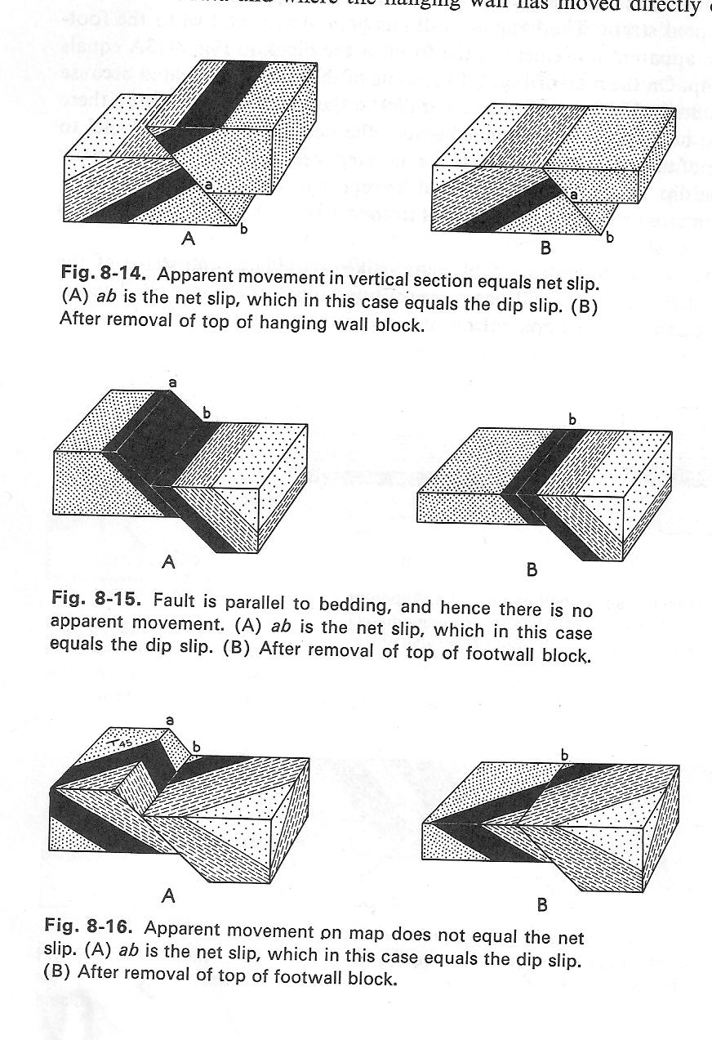
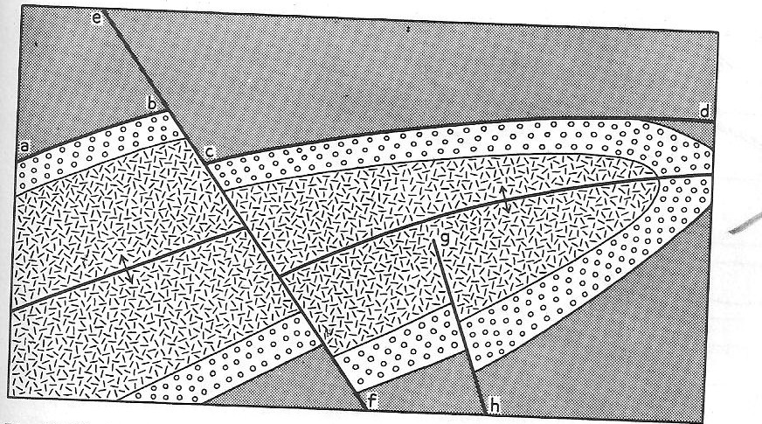
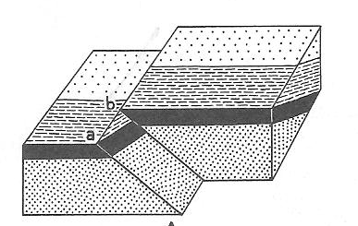
2-The attitude of the fault relative to attitude of adjacent beds:
A-Strike fault.
b-Bedding fault.
Strike of beds
C-Dip fault.
D-Diagonal or oblique fault.
A
A
E-Longitudinal .
F-Transverse fault
F
E
B
C
E
F
C
D

Slide 16
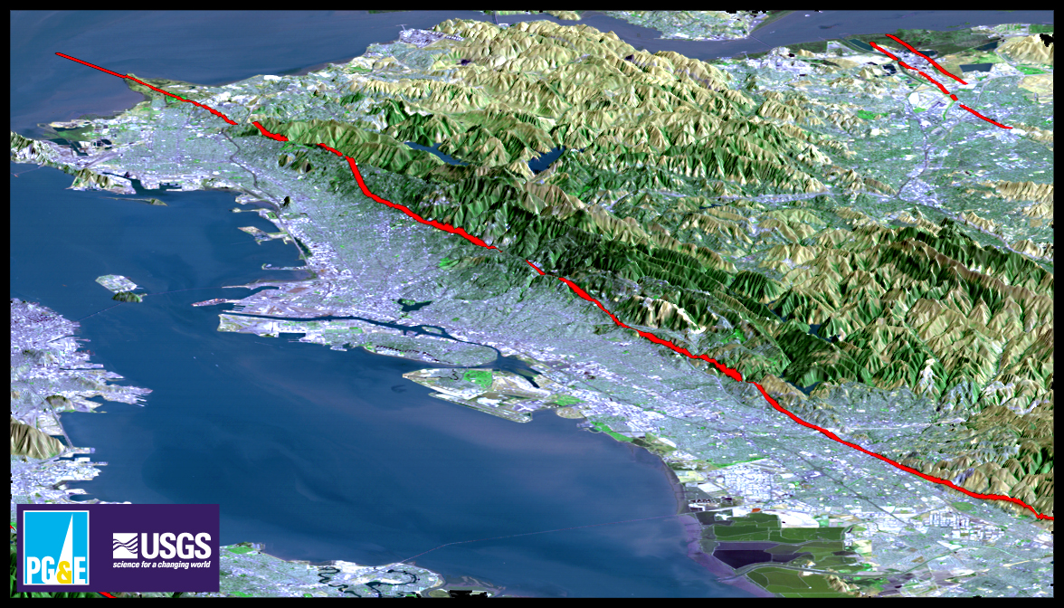
Longitudinal

Slide 17
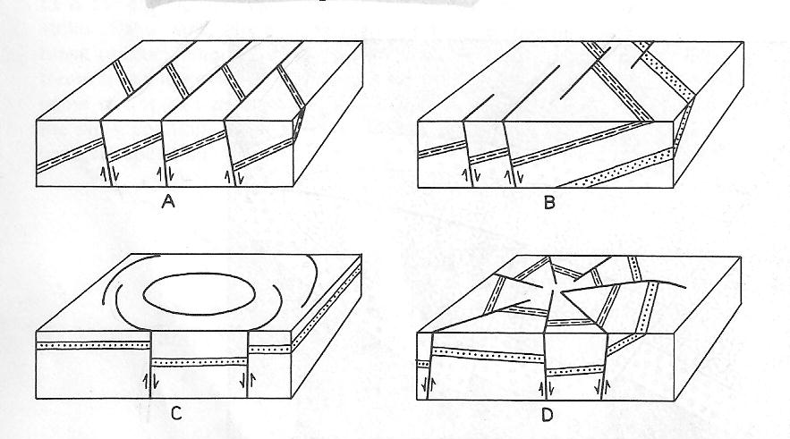
3- Based on fault pattern
It is depend on the pattern on the map, but it may be based on the pattern on the cross section.
pattern on the map
Parallel faults
Pattern on the
cross section
En echelon faults
Parallel faults
En echelon faults
Peripheral faults
Radial faults
Peripheral faults
Radial faults
4-Based on value of dip of fault.
High -angle fault are those that dip greater than 45°
Low-angle fault are those that dip less than 45°

Slide 18
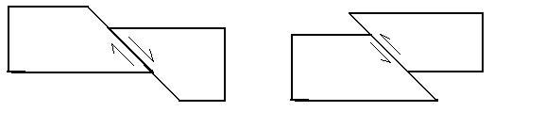
5- The apparent movement on the fault.
It is based upon the apparent movement in vertical cross section at right angles to the fault.
Apparent normal fault.
Hanging wall have goes down relative to the footwall.
Apparent reverse fault.
Hanging wall have goes up relative to the footwall.
Apparent thrust fault.
Hanging wall have goes up relative to the footwall.
at Low angle (<30°)
thrust fault
normal fault
reverse fault

Slide 19
Summery,
it is obviously hopeless to attempt to establish a single set of terms that will take into consideration all the factors enumerated above. As far better system is to describe faults by using several terms from the various classification given above.
thus the faults in one locality may described as
high angle,en echelon faults.
In another locality may be
low angle, parallel ,longitudinal faults

Slide 20
Genetic classification
The most satisfactory genetic classification is based on the nature of the relative movement along the fault. Therefore they divided into:-
Thrust fault: which indicate shortening of rocks involved.(caused by compressive stress)
(Hanging wall moved up relative to the footwall.)
Three categories are usually recognized;- reverse fault- is thrust that dip more than 45°
thrust fault- is one that dips less than 45°
overthrust- is one that dips less than about 10°
Normal fault: which indicate extension of rocks involved.(caused by tension stress)
(Hanging wall moved down relative to the footwall.)
detachment fault;- is a special category of low angle normal fault.
Strike –slip faults: also called wrench fault:
Displacement essentially parallel to the strike of the fault. Dip slip is nil.
Fault plane is vertical.

Slide 21
Sinistral strike-slip faults
Dextral strike-slip faults

Slide 22
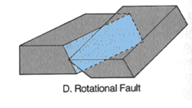
Faults types

Slide 23
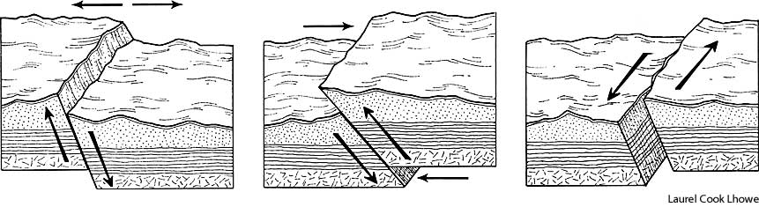
Caused by ----------stress
Define sense of slip
Caused by-------- stress
Sinistral strike-slip faults
Dextral strike-slip faults

Slide 24
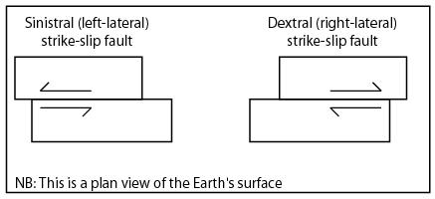
Define sense of slip of strike slip fault
1
2

Slide 25
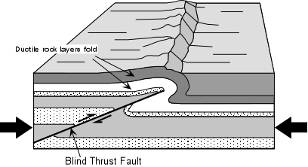
The fault that intersected the ground surface while it was active is an emergent fault.
A fault that dies out in the subsurface, and thus does not intersect the ground surface, is called a blind fault.
Blind thrust fault
A type of thrust fault, which does not appear on the surface, being completely hidden underneath ductile surface rock layers

