Slide 1
Balance cross section

Slide 2
A geologist is often required to use the observations that he or others have made at or near the surface to interpret the structural forms likely to be found at deeper levels.
Such constructions form a key to the understanding of regional tectonics and they often play a vital role in industry.
The exploration for oil and gas in particular requires the best possible control on underground structure in order to site drill holes for -stratigraphic investigation- or- for producing wells.
The application of this method (i.e. balance cross section) aids seismic interpretation, indicates pathways of hydrocarbon migration and locations of entrapment, and constrains structural and Stratigraphic histories of sedimentary basin.
The structural geologist whose predictions lead to many dry hole . Will not be a popular member of a petroleum exploration team!

Slide 3
When you are drawing a structure section, remember that, in general, it should be geometrically possible to unfold the folds and recover the fault slip in order to reconstruct an earlier, less deformed or undeformed state.
In other words, your structure section should be retrodeformable to its predeformed state without any resultant changes in cross-sectional areas in the plane of the section.
what is the cross section::A geologic cross section depicts subsurface geology along a vertical profile
. Cross sections are constructed from geologic maps, well data, seismic lines, and other geophysical data. Typically, a geologist can draw different cross sections that satisfy the available, and usually limited, data.
Hence, a balanced two-dimensional geological cross section provides a more accurate picture of subsurface deformation than a cross-section which is not balanced.

Slide 4
Requirements of balanced cross section.
1- rock volume is conserved during deformation.
2-lengths of the competent beds within a stratigraphic sequence should be the same both before and after deformation
3- the section must be taken perpendicular to the”orogenic strike”(i.e. the main fold trend).
-cross-sections that depart by more than 10 or 15 from the tectonic
movement direction will be distorted and not truly balanced
4- cross section must be restorable or retrodeformable, this mean no large gaps or overlap in strata when restored to its unfolded and ufaulted situations
A cross section that can be restored to a reasonable predeformational configuration is said to be viable.
restorable, or retrodeformable
This means that if all of the shortening represented by the faults and folds is removed, the layers should restore to a reasonable predeformational configuration, without large gaps or overlaps in strata
A balanced cross section must be both admissible and viable

Slide 5
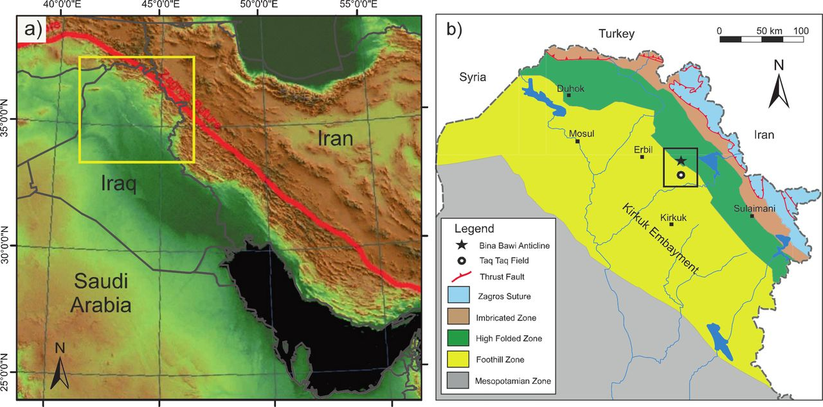
the section must be taken perpendicular to the”orogenic strike”(i.e. the main fold trend).

Slide 6
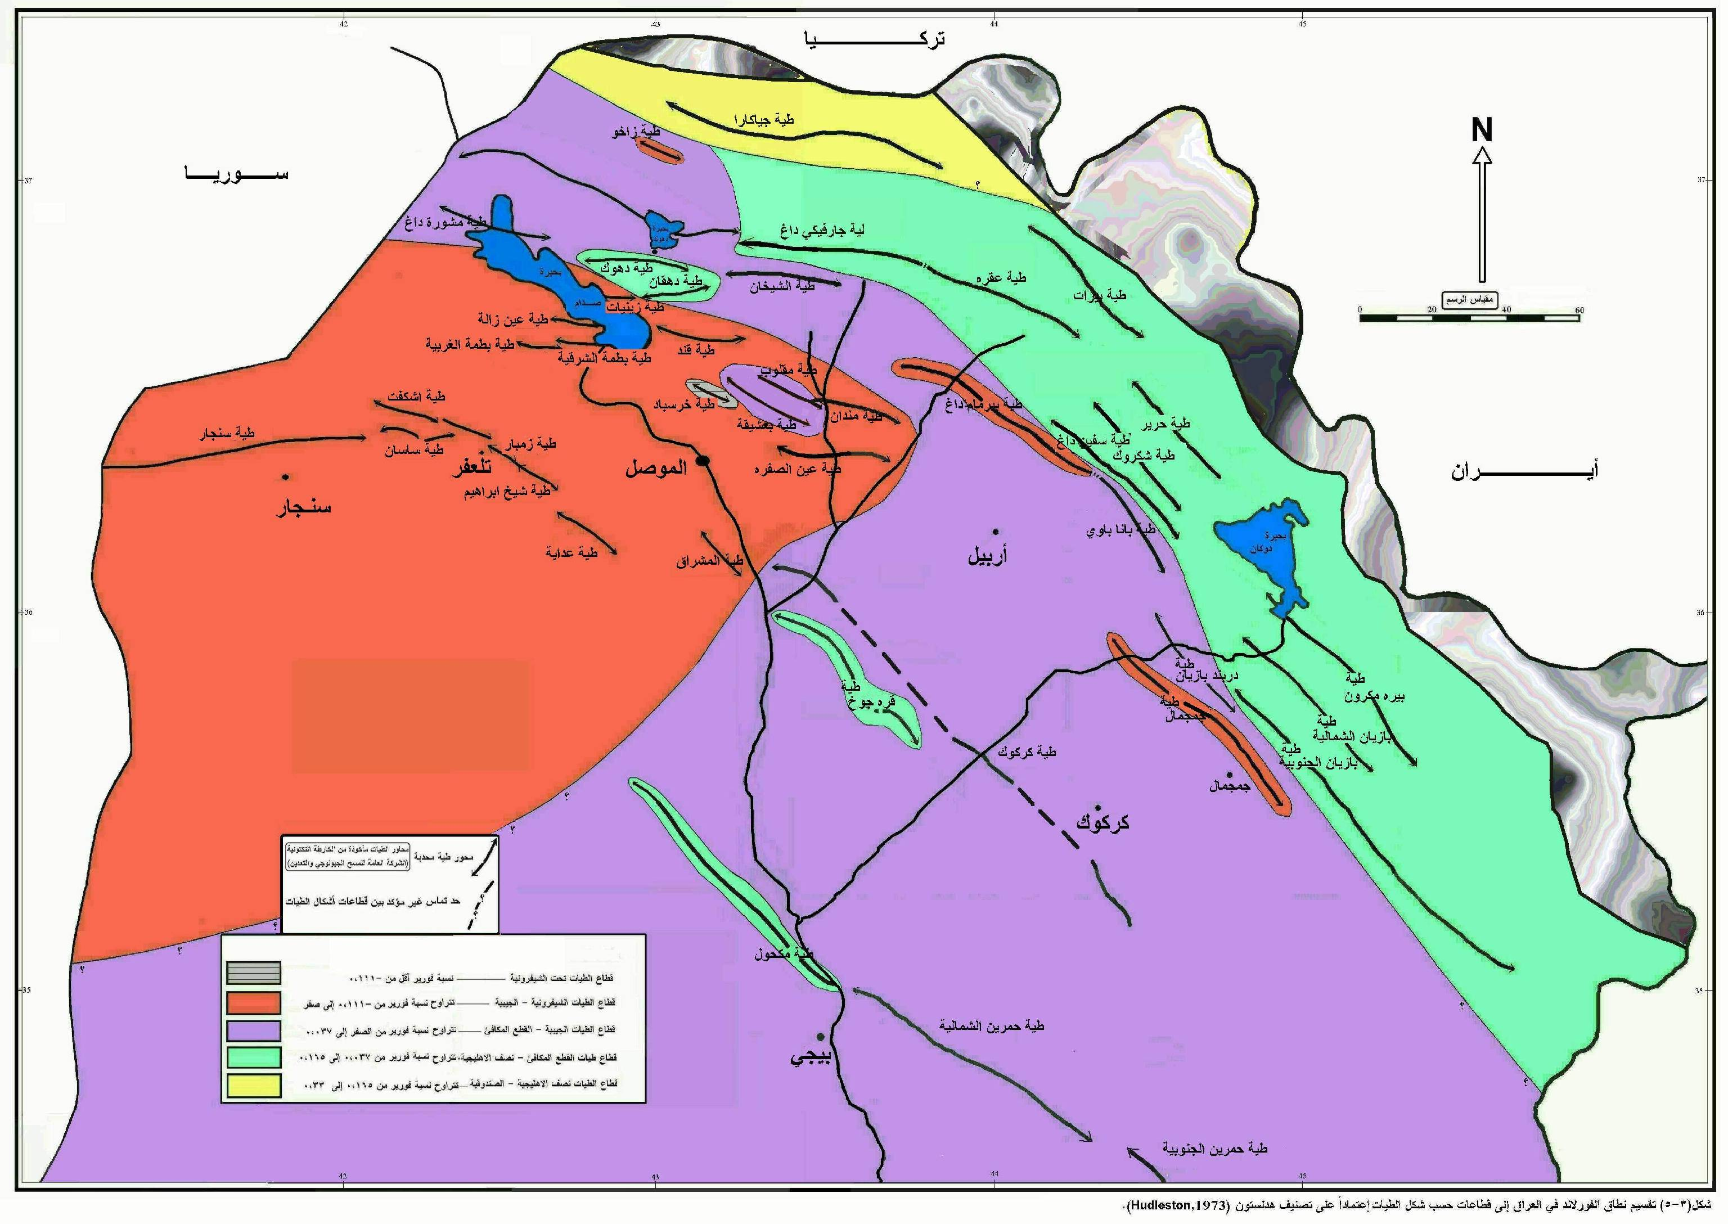
Major folds in northern Iraq and good site balance cross section

Slide 7
Constructing a balanced cross section
(line balance cross section)
1- Draw a regional pin line on the foreland side of the deformed cross section .
Pin line is a vertical line mark in the unfaulted section, which a bed lengths before and after deformation can be measured with reference to this line.
2- Draw another line, called the loose line, perpendicular to bedding on the hinterland side of the deformed cross section
loose-line is a line perpendicular to bedding in thrust sheets such lines are used to monitor the strain required in thrust sheets.
3-On the deformed cross section ,measure the length of each stratigraphic unit, from the pin line to the loose line
4-Transfer the bed-length measurements from the deformed section to the restored section.
5-Once a restored cross section is constructed, the amount of net shortening can be determined by
the equation:
[(ld lu)=lu] 100%
where lu is the bed length in the undeformed state, and ld is the bed length in the deformed state.

Slide 8
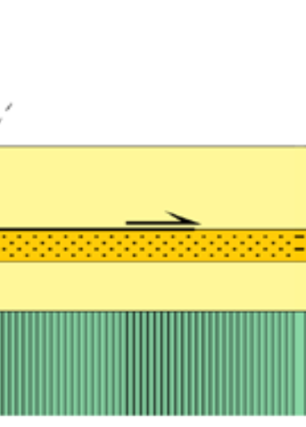
Pin line
Hinterland side= hanging wall thrust
Foreland side= footwall thrust
Loose line
Balanced cross section

Slide 9
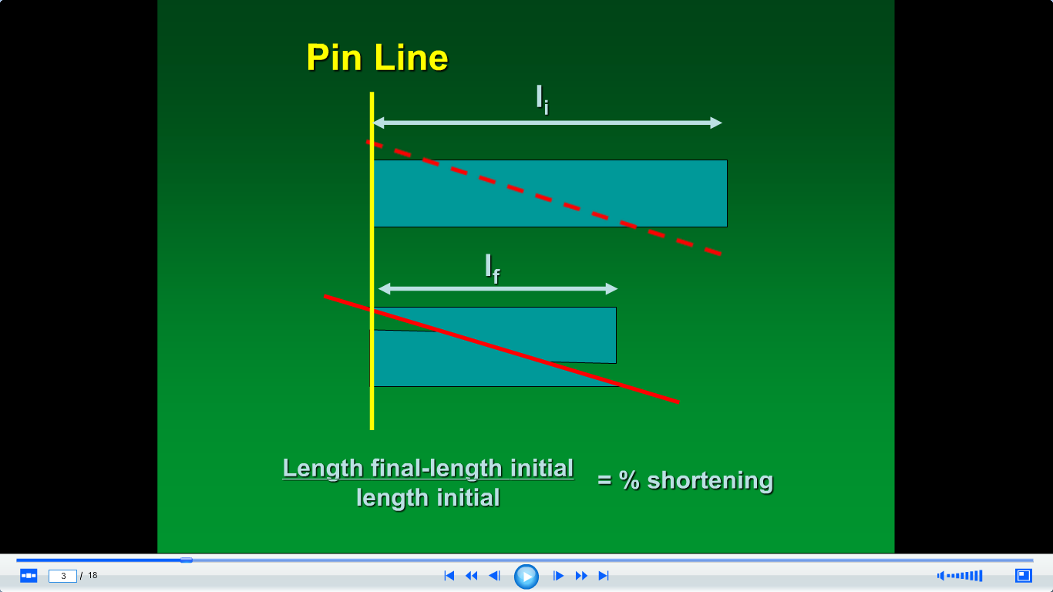
hinteland side
Foreland side

Slide 10
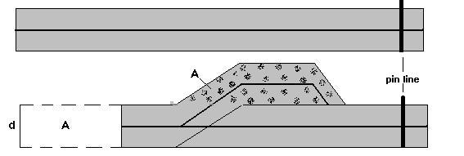
Balancing of cross sections provides a reasonable estimate of shortening
l_{o =} 50 km.
2
2
1
1
Loose line
flat
ramp
2
Foreland side
hinterland side
flat
1
L_{f =} 40 km.
l_{f} - l_{o}
40 - 50
Shortening =
* 100% =
* 100%= -20%
l_{o}
50

Slide 11
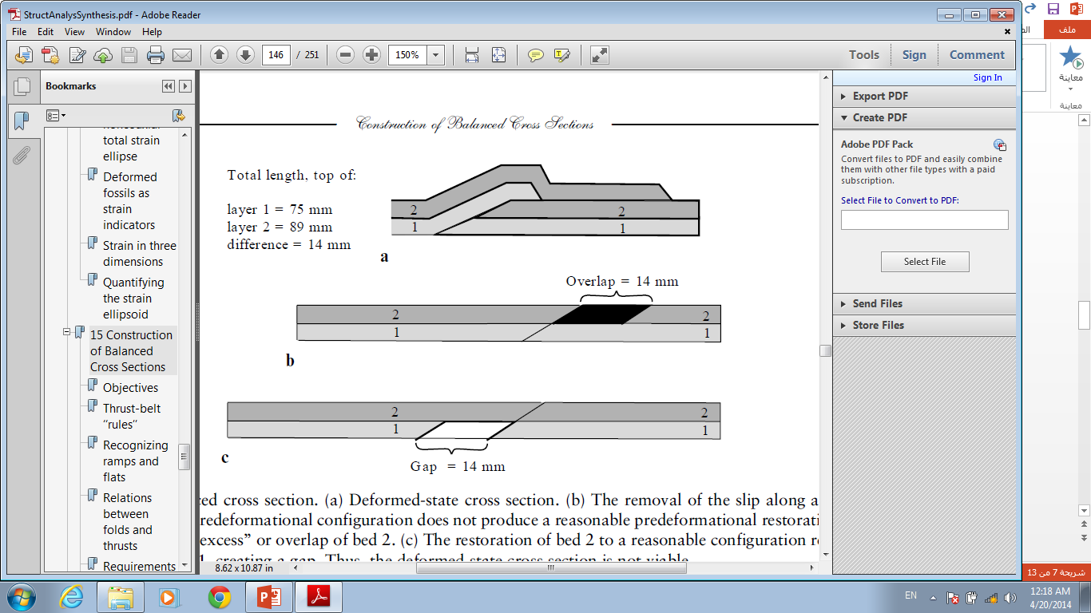
cross section must be restorable or retrodeformable, this mean no large gaps or overlap in strata when restored to its unfolded and ufaulted situations
Total length, top of:
layer 1 = 75 mm
layer 2 = 89 mm
difference = 14 mm
Unbalanced cross section
(a) Deformed-state cross section.
(b) The removal of the slip along a thrust to restore bed 1 to its predeformational configuration does not produce a reasonable predeformational restoration of bed 2, but results in an ‘‘excess’’ or overlap of bed 2.
(c) The restoration of bed 2 to a reasonable configuration results in a deficiency of bed 1, creating a gap.
Thus, the deformed-state cross section is not viable.

Slide 12
Advantage of balance cross section technique
1-Balanced geological cross-sections provide a means of developing a regional geological framework model (or models) for a specific area which represents
a geometrically reasonable interpretation of subsurface structures.
2-This technique permits an understanding of the geometric and kinematic evolution of faults (and folds) structures as well as indicating the sequences of faulting and activity on faults.
3-The application of these methods aids seismic interpretation, indicates pathways of hydrocarbon migration and locations of entrapment, and constrains structural and Stratigraphic histories of sedimentary basin.
4-A balanced two-dimensional geological cross section provides a more accurate picture of subsurface deformation than a cross-section which is not balanced.
5-Balancing of cross sections provides a reasonable estimate of shortening.
6- Determine the depth of detachment.

Slide 13
The ultimate goals of balancing are to restore complexly deformed rock to its initial state or to its correct palinspastic restoration and to determine the sequence of events.
Such information can be very useful to the geologist or geophysicist.
Not only is the geometry of the structure better understood, resulting in better and more accurate reservoir maps, but geologic trend such as sand lines can be more accurately located.
An understanding of the timing of the structural events should aid in oil migration studies, and define how and where fluids may have entered the structure.
Balancing can also be effectively utilized to check your assumption and interpretations.
Balancing is not unique and two geologist can data set and the better the interpretive techniques, the more likely that the balanced section will reflect reality.
Lastly, balancing tends to keep the interpreter more focused. If the section does not balance, then perhaps it is time to reconsider the interpretation.

Slide 14
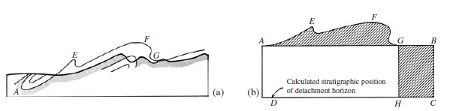
Depth of folding(detachment).
The position of this basal detachment is determined by the location within the sedimentary
sequence of weak layers, such as shale, or in extreme cases, salt and gypsum, or by the contact between the sedimentary rocks and the underlying rigid basement unit.
Calculation
1. The lateral shortening of a reference horizon between points of no slippage is determined
by comparing the bed length measured with a curvimeter, with the lateral
distance this horizon occupies in the folded packet. In (Fig. a )the bed length
measured at the top of the Mississipian Rundle group is AEFG = AB. The distance
GB represents the actual shortening.
2. The amount of increased area of the thickened packet between the two no-slip reference
points is measured with a planimeter.
In (Fig. b), this area lies between the straight line AG and the trace of the
folded reference horizon AEFG.
3. The depth AD of folding follows directly from the relationship:
Depth = area uplifted GBCH(equal to area of AEFG) مساحة المنطقة معلومة
shortening (GB) طول احد اضلاع المستطيل معلومة
.Note that the area of rectangle GBCH equals the area measured in step 2. طول الضلع الاخر= المساحة على طول الضلع المعلوم

