Slide 1
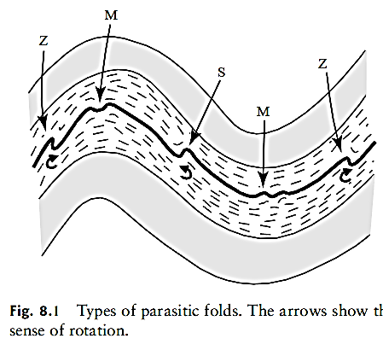
Minor Folds
Lecture 8
They are small asymmetric folds that form on the limbs of the major folds, and they arise in non-solid layers (incompetent beds) located between two rigid layers (competent beds) moved away from one across the other. They are also called parasitic folds because they have the same orientation of (axis and axial plane) as the major fold also because it was formed in the same phase of deformation, it can therefore be used (in general) to infer the orientation of the major fold when its outcrops are few and far between ...Sometime it is called a drag fold, but the term is true for the folds arising from fault-drag folds
The largest folds are called the ﬁrst-order folds, while
smaller associated folds are second- and higher-order folds.
Left hand limb
Shear clockwise
right hand limb
Shear anti clockwise
The minor folds take the shape of a Z-shape when the shear movement is clockwise, while the shape of the letter S if the movement is counterclockwise.
Therefore, the closure of the fold (the hinge zone) of the large anticline (for example), as in the figure, can be deduced by recognizing the shape of the minor folds.
Axial plane of major fold
Parasitic folds have a vergence directed toward the hinge zone of major fold. This relationship between parasitic and major folds can be extremely useful for mapping out fold structures that are too large to be observed in individual outcrops .

Slide 2
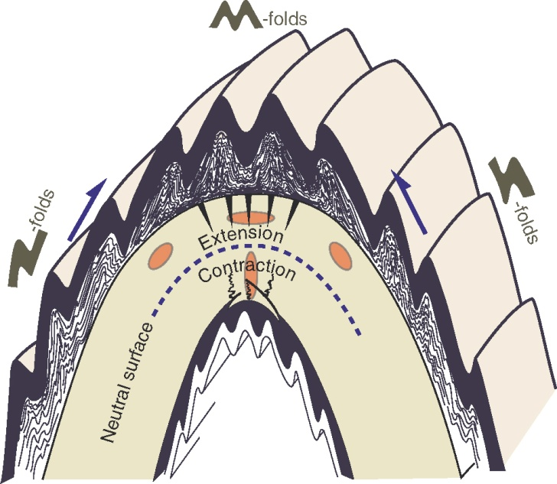
الطيات الثانوية minor folds
وهي طيات صغيرة غير متناظرة تتكون على اطراف الطيات الرئيسة وهي تنشأ في طبقات غير صلبة ( bed incompetent) واقعة بين طبقتين صلبتين (competent beds) تحركتا قصيًا احداهما عبر الاخرى , و يطلق عليها ايضا الطيات المتطفلة parasitic folds وذلك لامتلاكها نفس وضعية الطية الرئيسة من ناحية التوجية(المحور والمستوي المحوري). ولأنها تكونت بنفس نمط التشوه لذلك يمكن استخدامها ( عموما) في استنباط وضعية الطية الرئيسة عندما تكون مكاشفها قليلة ومتباعدة.. كما يطلق عليها drag foldالا ان المصطلح يصح اطلاقة على الطيات الناشئة عن الفوالق fault-drag folds
right hand limb
Left hand limb
تاخذ الطيات الثانوية شكل حرف Z عندما تكون الحركة القص مع عقارب الساعة فيما تاخذ شكل الحرف S اذا كانت حركة القص عكس عقارب الساعة
Axial plane of major fold
لذلك يمكن استنباط غلق الطية(منطقة المفصل) المحدبة الكبيرة (مثلا) كما في الشكل من خلال التعرف على شكل الطية الثانوية.
االاتكاء Vergency
للطيات الثانوية يشير نحو المستوي المحوري للطية الكبيرة

Slide 3
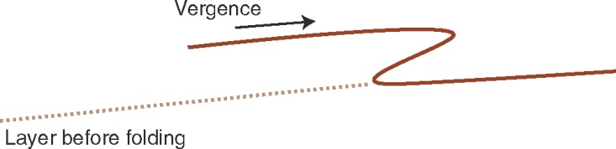
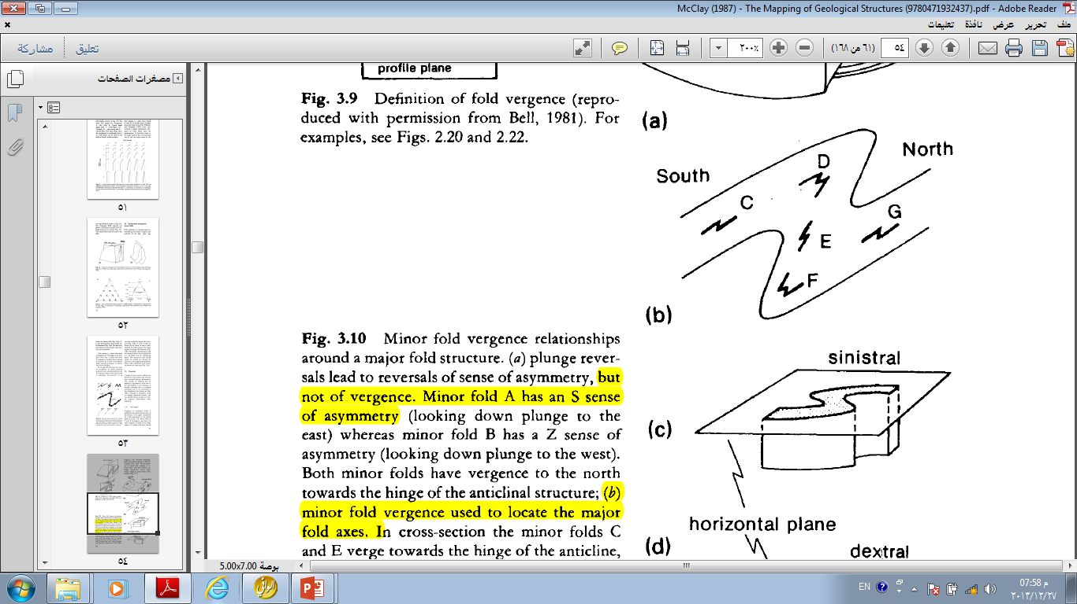
Symmetries of parasitic minor folds
Fold symmetry is characterized by considering the relative lengths and attitudes of the long—short—long limbs of a minor fold (Fig. 3.8a). Z, S, and M symmetry minor folds can be identified (Fig. 3.8a). M folds have fold limbs of equal length, and hence have no asymmetry.
The concept of fold vergence. This fold is right-verging and a Z-fold according to the clockwise rotation of the short limb.
Fold symmetry is always determined by looking down the plunge of the minor fold.
(Note that a minor fold with Z asymmetry looking down plunge would have an S sense of asymmetry when viewed up plunge: so, always look down plunge.)
In a large fold structure the sense of asymmetry of minor parasitic folds will vary systematically around the structure and as such can be used to determine the position of an outcrop within the larger fold structure (Fig. 3.8b). S and Z folds are found on the limbs of major folds , whereas M folds indicate the hinge region of a large fold structure. (Fig.3.8b). Systematic determination and recording of minor fold asymmetries is a powerful tool for identifying major fold structures and should always be carried out during the course of your mapping programme .Minor fold symmetries must always be plotted on your map (Fig. 3.8c).
There is need for some caution when folds are not plunging; that is, in horizontal upright folds where down-plunge observations cannot be defined. Imagine an antiform that is cut by a road perpendicular to the axial surface. The asymmetry of parasitic folds in this large structure appears clockwise or counterclockwise on opposite sides of the road. However, in both cases they make the same prediction for the location of the hinge area. As long as you define the direction in which you view the minor structure

Slide 4
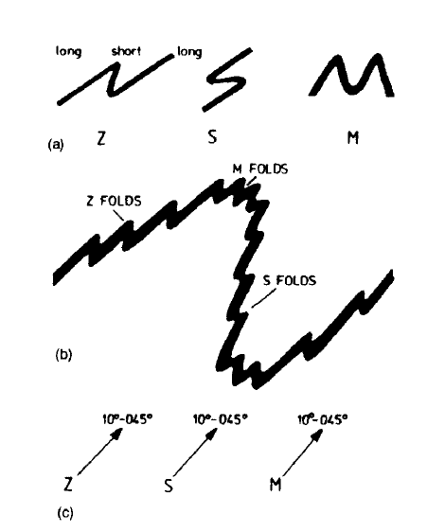
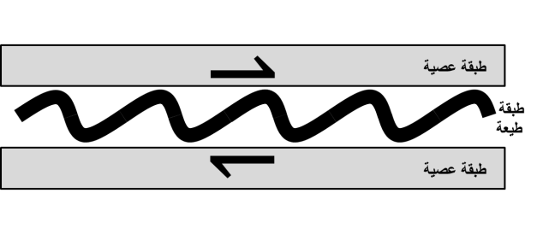
Fig. 3.8 Parasitic minor folds
(a) Z, S, and M
symmetry minor folds as viewed looking down the fold plunge;
(b) Symmetry of parasitic minor folds around major fold structures;
(c) Map symbols for minor folds and their symmetry.
Competent bed
Incompetent
bed
Competent bed

Slide 5
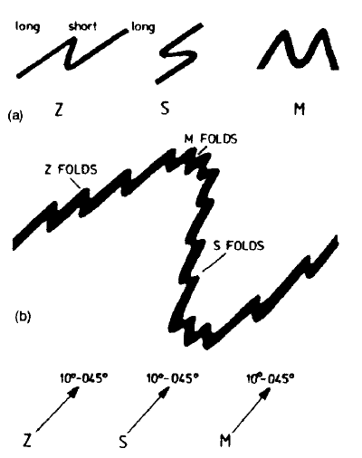
A note of caution; the sense of fold rotation-displacement will change if a fold is viewed from the opposite direction (i.e. S-folds will appear as Z-folds). Hence it is necessary to indicate the direction in which observations are made. Where possible, folds should be viewed down-plunge.
The principal use of minor fold vergence is to locate major fold axial surfaces. In simple geometries, minor folds change vergence across major fold surfaces.
in cross-section the minor folds C and E verge towards the hinge of the anticline,
whereas folds D and F have neutral vergence at the hinge lines.
Minor folds E and G verge away from the synclinal axis;

Slide 6
right hand limb
Left hand limb
حركة القص التدوير
عكس اتجاه دوران عقارب الساعة
حركة القص مع اتجاه دوران عقارب الساعة
أنواع الطيات المتطفلة (Z,M,S) الأسهم تشير الى حالة القص

Slide 7
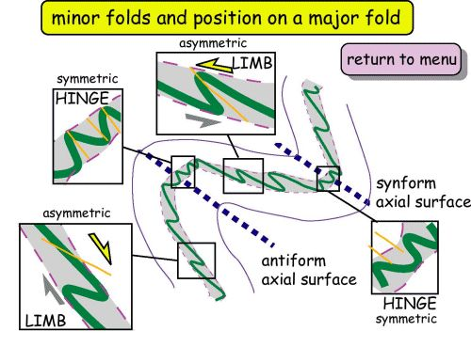

Slide 8
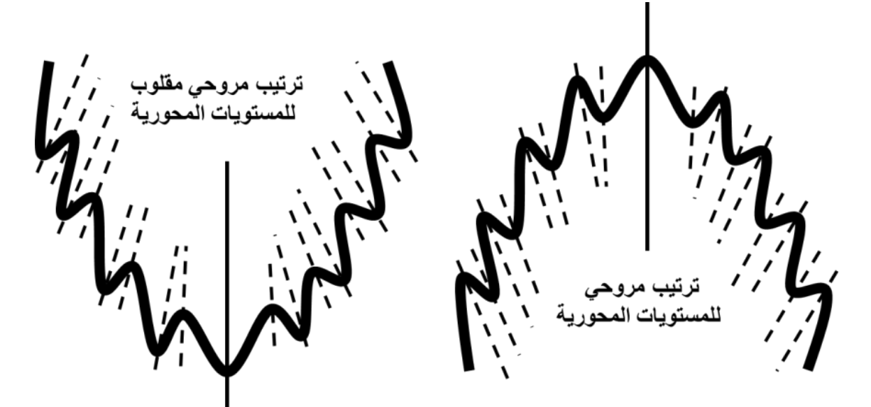
The arrangement of the axial planes of the Drag folds on the limbs of the main folds,
Take fan shape in the domain of main anticline, and an inverted fan arrangement in the domain of main syncline.
Inverted Fan shape arrangement of axial plane minor folds
Fan shape arrangement of axial plane of minor folds

Slide 9
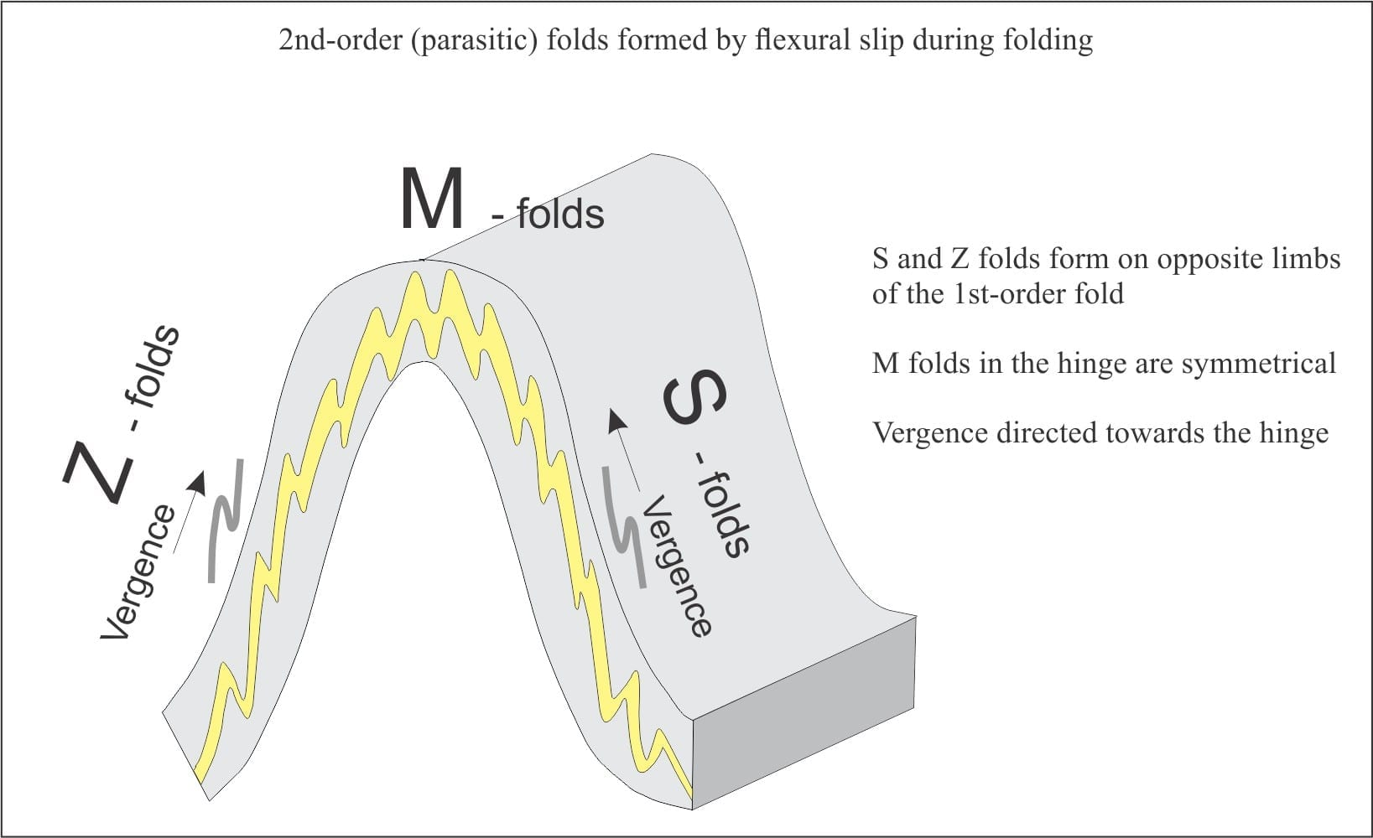
The difference between S- and Z-folds lies in their sense of rotation, or vergence. The long limbs of S-folds are connected by a shorter limb that implies counter-clockwise rotation or sense of displacement; the opposite applies to Z-folds. Thus, the vergence of parasitic folds is towards the hinge line (or zone)

Slide 10
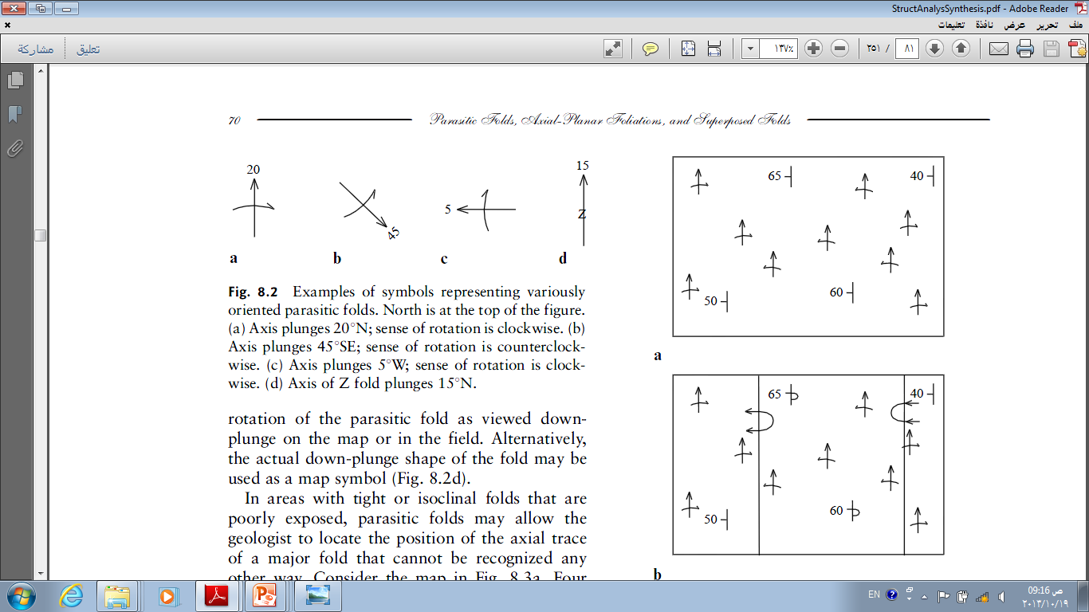
N
الرموز الخاصة بالطيات الثانوية

Slide 11
Show four minor folds in Azmar anticline limbs 1 and 2 are Z folds, 3 is approximately M fold is in the hinge of Azmar anticline, 4 is S fold

Slide 12
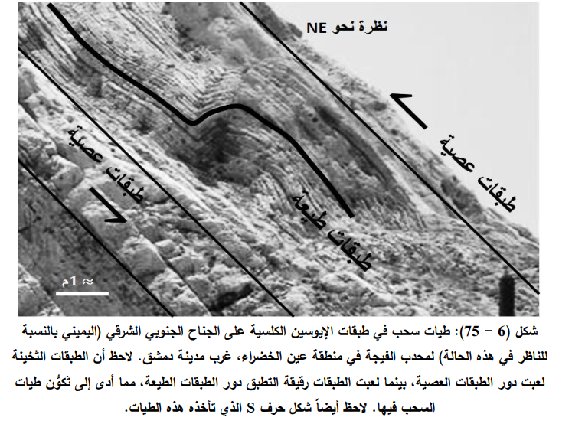

Slide 13
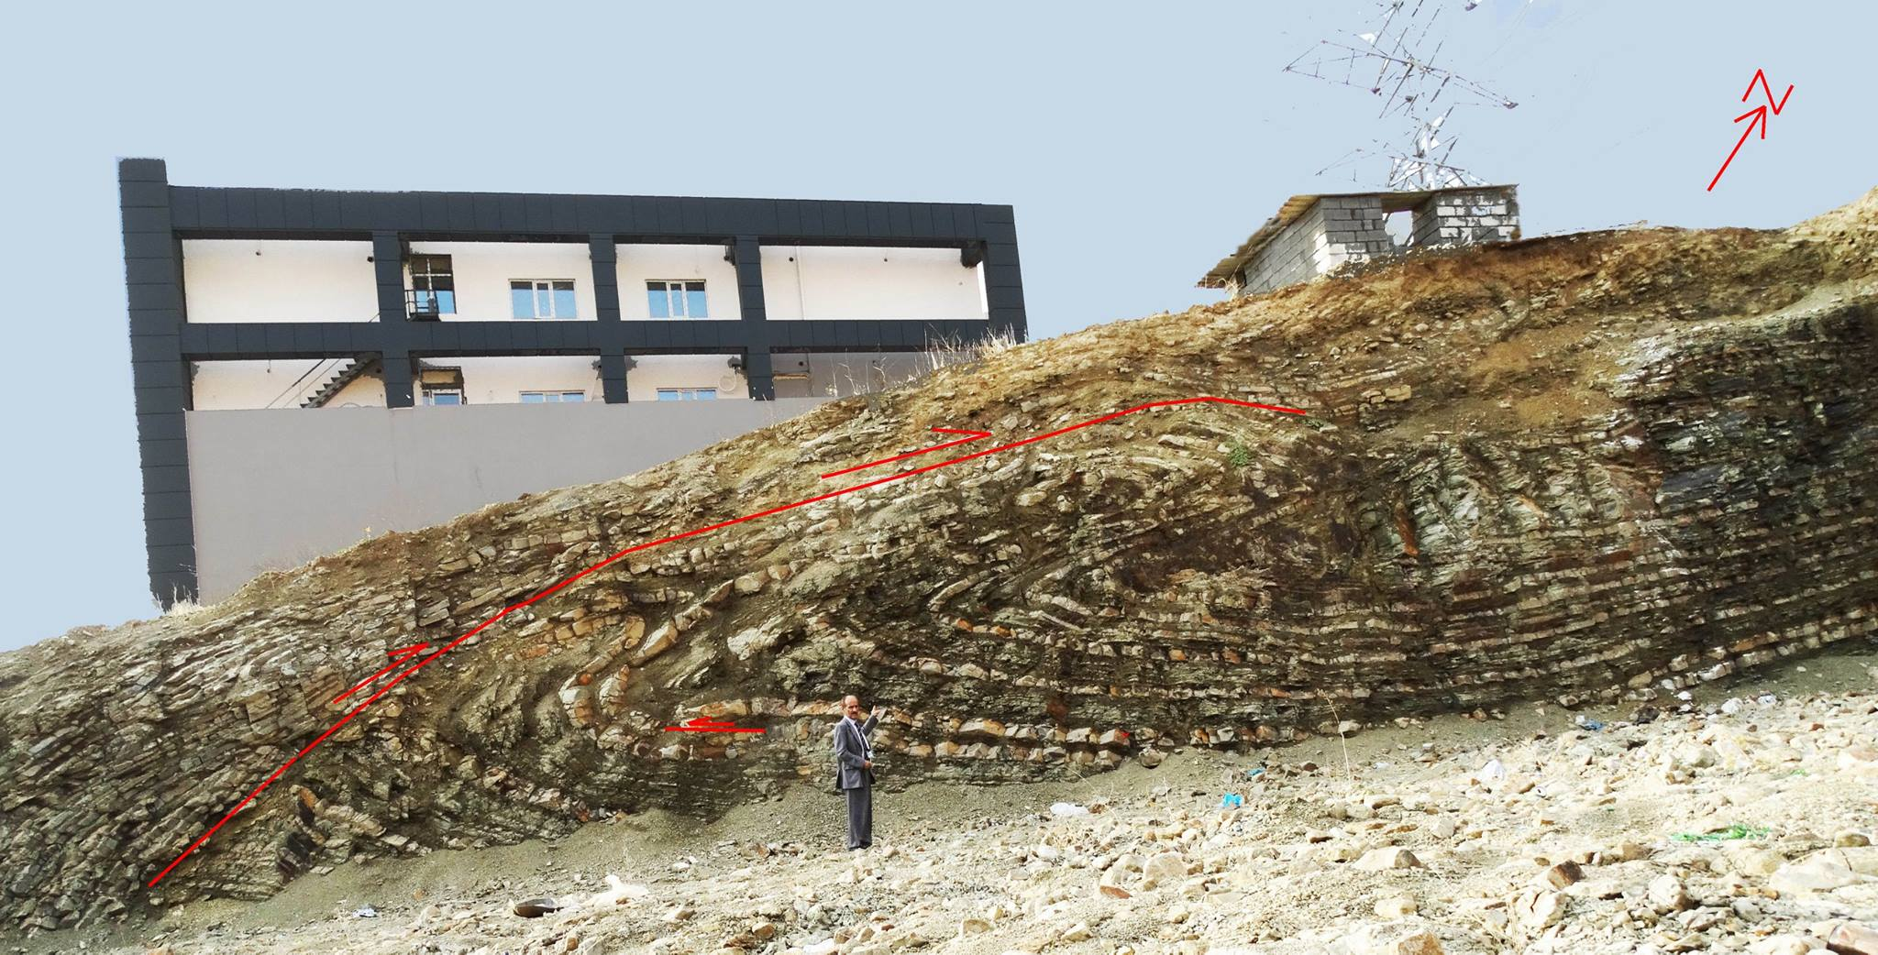
Z minor fold

Slide 14
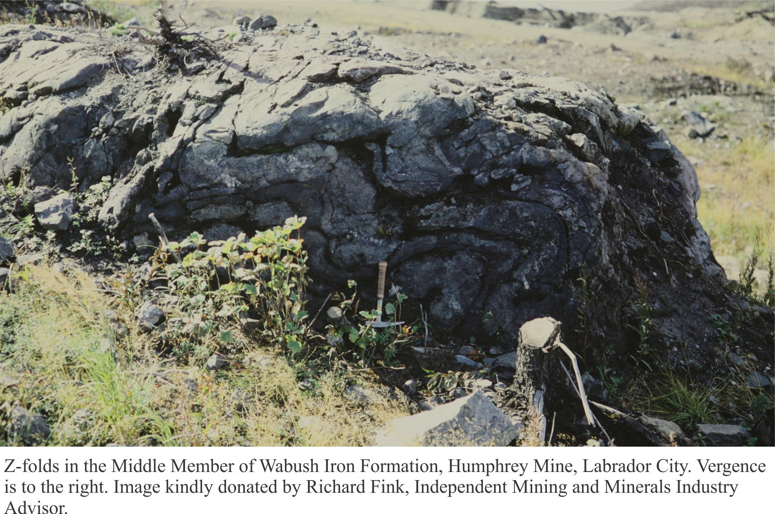

Slide 15
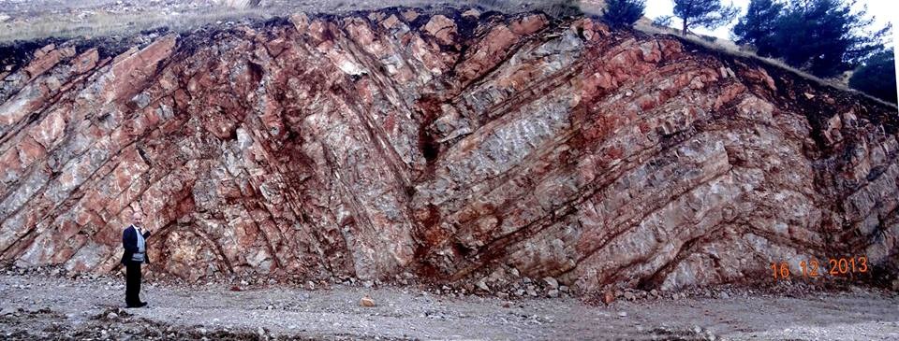
M fold in the core of Azmar Anticline, Sulaimania

Slide 16
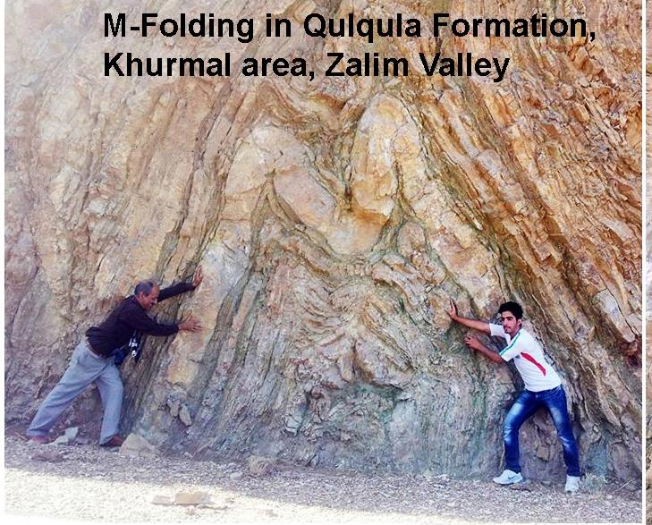

Slide 17
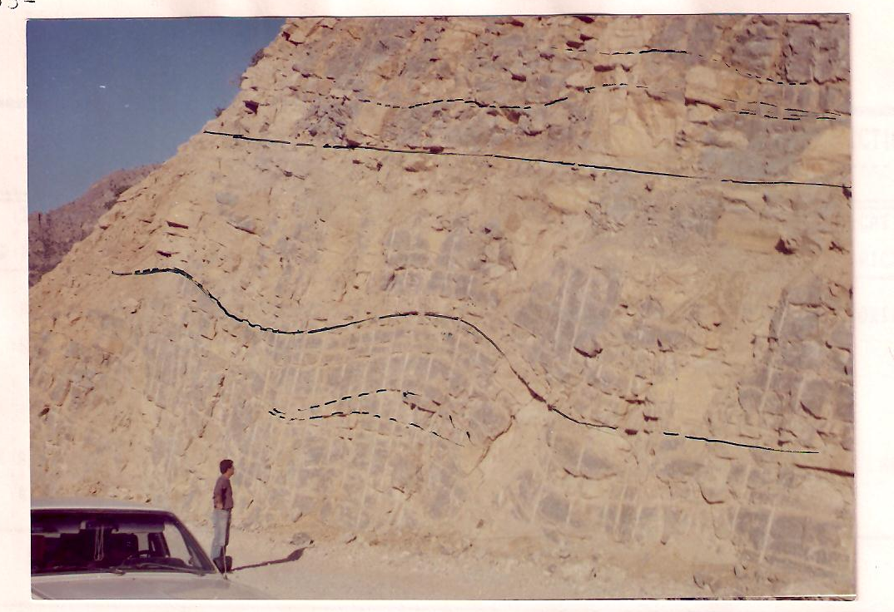
Minor folds in Chia Gara Formation .. Bekhme Gorge-Berat Anticline

Slide 18
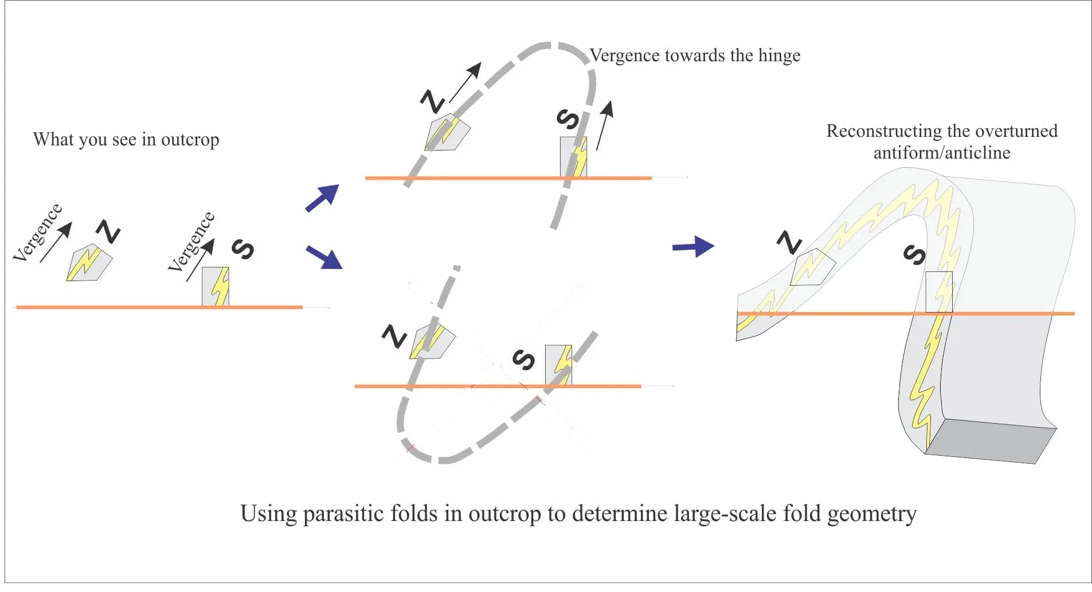
The geometric disposition of S- and Z-folds is extremely useful for deciphering large-scale folds, particularly when exposure is incomplete (as is commonly the case). The diagram below shows a scenario, where small folds are exposed in two outcrops.
IS THE MAJOR STRUCTURE AN ANTICLINE or SYNCLINE
A
B

Slide 19
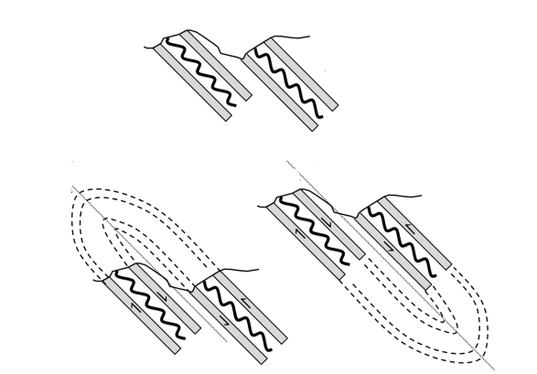
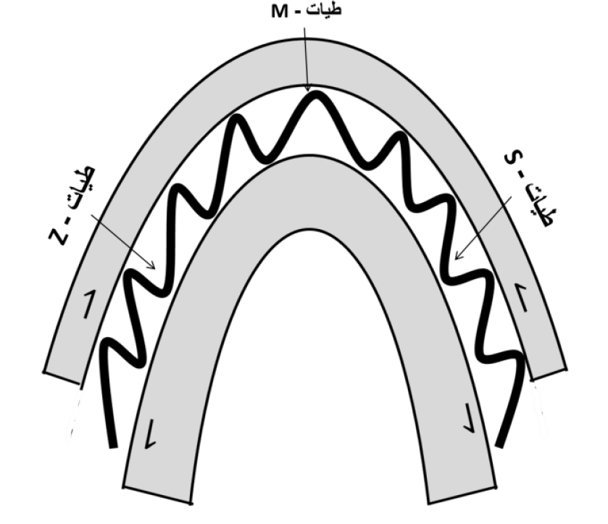
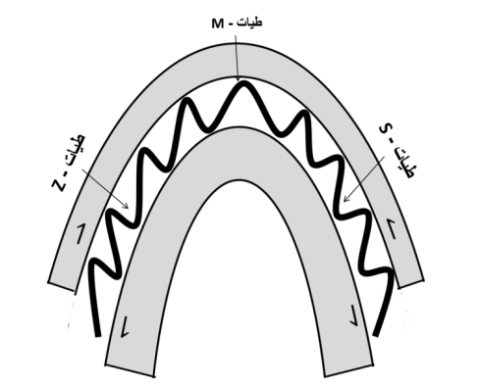
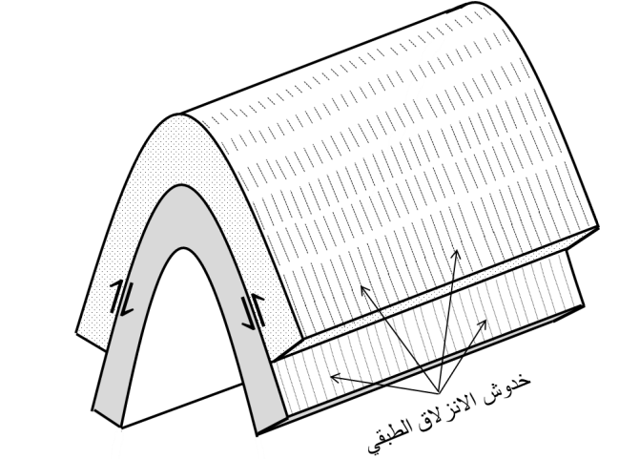
A
An overturned isoclinal fold (A), of which only a part of a whole is visible in its cross-section . An associated limbs with secondary(drag) folds in its incompetent layers. Does this fold represent An Anticline(B) or A Syncline (C) ?
A: طية مقلوبة متساوية الميل، لايظهر منها في مقطعها العرضي سوى جزء من كل جناح مترافق مع طيات ثانوية في طبقاته الطيعة. فهل تمثل هذه الطية شكلاً محدباً أم شكلاً مقعرا؟
remember:-Parasitic folds have a vergence directed toward the hinge zone of major fold
B
C
يبدو أن نمط عدم التناظر في الطيات الثانوية يتوافق مع الانزلاق الطبقي على جناحي شكل محدب مقلوب.

