Slide 1
Stylolite seams or
(pressure solution surfaces

Slide 2
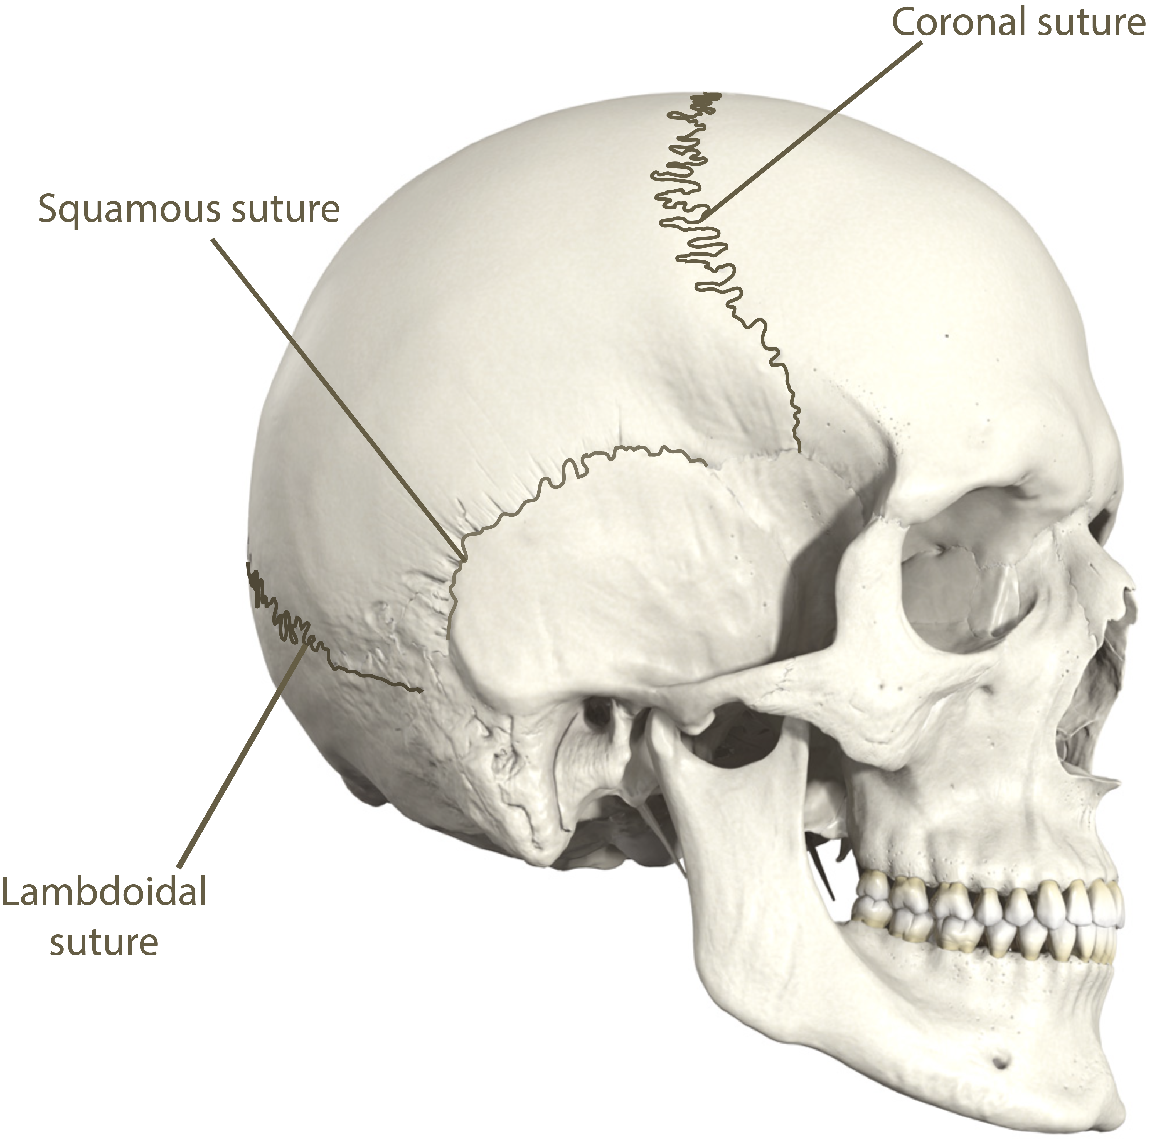
The term 'stylolite' is derived from the Greek word (Greek: stylos, pillar; lithos,
stone). Stylolites or English (pillar-stones) are serrated surfaces at which mineral
has been removed by pressure dissolution.
Stylolites are serrated boundaries between rock units, formed due to the accumulation of clays, some other minerals, and/or organic matter.
Bles and Feuga, (1986), defined the Stylolites as a very irregular
discontinuities that show alternating peaks and hollows that correspond to each
other on the two surfaces, and they added:
Stylolites form in rocks under the influence of compressive
stresses that force together rock on either side of a discontinuity. The
two sides interpenetrate as a result of dissolution of the rock matrix near
the boundary between them. The boundaries jagged and became as tooth-
like or saw-like dentations in cross section, like the (sutures in your skull),

Slide 3
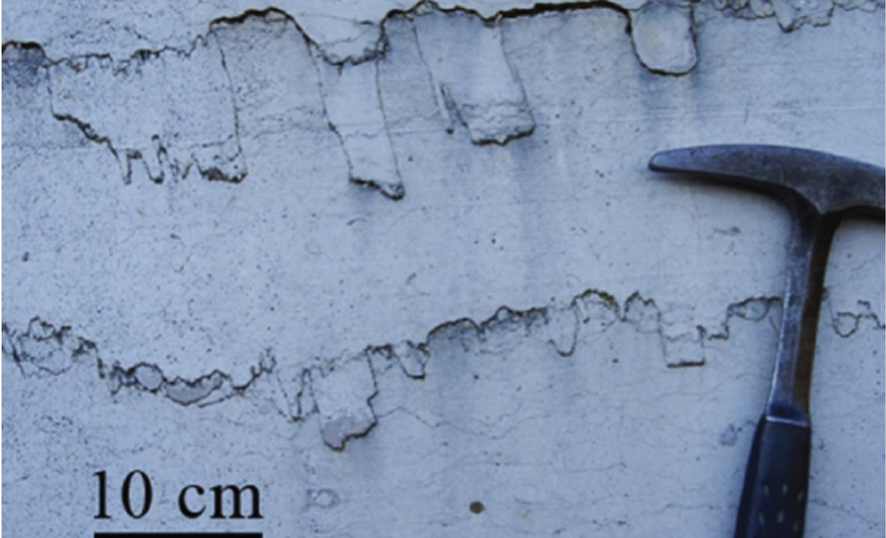
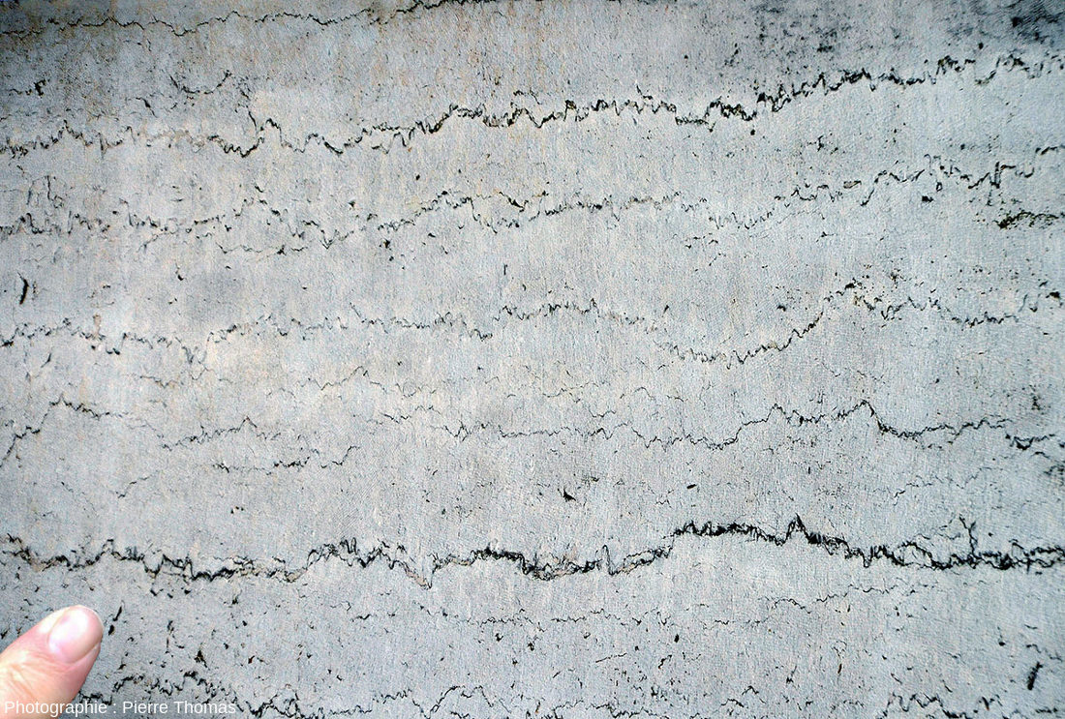
In cross section can be recognized by their appearance:-
there are Conical and cylindrical
The First (Conical)is of tectonic origin, whereas the Second (Cylindrical) thought to be of depositional (digenetic) origin. The lateral dimensions of conical stylolites range from a few tenth of millimeters to a few centimeters,
while of columns of cylindrical stylolite range from a few millimeters or centimeters up to several tenth of centimeters.
Cylindrical
Conical

Slide 4
It is reasonable to suppose that stylolites can form in rocks containing no previous discontinuities (intact rocks) starting from microscopic fissures in the rock matrix.
There are also discontinuities that can exist before stylolite formation such as bedding planes and joints or fissures.
Depending on the spatial arrangement of pre-existing fractures with respect to the
maximum compressive stress direction every kind of stylolite is possible, from
symmetric to asymmetric.
stress that caused them.
Symmetrical stylolite when the peaks are perpendicular to their seams.
A symmetrical when peaks are oblique to their seams and called
(slickolites), formation of stylolites or slickolites depends on the orientation of
preexisting fractures with respect to the maximum compressive

Slide 5
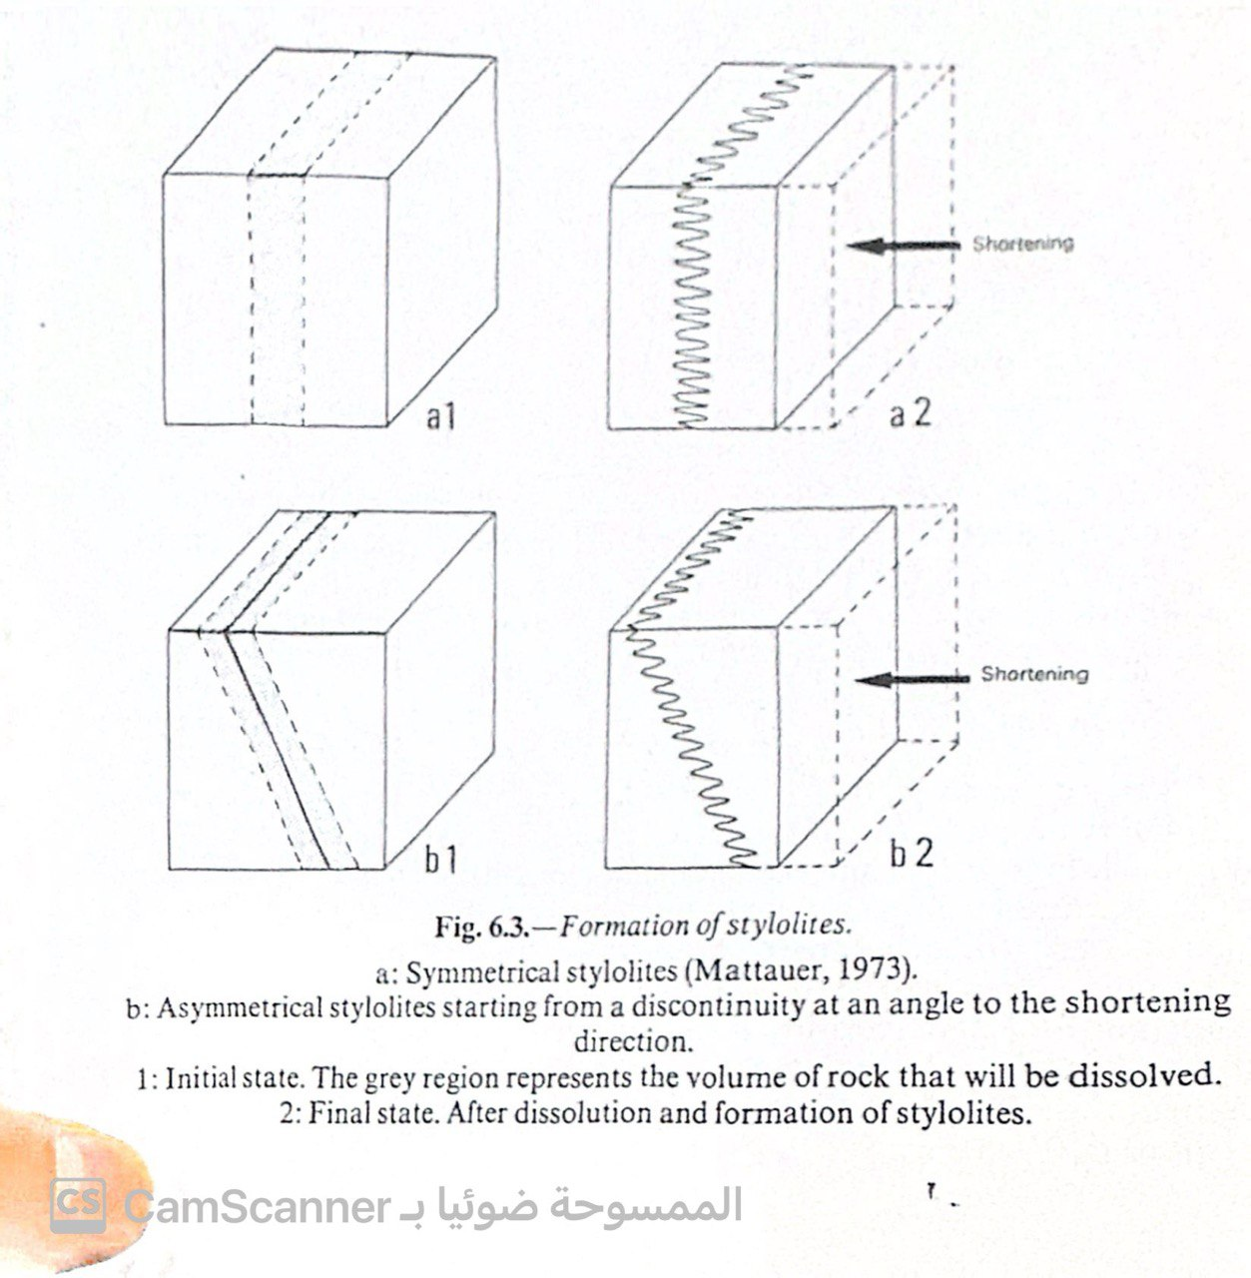
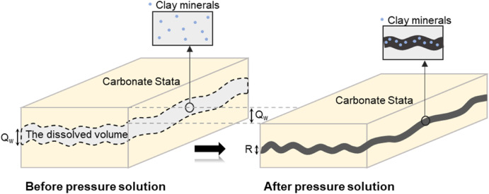
Formation of Stylolites
Stylolites form in rocks under the influence of compressive stresses that force together rock on either side of a discontinuity .the two sides interpenetrate as a result of dissolution of the rock matrix near the boundary between them.
Dissolution of the rock is clearly demonstrated by the disappearance of whole layers of fossils at a stylolite surface . It is still uncertain whether stylolites are formed during or after the diagenesis of sediments

Slide 6
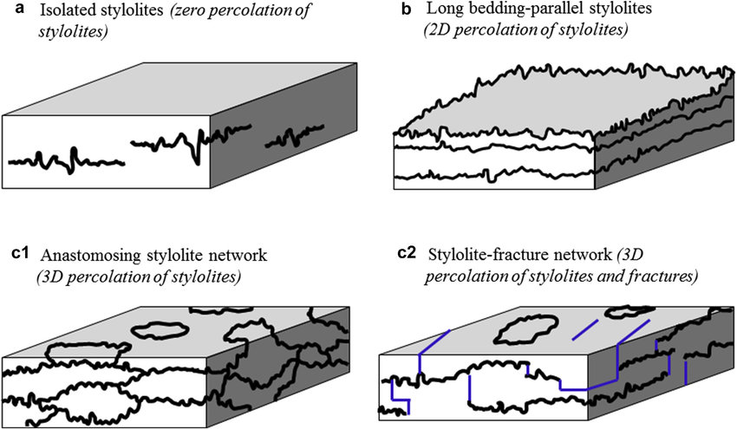
: Stylolites form when minerals dissolve under pressure, leaving behind insoluble materials like clays or oxides.
: They can be horizontal (parallel to bedding), inclined (oblique to bedding), or vertical (perpendicular to bedding).
: Stylolites act as indicators of compressive stress and can affect fluid flow in rocks..

Slide 7
Stylolites typically form perpendicular to the maximum principal stress direction. By analyzing the orientation of stylolites in a rock, researchers can infer the direction of past tectonic stresses.
For tectonic stylolites, anisotropy within the plane can indicate variations in horizontal stresses, providing further insights into stress orientations.
Paleostress Magnitude
The morphology of stylolites, particularly their height power spectra and crossover lengths between different scaling regimes, can be used to estimate paleostress magnitudes. This method involves analyzing high-resolution images or profiles of stylolite surfaces.
In summary, by studying both the orientation and morphological characteristics of stylolites, researchers can reconstruct not only the direction but also the magnitude of ancient stresses that acted on rocks during geological processes.

Slide 8
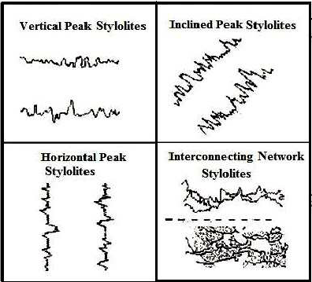
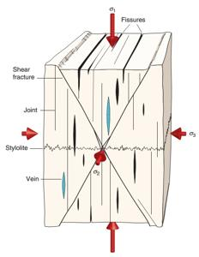
The peaks in these sutures oriented parallel to direction of the maximum principle
stress axis (σ1). They develop mostly in calcareous but less common in sandstone.

Slide 9
Types of Rocks
Carbonates (Limestone and Marble): These are common hosts for stylolites due to their susceptibility to chemical dissolution by groundwater. Stylolites often appear as serrated surfaces marked by concentrations of clay minerals or iron oxides35.
Cherts and Sandstones: While less common than in carbonates, stylolites can also occur in these sedimentary rocks under appropriate conditions1.
Igneous Rocks: Though rare, stylolites may be found in certain igneous rocks that have undergone sufficient deformation or alteration processes.
Ice: Large-scale stylolite-like structures can develop in ice due to similar pressure dissolution mechanisms

Slide 10
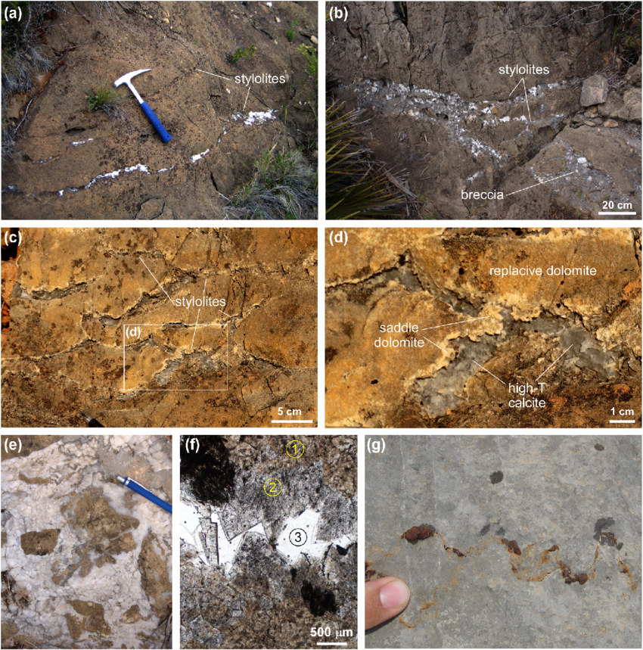

Slide 14
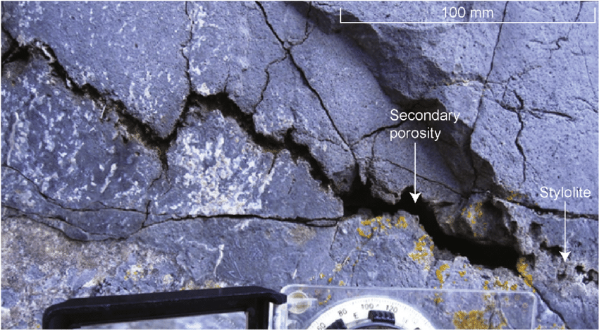

Slide 15
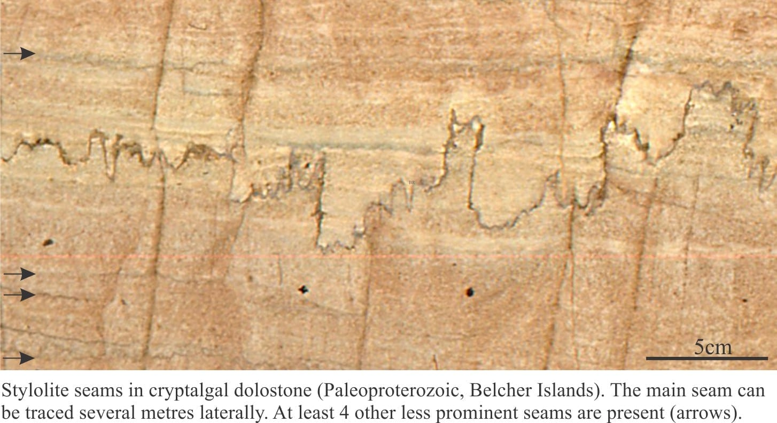

Slide 16
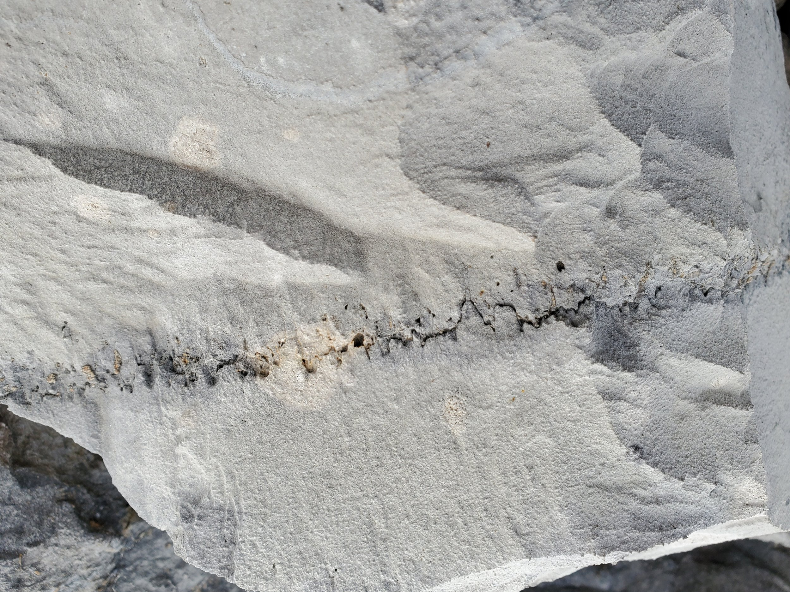

Slide 17
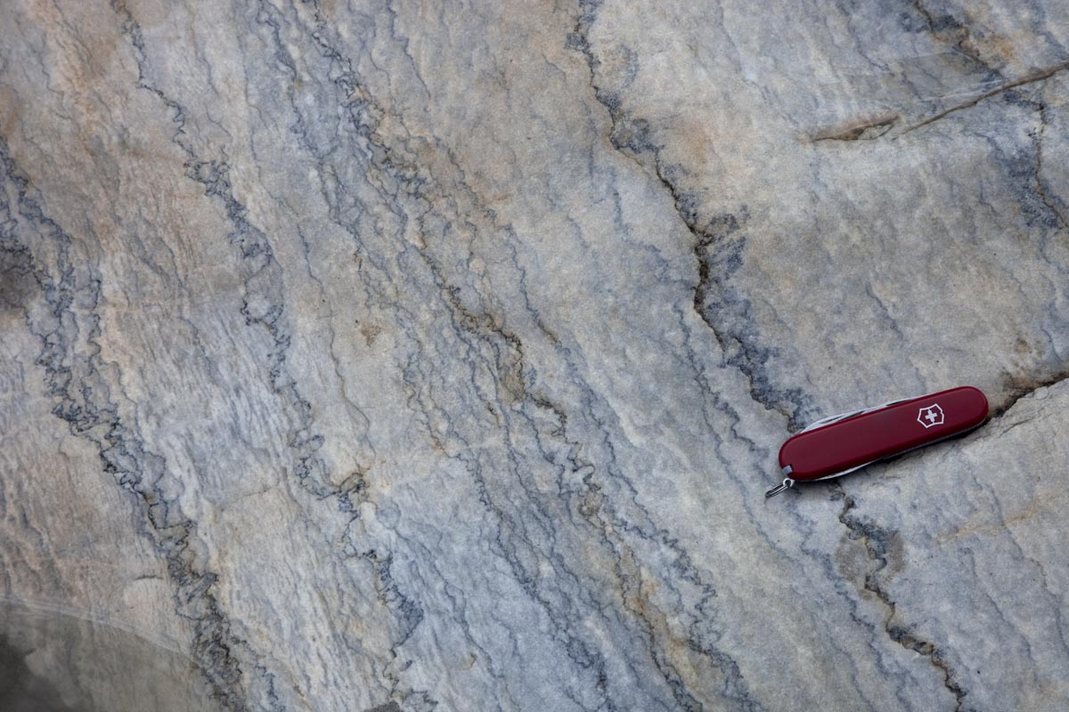

Slide 18
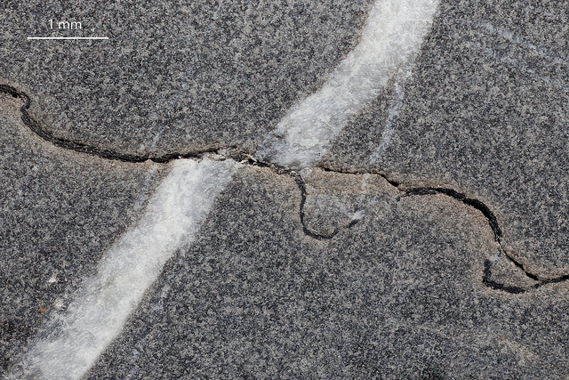

Slide 19
How do tectonic stylolites differ in orientation compared to sedimentary stylolites
Tectonic and sedimentary stylolites differ primarily in their orientation relative to bedding planes due to the different stress conditions under which they form:
SEDIMENTARY STYLOLITES:
Typically form parallel or nearly parallel to bedding planes.
Their orientation is influenced by overburden pressure during compaction, where the largest compressive stress is usually vertical (perpendicular to bedding) at the time of formation.
TECTONICS STYLOLITES:
-Often oriented perpendicular or oblique to bedding planes.
-Form in response to tectonic stresses, where the largest compressive principal stress axis can be horizontal or inclined, leading to vertical or inclined stylolite orientations12.
-These structures can intersect previously formed sedimentary stylolites as tectonic conditions change over time.
In summary, while sedimentary stylolites generally align with bedding due to gravitational loading, tectonic stylolites reflect more complex stress fields associated with deformation processes.

Slide 20
GEOLOGIC SIGNIFICANCE:
1-Sedimentary stylolites reflect compaction history and may influence stratigraphic thinning without significant tectonic implications.
2- Useful for determining paleostress orientation and magnitude due to their geometric properties.
3- Can either impede or facilitate fluid flow depending on their maturity and direction relative to flow paths.
4- Influence petrophysical properties by creating storage spaces but also impeding fluid migration in certain cases.
Overall, stylolites provide valuable insights into geological processes such as diagenesis, tectonics, and hydrology within sedimentary basins
IMPACT OF ROCK PROPERTIES:
Tectonically influenced stylolites can significantly affect fluid flow by creating barriers perpendicular to potential flow paths.
Sedimentarily formed stylolites might impede fluid migration less if aligned with bedding planes but still contribute to changes in rock texture and porosity.

