Slide 1
Folds –Faults relationshipعلاقة الطيات بالفوالق
محاضرة 5
Faults and Folds commonly occur in the same outcrop.The spatial juxtaposition of these structures, one brittle and one ductile, may seem paradoxical at first.
How can rock break at the same time that it distorts ductilely?
One explanation for the juxtaposition of faults and folds in an outcrop is that these structures formed at different times under different pressure and temperature conditions.
For example, imagine that the folds formed 500 million years ago at a depth of 15 km in
the crust, but, once formed, the rock body containing the folds was unroofed and moved to shallow depths,where a later, and totally separate, deformation event
created brittle faults in the body. Typically, in such examples, the faults cut across the preexisting folds and are not geometrically related to the folds.
But in many instances it is clear from the spatial and geometric relation between folds and faults that the two structures formed together during the same deformation event.
Folds that form in association with faults are called fault-related folds
Folds divided according to their relationships with faults into the three main parts according to the simultaneity between the folds and the faults:-

Slide 2
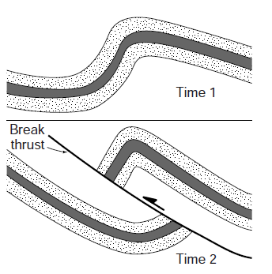
1- Pre-Faulting Folds:
These folds result from the buckling of a stratified sequence, initially the layers bend, without rupturing, to form an open anticline syncline pair (Fig. a). The folds tighten and become more asymmetric as folding progresses. Eventually, strain can no longer be accommodated by folding alone, and rupturing produces a thrust fault that breaks through the overturning limb (the “forelimb”) of the anticline. Because the thrust cuts through the limb of an already formed fold, it is called break thrust (Fig. b). Note that a break thrust develops after folding. After a break thrust has ruptured the forelimb of an asymmetric anticline, it displaces the anticline of the hanging wall to the foreland, relative to the syncline of the footwall. This fold is called also Fault–Inception Fold.
Back limb
forelimb
a
Formation of break-thrust fold,
(a) An asymmetric fold begins to form and tighten.
(b) Eventually, a fault break through the fold‘s forelimb .
b

Slide 3
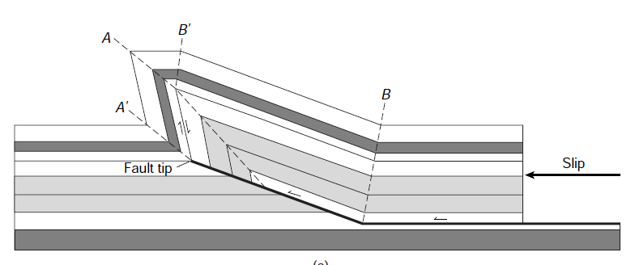
2- Syn-Faulting Folds:
A- Fault-propagation folding: the folding develops just in advance of the tip of a ramp as the ramp propagates up dip. Such folds develop concurrently with thrust development. The deformation is only in the hanging wall and there is no deformation in the foot wall. Fault-propagation fold is asymmetric and verge in the direction of thrusting
Cross-sectional model showing a simple fault-propagation fold. The dashed lines are the traces of axial surfaces

Slide 5
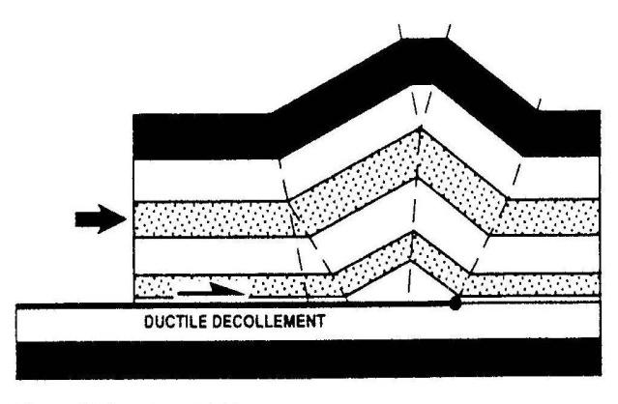
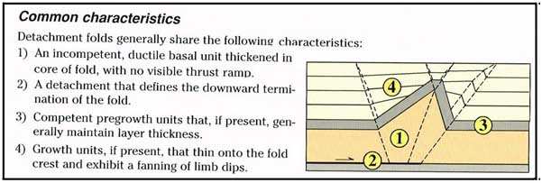
Detachment Fold:
Detachment Folds are folds developed above a detachment or bedding parallel thrust (i.e. the thrust is a flat and the folding does not require a ramp). Detachment folds require a ductile decollement layer (e.g. salt or shale) which can infill the space generated at the base of the fold. Detachment folds are rootless and commonly disharmonic

Slide 6
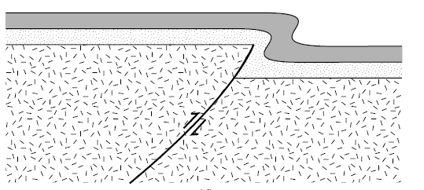
Drape Fold: This fold formed when steeply dipping faults in the basement reactivated, causing differential movement of basement blocks. This movement forces the overlying layer of sedimentary rocks to passively bend into a fold that drapes over the edge of the basement block. Fault-related folds that form in this way are called drape folds or forced folds . Kinematically , they are fault propagation folds, but they are given a separate name to emphasize their unique tectonic setting .
Wrench Folds: Is the folds which results from the relative horizontal movements of the strike slip faults which produced shear forces lead to fold the sedimentary strata

Slide 8
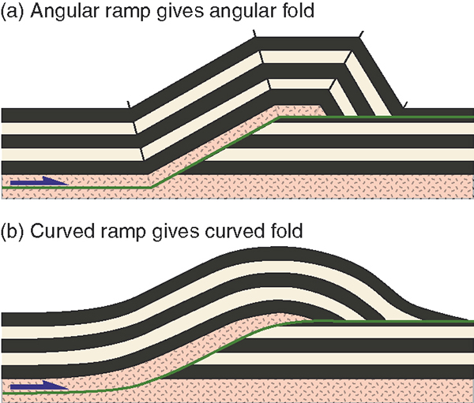
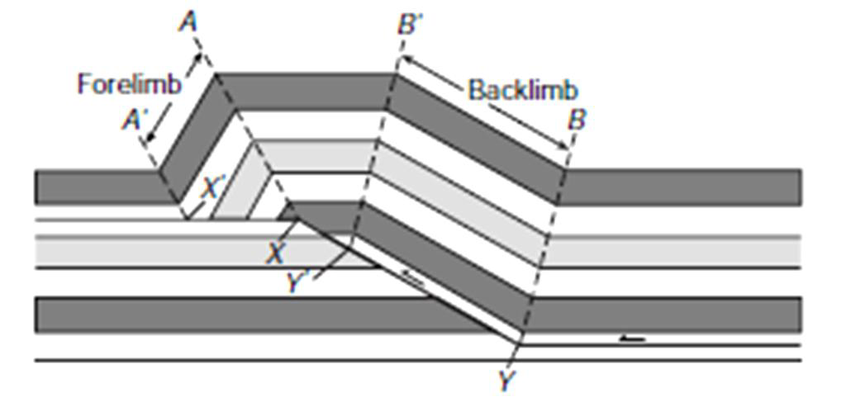
Post-Faulting Folds
are caused by displacement along a non-planar fault. In non-vertical faults, the hanging-wall deforms to accommodate the mismatch across the fault as displacement progresses.
When a simple thrust geometry in which a thrust that occurs as a flat in a weak layer bends, cuts up section across a strong layer as a ramp, and then bends again and becomes a flat at the top of the strong layer. If you push on the thrust sheet, the sheet must itself bend to climb the ramp. Because of Earth‟s gravity, the sheet cannot rise into the air at the top of the ramp. Rather, the layer bends again to form an anticline on the upper flat. Thus, by pushing strata up and over a preexisting stair-step thrust, strata of the thrust sheet must undergo folding. Note that this folding occurs after the formation of the thrust and the deformation is only in the hanging wall and there is no deformation in the foot wall. The resulting fold is called a fault-bend fold.

Slide 9
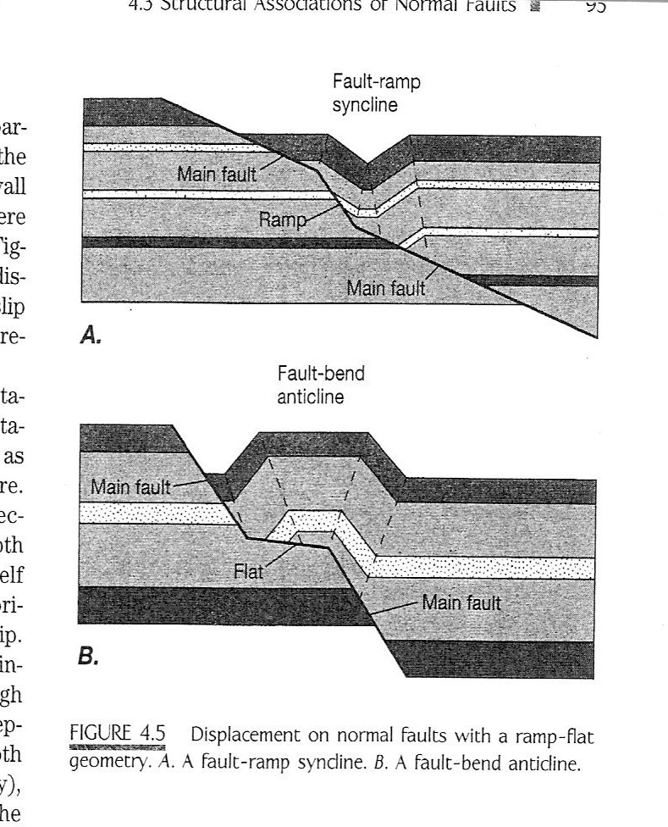
Fault bend folds occur in both extensional and thrust faulting. In extension, listric faults form rollover anticlines in their hanging walls. In thrusting, ramp anticlines are formed whenever a thrust fault cuts up section from one detachment level to another. Displacement over this higher-angle ramp generates the folding.
Hanging wall
Foot wall
flat
Extensional faulting
thrust faulting

Slide 10
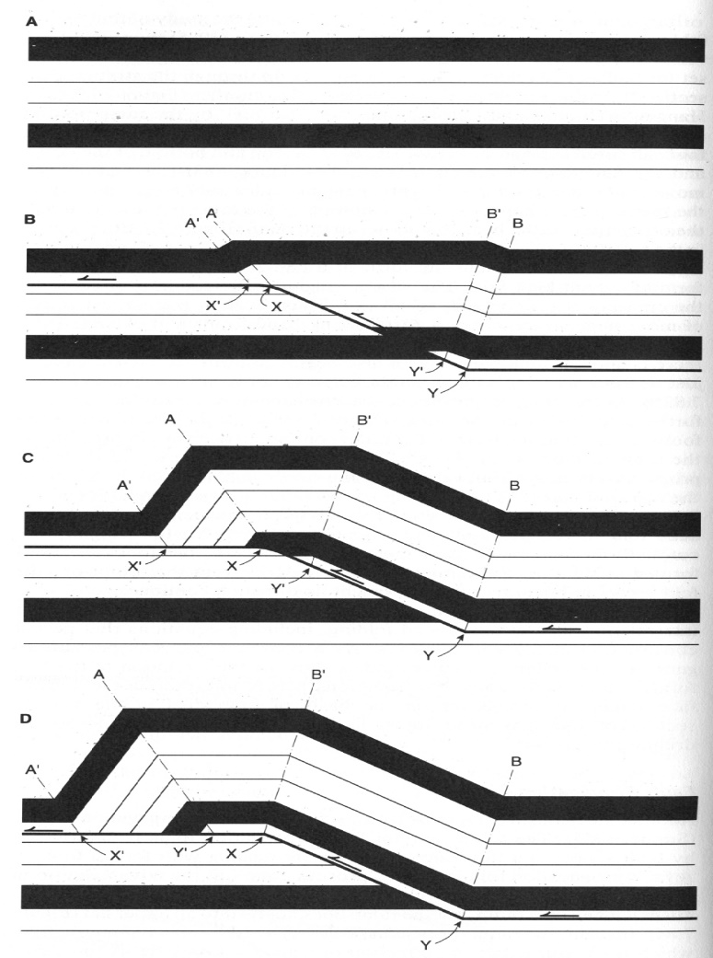
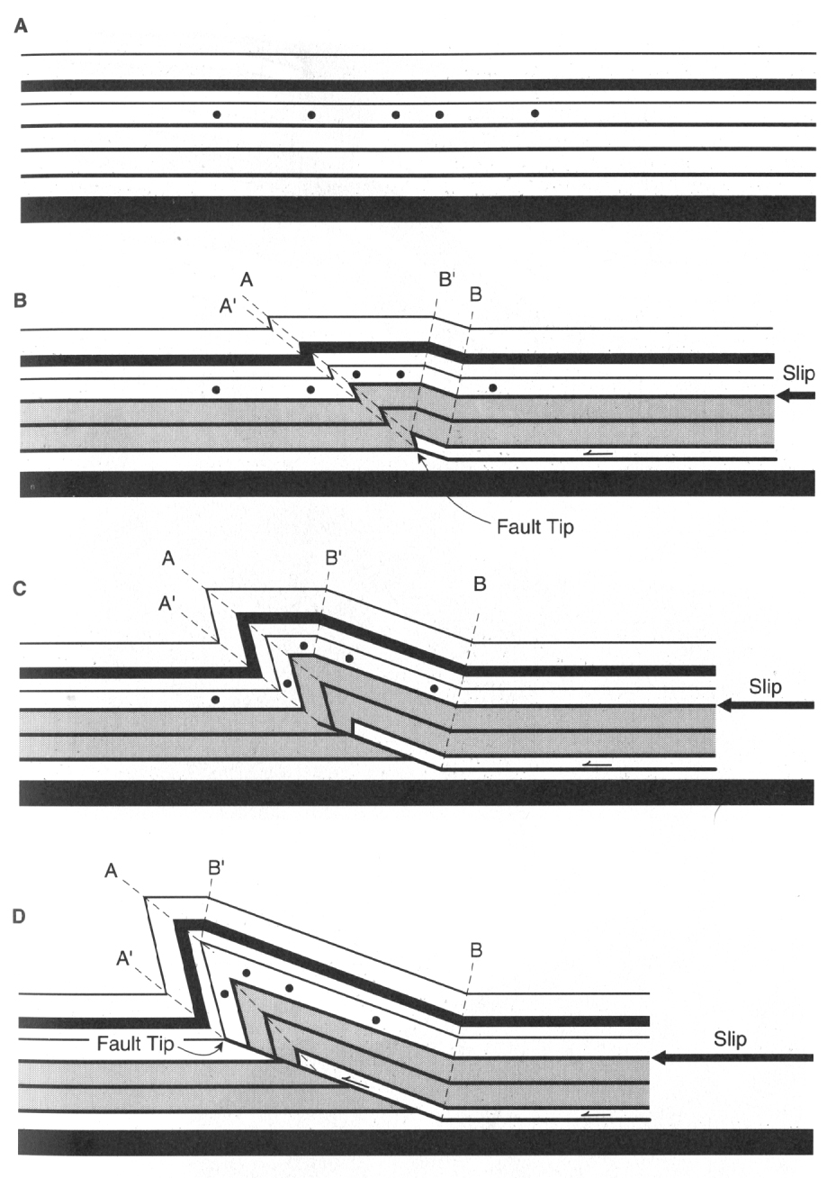
Fault-bend fold
Fault-propagation fold
-Fault-propagation folds are generally more asymmetric than fault-bend folds.
-fault slip is not conserved. Fault displacement is taken up by folding
-throughgoing faults - slip is conserved.
-Fold amplitude is determined by the thickness above the lower hanging wall flat.

