Slide 1
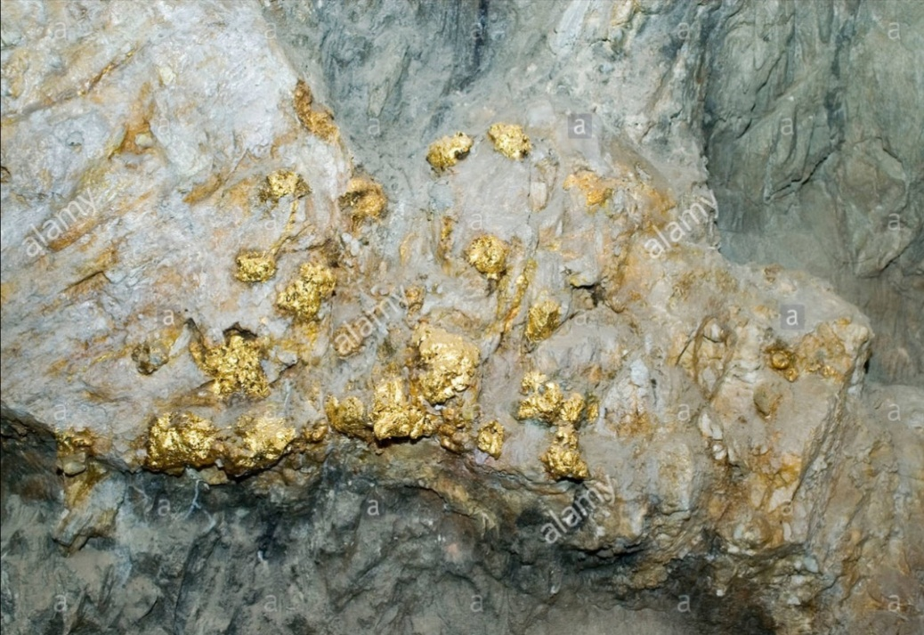
Ore Geology

Slide 2
Economic Geology :
A branch of geology deals with natural materials used for human benefit. These materials called "Economic Resources" and include:
1- Ores of metals (e.g., Cu, Pb, Au, Ag ….etc.) , gemstones ( e.g., diamond , opal , turgoise, ….. etc.) and rare earth elements (e.g., Se, La, Nb, ….. etc.)
2- Industrial rocks and minerals ( non-metallic), (e.g., bauxite, limestone , sandstone, …… etc.)
3- Energy Resources (Fuel) include oil, coal and gas
4- Water resources
1 & 2 are called "mineral resources"

Slide 3
Ore (Metallic Ore)Definition
A natural concentrated aggregates of metallic minerals ( galena, chalcopyrite, pyrite, …etc.) from which one or more metals can be economically extracted
Ore geology
A branch of economic geology that deals with metallic ores only concerning their: occurrences, mineralogy, geochemistry, their geological settings, genesis (process of formation), exploration, economic evaluation, mining, extraction and beneficiation.
This course involves with the genesis of metallic ores only (Their processes of Formation).

Slide 4
What are the three main constituents of any metallic ore (orebody, ore deposit)
1- Ore Minerals (metallic minerals)
2- Gangue Minerals
3- Host Rocks (country rocks)
Gangue mineral:
The unwanted materials, minerals or rocks, with which ore minerals are usually intergrown.
Protore:
This is mineral material in which an initial but uneconomic concentration of metals has occurred that may by further natural processes be upgraded to the level of ore.

