Slide 1
Factors affecting the formation of Metasomatic Ores
(A) Factors related to the intruded igneous body:
1- Chemical composition of the magma:
* Felsic magma of intermediate composition is the most suitable for the formation of metasomatic ore.
* Few ores are associated with syenite.
* Normal granite, mafic and ultramafic rocks rarely yield this kind of ore.

Slide 2
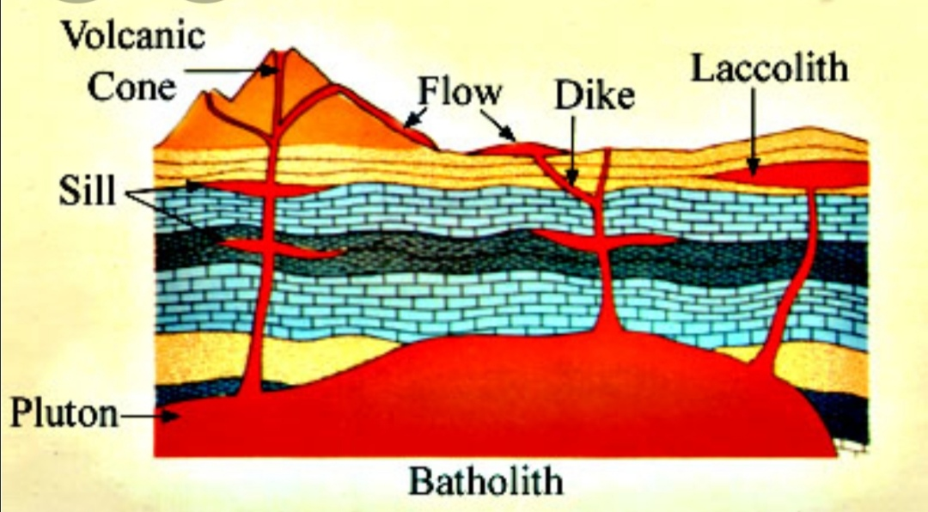
2- Size and form of igneous body:
* Stocks and batholiths usually associated with metasomatic ore
* Laccoliths and large sills rarely contain this ore
* Dikes and small sills never contain such ore

Slide 3
3- Depth of intrusion
* Metasomatic ores are associated with rocks characterized by coarse texture indicating slow cooling at depth.
* Metasomatic ores not found in rocks with glassy texture indicating rapid cooling near the surface.
* The most suitable depth in the formation of this kind of ores is 1000-2100m.

Slide 4
(B) Factors related to the surrounding rocks:
1- Chemical composition:
* These ores occur in association with the chemically high reactive rocks such as the sedimentary carbonate rocks.
* Less common in sandstones.
* Seldom in igneous and metamorphic rocks.
2- Structure of the surrounding rocks:
* Rocks with faults, joints, fractures are more suitable for metasomatic ores.
* Gently dipping sedimentary rocks are more suitable than horizontal sedimentary beds.

Slide 5
Properties of metasomatic ores:
1- The ore minerals consist of oxides, native metals, sulfides, and sulfosalts.
2- The gangue minerals are high temperature minerals such as; tremolite, actinolite, garnet.
3- The deposits consist of several disconnected ore-bodies.
4- Metasomatic ore deposits are small in size (30-120m³).
5-The deposits are scattered irregularly around the contact close to be the igneous body.
6- The ore minerals are coarse in texture containing large crystals or clusters of crystals.

